Slide 1
Biblical Foundations for Freedom (BFF)
Training for the World
BFF Training Courses/Seminars
Releasing God’s Truth to a New Generation!
Rev. Paul J. Bucknell
pb@foundationsforfreedom.net
WWW.FOUNDATIONSFORFREEDOM.NET
Notes:
Biblical Foundations for Freedom introduction
https://www.foundationsforfreedom.net/_Transfer/BFF_Courses2018-red.pdf

Slide 2
THE LIFE CORE
Discovering the Heart of Great Training
This powerful discipleship training seminar arises from combining two Biblical life analogies showing not only the principles of Christian life but the overall thrust of life itself, enabling church leaders to understand and practically further the growth of the church no matter what the difficulty.
7-15 sessions
Notes:
To have people everywhere encounter the power and relevance of God’s Word in their lives through challenging BFF articles,
To equip the church with media-rich Christian training material and programs for each level of maturity, and
To provide instruction through advanced training material and programs for the development of strong and godly Christian leaders.

Slide 3
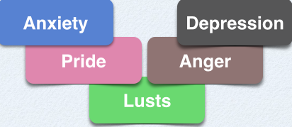
Reaching Beyond Mediocrity
Faith’s Triumph Over Temptation
8-10 sessions
V for Victory in Christ!
The first four sessions identify the spiritual principles from God's Word foundational to overcome all sorts of temptations while the following ones demonstrate how to use these truths to overcome the most challenging spiritual issues troubling Christians.
Notes:
To have people everywhere encounter the power and relevance of God’s Word in their lives through challenging BFF articles,
To equip the church with media-rich Christian training material and programs for each level of maturity, and
To provide instruction through advanced training material and programs for the development of strong and godly Christian leaders.

Slide 4
The Godly MaN
When God Touches a Man’s Life
10 sessions
The only path to holiness is to know God more! "Till I die I will not put away my integrity from me" (Job 27:5).
God's attributes are not only to observe from far off but to dynamically change our lives by producing godly lives.
Notes:
To have people everywhere encounter the power and relevance of God’s Word in their lives through challenging BFF articles,
To equip the church with media-rich Christian training material and programs for each level of maturity, and
To provide instruction through advanced training material and programs for the development of strong and godly Christian leaders.

Slide 5
Redemption Through the Scriptures
Gaining a Clearer Picture of Christ and His Work
10-16 sessions
The theme of salvation is woven throughout the Bible, revealing God’s plan for a deeper and more intimate walk with His people.
A biblical and chronological theological study on redemption with many charts!
Notes:
To have people everywhere encounter the power and relevance of God’s Word in their lives through challenging BFF articles,
To equip the church with media-rich Christian training material and programs for each level of maturity, and
To provide instruction through advanced training material and programs for the development of strong and godly Christian leaders.

Slide 6
The Bible Teaching Commentary on
Romans
Laying a Solid Foundation
6-12 sessions
A practical expository series on the Book of Romans that helps the teacher, preacher, and student to be able to understand, explain, and teach the relevance of Romans to those living in today's world.
Notes:
To have people everywhere encounter the power and relevance of God’s Word in their lives through challenging BFF articles,
To equip the church with media-rich Christian training material and programs for each level of maturity, and
To provide instruction through advanced training material and programs for the development of strong and godly Christian leaders.

Slide 7
the Church in All Her Glory
A Biblical Theology of the Church
10-16 sessions
The Church’s Nature
The Church’s Development
The Church’s Purpose
Our commitment, mission, and growth as God’s people depend on our faith in our Lord’s ability and purpose to work in and through the church.
Notes:
To have people everywhere encounter the power and relevance of God’s Word in their lives through challenging BFF articles,
To equip the church with media-rich Christian training material and programs for each level of maturity, and
To provide instruction through advanced training material and programs for the development of strong and godly Christian leaders.

Slide 8
a spiritual map for unity
Breakthrough Impasses in the Church
1-3 sessions
We all know that the church is one body,
BUT
there is great ignorance—obvious by the divisions in the church—on how to preserve or reach that God-promised blessed unity.

Slide 9
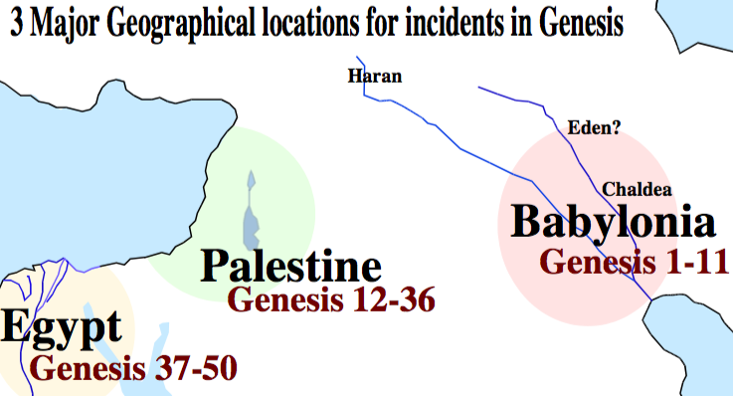
The Bible Teaching Commentary on
GENESIS
The Book of Foundations
6-12 sessions
This expository series on Genesis builds a strong foundation for Christian lives. Gain great insight into God's design, what is wrong, and how to restore things the way the Lord desires. A very Biblical and practical study for our lives!
Notes:
To have people everywhere encounter the power and relevance of God’s Word in their lives through challenging BFF articles,
To equip the church with media-rich Christian training material and programs for each level of maturity, and
To provide instruction through advanced training material and programs for the development of strong and godly Christian leaders.

Slide 10
Training Leaders
Helping Your Leaders into Ministry
3-6 sessions
Prepare your leaders for ministry with or without seminary! The training for effective ministry starts in your church and relationships with these leaders right now!
Notes:
To have people everywhere encounter the power and relevance of God’s Word in their lives through challenging BFF articles,
To equip the church with media-rich Christian training material and programs for each level of maturity, and
To provide instruction through advanced training material and programs for the development of strong and godly Christian leaders.

Slide 11
The Bible Teaching Commentary on
Ephesians
Living in the Heavenlies
6-12 sessions
The Book of Ephesians opens the doors of heaven so that we can step in and start living in the heavenlies. The vivid picture of the redemption in Jesus Christ becomes a powerful means to stir up our love and passion for Christ and the church of God.
Notes:
To have people everywhere encounter the power and relevance of God’s Word in their lives through challenging BFF articles,
To equip the church with media-rich Christian training material and programs for each level of maturity, and
To provide instruction through advanced training material and programs for the development of strong and godly Christian leaders.

Slide 12
The Book of Job
Facing the Tests of Life
6-8 sessions
This expository treatment of the Book of Job enables us to see the crafty maneuvers of the evil one as well as the gapping difference between God’s concerns and those of his friends. The chief purpose of Job is interestingly to prepare the way for the work of Jesus the Messiah on the cross.
Notes:
To have people everywhere encounter the power and relevance of God’s Word in their lives through challenging BFF articles,
To equip the church with media-rich Christian training material and programs for each level of maturity, and
To provide instruction through advanced training material and programs for the development of strong and godly Christian leaders.

Slide 13
Overcoming Anxiety
Finding Peace, Discovering God
10 sessions
People worry because they were never designed to handle the stresses of life on their own. God your Creator wants to help you by designing a way to experience His inner peace while walking through the stresses of life. The bridge illustrates the pathway across the difficulties of life into His peace.
Notes:
To have people everywhere encounter the power and relevance of God’s Word in their lives through challenging BFF articles,
To equip the church with media-rich Christian training material and programs for each level of maturity, and
To provide instruction through advanced training material and programs for the development of strong and godly Christian leaders.

Slide 14
Abiding in Christ
Walking with Jesus
7-12 sessions
This was not a planned series! The Lord caught me off guard and broke into my routine life drawing me closer to Himself and preparing me for greater ministry. The way He did this totally shook my life, and though, often bringing remorse to my soul, He also strengthened and fortified my faith in Him, His Word, and His purposes.
Join me in walking with the disciples!
Notes:
To have people everywhere encounter the power and relevance of God’s Word in their lives through challenging BFF articles,
To equip the church with media-rich Christian training material and programs for each level of maturity, and
To provide instruction through advanced training material and programs for the development of strong and godly Christian leaders.

Slide 15
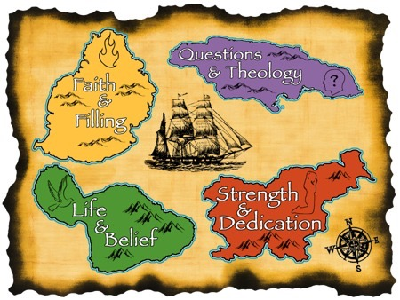
10-18 sessions
Follow the path of biblical learning and learn how the Holy Spirit enables you to live rich Christian lives so that you can serve God and others filled with His Spirit! Four special foci enable us to resolve lingering questions and better pursue God’s purpose for our lives.
Notes:
Life in the Spirit!
Experiencing the Fullness of Christ

Slide 16
Building a Great Marriage
Finding Faith, Forgiveness and Friendship
10 sessions
Building
A
Great
Marriage
If our marriages are carefully built according to the design of our Maker, then these strong foundations will enable us to build elegant and glorious unions. Building a Great Marriage focuses around three important building blocks for a great marriage: faith, forgiveness and friendship.
Notes:
To have people everywhere encounter the power and relevance of God’s Word in their lives through challenging BFF articles,
To equip the church with media-rich Christian training material and programs for each level of maturity, and
To provide instruction through advanced training material and programs for the development of strong and godly Christian leaders.

Slide 17
At this critical point of moral decay believers need a solid foundation not only to withstand temptation but more importantly to develop a vision and confidence for a sexually pure life in and out of marriage.
Striving for Moral Purity
5-10 sessions
#1 Our Approach
Brings truth
What does God say anyway?
Understanding how God’s commands helps us grasp His special design for us.
#2 Our Clean-up
Brings light
Why do I regularly fall?
Exposing our impure roots shows us how serious we need to fight.
#3 Our Foundation
Brings confidence
How does theology help me?
Stepping out of failure enables us to conquer the enemy of defeat.
#4 Our Training
Brings wisdom
What do I need to do to overcome?
By getting around Satan’s temptations our faith becomes strong.
#5 Our Questions
Brings boldness
How does God want to use me?
Properly discerning and responding to attacks on our godly pursuits.
Notes:
To have people everywhere encounter the power and relevance of God’s Word in their lives through challenging BFF articles,
To equip the church with media-rich Christian training material and programs for each level of maturity, and
To provide instruction through advanced training material and programs for the development of strong and godly Christian leaders.

Slide 18
Knowing God
Experience and Love Him!
7-16 sessions
Every Christian is embarked on a spiritual journey of developing a relationship with God his/her Creator. This series carefully studies the scriptures to find out who God the Father is and how this shapes His purposes and involvement in our lives. "So let us know, let us press on to know the LORD” (Hosea 6:3).
Notes:
To have people everywhere encounter the power and relevance of God’s Word in their lives through challenging BFF articles,
To equip the church with media-rich Christian training material and programs for each level of maturity, and
To provide instruction through advanced training material and programs for the development of strong and godly Christian leaders.

Slide 19
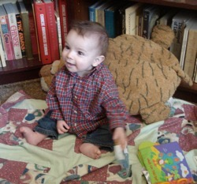
Principles & Practices of Biblical Parenting
Raising Godly Children
8-12 sessions
You can develop a beautiful godly family! Learn how God designed parenting to work – from toddler to teen years. This book uses God’s Word to map out the way to obtain a godly family and the means to enjoy the fruits from rich relationships and closeness with God.
Notes:
To have people everywhere encounter the power and relevance of God’s Word in their lives through challenging BFF articles,
To equip the church with media-rich Christian training material and programs for each level of maturity, and
To provide instruction through advanced training material and programs for the development of strong and godly Christian leaders.

Slide 20
RELATIONAL DISCIPLESHIP
Learning to grow in relationship with God and people!
10-12 sessions
Each biblical analogy unlocks the healing process found in one key relationship. These twelve discipleship studies are founded upon Jesus’ summary of all the commandments: ‘to love God’ and ‘to love others’ thus forming Cross Training, horizontal and vertical relational development.
Notes:
To have people everywhere encounter the power and relevance of God’s Word in their lives through challenging BFF articles,
To equip the church with media-rich Christian training material and programs for each level of maturity, and
To provide instruction through advanced training material and programs for the development of strong and godly Christian leaders.

Slide 21
A Study on Biblical Meditation
Deepen Your Roots
A Study on Biblical Meditation
5-7 sessions
Biblical meditation excites me not only because of what the Bible teaches about its importance in a believer’s personal growth but also by observing the ways the Lord used such times meditating in His Word to direct and empower my life. The fact is, God is seeking to get further involved in the lives of all those that seek after Him and to have His Word powerfully awaken and guide their lives. — Exercises included

Slide 22
Godly Beginnings for the Family
Family: Expecting: Arrival: Routines
6-8 sessions
Many new or expecting Christian parents have no idea what to think about the birth process or early baby care. Even worse, they do not know how God’s Word can aid them in this early stage of training.
Biblical principles are integrated with practical advice specifically geared toward expecting parents or those engaged in baby care.
Notes:
To have people everywhere encounter the power and relevance of God’s Word in their lives through challenging BFF articles,
To equip the church with media-rich Christian training material and programs for each level of maturity, and
To provide instruction through advanced training material and programs for the development of strong and godly Christian leaders.

Slide 23
Initiating Spiritual Growth in the Church
The Flow
8-10 sessions
This first discipleship training seminar (D1) provides a much-needed comprehensive view of the Christian life enabling believers to initiate renewal by humbly evaluating a person’s spiritual growth and knowing how to foster further growth in oneself and others.
The seminar highlights the three stages of Christian development taught in 1 John 2:12-14 and demonstrates how the predominant spiritual operations at those stages apply to personal discipleship.
Notes:
To have people everywhere encounter the power and relevance of God’s Word in their lives through challenging BFF articles,
To equip the church with media-rich Christian training material and programs for each level of maturity, and
To provide instruction through advanced training material and programs for the development of strong and godly Christian leaders.

Slide 24
The Origins of the Bible
Build up Your Confidence in God’s Word
4-6 sessions
Why is it so important that we know the Bible is reliable? The strength of our faith in God and Jesus stems from our confidence in the teaching of His Word.
The world attempts to chip away at the faith God’s people have in the Bible, but we can counter this trend by building up our confidence in God’s Word by closely looking at its amazing origins.
Studies include a look at canonization, original texts, and attacks on the scriptures.
Notes:
To have people everywhere encounter the power and relevance of God’s Word in their lives through challenging BFF articles,
To equip the church with media-rich Christian training material and programs for each level of maturity, and
To provide instruction through advanced training material and programs for the development of strong and godly Christian leaders.

Slide 25
Reviving Our Lives and Ministries Through God’s Word
4 longer sessions
Renewal of our spirits through God’s Word is one of the chief and clear ways to better equip us for life’s decisions and ministry. Key insights lead to vibrant ongoing growth!
Notes:
To have people everywhere encounter the power and relevance of God’s Word in their lives through challenging BFF articles,
To equip the church with media-rich Christian training material and programs for each level of maturity, and
To provide instruction through advanced training material and programs for the development of strong and godly Christian leaders.

Slide 26
Biblical Foundations for Freedom (BFF)
Training for the World
BFF Training Courses/Seminars
Releasing God’s Truth to a New Generation!
Rev. Paul J. Bucknell
pb@foundationsforfreedom.net
WWW.FOUNDATIONSFORFREEDOM.NET
Notes:
Biblical Foundations for Freedom introduction

