Slide 1
Revelation 1:1-8
Prologue
OIF
Calvin Chiang

Slide 2
Why Study Revelation?
Least understood and causes the most amount of fear, therefore many Christians ignore it.
There are lots of misinterpretations cults often use it to their advantage.
Rich book with some in depth teachings and encouragements for us.
Prepare/Read ahead. One helpful book is the Wilcox commentary which you can purchase for $5.
Author is the disciple John. Wrote it on exile approximately AD96 on the island of Patmos to 7 churches.
Original intention of the book was to encourage and bless and not to instill fear.
“revelatio”
“apokalypsis”
Notes:
***The example of the movie “The Imitation Game”
Read some of the questions from class from survey.
*Revelatio: Latin word for “to bring light to what was formerly hidden, veiled and in secret”
*Apokalypsis:

Slide 3
Revelation 1:1-8
John Tells Us About the Book
The Revelation of Jesus Christ, which God gave Him to show to His bond-servants, the things which must soon take place; and He sent and communicated it by His angel to His bond-servant John, 2 who testified to the word of God and to the testimony of Jesus Christ, even to all that he saw. 3 Blessed is he who reads and those who hear the words of the prophecy, and heed the things which are written in it; for the time is near.
3 Main Points Here:
Purpose of the book.
Comes directly from God.
You will be blessed...
God →Jesus→Angel→John→Christians
Notes:
V. 1 Shows the purpose of the book. In it, God will reveal about things that will happen soon.
V. 2 Apostle John tells us that this book has no human origin. It comes from God alone. Forty-four times in the book John wrote, “I saw”. There is a hierarchy of revelation here.
--One often misunderstanding is that the book is only for the future. However we must be careful not to read it as to what will happen in the future but that it is practical and useful to us in the “Here and Now”
--John calls this book a prophecy because it contains not only about what will happen in the future but also give us moral instructions as well. The purpose of a prophecy is to help people to live now and it aims to warn and to encourage them.

Slide 4
Blessings from Revelation
Rev. 1:3—Blessed are those who read the words; blessed are those to hear it and take into action.
Rev. 14:13—Blessed are the dead who die in the Lord.
Rev. 16:15—Blessed is the one who stays awake (alert)
Rev. 19:9—Blessed are those who are invited to the wedding supper of the Lamb.
Rev. 20:6—Blessed and holy are those who share in the first resurrection; they will reign with Christ.
Rev. 22:7—Blessed are those who keep the words of this prophesy.
Rev. 22:14--Blessed are those who have the right to the tree of life.

Slide 5
Revelation 1:4-8 John Addresses the 7 Churches
4 John to the seven churches that are in Asia: Grace to you and peace, from Him who is and who was and who is to come, and from the seven Spirits who are before His throne, 5 and from Jesus Christ, the faithful witness, the firstborn of the dead, and the ruler of the kings of the earth. To Him who loves us and released us from our sins by His blood— 6 and He has made us to be a kingdom, priests to His God and Father—to Him be the glory and the dominion forever and ever. Amen. 7 Behold, He is coming with the clouds, and every eye will see Him, even those who pierced Him; and all the tribes of the earth will mourn over Him. So it is to be. Amen. 8 “I am the Alpha and the Omega,” says the Lord God, “who is and who was and who is to come, the Almighty.”

Slide 6
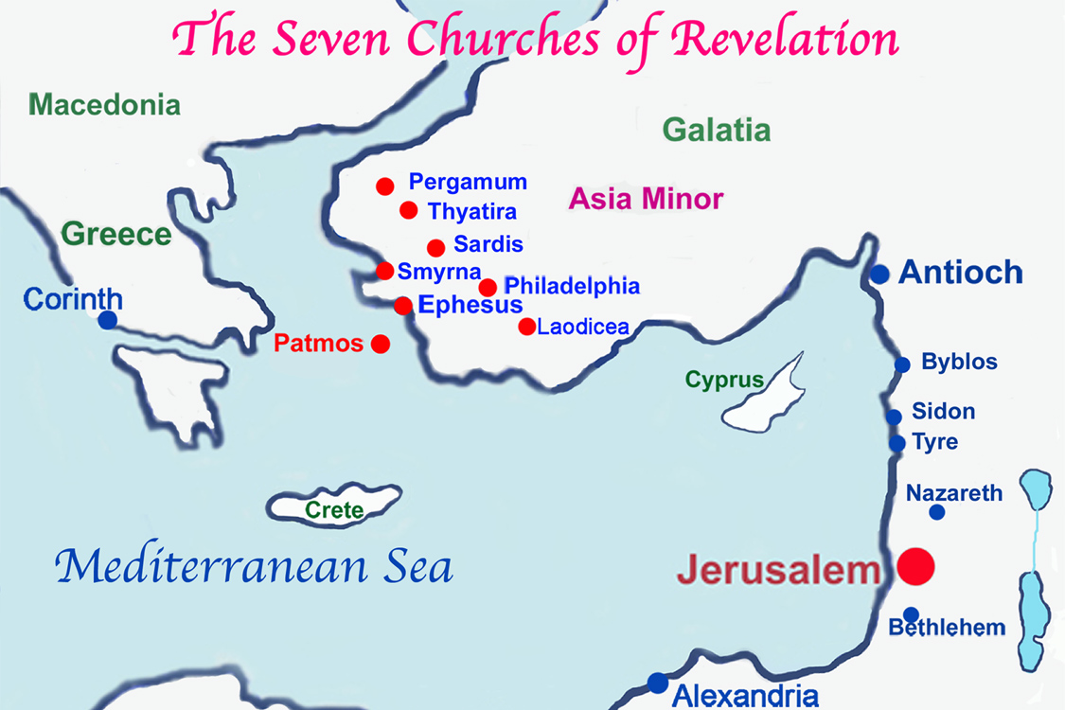

Slide 7
Holy Trinity
1st part of the trinity: From Him who is and who was and who is to come. (v. 4)
2nd part of the trinity: 7 Spirits = Holy Spirit as the seven spirits to indicate the truth that the Holy Spirit dwells in each and every church in equal measure. There is only 1 Holy Spirit but he is equal and wholly present in every church throughout time and is being referred to by John as the 7 Spirits: A symbol of completeness and fullness.
3rd part of the trinity: Description of Jesus
Faithful witness
First born of the dead
Ruler of the kings of the earth (Psalm 2)
Notes:
v. 4 and 5 alludes to the trinity…which was not an concept understood by the Christians at the time.
Trinity Part 1: From Him who is and who was and who is to come…refers back to the OT days of God himself. “I am who I am”
Trinity Part 2: More than 50 references to the number 7 (biblical number of completeness, totality, wholeness). Reference to Isaiah 11
Trinity Part 3:
Faithful witness: Showed us what God was like when He lived on earth; taught us what God said; did all things that God asked Him to do; We can now all know God because of Jesus.
First born of the dead: Own resurrection; power to raise people to life after death; promised to do this for all those who believe in Him.

Slide 8
Psalm 2
I will proclaim the Lord’s decree:
He said to me, “You are my son;
today I have become your father.
8
Ask me,
and I will make the nations your inheritance,
the ends of the earth your possession.
9
You will break them with a rod of iron;
you will dash them to pieces like pottery.”
10
Therefore, you kings, be wise;
be warned, you rulers of the earth.
11
Serve the Lord with fear
and celebrate his rule with trembling.
12
Kiss his son, or he will be angry
and your way will lead to your destruction,
for his wrath can flare up in a moment.
Blessed are all who take refuge in him.
Notes:
Reminder to the Christians that even though Romans are in rule, Christ ultimately is the ruler of the kings of the earth. It was a message of comfort for the believers.

Slide 9
Summary of Verses 4&5
These 2 verses sum up the incredible description of God. He is the eternal Father, beyond all time and space who is and who was and is to come. He is the Holy Spirit walking amongst us, dwelling with us in completeness and fullness throughout His whole church. He is the Son, the Messiah long ago prophesied who bears witness to the grace and peace of God, who is our guarantee of resurrection and eternal life, who is the ruler of the world, even over the powers of the most scary Emperors.

Slide 10
Christians as Priests
V. 5, 6 “To Him who loves us and released us from our sins by His blood— 6 and He has made us to be a kingdom, priests to His God and Father—to Him be the glory and the dominion forever and ever. Amen”
The Lord has made each Christian a priest to serve God the Father. Because of Christ, Christians can now approach God the Father and do not need a priest to act on their behalf.
In the OT, the priests is the agent of the people. He is the mediator between God and His people. He is also the agent of God to the people. As priests, Christians are witnesses to the world about what God has done and brings the message of hope to them.
Notes:
Jesus has made all believers a kingdom (corporately) and priests (individually). That’s why sometimes when we meet a fellow believer, we have a sense of like we have known them for a long time.

Slide 11
Prophecy of the Future Verse 7
The key point and theme of the book is that Jesus promises that He will return physically to earth.
All who are alive at His second coming will see Him and weep.
People in Jerusalem will weep because they will repent their sins (those who pierced Him).
Notes:
Combination of Daniel 7:13—”I saw one like a human being coming with the clouds of heaven.”
Zechariah 12:10—”When they look on the one who they have pierced, they shall mourn for Him…and weep bitterly over Him.”
Jesus used similar verses in Matt 24:30.

Slide 12
God is Alpha and Omega
Signifies God’s comprehensive control over all things including time. He is the Lord of all from start to finish.
God was there before time began and will be there beyond the end of time.
There is nothing outside the control of God and no one can escape the power of God.

Slide 13
Summary
It’s a prophecy given to struggling Christians to give hope and encouragement in the face of their trials.
It is a blessing to those who hear it and obey its teaching.
It comes from the Triune God, Father, Son, and Holy Spirit, the same God who has been worshipped in the past, present , and future.
It shows that God has been active throughout history and that He is in control of future events as well. It presents God as one who is faithful to His promises and powerful to bring these events to pass.

Slide 14
Discussion Questions
Being a follower of Christ results in many benefits and blessings. Can you name one way your obedience is connected to a blessings?
Throughout the 1st chapter of Revelation, many characteristics of Jesus are revealed. Can you list some of these?
How does the knowledge of Christ’s second coming help to shape your life and the decisions that you make?

