Slide 1
Revelation 1:9-3:22
Scene 1: The Church in the World
OIF
Calvin Chiang

Slide 2
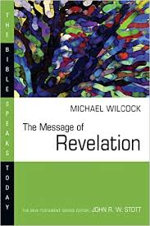
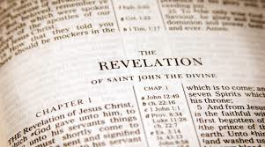
Review of Last Week’s Lesson:
Preterists
Historicists
Futurists
Idealists
Eclecticism
Notes:
Ask class the definition of each of the views.

Slide 3
Revelation 1:9-20
9 I, John, your brother and partner in the tribulation and the kingdom and the patient endurance that are in Jesus, was on the island called Patmos on account of the word of God and the testimony of Jesus. 10 I was in the Spirit on the Lord's day, and I heard behind me a loud voice like a trumpet 11 saying, “Write what you see in a book and send it to the seven churches, to Ephesus and to Smyrna and to Pergamum and to Thyatira and to Sardis and to Philadelphia and to Laodicea.”12 Then I turned to see the voice that was speaking to me, and on turning I saw seven golden lampstands, 13 and in the midst of the lampstands one like a son of man, clothed with a long robe and with a golden sash around his chest. 14 The hairs of his head were white, like white wool, like snow. His eyes were like a flame of fire, 15 his feet were like burnished bronze, refined in a furnace, and his voice was like the roar of many waters. 16 In his right hand he held seven stars, from his mouth came a sharp two-edged sword, and his face was like the sun shining in full strength.17 When I saw him, I fell at his feet as though dead. But he laid his right hand on me, saying, “Fear not, I am the first and the last, 18 and the living one. I died, and behold I am alive forevermore, and I have the keys of Death and Hades. 19 Write therefore the things that you have seen, those that are and those that are to take place after this. 20 As for the mystery of the seven stars that you saw in my right hand, and the seven golden lampstands, the seven stars are the angels of the seven churches, and the seven lampstands are the seven churches.

Slide 4
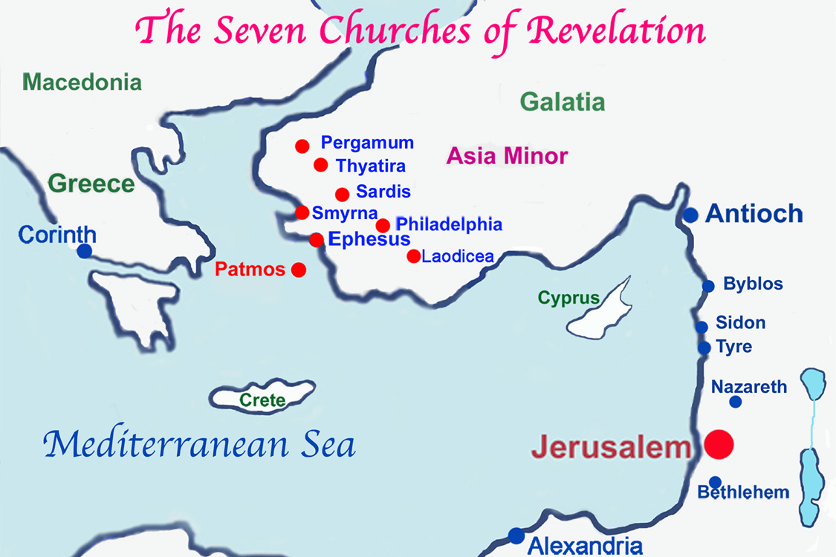

Slide 5
General Observations:
The letters to the seven churches is Jesus’ instruction on what the overcoming church looks like. In Revelation 1-3, we see truths that Jesus wants emphasized to prepare His Church to be used in the greatest revival in history—the end-time revival. He gives us a picture of what He wants in the Church and defines the quality of love and spiritual maturity that the Church will need to overcome in the face of great temptation and persecution.
Each letter to the seven churches is introduced by God with the phrase, “I know…” God is aware of the distresses and persecutions the church members are facing. He also knows what they have achieved and where they have fallen short.
Letter written to the 7 churches in Asia. Follows the similar format of the Lord’s (1) self-designation, (2) encouragement, (3) problems/change (warnings), (4) and promise.

Slide 6
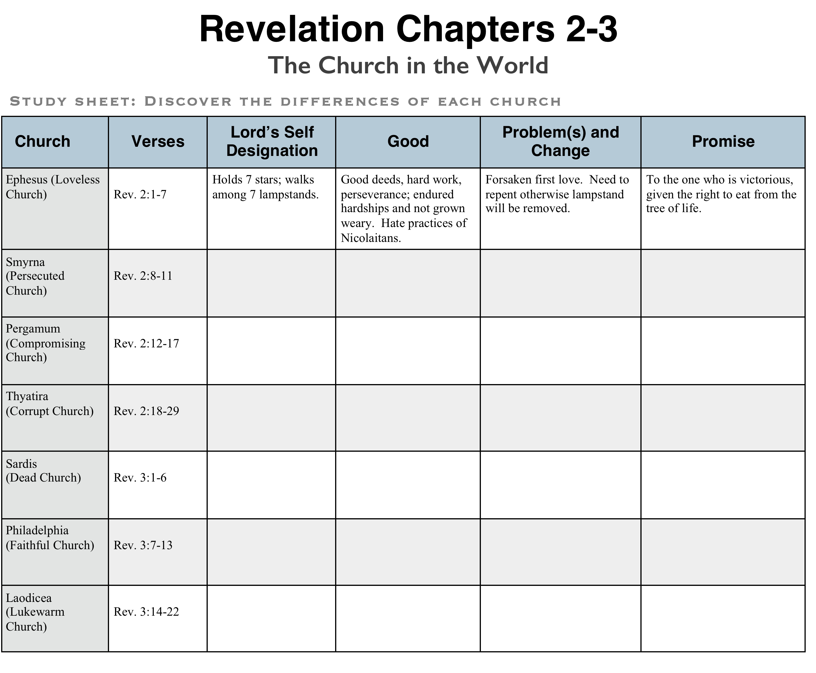

Slide 7
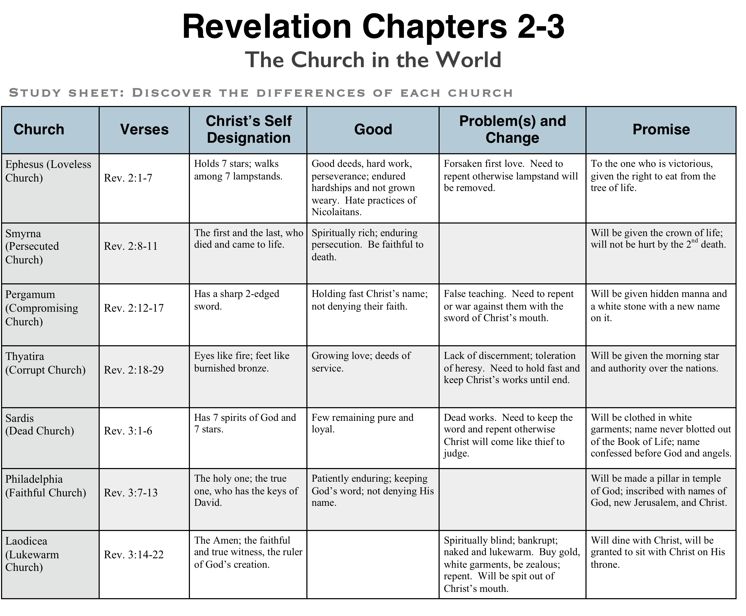

Slide 8
2 Important Intents of the Seven Letters:
1. Reassure all those who have picked up their crosses and followed Him that their faithfulness will be recognized and rewarded at the end time. This was important to the early churches because they were under constant and severe persecutions by the Jewish and Gentile authorities.
2. Out of the 7 churches, 5 of them were rebuked and all of them were asked to repent. Each church's message, though specific to its situation, also offers applications for our lives today. Ephesus was commanded to return to its first love (2:4). Smyrna was told it would endure persecution (2:10). Pergamum was called to repentance (2:16). Thyatira was commanded to remove its false prophetess (2:20). Sardis needed to wake from its sleep (3:2). Philadelphia was to continue its patient endurance (3:10). Laodicea was to end its lukewarm faith (3:16). The second intent of the Seven Letters was to warn those who have gone astray and have abandoned the Lord and His teachings.

Slide 9
The 8 Scenes of Revelation
# | Scenes | 7 Settings | Opening scene | Summary | Special focus | Key thought
1 | 1:19-3:22 Church in the World | Seven letters dictated | John turns to see who is speaking | Christ speaks to the 7 churches | 7 commonalities with pointed differences. | Churches called to overcome by returning to the teachings of Christ
2 | 4:1-8:1 Suffering for Church
3 | 8:2-11:18 Warnings for World
4 | 11:19-15:4 Drama of History
5 | 15:5-16:21 Punishment for World
6 | 17:1-19:10 Babylon the Whore
7 | 19:11-21:8 Drama Behind History
8 | 21:9-22:19 Jerusalem the Bride

