Slide 1
Revelation 8:2-11:18
Scene 3: Trumpet Warnings for the World
OIF
Paul J. Bucknell

Slide 2
The 8 Scenes of Revelation
# | Scenes | 7 Settings | Opening scene | Summary | Special focus | Key thought
1 | 1:19-3:22 Church in the World | Seven letters dictated | John turns to see who is speaking | Christ speaks to the 7 churches | 7 commonalities with pointed differences. | Cure for lukewarmness?Readmit the excluded Christ! p.58
2 | 4:1-8:1 Suffering for Church | Seven seals opened | A door in heaven opens | God’s power (4-5); woes in history | Seals will not be opened until chapter. 6. p.66 | Christ’s explanation of history makes it full of meaning. p.69
3 | 8:2-11:18 Warnings for World | Seven trumpets sounded | Angels with trumpets appear | #1-4 prove God’s power; 5-7 are 3 woes | Non-datable events phased in as birth pangs. | Evil is exposed for what it is–absolute wickedness. p. 108
4 | 11:19-15:4 Drama of History
5 | 15:5-16:21 Punishment for World
6 | 17:1-19:10 Babylon the Whore
7 | 19:11-21:8 Drama Behind History
8 | 21:9-22:19 Jerusalem the Bride
What will the tribulation be like?
What do these scary scenes mean?
How does that affect my life?

Slide 3
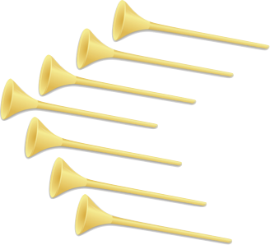
Revelation 8:2–11:18
Scene 3: Trumpet Warnings for the World
7 Trumpet sounds
^{8:2} And I saw the seven angels who stand before God; and seven trumpets were given to them. ³ And another angel came and stood at the altar, holding a golden censer; and much incense was given to him, that he might add it to the prayers of all the saints upon the golden altar which was before the throne. ⁴ And the smoke of the incense, with the prayers of the saints, went up before God out of the angel’s hand. ⁵ And the angel took the censer; and he filled it with the fire of the altar and threw it to the earth; and there followed peals of thunder and sounds and flashes of lightning and an earthquake. ⁶ And the seven angels who had the seven trumpets prepared themselves to sound them. (NASB)

Slide 4
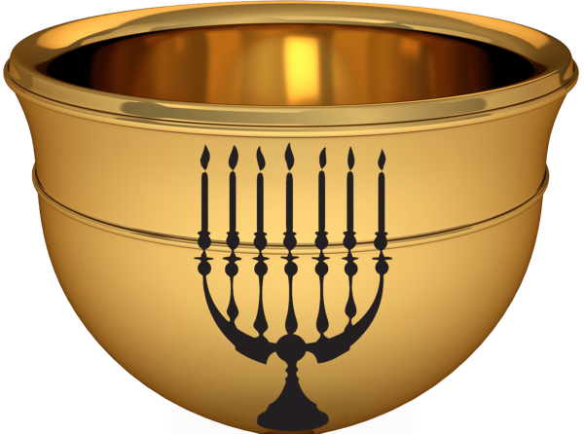
Revelation Chapters 8:2-11:18
Scene #3
Study sheet: Listen to the Trumpet Soundings!
Seal | Reference | Saw or Heard | Authority/Observation | Other/Interpretation
1 | Rev. 8:7 | Hail and fire mixed with blood thrown down to earth | Causes great calamity: 1/3 earth burnt up so trees and grasses disappeared. Vegetation, ‘green’. | Natural? Atomic bomb? Disaster from God (Ex 9:23)?
2
3
4
5
6
7
6 Now the seven angels who had the seven trumpets prepared to blow them. 7 The first angel blew his trumpet, and there followed hail and fire, mixed with blood, and these were thrown upon the earth. And a third of the earth was burned up, and a third of the trees were burned up, and all green grass was burned up.

Slide 5
Revelation Chapters 8:2-11:18
Scene #3
1/4 => 1/3
The Seven Trumpets
6 Now the seven angels who had the seven trumpets prepared to blow them.
7 The first angel blew his trumpet, and there followed hail and fire, mixed with blood, and these were thrown upon the earth. And a third of the earth was burned up, and a third of the trees were burned up, and all green grass was burned up.
8 The second angel blew his trumpet, and something like a great mountain, burning with fire, was thrown into the sea, and a third of the sea became blood. 9 A third of the living creatures in the sea died, and a third of the ships were destroyed.
10 The third angel blew his trumpet, and a great star fell from heaven, blazing like a torch, and it fell on a third of the rivers and on the springs of water. 11 The name of the star is Wormwood. A third of the waters became wormwood, and many people died from the water, because it had been made bitter.
12 The fourth angel blew his trumpet, and a third of the sun was struck, and a third of the moon, and a third of the stars, so that a third of their light might be darkened, and a third of the day might be kept from shining, and likewise a third of the night.
13 Then I looked, and I heard an eagle crying with a loud voice as it flew directly overhead, “Woe, woe, woe to those who dwell on the earth, at the blasts of the other trumpets that the three angels are about to blow!”
9 And the fifth angel blew his trumpet, and I saw a star fallen from heaven to earth, and he was given the key to the shaft of the bottomless pit. 2 He opened the shaft of the bottomless pit…
vegetation
Sea
Fresh water
Light

Slide 6
Special Explanations
7 Churches
7 Seals
7 Trumpets
God knows His people
God seals His people
God timely revenges His people
Chapters 9-11:
Apollyon (lit. destruction)/Satan: is released from the bottomless pit (ch. 9). (Fifth trumpet)
The Angel and the Scroll (chapter 10) acts similar to 7:9 ff where a pause provides needed insights.
Measure temple of God (11:1-2) - 42 months
The Two witnesses (11:3-13)

Slide 7
4 Stages of Satan
(1) From Heaven (Rev 9:1; 12:9; Lu 10:17-18; Is 14:12-14)
Seen in Revelation
9:1 And the fifth angel sounded, and I saw a star from heaven which had fallen to the earth; and the key of the bottomless pit was given to him.
12:9 And the great dragon was thrown down, the serpent of old who is called the devil and Satan, …was thrown down into the earth, and his angels…
(3) Released from Abyss (Rev 17:8; 20:1)
17:8 The beast that you saw was and is not, and is about to come up out of the abyss…
20:1 He must be released for a short time.
(4) In Lake of Fire (Rev 17:8; 20:10)
(2) In Earth/Abyss Limited (Rev 9:11; 20:1)
17:8 The beast … is about to come up out of the abyss and to go into destruction.
20:10 And the devil who deceived them was thrown into the lake of fire and brimstone… they will be tormented day and night forever and ever.
9:11 They have as king over them, the angel of the abyss; his name in Hebrew is Abaddon, and in the Greek.
20:1 And I saw an angel coming down from heaven, having the key of the abyss and a great chain in his hand… 3 and threw him into the abyss, and shut it and sealed it over him, so that he should not deceive the nations any longer.
The Destroyer is destroyed (19:19-21).

Slide 8
Fifth Angel Sounds
9:1 And the fifth angel blew his trumpet, and I saw a star fallen from heaven to earth, and he was given the key to the shaft of the bottomless pit. 2 He opened the shaft of the bottomless pit, and from the shaft rose smoke like the smoke of a great furnace, and the sun and the air were darkened with the smoke from the shaft. 3 Then from the smoke came locusts on the earth, and they were given power like the power of scorpions of the earth. 4 They were told not to harm the grass of the earth or any green plant or any tree, but only those people who do not have the seal of God on their foreheads. 5 They were allowed to torment them for five months, but not to kill them, and their torment was like the torment of a scorpion when it stings someone. 6 And in those days people will seek death and will not find it. They will long to die, but death will flee from them.
7 In appearance the locusts were like horses prepared for battle: on their heads were what looked like crowns of gold; their faces were like human faces, 8 their hair like women's hair, and their teeth like lions' teeth; 9 they had breastplates like breastplates of iron, and the noise of their wings was like the noise of many chariots with horses rushing into battle. 10 They have tails and stings like scorpions, and their power to hurt people for five months is in their tails. 11 They have as king over them the angel of the bottomless pit. His name in Hebrew is Abaddon, and in Greek he is called Apollyon.
12 The first woe has passed; behold, two woes are still to come.
5th angel. This extension of the evil one’s power is all under God’s control. (9:1)
Star-fallen is Satan whose ‘throne’ is in the Abyss. (9;1,11)
Targets only unbelievers (no seal c.f. 7:1-3) so does not represent Muslims.
Agonizing 5 month’s pain without death.
Locusts from abyss: Tanks? Drones? Army?
Like in Job, when able the evil one extends pain and suffering.
Message: Saints protected from some aspects of judgment as in Exodus.

Slide 9
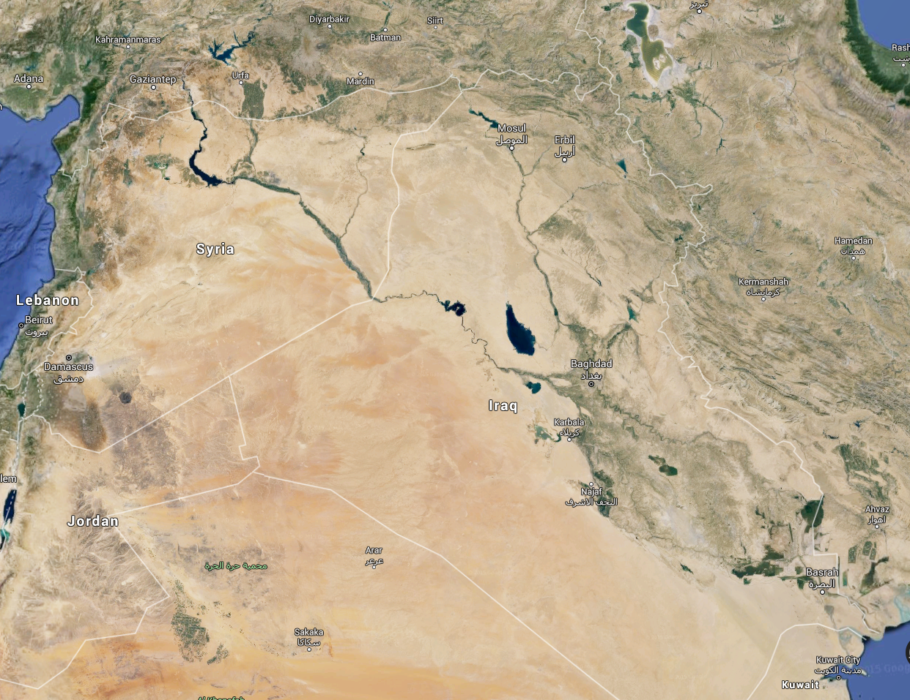
The Day of Invasion
Turkey
9^{:13} Then the sixth angel blew his trumpet, and I heard a voice from the four horns of the golden altar before God, ¹⁴ saying to the sixth angel who had the trumpet, “Release the four angels who are bound at the great river Euphrates.” ¹⁵ So the four angels, who had been prepared for the hour, the day, the month, and the year, were released to kill a third of mankind. ¹⁶ The number of mounted troops was twice ten thousand times ten thousand; I heard their number.
2*10,000*10,000= 200,000,000
Syria
Iraq
EUPHRATES RIVER
Iran
Iraq
Google maps

Slide 10
Revelation 10 (Angel and Scroll)
Then I saw another mighty angel coming down from heaven, wrapped in a cloud, with a rainbow over his head, and his face was like the sun, and his legs like pillars of fire. 2 He had a little scroll open in his hand. And he set his right foot on the sea, and his left foot on the land, 3 and called out with a loud voice, like a lion roaring. When he called out, the seven thunders sounded. 4 And when the seven thunders had sounded, I was about to write, but I heard a voice from heaven saying, “Seal up what the seven thunders have said, and do not write it down.” 5 And the angel whom I saw standing on the sea and on the land raised his right hand to heaven 6 and swore by him who lives forever and ever, who created heaven and what is in it, the earth and what is in it, and the sea and what is in it, that there would be no more delay, 7 but that in the days of the trumpet call to be sounded by the seventh angel, the mystery of God would be fulfilled, just as he announced to his servants the prophets. (Rev 10:1-7)
The pause at the end of Trumpet sound #6 and before #7.
Very animate scenes, but it does pause from the intense focus on earthly judgment–refreshes one’s mind (cf. 4-5).
“Seal up what the seven thunders have said” (10:4) continues to refocus on God’s glory rather than judgment.
“Seven thunders” is a hidden set of plans He can at His discretion use.
Notes:
8 Then the voice that I had heard from heaven spoke to me again, saying, “Go, take the scroll that is open in the hand of the angel who is standing on the sea and on the land.” 9 So I went to the angel and told him to give me the little scroll. And he said to me, “Take and eat it; it will make your stomach bitter, but in your mouth it will be sweet as honey.” 10 And I took the little scroll from the hand of the angel and ate it. It was sweet as honey in my mouth, but when I had eaten it my stomach was made bitter. 11 And I was told, “You must again prophesy about many peoples and nations and languages and kings.”

Slide 11
42 Months & 1,260 Days (11:1-3)
11 Then I was given a measuring rod like a staff, and I was told, “Rise and measure the temple of God and the altar and those who worship there, 2 but do not measure the court outside the temple; leave that out, for it is given over to the nations, and they will trample the holy city for forty-two months. 3 And I will grant authority to my two witnesses, and they will prophesy for 1,260 days, clothed in sackcloth.”
“Measure the temple of God”… (11:1) God will carefully watch over His people (Jews and Christians) Like counting 144,000 and sealing the saints.
The court outside the temple (Gentile court)
Trample the holy city (Jerusalem)
“Times of the Gentiles be fulfilled.”
“They will fall by the edge of the sword, and will be led captive into all the nations; and Jerusalem will be trampled under foot by the Gentiles until the times of the Gentiles be fulfilled” (Lu 21:24).

Slide 12
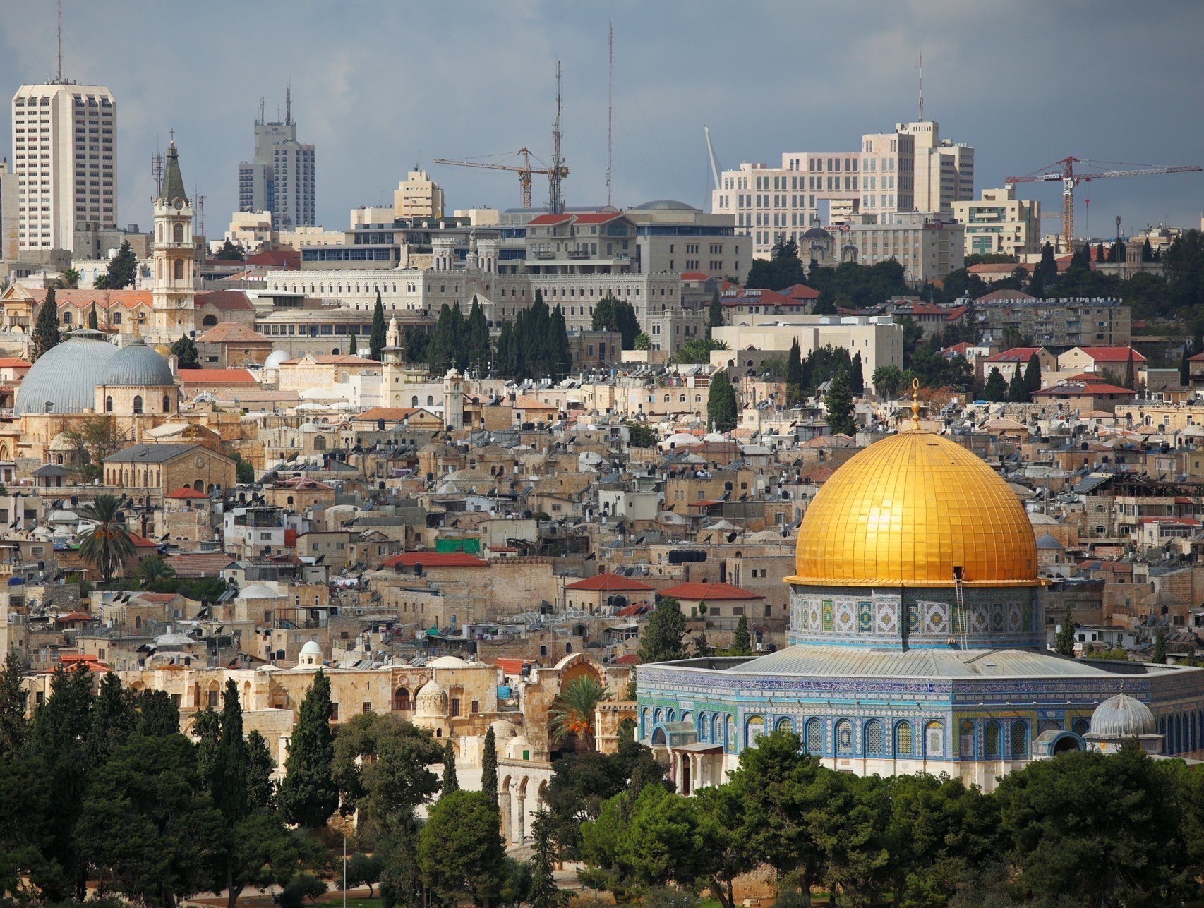
Trample the holy city for forty-two months
42 months = 3 ½ years = 1260 days • 3 ½ years = ½ of a supposed 7 year tribulation • 1260 days ≃ 1260 years • 1260 years = 1278 solar years (365.24 days)
1967 AD – 1278.5 = 688.5 AD ... the Dome of the Rock!
583 BC +1271.34 = 688.66 AD... the Dome of the Rock!
“And from the time that the regular sacrifice is abolished, and the abomination of desolation is set up, there will be 1290 days” (Dan 12:11). “In the three and twentieth year of Nebuchadnez-zar, Nebuzaradan the captain of the guard carried away captive of the Jews seven hundred forty and five persons.” (Jer 52:30) 606-23=583 BC

Slide 13
A Little History of Jerusalem
583 BC +1271.34 = 688.66 AD
688.5 AD+ 1278.5 =1967 AD
Dome of Rock
Abomination of Desolation
Built over 3 years 688 A.D.
Over Solomon’s temple
But in the Court of Gentiles
1967 Israel regained control
fishhouseministries.com
Ellis Skolfield

Slide 14
The Two Witnesses (Rev 11:1-14)
3 And I will grant authority to my two witnesses, and they will prophesy for 1,260 days, clothed in sackcloth.” 4 These are the two olive trees and the two lampstands that stand before the Lord of the earth. 5 And if anyone would harm them, fire pours from their mouth and consumes their foes. If anyone would harm them, this is how he is doomed to be killed. 6 They have the power to shut the sky, that no rain may fall during the days of their prophesying, and they have power over the waters to turn them into blood and to strike the earth with every kind of plague, as often as they desire. 7 And when they have finished their testimony, the beast that rises from the bottomless pit will make war on them and conquer them and kill them, 8 and their dead bodies will lie in the street of the great city that symbolically is called Sodom and Egypt, where their Lord was crucified. 9 For three and a half days some from the peoples and tribes and languages and nations will gaze at their dead bodies and refuse to let them be placed in a tomb, 10 and those who dwell on the earth will rejoice over them and make merry and exchange presents, because these two prophets had been a torment to those who dwell on the earth. 11 But after the three and a half days a breath of life from God entered them, and they stood up on their feet, and great fear fell on those who saw them. 12 Then they heard a loud voice from heaven saying to them, “Come up here!” And they went up to heaven in a cloud, and their enemies watched them. 13 And at that hour there was a great earthquake, and a tenth of the city fell. Seven thousand people were killed in the earthquake, and the rest were terrified and gave glory to the God of heaven. 14 The second woe has passed; behold, the third woe is soon to come.
“1260 days” is evidently same time Jerusalem is lost to the Gentiles (rather than literal 3.5 years during tribulation).
Two witnesses = “two olive trees and two lampstands” which represents God’s chosen people, whether Jew or Gentile.
Mid-tribulationists and pre-tribulationists (Rev 11:12).

Slide 15
Revelation 11 The Seventh Trumpet
14 The second woe has passed; behold, the third woe is soon to come.15 Then the seventh angel blew his trumpet, and there were loud voices in heaven, saying, “The kingdom of the world has become the kingdom of our Lord and of his Christ, and he shall reign forever and ever.” …
“We give thanks to you, Lord God Almighty, who is and who was, for you have taken your great power and begun to reign. 18 The nations raged, but your wrath came, and the time for the dead to be judged, and for rewarding your servants, the prophets and saints, and those who fear your name, both small and great, and for destroying the destroyers of the earth.” (Rev 11:14-18)
7th Trumpet is the 3rd Woe (11:14)–completion.
Declaration of God’s reign (always reigned but now fully displays it) (11:15)
List of end time projects (chart)
“And to wait for His Son from heaven, whom He raised from the dead, that is Jesus, who rescues us from the wrath to come.” (1 Th 1:10)
Scene 7 reiterates the same end of the world theme blending into the eternal.
The nations raged
But your wrath came
Time for the dead to be judged
Time for rewarding your servants, the prophets and saints, and those who fear your name, both small and great,
Time for destroying the destroyers of the earth.
Notes:
8 Then the voice that I had heard from heaven spoke to me again, saying, “Go, take the scroll that is open in the hand of the angel who is standing on the sea and on the land.” 9 So I went to the angel and told him to give me the little scroll. And he said to me, “Take and eat it; it will make your stomach bitter, but in your mouth it will be sweet as honey.” 10 And I took the little scroll from the hand of the angel and ate it. It was sweet as honey in my mouth, but when I had eaten it my stomach was made bitter. 11 And I was told, “You must again prophesy about many peoples and nations and languages and kings.”

Slide 16
Mercy in Judgment
Special themes are scattered through Revelation such as God’s mercy.
God’s judgment is often despised but its majesty and necessary justice is beautifully touched up with sprinkles of mercy.
Note how the seals and trumpets are not the full unleashing but act as warnings, signaling we need to turn to the Living Lord.
The signs spoke of destruction of 1/4 of the earth while here only 1/3 (8:7,9). It would be much easier to kill all in one go.
The judgments become means God tries to awaken the people to repent before the final end. “Two Witnesses” prophesy (11:1-11, 13).
“Did not repent” (9:20-21) – Many, however, did not repent.
Earthly judgments
Final judgment

Slide 17
Revelation 8:2-11:18
Scene 3: Trumpet Warnings for the World
OIF
Paul J. Bucknell

