Slide 1
Revelation 15:5-16:21
Scene 5: Punishment for the World
OIF
Calvin Chiang

Slide 2
Review
Prophecy given to struggling Christians to give hope and encouragement in the face of their trials.
It is a blessing to those who hear it and obey it’s teaching.
Chapters 12-22 are similar to Chapter 1-11.
Those who are in opposition to Christ and his church is introduced in greater detail: The dragon, the beast out of the sea, and the beast out of the earth (the false prophet) and the whore Babylon. John encourages believers to endure the Devil’s onslaught as God refines the church’s faith.
1st Sign: The conflict of the dragon with the woman and her seed (Chapter 12)
2nd Sign: Persecution by the beast from the sea (13:1-10)
3rd Sign: Persecution by the beast from the land (13:11-18)
4th Sign: The Lamb and the 144,000 standing on Mount Zion (14:1-5)
5th Sign: The proclamation of the Gospel and of judgment by three angels (14:6-13)
6th Sign: The Son of man’s harvest of the earth (14:14-20)
7th Sign: The saints’ victory over the sea beast and their victory song (15:1-4)
Notes:
*Lots of information covered last week from second part of Chapter 11 to beginning of Chapter 15.
*The 7 signs form an extended interlude between the sounding of the 7th trumpet to the pouring out of the 7 bowls of wrath.

Slide 3
The 8 Scenes of Revelation
# | Scenes | 7 Settings | Opening scene | Summary | Special focus | Key thought
1 | 1:19-3:22 Church in the World | Seven letters dictated | John turns to see who is speaking | Christ speaks to the 7 churches | 7 commonalities with pointed differences. | Cure for lukewarmness?Readmit the excluded Christ! p.58
2 | 4:1-8:1 Suffering for Church | Seven seals opened | A door in heaven opens | God’s power (4-5); woes in history | Seals will not be opened until chapter. 6. p.66 | Christ’s explanation of history makes it full of meaning. p.69
3 | 8:2-11:18 Warnings for World | Seven trumpets sounded | Angels with trumpets appear | #1-4 prove God’s power; 5-7 are 3 woes | No datable events but can be true at anytime. p.92 | Evil must be exposed for what it is–absolute wickedness. p. 108
4 | 11:19-15:4 Drama of History | Seven visions of cosmic conflict | The temple in heaven opens | Perennial spiritual conflict of history | Seven visions are oddly static; an ongoing battle. p.121 | Spiritual deliverance by Christ is the real Exodus!
5 | 15:5-16:21 Punishment for World | Seven bowls poured out | Tabernacle of testimony in heaven opens | Babylon’s career | The plagues from the bowls are total; no more time for repentance. p.144 | Classic horror: Finding oneself locked in with what you fear. p.143
6 | 17:1-19:10 Babylon the Whore
7 | 19:11-21:8 Drama Behind History
8 | 21:9-22:19 Jerusalem the Bride

Slide 4
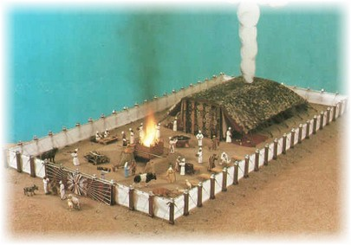
Revelation 15:5-8
5 After these things I looked, and the temple of the tabernacle of testimony in heaven was opened, 6 and the seven angels who had the seven plagues came out of the temple, clothed in linen, clean and bright, and girded around their chests with golden sashes. 7 Then one of the four living creatures gave to the seven angels seven golden bowls full of the wrath of God, who lives forever and ever. 8 And the temple was filled with smoke from the glory of God and from His power; and no one was able to enter the temple until the seven plagues of the seven angels were finished.
V. 5-6 John saw the “temple in heaven”. It was the most holy place and seven angels who has just been in the presence of God would strike the earth with plagues to punish those that have chosen to serve the Antichrist. These angels are identified with Christ by the description of their apparel.
V. 7 Each of the seven angels received a gold bowl from one of the creatures. These bowls contained the 7 judgments coming from God. The temple was filled with smoke because God is about to act.

Slide 5
Revelation 16:1-12
Six Bowls of Wrath
Then I heard a loud voice from the temple, saying to the seven angels, “Go and pour out on the earth the seven bowls of the wrath of God.” 2 So the first angel went and poured out his bowl on the earth; and it became a loathsome and malignant sore on the people who had the mark of the beast and who worshiped his image. 3 The second angel poured out his bowl into the sea, and it became blood like that of a dead man; and every living thing in the sea died. 4 Then the third angel poured out his bowl into the rivers and the springs of waters; and they became blood. 5 And I heard the angel of the waters saying, “Righteous are You, who are and who were, O Holy One, because You judged these things; 6 for they poured out the blood of saints and prophets, and You have given them blood to drink. They deserve it.” 7 And I heard the altar saying, “Yes, O Lord God, the Almighty, true and righteous are Your judgments.” 8 The fourth angel poured out his bowl upon the sun, and it was given to it to scorch men with fire. 9 Men were scorched with fierce heat; and they blasphemed the name of God who has the power over these plagues, and they did not repent so as to give Him glory. 10 Then the fifth angel poured out his bowl on the throne of the beast, and his kingdom became darkened; and they gnawed their tongues because of pain, 11 and they blasphemed the God of heaven because of their pains and their sores; and they did not repent of their deeds. 12 The sixth angel poured out his bowl on the great river, the Euphrates; and its water was dried up, so that the way would be prepared for the kings from the east.

Slide 6
Consequences of 7 Bowls
Tribulation Judgments
Seals (Chapter 6) | Trumpets (Chapters 8-9) | Bowls (Chapter 16)
Antichrist | Storm
War | Meteor
Famine | Bitterness
Death (1/4 of Population) | Darkness
Imprecations | Locusts
Earthquake | Horses (1/3 of Population)
7 Trumpets | 7 Bowls
Seals (Chapter 6) | Trumpets (Chapters 8-9) | Bowls (Chapter 16)
Antichrist | Storm | Sores
War | Meteor | Bloody Seas
Famine | Bitterness | Bloody Springs
Death (1/4 of Population) | Darkness | Fire
Imprecations | Locusts | Darkness
Earthquake | Horses (1/3 of Population) | Invasion
7 Trumpets | 7 Bowls | Earthquake and Hail
Notes:
V. 1 The voice that John heard was from God. The fact that God told the angels to pour out their bowls seems to indicate that these judgments will follow each other in rapid succession. The first four plagues seem to affect individuals directly through personal affliction or through objects of nature while the last three are on more on an international scale.
V. 2 First Bowl: poured on the land and brings harmful and painful sores on those who have the mark of the beast and worship it’s image. (Compare with the present spread of the AIDS epidemic)
V. 3 Second Bowl: poured on the sea, turning it into blood and killing all living things. (Similar to Nile turning to blood in Exodus)
V. 4 Third Bowl: poured on the rivers and springs of water and they become blood.
V. 5-7 John heard praises of God in heaven that interrupted his narration of the outpouring of the bowls of wrath. Specifically God poured out blood on the earth dwellers because of what they did to the saints and prophets. (i.e. Pharaoh/Jewish babies, Haman/Mordecai)
V. 8 Fourth Bowl: poured out on the sun, giving it power to scorch people with fire.
V. 10-11 Fifth Bowl: poured out on the throne of the beast, plunging it into darkness.
V. 12 Sixth Bowl: poured out on the great river Euphrates drying it up to prepare the way for the kings of the East (represents all ruling authority of humanity).

Slide 7
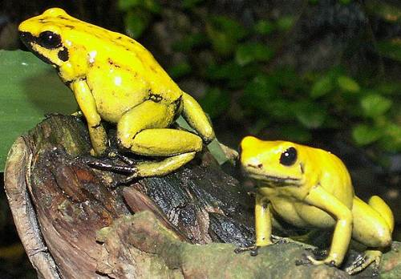
Revelation 16:13-16
Armageddon
13 And I saw coming out of the mouth of the dragon and out of the mouth of the beast and out of the mouth of the false prophet, three unclean spirits like frogs; 14 for they are spirits of demons, performing signs, which go out to the kings of the whole world, to gather them together for the war of the great day of God, the Almighty. 15 (“Behold, I am coming like a thief. Blessed is the one who stays awake and keeps his clothes, so that he will not walk about naked and men will not see his shame.”) 16 And they gathered them together to the place which in Hebrew is called Har-Magedon.
V. 13, the Trinity of Evil: dragon (devil and Satan Rev. 12:9), beast (Antichrist from the sea Rev. 13:1-10), and false prophet (second beast that came from the earth Rev. 13:11-17) = FROGS?
V. 14 Have the spirits of demons, performing signs and goes out to the kings of the whole world to gather them for war against the forces of God.
In the sixth bowl we also see the assembling of the kings of the earth at the place called Armageddon (Harmagedon is the Hebrew word, “Har-Megiddo” which mean the mountain of Megiddo. All that is revealed here is that this is a place they will gather. The text doesn’t actually say if a battle will take place there.
In the OT, we do see several decisive battles that take place at Megiddo. In 2Kings 9:27 we see that Ahaziah, king of Judah was slain there. In 2Kings 23:29, and 2 Chron 35:22, King Josiah is slain in battle. Judges 5:19 speaks of kings fighting by the waters of Megiddo but failing to take the spoil. When you put all of these things together, you can see that the work of Satan will dry up and fail. They may gather up battle but it is a decisive loss for Satan. Gathering in Armageddon is a symbol of destruction and judgment.
Notes:
*Golden poisonous dart frogs has enough poison in their bodies to kill 20,000 mice.

Slide 8
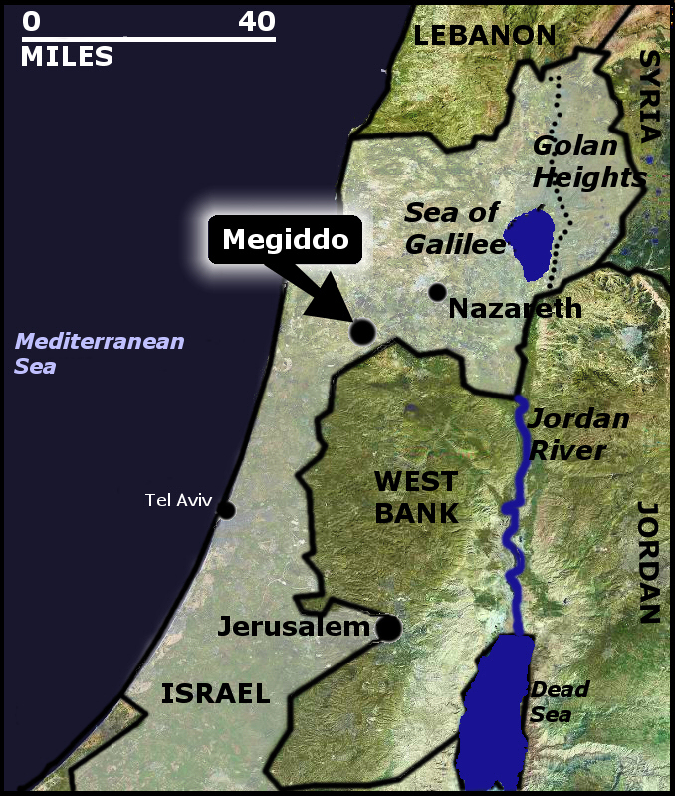
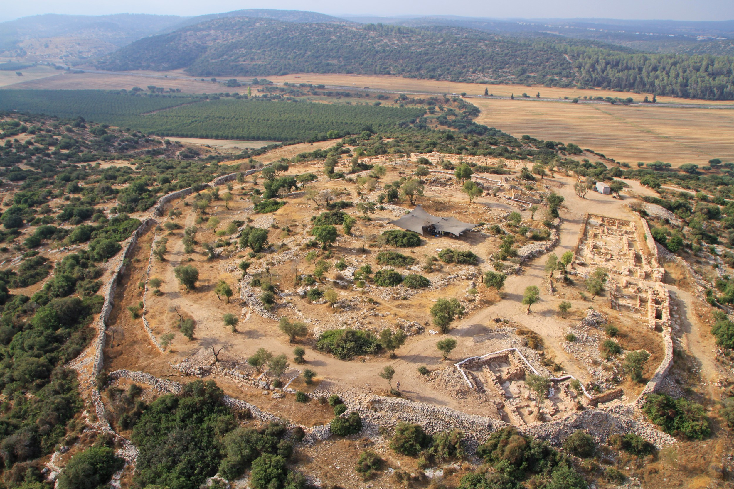
Tel Megiddo
Notes:
*In ancient times Megiddo was an important city-state (excavations unearthed that there are 26 levels of ruins indicating long periods of settlements). It guarded a narrow pass and trade route connecting Egypt and Assyria.
*In the OT, we do see several decisive battles that take place at Megiddo. In 2Kings 9:27 we see that Ahaziah, king of Judah was slain there. In 2Kings 23:29, and 2 Chron 35:22, King Josiah is slain in battle. Judges 5:19 speaks of kings fighting by the waters of Megiddo but failing to take the spoil. When you put all of these things together, you can see that the work of Satan will dry up and fail. They may gather up battle but it is a decisive loss for Satan. Gathering in Armageddon is a symbol of destruction and judgment.

Slide 9
Be Prepared and Stay Alert
“Behold, I am coming like a thief. Blessed is the one who stays awake and keeps his clothes, so that he will not walk about naked and men will not see his shame.”
Matthew 24:42-44 (ESV)
42 Therefore, stay awake, for you do not know on what day your Lord is coming. 43 But know this, that if the master of the house had known in what part of the night the thief was coming, he would have stayed awake and would not have let his house be broken into. 44 Therefore you also must be ready, for the Son of Man is coming at an hour you do not expect.
Mark 13:32-33 (ESV)
32 “But concerning that day or that hour, no one knows, not even the angels in heaven, nor the Son, but only the Father. 33 Be on guard, keep awake.[a] For you do not know when the time will come.
2 Peter 3:10 (ESV)
10 But the day of the Lord will come like a thief, and then the heavens will pass away with a roar, and the heavenly bodies[a] will be burned up and dissolved, and the earth and the works that are done on it will be exposed.[b]
Notes:
**V. 15: gives a call to preparation for the people of God. God’s judgment will come like a thief. Be prepared. Stay awake. Do not be caught by surprise.
**This is the 3rd of the 7 blessings in Revelation mentioned in v. 15. Those who trust in the Lord must be ready for this great event. The Lord describes them like soldiers before the command to go into battle. Such a soldier has his clothes ready for the battle. Those who are not ready will be ashamed. Don’t be caught like the soldier without any clothes to protect them for battle.

Slide 10
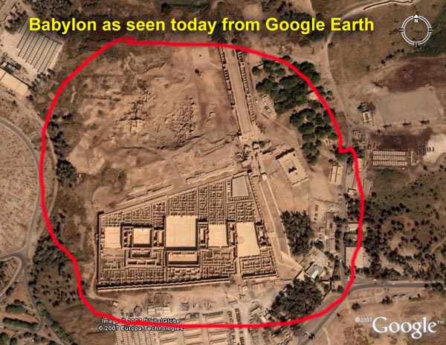
Revelation 16:17-21
The Seventh Bowl of Wrath
17 Then the seventh angel poured out his bowl upon the air, and a loud voice came out of the temple from the throne, saying, “It is done.” 18 And there were flashes of lightning and sounds and peals of thunder; and there was a great earthquake, such as there had not been since man came to be upon the earth, so great an earthquake was it, and so mighty. 19 The great city was split into three parts, and the cities of the nations fell. Babylon the great was remembered before God, to give her the cup of the wine of His fierce wrath. 20 And every island fled away, and the mountains were not found. 21 And huge hailstones, about one hundred pounds each, came down from heaven upon men; and men blasphemed God because of the plague of the hail, because its plague was extremely severe.
Notes:
V. 17 The seventh angel poured out his bowl of God’s anger into the air and with a loud voice, God shouts “It is done.”
V. 18 There were flashes of lightning and crashes of thunder followed by the most powerful earthquake that shook the earth.
V.19 The great city that split into three seems to mean Babylon. It was a city on the Euphrates and was the heart of evil practices. Perhaps Babylon will become powerful again or it is just a description of another powerful city. This city will be the most important city for religion and trade.
V.21 Huge hailstones fell from the sky but even this didn’t persuade people to turn to God. Instead they cursed God for this terrible storm.

Slide 11
Summary
“Now concerning the times and the seasons, brothers, you have no need to have anything written to you. For you yourselves are fully aware that the day of the Lord will come like a thief in the night. While people are saying, “There is peace and security,” then sudden destruction will come upon them as labor pains come upon a pregnant woman, and they will not escape. But you are not in darkness, brothers, for that day to surprise you like a thief. For you are all children of light, children of the day. We are not of the night or of the darkness. So then let us not sleep, as others do, but let us keep awake and be sober. For those who sleep, sleep at night, and those who get drunk, are drunk at night. But since we belong to the day, let us be sober, having put on the breastplate of faith and love, and for the helmet the hope of salvation. For God has not destined us for wrath, but to obtain salvation through our Lord Jesus Christ, who died for us so that whether we are awake or asleep we might live with him. Therefore encourage one another and build one another up, just as you are doing. (1 Thess 5:1-11 ESV)

Slide 12

Discussion Questions
How does the verses 16:9; 16:11 epitomize the response and condition of the human heart?
What are some ways that we can remain faithful in the face of any calamity?

