Slide 1
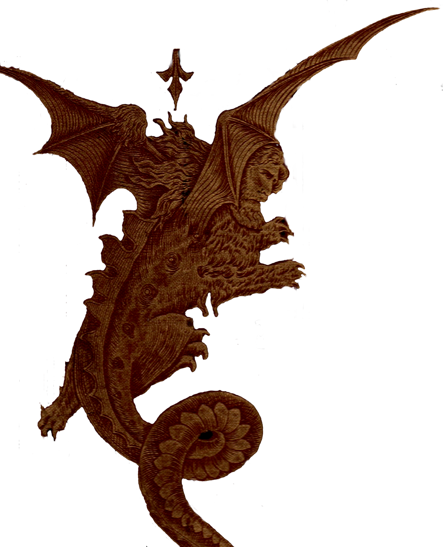
Revelation 20
Special focus on The Millennium
Paul J. Bucknell

Slide 2
Revelation 20:1-15
“^{20:1} And I saw an angel coming down from heaven, having the key of the abyss and a great chain in his hand. ² And he laid hold of the dragon, the serpent of old, who is the devil and Satan, and bound him for a thousand years, ³ and threw him into the abyss, and shut it and sealed it over him, so that he should not deceive the nations any longer, until the thousand years were completed; after these things he must be released for a short time. ⁴ And I saw thrones, and they sat upon them, and judgment was given to them. And I saw the souls of those who had been beheaded because of the testimony of Jesus and because of the word of God, and those who had not worshiped the beast or his image, and had not received the mark upon their forehead and upon their hand; and they came to life and reigned with Christ for a thousand years. ⁵ The rest of the dead did not come to life until the thousand years were completed. This is the first resurrection. ⁶ Blessed and holy is the one who has a part in the first resurrection; over these the second death has no power, but they will be priests of God and of Christ and will reign with Him for a thousand years.⁷ And when the thousand years are completed, Satan will be released from his prison,
⁸ and will come out to deceive the nations which are in the four corners of the earth, Gog and Magog, to gather them together for the war; the number of them is like the sand of the seashore. ⁹ And they came up on the broad plain of the earth and surrounded the camp of the saints and the beloved city, and fire came down from heaven and devoured them. ¹⁰ And the devil who deceived them was thrown into the lake of fire and brimstone, where the beast and the false prophet are also; and they will be tormented day and night forever and ever.
¹¹ And I saw a great white throne and Him who sat upon it, from whose presence earth and heaven fled away, and no place was found for them. ¹² And I saw the dead, the great and the small, standing before the throne, and books were opened; and another book was opened, which is the book of life; and the dead were judged from the things which were written in the books, according to their deeds. ¹³ And the sea gave up the dead which were in it, and death and Hades gave up the dead which were in them; and they were judged, every one of them according to their deeds. ¹⁴ And death and Hades were thrown into the lake of fire. This is the second death, the lake of fire. ¹⁵ And if anyone’s name was not found written in the book of life, he was thrown into the lake of fire” (Rev 20:1-15 NASB).

Slide 3
A. Different Views of the Millennium
Premillennial
Postmillennial
Amillennial (Realized millennialist)
Old Testament
New Testament
It is astonishing to discover that a literal 1000 year age is not taught in any other part of the Bible but is proposed to be a last moment revelation.
“2 And he laid hold of the dragon, the serpent of old, who is the devil and Satan, and bound him for a thousand years, 3 and threw him into the abyss, and shut it and sealed it over him, so that he should not deceive the nations any longer, until the thousand years were completed; after these things he must be released for a short time. 4 And I saw thrones, and they sat upon them, and judgment was given to them. And I saw the souls of those who had been beheaded because of the testimony of Jesus and because of the word of God, and those who had not worshiped the beast or his image, and had not received the mark upon their forehead and upon their hand; and they came to life and reigned with Christ for a thousand years. 5 The rest of the dead did not come to life until the thousand years were completed. This is the first resurrection. 6 Blessed and holy is the one who has a part in the first resurrection; over these the second death has no power, but they will be priests of God and of Christ and will reign with Him for a thousand years.7 And when the thousand years are completed, Satan will be released from his prison” (Rev 20:2-7).
“The tail that wags the dog.” (Blevin)

Slide 4
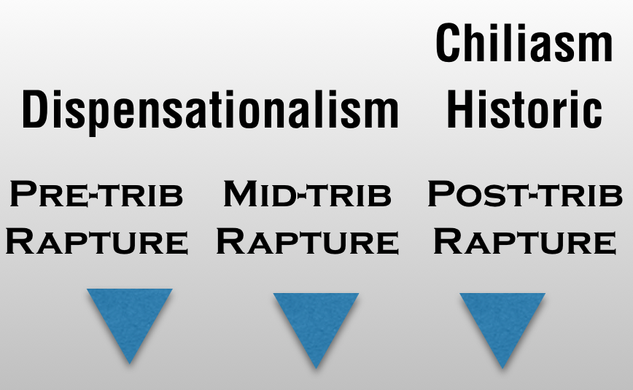
Premillennialist’s Viewpoint
The church age is separated from the tribulation (by some) and the millennium.
Second Coming for church
Second Coming with church
Resurrection of wicked
Final Judgment
Church age
tribulation
Millennium Literal 1000
7 Years
Eternal kingdom
?
Armageddon
?
Most premillennialists focus on the rapture to escape any form of suffering and the millennium rather than on Christ’s coming to deliver His people.
The multiplicity of several comings, judgments, and resurrections truly confuse the simple teaching of the scriptures.
BUT

Slide 5
Postmillennialist’s Viewpoint
The Kingdom of God is extended by preaching/teaching of God’s Word.
The world becomes progressively ‘Christianized.’
great tribulation
Israel’s Destruction
General resurrection
67-70 A.D.
Final Judgment
Church age
The millennium
Eternal kingdom
Symbolic 1000 years An increasing Christianized world
“The golden age postmillennialist has his sights fixed upon the coming golden age rather than the return of Christ at the end of the age.” (Cornelis Venema quoted in Three Views… Block, ed. p.66)
The postmillennialist cannot easily link all NT tribulation and evil with Israel’s 70 A.D. judgment (e.g. Rev 2-3; 2 Th 1:5-10;2:2-11). (They hold to the preterist view of the Book of Revelation.)
BUT

Slide 6
Amillennialist’s Viewpoint
Christ presently rules by His Word and Spirit as He builds His church, extending His Kingdom.
great tribulation
General resurrection
Final Judgment
Church age
The millennium
Eternal kingdom
evil and good continue to the end.
Symbolic 1000 years
BUT
They are often criticized for assigning general time periods to the literal “figures” given in the scripture such as the number 1000.

Slide 7
B. A Literal or Symbolic Millennium?
^{20:1} And I saw an angel coming down from heaven, having the key of the abyss and a great chain in his hand. ² And he laid hold of the dragon, the serpent of old, who is the devil and Satan, and bound him for a thousand years, ³ and threw him into the abyss, and shut it and sealed it over him, so that he should not deceive the nations any longer, until the thousand years were completed; after these things he must be released for a short time.
Premils’ support for a literal 1000 years depends on:
Literal numbers
Shaky chronological order
Messianic promises (Point C)
Is “7” used literally? No symbolic meaning? What about 144,000 or 1000? Can we be sure?
No strict chronological order found for Rev 19-20!
Non-chronological markers:
“After these things” (7 times) “And I saw” (27 times) “And I heard” (17 times)
All encapsulate recapitulated events and sequences not in historical chronology but indicative of what John saw (See following slides).
Re 4:1 After these things I looked, and behold, a door standing open in heaven, and the first voice which I had heard, like the sound of a trumpet speaking with me, said, “Come up here, and I will show you what must take place after these things.”
Re 7:9 After these things I looked, and behold, a great multitude, which no one could count, from every nation and all tribes and peoples and tongues, standing before the throne and before the Lamb, clothed in white robes, and palm branches were in their hands;
Re 9:12 The first woe is past; behold, two woes are still coming after these things.
Re 15:5 After these things I looked, and the temple of the tabernacle of testimony in heaven was opened,
Re 18:1 After these things I saw another angel coming down from heaven, having great authority, and the earth was illumined with his glory.
Re 19:1 After these things I heard, as it were, a loud voice of a great multitude in heaven, saying, “Hallelujah! Salvation and glory and power belong to our God;
Re 20:3 and threw him into the abyss, and shut it and sealed it over him, so that he should not deceive the nations any longer, until the thousand years were completed; after these things
Notes:
“After these things” is used seven times throughout Revelation not necessarily to show the chronological events but the next set of events John saw or heard.
Note the completed judgment in early chapter 19 is reiterated again two later times in later 19 and halfway through chapter 20 all with significant topical breaks (see diagram). Nor does Rev 19:11-21 prove to be different from former scenes (Wilcock has 8, Rev 20 being part of the 7th) for each has seven scenes (e.g. 7 seals, trumpets, etc.) often marked with: “And I saw” (27 times) or “And I heard” (17 times).

Slide 8
Chiastic Diagrams in Revelation
Chiastic diagrams necessarily supersede chronology patterns.
Satan
X
Evil works revealed
beast
false prophet
false prophet
Person Judged
beast
Satan

Slide 9
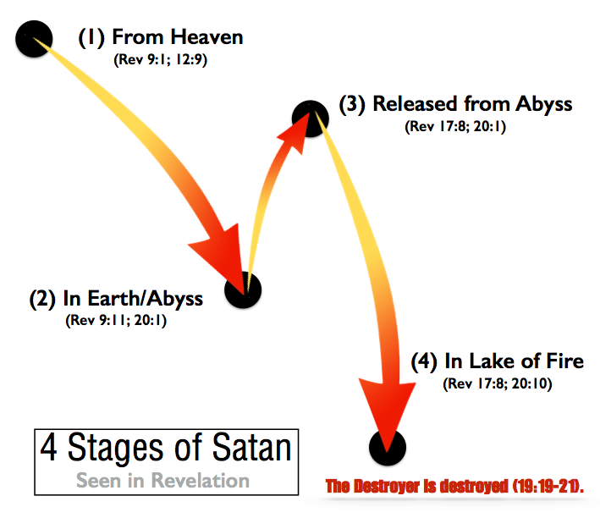
Millennium Doctrinal Conflict
And the seventy returned with joy, saying, “Lord, even the demons are subject to us in Your name.” ¹⁸ And He said to them, “I was watching Satan fall from heaven like lightning. ¹⁹ Behold, I have given you authority to tread upon serpents and scorpions, and over all the power of the enemy…” (Lu 10:17-19).

Slide 10
Checking for Chronological Sequence
Rev 19:1-10
Rev 19:11-21
Rev 20:1-10
19:1 After these things I heard, as it were, a loud voice of a great multitude in heaven, saying, “Hallelujah! Salvation and glory and power belong to our God; 2 BECAUSE HIS JUDGMENTS ARE TRUE AND RIGHTEOUS; for He has judged the great harlot who was corrupting the earth with her immorality, and HE HAS AVENGED THE BLOOD OF HIS BOND-SERVANTS ON HER.” 3 And a second time they said, “Hallelujah! HER SMOKE RISES UP FOREVER AND EVER.” 4 And the twenty-four elders and the four living creatures fell down and worshiped God who sits on the throne saying, “Amen. Hallelujah!” 5 And a voice came from the throne, saying, “Give praise to our God, all you His bond-servants, you who fear Him, the small and the great.” 6 And I heard, as it were, the voice of a great multitude and as the sound of many waters and as the sound of mighty peals of thunder, saying, “Hallelujah! For the Lord our God, the Almighty, reigns. 7 “Let us rejoice and be glad and give the glory to Him, for the marriage of the Lamb has come and His bride has made herself ready.” 8 And it was given to her to clothe herself in fine linen, bright and clean; for the fine linen is the righteous acts of the saints.
19:11 And I saw heaven opened; and behold, a white horse, and He who sat upon it is called Faithful and True; and in righteousness He judges and wages war. 12 And His eyes are a flame of fire, and upon His head are many diadems; and He has a name written upon Him which no one knows except Himself. 13 And He is clothed with a robe dipped in blood; and His name is called The Word of God. 14 And the armies which are in heaven, clothed in fine linen, white and clean, were following Him on white horses. 15 And from His mouth comes a sharp sword, so that with it He may smite the nations; and He will rule them with a rod of iron; and He treads the wine press of the fierce wrath of God, the Almighty. 16 And on His robe and on His thigh He has a name written, “KING OF KINGS, AND LORD OF LORDS.” 19 And I saw the beast and the kings of the earth and their armies, assembled to make war against Him who sat upon the horse, and against His army.
20 And the beast was seized, and with him the false prophet who performed the signs in his presence, by which he deceived those who had received the mark of the beast and those who worshiped his image; these two were thrown alive into the lake of fire which burns with brimstone. 21 And the rest were killed with the sword which came from the mouth of Him who sat upon the horse, and all the birds were filled with their flesh.
20:1 And I saw an angel coming down from heaven, having the key of the abyss and a great chain in his hand. 2 And he laid hold of the dragon, the serpent of old, who is the devil and Satan, and bound him for a thousand years, 3 and threw him into the abyss, and shut it and sealed it over him, so that he should not deceive the nations any longer, until the thousand years were completed; after these things he must be released for a short time. 4 And I saw thrones, and they sat upon them, and judgment was given to them. And I saw the souls of those who had been beheaded because of the testimony of Jesus and because of the word of God, and those who had not worshiped the beast or his image, and had not received the mark upon their forehead and upon their hand; and they came to life and reigned with Christ for a thousand years. 5 The rest of the dead did not come to life until the thousand years were completed. This is the first resurrection. 6 Blessed and holy is the one who has a part in the first resurrection; over these the second death has no power, but they will be priests of God and of Christ and will reign with Him for a thousand years. 7 And when the thousand years are completed, Satan will be released from his prison, 8 and will come out to deceive the nations which are in the four corners of the earth, Gog and Magog, to gather them together for the war; the number of them is like the sand of the seashore. 9 And they came up on the broad plain of the earth and surrounded the camp of the saints and the beloved city, and fire came down from heaven and devoured them. 10 And the devil who deceived them was thrown into the lake of fire and brimstone, where the beast and the false prophet are also; and they will be tormented day and night forever and ever.
Christ’s glorious leadership
A binding of evil one
Glorious victor
Harlot judged
kingdom growth
Victorious army comes
Celebrate judgment
persecution
Ready to smite nations
Great throng praising
resurrection
Assembles for war
Satan released
Beast and false prophet seized
Bride ready for marriage
Amageddon
Final judgment
Marriage
All judged
How can final judgment come after the victor’s march and marriage of the lamb?
27 x
“And I saw”

Slide 11
Recapitulated Events
Chapter 19
Chapter 20
Satan bound
Repeated themes through Revelation prove they are not given in chronological order!
Judgment seen
Leader of army
1000 great years
Harlot judged
Victorious army comes
Satan bound
Celebrate judgment
Reigned with Christ
Ready to smite nations
Great throng praising
Priests and reign
Assembles for war
1000+ satan released
Rev 21:1 And I saw a new heaven and a new earth; for the first heaven and the first earth passed away, and there is no longer any sea. 2 And I saw the holy city, new Jerusalem, coming down out of heaven from God, made ready as a bride adorned for her husband. 3 And I heard a loud voice from the throne, saying, “Behold, the tabernacle of God is among men, and He shall dwell among them, and they shall be His people, and God Himself shall be among them,
Bride ready for marriage
Beast and false prophet seized
All come against saints
Marriage
All judged
All judged

Slide 12
OT Messianic Kingdom Prophecies
Ezekiel 37:24-28
“24 My servant David will be king over them, and they will all have one shepherd; and they will walk in My ordinances and keep My statutes and observe them. 25 They will live on the land that I gave to Jacob My servant, in which your fathers lived; and they will live on it, they, and their sons and their sons’ sons, forever; and David My servant will be their prince forever. 26 I will make a covenant of peace with them; it will be an everlasting covenant with them. And I will place them and multiply them, and will set My sanctuary in their midst forever. 27 My dwelling place also will be with them; and I will be their God, and they will be My people. And the nations will know that I am the LORD who sanctifies Israel, when My sanctuary is in their midst forever.”
24 Not always literal - this refers to the promised son of David - Jesus (2 Sa 7:14; Rev 15:3; 17:4;19:6;22:16)
24 The true Shepherd is undoubtedly Jesus (Mt 2:6; John 10:14-16; Rev 7:17;21:4)
25 ‘Forever’ (49) and eternal’ (70) are common words in the NT but cannot describe the millennium (only 1000 years–Rev 11:15; 22:5).
26-27 God’s dwelling, promised sanctuary, intimate knowledge of is fulfilled not in a rebuilt temple but in the church and the final glorious new Jerusalem (city/temple) in Rev 21-22.
“And I heard a loud voice from the throne, saying, “Behold, the tabernacle of God is among men, and He shall dwell among them, and they shall be His people, and God Himself shall be among them” (Rev 21:3).

Slide 13
OT Messianic Kingdom Prophecies
Isaiah 65:17-25 (Is 25:6-9)
20-25 Often is used as proof for a millennium: people live to be 100+ and “wolf and lamb” graze together but prior verses don’t allow it!
17 Context is of “new heaven and earth”: “And I saw a new heaven and a new earth; for the first heaven and the first earth passed away…” (Rev 21:1).
18 New Jerusalem: “And I saw the holy city, new Jerusalem, coming down out of heaven from God, made ready as a bride adorned for her husband” (Rev 21:2)
19 ‘Forever’ “God Himself shall be among them, 4 and He shall wipe away every tear from their eyes; and there shall no longer be any death; there shall no longer be any mourning, or crying, or pain; the first things have passed away” (Rev 21:3-4).
17 “For behold, I create new heavens and a new earth; And the former things shall not be remembered or come to mind. 18 “But be glad and rejoice forever in what I create; For behold, I create Jerusalem for rejoicing, And her people for gladness. 19 “I will also rejoice in Jerusalem, and be glad in My people; And there will no longer be heard in her The voice of weeping and the sound of crying. 20 “No longer will there be in it an infant who lives but a few days, Or an old man who does not live out his days; For the youth will die at the age of one hundred And the one who does not reach the age of one hundred Shall be thought accursed. 21 “And they shall build houses and inhabit them; They shall also plant vineyards and eat their fruit. 22 “They shall not build, and another inhabit, They shall not plant, and another eat; For as the lifetime of a tree, so shall be the days of My people, And My chosen ones shall wear out the work of their hands. 23 “They shall not labor in vain, Or bear children for calamity; For they are the offspring of those blessed by the LORD, And their descendants with them. 24 “It will also come to pass that before they call, I will answer; and while they are still speaking, I will hear. 25 “The wolf and the lamb shall graze together, and the lion shall eat straw like the ox; and dust shall be the serpent’s food. They shall do no evil or harm in all My holy mountain,” says the LORD. (Is 65:17-25)

Slide 14
The Millennium
Summary
3 major millennial interpretations, each shape a person’s eschatology.
All views are orthodox.
The biggest issue is not the content of the millennium but when it should take place, whether literal 1000 years or symbolically describing in the church age.
Literal numbers
Chronological order
Messianic promises
“The proper Christian preunderstanding in reading Old Testament prophetic passages is the authoritative apostolic, post-Pentecost, New Testament interpretative pattern, which consistently sees these prophecies as filled in Christ and his messianic kingdom, both in its present, partially realized phase and in its future, fully realized phase.” (Robert Strimple, Three Views on the Millennium and Beyond (Ed. Darrell Bock, p. 267).

Slide 15
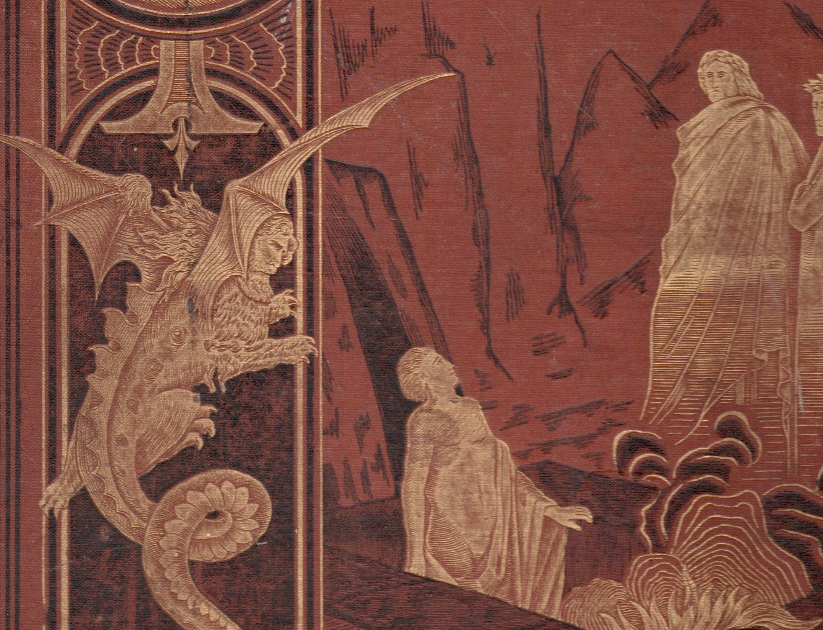
“And if anyone’s name was not found written in the book of life, he was thrown into the lake of fire.”
Revelation 20:15
Discussion Questions
Before this Revelation class have you ever heard of the millennium? If so, what view were you taught?
Why is it important that we have the right view of the millennium?
What part of Revelation 20 and this discussion stands out as most significant for you? Why?

Slide 16
Revelation 20
Special focus on The Millennium
Paul J. Bucknell

