Slide 1

“I am a great student of Revelation. I always believe the last thing I heard!”

Slide 2
Revelation 22:20-21
Epilogue and Summary
Oakland International Fellowship
Paul J. Bucknell

Slide 3
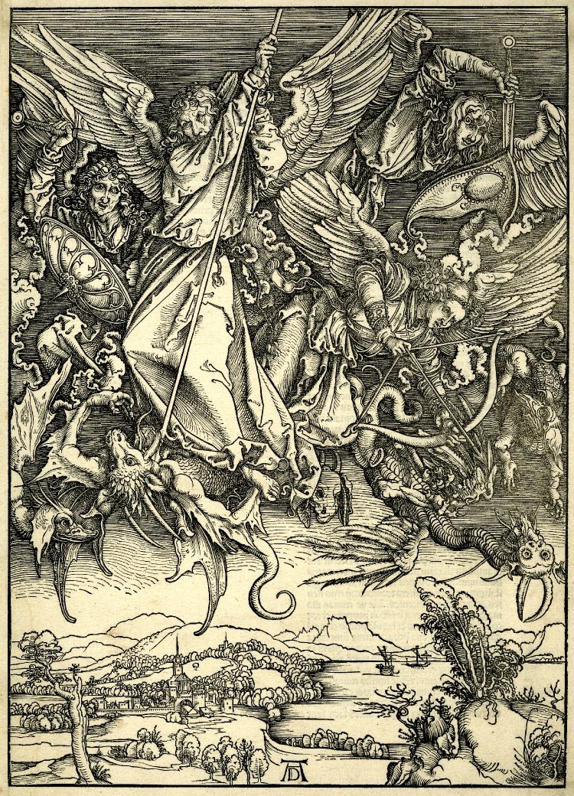
St Michael fighting the Dragon
Albrecht Dürer
1498

Slide 4
A. The Profit from Revelation
“Blessed is he who reads and those who hear the words of the prophecy, and heed the things which are written in it; for the time is near” (Rev 1:3).
How does God’s revelation help us?
What more we can we know from Revelation?
What can we not know from Revelation?
Revelatory knowledge enables us to know what otherwise is unknowable, directing us to prioritize what is truly important.
The Book of Revelation raises awareness and alertness, further shaping commitment to live godly lives to the end.
God uses the Book of Revelation to strengthen our confidence and faith rather than provide specific dates and events of Jesus’ second coming. (Ac 1:6-11)

Slide 5

B. The Meaningful Structure of Revelation
# | Scenes | 7 Settings | Opening scene
1 | 1:19-3:22 Church in the World | Seven letters dictated | John turns to see who is speaking
2 | 4:1-8:1 Suffering for Church | Seven seals opened | A door in heaven opens
3 | 8:2-11:18 Warnings for World | Seven trumpets sounded | Angels with trumpets appear
4 | 11:19-15:4 Drama of History | Seven visions of cosmic conflict | The temple in heaven opens
5 | 15:5-16:21 Punishment for World | Seven bowls poured out | Tabernacle of testimony in heaven opens
6 | 17:1-19:10 Babylon the Whore | Seven words of justice | Angel shows John the harlot
7 | 19:11-21:8 Drama Behind History | Seven visions of ultimate reality | Heaven itself is opened
8 | 21:9-22:19 Jerusalem the Bride | Seven final revelations | Angel calls John view the bride of Christ
The scenes overlap – because they typically describe the same event(s)
The scenes are progressively intensive
The scenes gradually move from earthly to heavenly views
Please note this excludes a historical chronology

Slide 6

1
2
3
4
5
6
7
“The scenes of revelation have brought us to the world’s end at each sixth section, and at each seventh section have shown us the triumph of Christ.” (Wilcock, p.203)
The world’s end
The triumph of Christ

Slide 7


“Scene 8 (Rev 21:9>) takes up the seventh sections of nearly all the previous scenes, and blends them into a single but complex picture of the life of the world to come.” (Wilcock, p.198)
“It is as if we have passed through a series of seven-sided rooms, in each of which one window has looked out on to eternity; and in a moment we shall step out of the seventh room and find ourselves in the open air.” p.198.

Slide 8
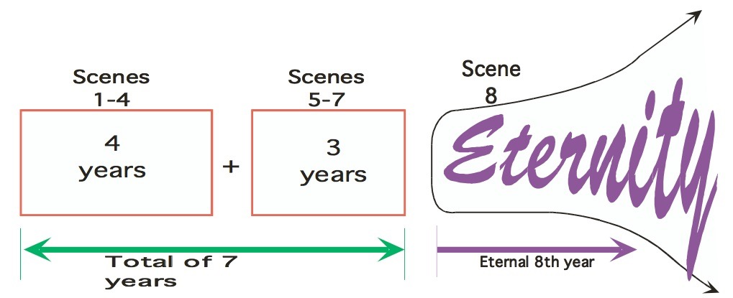
B. The Meaningful Structure of Revelation
“Blessed is he who reads and those who hear the words of the prophecy, and heed the things which are written in it; for the time is near” (Rev 1:3).
Openings
These bring hope to the world.
1) Scene 1 portrays the condition of the church in the world.
2) Scene 2 is a breaking of the seals to reveal the troubles that affect church and world alike.
3) Scene 3 brings blasts of trumpet sounds bringing warning and a choice of repentance or doom.
4) Scene 4 unfolds the spiritual drama of history.
Endings
These scenes close off some story.
5) Scene 5 reveals the angels that will destroy the whole earth.
6) Scene 6 shows the total end of the world and its power.
7) Scene 7 enable us to see the end of Satan.
Eternal
Summary
“Write therefore the things which you have seen, and the things which are, and the things which shall take place after these things.”
Shall take place:
  In time
  Beyond time

Slide 9
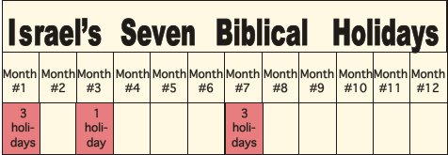
Start
definite time
limited time
eternal
14-21 day
1st month
6th day
3rd month
15-21
day
7th month
Only the father knows
Calendar for God’s people
Slavery
7 weeks
Freedom

Slide 10
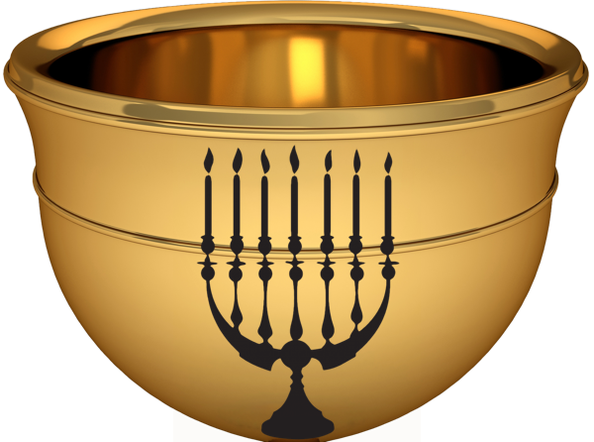
C. Revelation’s Epilogue (Rev 22:20-21)
“20 He who testifies to these things says, ‘Yes, I am coming quickly.’ ‘Amen. Come, Lord Jesus.’ 21 The grace of the Lord Jesus be with all. Amen” (Rev 22:20-21).
Bible Quote | Church’s Response
“I am coming quickly.”(20b) | The pure church readies herself for Christ’s coming.
“Amen. Come, Lord Jesus.” (20c) | The holy church has a deep desire to be with Christ.
“The grace of the Lord Jesus be with all.” (21) | God’s people recognize their need for God’s grace during these last days.

Slide 11
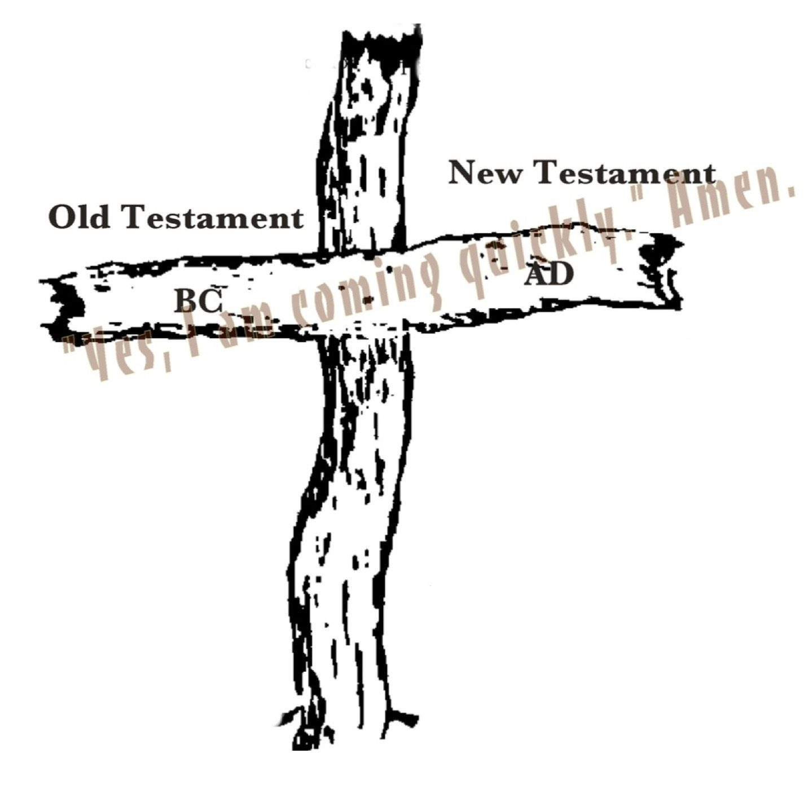
C. Revelation’s Epilogue (Rev 22:20-21)
“The Revelation of Jesus Christ, which God gave Him to show to His bond-servants, the things which must shortly take place.” (Rev 1:1)
“But as for you, Daniel, conceal these words and seal up the book until the end of time; many will go back and forth, and knowledge will increase.”
(Dan 12:4)
“And he said to me, “Do not seal up the words of the prophecy of this book, for the time is near.” (Rev 22:10)

Slide 12
D. Problems Understanding Revelation
Uncomprehensive: Glimpses of the spiritual world shake up our basic understanding of life (Rev 21:1-2).
Ignorant: Inadequate understandings of OT scriptures and Revelation invite us to further dive into the pool of God’s holy Word.
Misguided: We presume Revelation is discussing something which it is not.
Speculative: We are not asking the questions most Christians around the world are asking. Revelation is written to the persecuted.

Slide 13
D. Problems Understanding Revelation
Doubtful: We wonder how the Lord allows His beloved people to be assailed while on earth (Rev 6:9-10).
Secretive: The presence of evil does not reflect God’s weakness but His special purposes (Rev 4:11).
Unconvinced: Christ, the only and mighty sovereign, is at all times fully in charge (Rev 1:17-18).

Slide 14


Conclusion
The book of Revelation answers the two questions:
  (1) “Why has Christ not yet come back?” and
  (2) “Is Christ really in charge with so much evil around?”
Not: “When is Christ going to come back?”
Jesus emphatically requests His disciples not to focus on the times of the end but our responsibilities (Acts 1:7-8).

Slide 15
Discussion Questions
What is the most important truth, image, or phrase that has helped you in the study of the Book of Revelation? Why is it important to you?
How important is it that we believe Christ is returning soon? Many doctrinal statements include “believe in the near return of Jesus Christ.” How does verse 22:20 shed light on this?
“²⁰ He who testifies to these things says, ‘Yes, I am coming quickly.’ Amen. Come, Lord Jesus. ²¹ The grace of the Lord Jesus be with all. Amen” (Rev 22:20-21).

Slide 16
Revelation 22:20-21
Epilogue and Summary
Oakland International Fellowship
Paul J. Bucknell

Slide 17
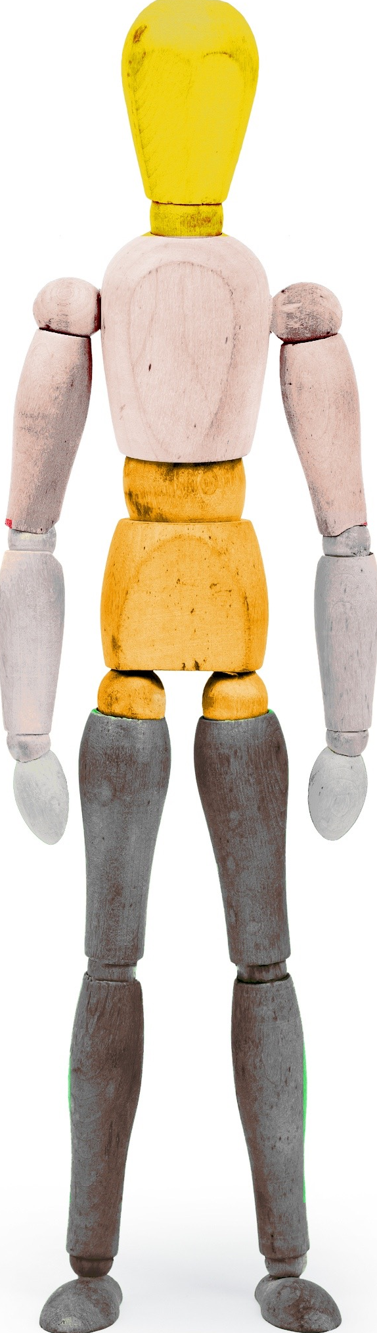
Daniel 2
(1) Head of gold:
(2) Chest and arms of silver:
(3) Belly and thighs of bronze:
(4) Legs of iron:
Babylonian Empire
Medo-Persian Empire
Grecian Empire
Islamic Caliphate
Roman Empire
Excerpt From: Richardson, Joel. “Mideast Beast: The Scriptural Case for an Islamic Antichrist.”

