Slide 1
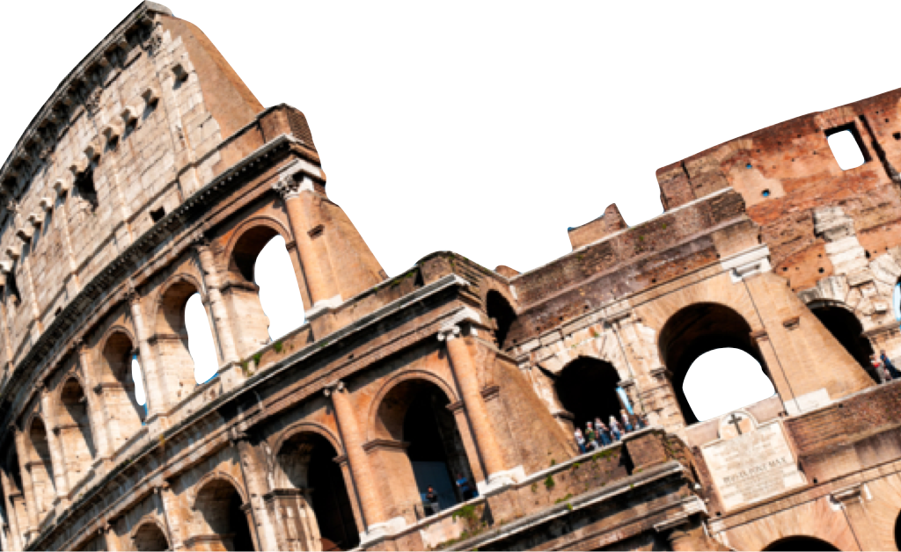
ROMANS
A Sneak Preview
Romans 1:1-7
Laying a solid foundation
Paul Bucknell

Slide 2
Overview of Romans
Purpose of the Book of Romans
God’s goals for Romans
What does He want to teach me or change in my life through the Book of Romans?
Laying a solid foundation for the people of God
The gospel of Jesus Christ is presented, defended and applied so that God’s people, no matter what nationality, completely set themselves apart for God (Rom 12:1-2).
“I urge you therefore, brethren, by the mercies of God, to present your bodies a living and holy sacrifice, acceptable to God, which is your spiritual service of worship. And do not be conformed to this world, but be transformed by the renewing of your mind, that you may prove what the will of God is, that which is good and acceptable and perfect” (Rom 12:1-2).
Romans: Chapters 1-11

Slide 3
Overview of Romans
Two Powerful Quotes
“I felt my heart strangely warmed. I felt I did trust in Christ, Christ alone, for salvation; and an assurance was given me that He had taken away my sins, even mine, and saved me from the law of sin and death.” – John Wesley 1738
“For I am not ashamed of the gospel, for it is the power of God for salvation to everyone who believes, to the Jew first and also to the Greek. For in it the righteousness of God is revealed from faith to faith; as it is written, ‘BUT THE RIGHTEOUS man SHALL LIVE BY FAITH’” (Romans 1:16-17).

Slide 4
Overview of Romans
The Situation of the Book of Romans
The city of Rome
The believers in Rome
Persecution against Jewish people and Christians
The time of its writing (15:26; 16:1)
The occassion for its writing
Clarify the gospel due to the absence of an apostle’s presence
Provides that key Jewish-Gentile Christian perspective for peace
A Jewish gospel tract - save his Jewish brethren
Announce his plans for a trip to Rome and far West (1:8-15 and 15:20-32).

Slide 5
Overview of Romans
An Outline of the Book of Romans
A. Righteousness Revealed: Gospel (Rom 1:1-17)
B. Righteousness Obsolete: Sin (Rom 1:18-3:20)
C. Righteousness Made: Justification (Rom 3:21-5:21)
D. Righteousness Attained: Sanctification (Rom 6-8)
E. Righteousness eNlarged: Worldwide (Rom 9-11)
F. Righteousness Spread: Service (Rom 12-16)

Slide 6
Overview of Romans
A Survey of the Book of Romans

Slide 7
The Gospel’s Message ( Rom 1:1-7)
The powerful gospel message and its implications for our lives is presented in Romans 1:1-7.
Romans 1:1-7 answers the question, “What is the Gospel?”
God’s righteousness is shown through the glorious Gospel of Jesus Christ. (1:1,9,15,16)

Slide 8
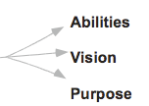
The Gospel’s Message ( Rom 1:1-7)
1. The Proclaimer of the Gospel (1:1)
¹Paul, a bond-servant of Christ Jesus, called as an apostle, set apart for the gospel of God.
Paul the slave of Christ Jesus
Called as an apostle
Purposed: “Set apart for the gospel of God.”

Slide 9
The Gospel’s Message ( Rom 1:1-7)
2. The Promise of the Gospel (1:2)
²Which he promised beforehand through his prophets in the Holy Scriptures.
“Beforehand” – Purposed rather than accidental
“Through His prophets” – Recorded in the ancient holy Scriptures
“Promised” – God’s commitment to rescue and restore mankind

Slide 10
The Gospel’s Message ( Rom 1:1-7)
3. The Person of the Gospel (1:3-5)
³Concerning his son, who was born of the seed of David according to the flesh, ⁴who was declared with power to be the Son of God by the resurrection from the dead according to the Spirit of holiness, Jesus Christ our Lord, ⁵through whom we have received grace and apostleship to bring about the obedience of faith among all the Gentiles, for His name’s sake.
Gospel is all about Jesus (3)
Jesus’ earthly birth (3)
Jesus’ death (4)
Jesus’ resurrection (4)
Jesus’ lordship (4)
Jesus’ grace and gifts (5)
Jesus’ mission (5)
Note Romans 12 where Paul clearly sees each believer a member of Christ’s body and each having a spiritual gift and responsibility for the body of Christ and the lost.

Slide 11
The Gospel’s Message ( Rom 1:1-7)
4. The People of the Gospel (1:6-7)
⁶Among whom you also are the called of Jesus Christ; ⁷to all who are beloved of God in Rome, called as saints: Grace to you and peace from God our Father and the Lord Jesus Christ.
Review 1:3-5. Jesus’ work and purpose changes our relationship to Him.
Participation in the calling (6-7a)
- Indian restaurant owner example
Partakers of the benefits (7b)
Grace is the favor God bestows on us unworthy creatures to know and obey Him.
Peace is the calmness within our hearts and minds that governs our lives in a tumultuous world.

Slide 12
The Gospel’s Message ( Rom 1:1-7)
Summary
Jesus is alive working powerfully in our lives along as well as other genuine believers of God, the church.
Discussion questions
What truth about Christian faith or life do you wrestle with most?
Do you see yourself as God’s specially gifted servant carrying out God’s greater purposes? Explain.
What has God called you for? How has He specially gifted you for this purpose? What are you doing about it?

Slide 13
ROMANS
A Sneak Preview
Romans 1:1-7
Laying a solid foundation
Paul Bucknell

