Slide 1
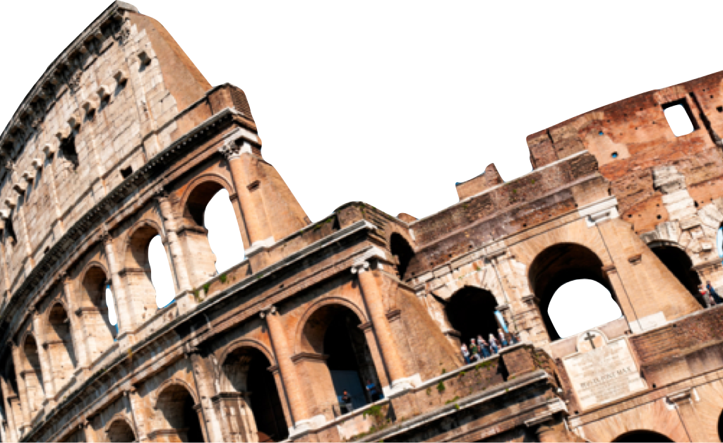
ROMANS
The Importance of Sharing the Right Gospel
Romans 9:30-10:15
Laying a solid foundation
Calvin Chiang

Slide 2
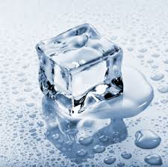
Icebreaker Question
If you were to ask this question in different parts of the world, “How does a person get into heaven?”, what kinds of answers would you get?
Notes:
*Common answers: By being a good person, sincerely trying to do your best, by being moral or religious, doing good works and helping the poor.
*Example of growing up in Taiwan, see monks take a vow of poverty and devote hours everyday to rituals and prayers.
Examples of sticks. Dave’s example of adoption.
*If you were to travel to a predominately Muslim country, like Turkey, you would be awakened in the middle of the night by sirens so that you can pray to towards the direction of Mecca, 5 times a day, observe the fast of Ramadan.
*Cults are also based on the same principle, the way to heaven is through good works, sharing your faith, going on a 2 year mission, giving up your money, abstaining from certain foods and drinks.
*Even Martin Luther, the father of the Reformation, gave up a career in law to join a monastery where he devoted himself to fasting and prayers, confession of sins, and self imposed harsh living conditions. However he couldn’t find peace with God because he knew that all of his good works were ultimately tainted by his sins.
*Example of Jesus welcoming the man who lived his whole life as a thief but in his dying breath he cried, “Jesus, remember me when you come in your kingdom (Luke 23:42)”. The thief gets to enter eternal joy with Jesus while you who worked so hard for salvation your whole life at the end is turned away.
*What an important question we must answer!!! We need to understand God’s way of Righteousness!

Slide 3
Previously on Romans…
If God is faithful to His covenant promises to His chosen people, then why are most of the Jews rejecting Jesus as their Messiah and Lord?
The idea of remnant and election is introduced. It was never God’s purpose to save all of Israel, but rather only a remnant. God always accomplishes His purpose through a chosen remnant according to His grace. Since all deserve His wrath and judgment, it is not unfair of Him to choose some as objects of mercy, but to leave the rest in their sin to glorify His justice in judgment.*
Notes:
Funny that often people like the idea of “free will” when it comes to choosing God, but when they are told about the doctrine of election, they blame God for not choosing them.

Slide 4
The Right vs. Wrong Way to God (Romans 9:30-33)
30 What shall we say then? That Gentiles, who did not pursue righteousness, attained righteousness, even the righteousness which is by faith; 31 but Israel, pursuing a law of righteousness, did not arrive at that law. 32 Why? Because they did not pursue it by faith, but as though it were by works. They stumbled over the stumbling stone, 33 just as it is written, “Behold, I lay in Zion a stone of stumbling and a rock of offense, and he who believes in Him will not be disappointed.”
Approaching God through our works built on faith in ourselves will cause us to remain lost in sin.
Israel tried to pursue righteousness through the Law of Moses not by faith but by works. The problem with this approach is that it will always fall short.
We are taught at a young age that success comes from “believing in yourself” and you need to have “self-confidence”. However Jesus teaches us the opposite in (Mark 8:34)*. Those who come to God by works are completely blind to their own sinfulness. (Isaiah 64:6)*
Notes:
**Mark 8:34: must deny themselves and take up the cross to follow me….
**Isaiah 64:6: reminds us that we are unclean and all our good works are like filthy rags in God’s sight. Same conclusion for Martin Luther.

Slide 5
The Right vs. Wrong Way to God Continued…
Approaching God through our works will cause us to stumble over Christ.
The stone (v.32) is referring to Christ. It is a combination of verses from Isa 28:16 (God said that He has put a cornerstone as a solid foundation and those who relies it will never be disappointed) and Isa 8:14 (a stone that causes people to stumble and fall).
Paul shows that Christ is both the hope and salvation of those who trusts in Him and yet at the same time a rock of stumbling and stone of offense for those who take pride in their own good works.
The true gospel inherently offends and it confronts our sinful pride (1 Cor. 1:29)*
Notes:
**False teaching will feed our pride and tell us how great we are…minimize negative stuff about sin and judgment, tell us that we will succeed and have happy lives.
**1 Cor 1:29: so that no one can boast before God…the fact that I am told I need MERCY is offensive. Mercy means that I am unable to do anything to gain God’s favor.
**Those who believes in Him will not be disappointed. (v.33)

Slide 6
Paul’s Concern for Israel (Romans 10:1-4)
Brethren, my heart’s desire and my prayer to God for them is for their salvation. 2 For I testify about them that they have a zeal for God, but not in accordance with knowledge. 3 For not knowing about God’s righteousness and seeking to establish their own, they did not subject themselves to the righteousness of God. 4 For Christ is the end of the law for righteousness to everyone who believes.
Israel missed out on salvation despite their zeal because it is not in accordance with knowledge (v.2).
Paul’s own personal testimony and experience shows how intensely a Jew can be in their concept of God. (Phil. 3:4-6)*
Zeal without accurate wisdom and understanding has often been the source of many great tragedies. What are some examples?
Our current culture discourages us to believe in absolute truth but rather that each person should determine their own truth.*
Notes:
**Phil 3:4-6: kept all the laws, circumcised on the 8th day, persecuting the Christians based on the law, faultless.
**Example of Jehovah’s Witnesses (reject Trinity, do not observe Christmas, Easter, birthdays), ISIS group (ethnic cleansing, human rights violations, war crimes)
**Example of a doctor’s prescription. No absolute truth, just take the medicine whenever you feel like it.

Slide 7
Paul’s Concern for Israel Continued…
Israel missed salvation because they do not know about God’s perfect righteousness so they seek to establish their own. (v.3).
The perfect imputed righteousness was revealed to them in Gen 15:6, but willfully ignored this but chose instead to take pride in keeping the law.
Jesus showed them that God looks at the heart instead. To be angry with your brother is to murder him and to lust after a woman in your heart is to commit adultery with her.
Notes:
**Gen 15:6: Abram believed and it was credited to him as righteousness.

Slide 8
Steps to Being Saved (Romans 10:5-10)
5 For Moses writes that the man who practices the righteousness which is based on law shall live by that righteousness 6 But the righteousness based on faith speaks as follows: “Do not say in your heart, ‘Who will ascend into heaven?’ (that is, to bring Christ down), 7 or ‘Who will descend into the abyss?’ (that is, to bring Christ up from the dead).” 8 But what does it say? “The word is near you, in your mouth and in your heart”—that is, the word of faith which we are preaching, 9 that if you confess with your mouth Jesus as Lord, and believe in your heart that God raised Him from the dead, you will be saved; 10 for with the heart a person believes, resulting in righteousness, and with the mouth he confesses, resulting in salvation.
To gain eternal life by keeping the law, you must obey it perfectly (v.5).
Truth is we have all repeatedly broken God’s law, both outwardly and on the heart level.
To be saved, you must recognize that you cannot save yourself by keeping God’s law. Rather it condemns you.

Slide 9
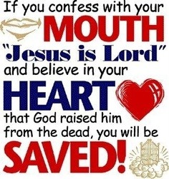
Steps to Being Saved Continued…
In order to be saved, you must accept what Christ has done for you is something that you can never do for yourself (v.6-8)
Righteousness of faith. Paul points out that the righteousness of Christ provides is a gift based on His finished work on the cross; it is not something that can be earned. Paul quotes from (Deut 30:12-14) to show that God does not ask for some great spiritual feat to receive this gift of righteousness. Just a simple and humble act of faith.
Simple action of first believing in the heart and then that heart belief finds outward expression in confession with our mouths and with our lives. (v.9-10)

Slide 10
Good News for All (Romans 10:11-15)
11 For the Scripture says, “Whoever believes in Him will not be disappointed.” 12 For there is no distinction between Jew and Greek; for the same Lord is Lord of all, abounding in riches for all who call on Him; 13 for “Whoever will call on the name of the Lord will be saved.” 14 How then will they call on Him in whom they have not believed? How will they believe in Him whom they have not heard? And how will they hear without a preacher? 15 How will they preach unless they are sent? Just as it is written, “How beautiful are the feet of those who bring good news of good things!”
The Gospel is “Good News” for all (v.11-13)
All people have the critical need to be saved before they die and face judgment. For all have sinned and fallen short of the glory of God (Rom. 3:23). All have the need to be reconciled to God.
The assurance that whoever believes in Him will not be disappointed (put to shame).
“The Good News” must be proclaimed (v.14-15)
We become the instruments of God’s grace.
Supporting our missionaries.

Slide 11
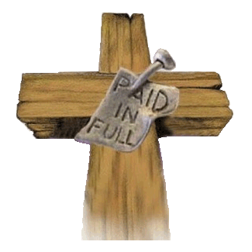
Conclusion
God’s way of salvation is not being a good, religious person, because you can never be good enough. Our “disease” of sin only grows progressively worse over time. Our good works does not avert the judgment which will ultimately come from God, who knows the thoughts and intentions of our heart.
Salvation in God is to trust Jesus so that the righteousness of God is imputed to you. We are justified by grace through the redemption that is in Christ Jesus.

Slide 12
Discussion Questions
Who is more difficult to reach with the gospel: a good person or a self-professing sinner? How should our approach differ with each of these types?
What are some biblical tests to determine if your zeal is godly or ungodly?
Can you think of 1-2 people in your life currently that you can share the “Good News” with?

