Slide 1
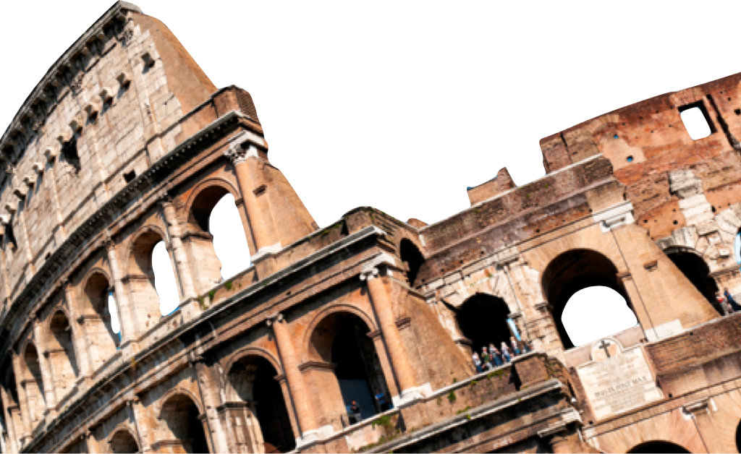
ROMANS
The Principles of Belonging
Romans 11:11-24
Laying a solid foundation
Calvin Chiang

Slide 2
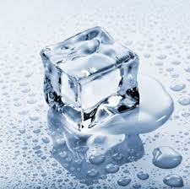
Icebreaker Question
What do you think of the tactic of motivating people by using jealousy?
Notes:
God’s definition of jealousy is different from our understanding of jealousy. Our definition when we are jealous is that we are envious of someone who has something that we do not have.
God is jealous when someone gives to another something that rightly belongs to Him. God is possessive of the worship and service that belongs to Him.

Slide 3
Previously on Romans…
Set out to answer the question: “Did God reject His people?”
Paul makes clear the point that Israel’s rejection of God is partial and not total. There is a remnant of believing Jews.
Did God forget His promises?

Slide 4
God’s Plan for Israel (Romans 11:11-15)
11 I say then, they did not stumble so as to fall, did they? May it never be! But by their transgression salvation has come to the Gentiles, to make them jealous. 12 Now if their transgression is riches for the world and their failure is riches for the Gentiles, how much more will their fulfillment be! 13 But I am speaking to you who are Gentiles. Inasmuch then as I am an apostle of Gentiles, I magnify my ministry, 14 if somehow I might move to jealousy my fellow countrymen and save some of them. 15 For if their rejection is the reconciliation of the world, what will their acceptance be but life from the dead?
God has a greater purpose in allowing Israel to reject Him.
The transgression of Israel rejecting Christ has caused the gospel to be preached to the Gentiles (v.11).
Paul states that with the Gentiles experiencing salvation, God’s grace, joy, power, blessing, and changed lives, it will provoke Israel to look again at the gospel.*
Once Israel realizes their need to come back to God, it will result in “life from the dead” (v.15).
Notes:
*Going back to Deut 32:21 when Israelites made God jealous by worshipping idols.
“They have made me jealous by what is no god and angered me with their worthless idols. I will make them envious by those who are not a people; I will make them angry by a nation that has no understanding.”

Slide 5
The Gentiles Engrafted onto Israel’s Olive Tree (Romans 11:16-19)
16 If the first piece of dough is holy, the lump is also; and if the root is holy, the branches are too.
17 But if some of the branches were broken off, and you, being a wild olive, were grafted in among them and became partaker with them of the rich root of the olive tree, 18 do not be arrogant toward the branches; but if you are arrogant, remember that it is not you who supports the root, but the root supports you. 19 You will say then, “Branches were broken off so that I might be grafted in.”

Slide 6
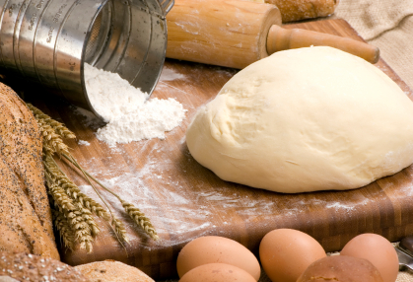
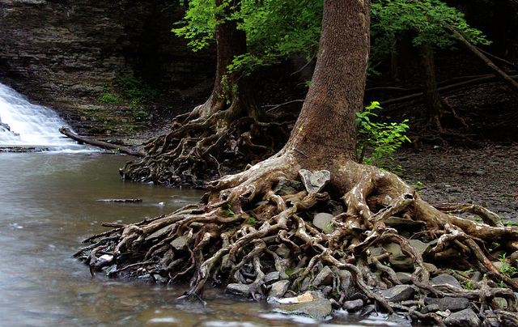
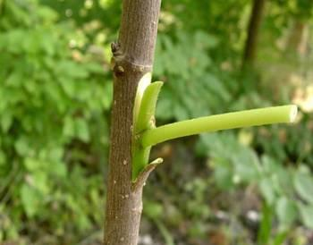
Romans 11:16-19 Continued…
Two Illustrations:
Notes:
*Illustration of the dough is drawn from the OT. God asked the Israelites to offer the first part of the harvest to Him and if He accepts it, the whole harvest was sanctified. Numbers 15:19-21.
*Original faith of the Israelites (ie. Abraham, Isaac, and Jacob) is good and holy and acceptable to God. That meant the rest of the Israelites are good in the eyes of God. There is a special relationship between Israel and God.
*Experience of going to Israel a few years ago. Wailing wall. Experienced first hand what that zeal (passion for God) is all about.
*2nd illustration is one of an Olive Tree. Take the 1st illustration a bit further, some branches were broken off (v.17) signifying some Jews being rejected from the covenant because of their disobedience.
*Because of the rich root (original), the wild olive (Gentiles) is able to be grafted into the olive tree and able to thrive and flourish.
Grafting takes a branch of an uncultivated (wild) tree that has some favorable qualities, cuts it off from the tree it is currently a part of, strips it of its leaves, and then cuts the host tree in order to incorporate the mutilated branch. It isn’t a pleasant thing. The grafted branch has to change, and the host has to support and nourish.
But here are some important facts about grafting — the host never changes. It is the graft that changes, but the graft will never, ever become like the original branch that was cut off. The fruit won’t ever look or taste exactly the same as the fruit the host tree originally produced, but it will change. Within a few years, the grafted branch will produce fruit that is far superior in quantity to what it once produced
.
Grafting is not a fast process, it takes time — in nature and in the Spirit. Grafting occurs for the express purpose of changing the branch, giving it a strong root and disease resistance — BUT no one would ever graft a wild branch onto a cultivated tree unless they wanted fruit that looked and tasted slightly different than that of the original tree!
.
When we, who are not natural branches are grafted into the root of Israel, our fruit and flavor will never be identical to the natural branches that are already there (those who are by birth descendants of Abraham, Isaac, and Jacob). We are still going to produce olives, the same species of fruit, and far more of it than before, but we aren’t supposed to taste or look exactly the same. When someone sees our fruit they should be able to say, “Aha! Look at that grafted branch, glory to YHVH! The fruit is indeed good and abundant!
Every believer is now part of the Jewish heritage. We are able to have the same benefits as it was originally intended for the Israelites.
*Example of adoption. That adopted child is treated as their own, given and receiving all the benefits as if the child was their own.

Slide 7
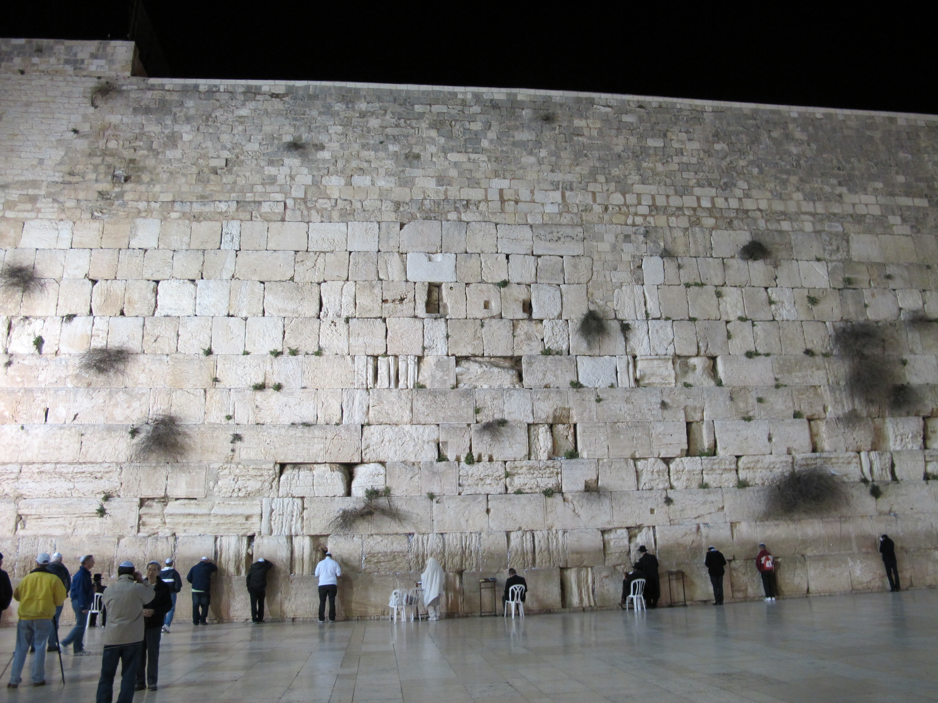

Slide 8
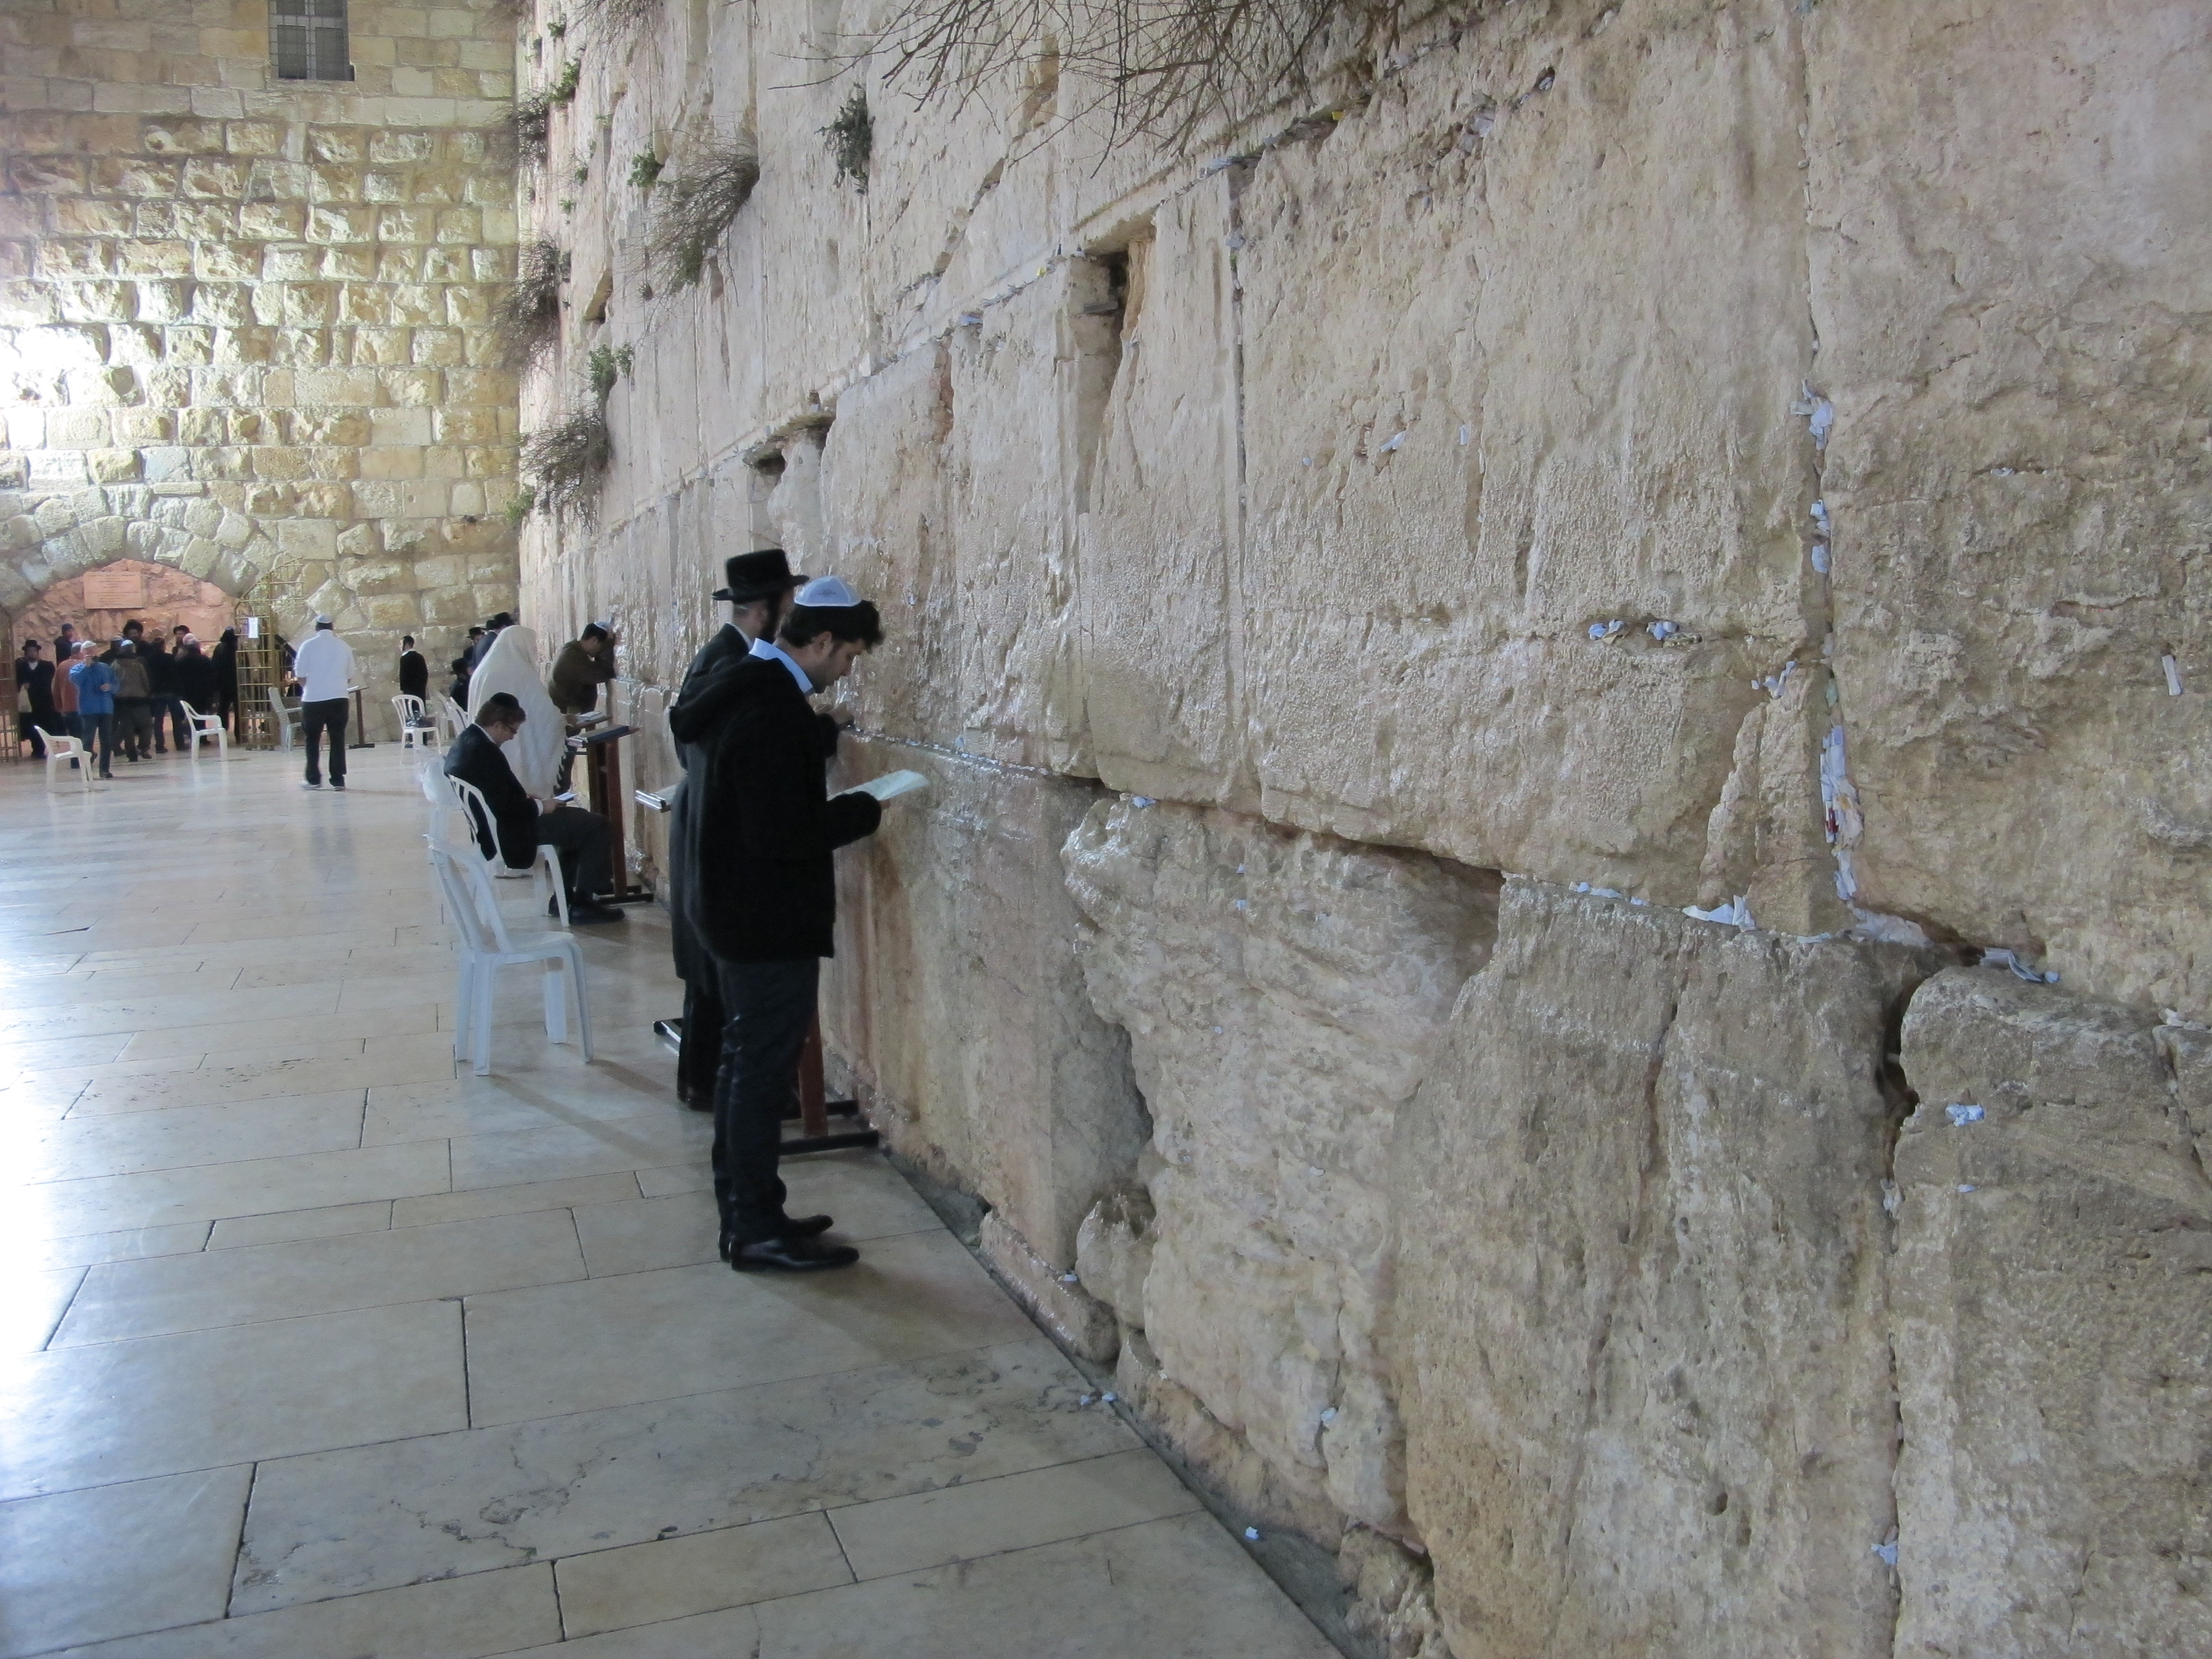

Slide 9
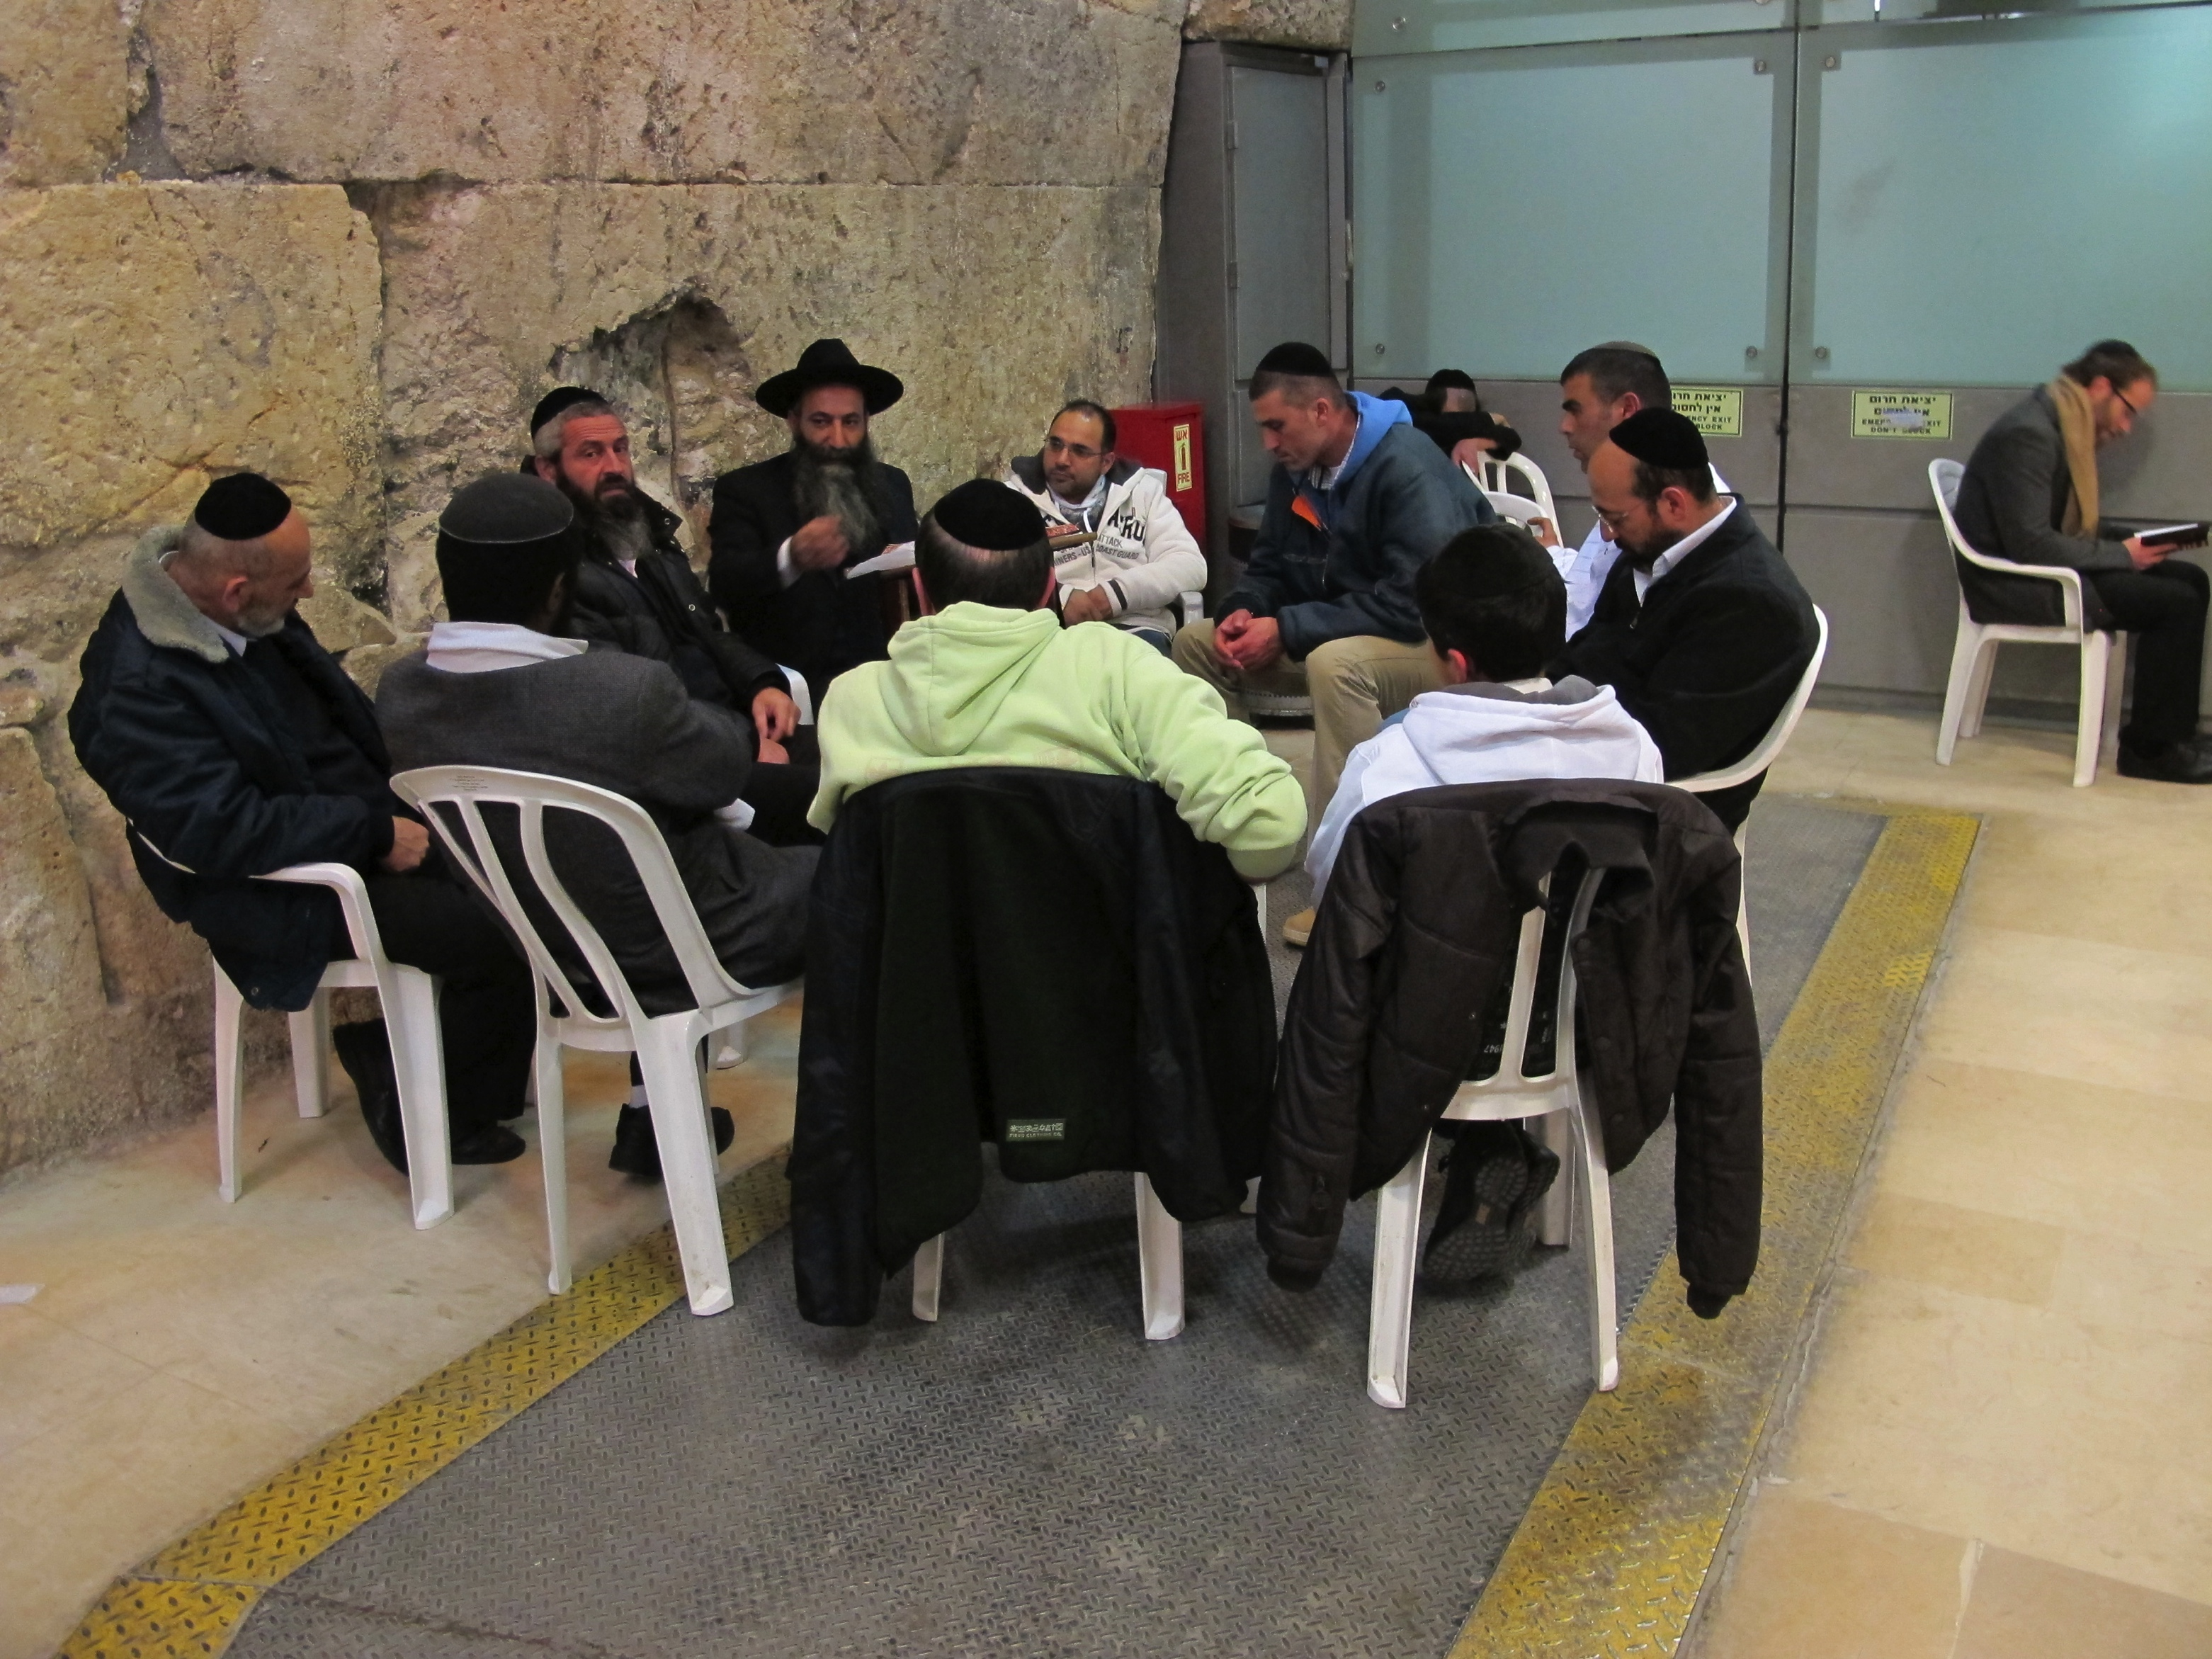

Slide 10
Changed Lives and Attitudes (Romans 11:20-24)
20 Quite right, they were broken off for their unbelief, but you stand by your faith. Do not be conceited, but fear; 21 for if God did not spare the natural branches, He will not spare you, either. 22 Behold then the kindness and severity of God; to those who fell, severity, but to you, God’s kindness, if you continue in His kindness; otherwise you also will be cut off. 23 And they also, if they do not continue in their unbelief, will be grafted in, for God is able to graft them in again. 24 For if you were cut off from what is by nature a wild olive tree, and were grafted contrary to nature into a cultivated olive tree, how much more will these who are the natural branches be grafted into their own olive tree?

Slide 11
Take Away Lessons (v.18-24)
There is only 1 people of God. There are not Jewish or Gentile believers but rather believers vs. non-believers. When we come to Christ our nationalities are no longer significant. (May be different branches but only 1 root).
People of God are expected to produce fruit. Genuine believers will produce fruit. The believer starts to change the way their live, the way they think, the way they treat others. (John 15:5,6)*
Salvation is by grace along. We have contributed nothing to the salvation process. Guard yourself against spiritual pride. (v.20-21)*
Israel is not done yet. The remnant is eventually going to yield a fresh and great harvest. (v.23-24)
The importance of personal faith.*
Notes:
*Jesus said, I am the vine, you are the branches. If a man remains in me and I in him, he will bear much fruit; apart from me you can do nothing. If anyone does not remain in me, he is like a branch that is thrown away and withers; such branches are picked up, thrown into the fire and burned.
*Prone to compare ourselves to others rather than to God.
*Tend to drift into salvation by works rather than faith.
*Behold the kindness and severity of God.
*We need to be constantly growing in our faith, walk with the Lord. It cannot depend on others. It is a personal relationship.

Slide 12
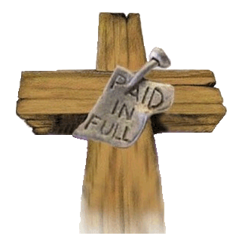
Conclusion
God is indeed a faithful God. He keeps His promises and fulfills them according to His time and plan. Paul reminds us that Israel’s rejection is is partial and not total. There is still a remnant of believing Jews. God uses this rejection to spread the gospel amongst the Gentiles. Then He will use the Gentiles’ reception of the gospel to bring the Jews to faith in Christ. The end result will be a greater blessing to the whole world.

Slide 13

Discussion Questions
God has shown us through Paul that human unbelief and sin cannot thwart God’s greater purpose for humanity. How is this both a comfort (Acts 4:27-28) and a danger (Rom 3:8)?
Why is it foolish for Christians today to feel superior to non-Christians? Can you list some examples of spiritual pride that we should guard against?

