Slide 1
Romans 11:25-36
OIF
Paul J. Bucknell
Israel’s Future and God’s Wisdom

Slide 2
Overview of Romans
An Outline of the Book of Romans
A. Righteousness Revealed: Gospel (Rom 1:1-17)
B. Righteousness Obsolete: Sin (Rom 1:18-3:20)
C. Righteousness Made: Justification (Rom 3:21-5:21)
D. Righteousness Attained: Sanctification (Rom 6-8)
E. Righteousness eNlarged: Worldwide (Rom 9-11)
F. Righteousness Spread: Service (Rom 12-16)

Slide 3
A) God’s Abundant Mercy (Ro 11:25-32)
Everything is working perfectly according to God’s glorious design, including the fulfillment of His promises to treacherous Israel.
11:24 For if you were cut off from what is by nature a wild olive tree, and were grafted contrary to nature into a cultivated olive tree, how much more shall these who are the natural branches be grafted into their own olive tree?
11:25 For I do not want you, brethren, to be uninformed of this mystery, lest you be wise in your own estimation, that a partial hardening has happened to Israel until the fullness of the Gentiles has come in; 26 and thus all Israel will be saved; just as it is written, "THE DELIVERER WILL COME FROM ZION, HE WILL REMOVE UNGODLINESS FROM JACOB." 27 "AND THIS IS MY COVENANT WITH THEM, WHEN I TAKE AWAY THEIR SINS." 28 From the standpoint of the gospel they are enemies for your sake, but from the standpoint of God's choice they are beloved for the sake of the fathers; 29 for the gifts and the calling of God are irrevocable. 30 For just as you once were disobedient to God, but now have been shown mercy because of their disobedience, 31 so these also now have been disobedient, in order that because of the mercy shown to you they also may now be shown mercy. 32 For God has shut up all in disobedience that He might show mercy to all. (NASB used)

Slide 4
A) God’s Abundant Mercy (Romans 11:25-32)
Three stages of mercy in God’s redemption plan (Eschatology in Romans)
Israel’s hardening Stage #1 | Gentiles saved Stage #2 | Israel saved Stage #3
“... a partial hardening has happened to Israel” (25) | “... until the fullness of the Gentiles has come in” (25) | “... and thus all Israel will be saved” (26).
Israel’s hardening is evident. The number of Jewish believers was soon surpassed by Gentile believers. The Jews, hardened in heart, did not as a nation embrace the Messiah. The hardening is partial in that we can anticipate some positive response to the gospel from the Jews. | The hardening became the means by which the Gentiles could be saved (32). The flow of God’s mercy is, for a time, diverted to the Gentiles. The fullness could refer to all the nations being reached or to the “fulfillment” where the Jews would join in and finish the task (cf. 11:11-12). | Since Paul has effectively shown not all the Jews would be saved, he must not be referring to the nation Israel as a whole. The phrase, “all Israel.” probably refers to the whole olive tree (11:17)–all the chosen people of God, including both Jews and Gentiles (cf. Eph 3:1-13).
Israel, then, will be the last nation that the Lord comes to visit before Christ’s return.

Slide 5
A) God’s Abundant Mercy (Romans 11:25-32)
9:27 "AND THIS IS MY COVENANT WITH THEM, WHEN I TAKE AWAY THEIR SINS." 28 From the standpoint of the gospel they are enemies for your sake, but from the standpoint of God's choice they are beloved for the sake of the fathers; 29 for the gifts and the calling of God are irrevocable. 30 For just as you once were disobedient to God, but now have been shown mercy because of their disobedience, 31 so these also now have been disobedient, in order that because of the mercy shown to you they also may now be shown mercy. 32 For God has shut up all in disobedience that He might show mercy to all.
God’s calling and great mercy (27-32)
“For the gifts and the calling of God are irrevocable” (Ro 11:29)
World mission - “In order that because of the mercy shown to you …may now be shown” (32) …that he might show mercy to all (33).
Everything is working perfectly according to God’s glorious design, including the fulfillment of His promises to treacherous Israel. Romans 9-11

Slide 6
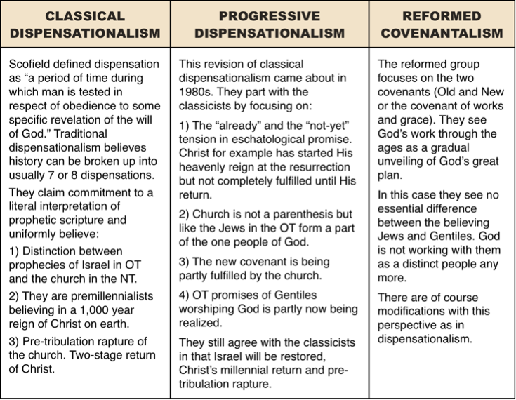
A) God’s Abundant Mercy (Romans 11:25-32)

Slide 7
B) God’s Awesome Glory (Romans 11:33-36)
33 Oh, the depth of the riches both of the wisdom and knowledge of God! How unsearchable are His judgments and unfathomable His ways! 34 For WHO HAS KNOWN THE MIND OF THE LORD, OR WHO BECAME HIS COUNSELOR? 35 Or WHO HAS FIRST GIVEN TO HIM THAT IT MIGHT BE PAID BACK TO HIM AGAIN? 36 For from Him and through Him and to Him are all things. To Him be the glory forever. Amen
God’s wisdom
God’s knowledge
God’s judgments
God’s Ways
Notes:
Are there situations that confound the Lord?
Is it right to ever blame God?
Can we really understand God?
Can our Christian growth ever max out?
Is any problem to hard for the Lord to solve?
Is it ever right to think that God owes us something?

Slide 8
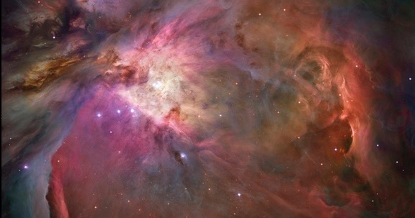
B) God’s Awesome Glory (Romans 11:33-36)
For from Him and
through Him and
to Him
are all things
To Him be the glory forever!
Amen
Orion nebula - Nasa
Notes:
Orion Nebula
This dramatic image offers a peek inside a cavern of roiling dust and gas where thousands of stars are forming. More than 3,000 stars of various sizes appear in this image of the Orion Nebula. Some of them have never been seen in visible light. Ultraviolet light unleashed by the four central stars is carving a cavity in the nebula and disrupting the growth of hundreds of smaller stars.

Slide 9
Israel’s Future and God’s Wisdom ( Ro 11:25-36)
Summary
Like the end of Job, a bright blast of God’s glory shines into our confusion, keeping us from quickly dismissing His promises as impossible and subduing our doubts regarding His good purposes for our lives.
Discussion questions
What are some signs of the ends of the age and how should this help shape our lives?
Presently, God is exercising His great mercy. Do you think there is a chance to gain mercy after death if it rejected now? On what basis do you answer this?
There are many things that we do not understand. How does Ro 11:36 help take us that further step where we can trust our Maker with all the events that have or will occur? What is one area of life that you have difficulty trusting Him with?

Slide 10
Romans 11:25-36
Paul J. Bucknell
Israel’s Future and God’s Wisdom

