Slide 1
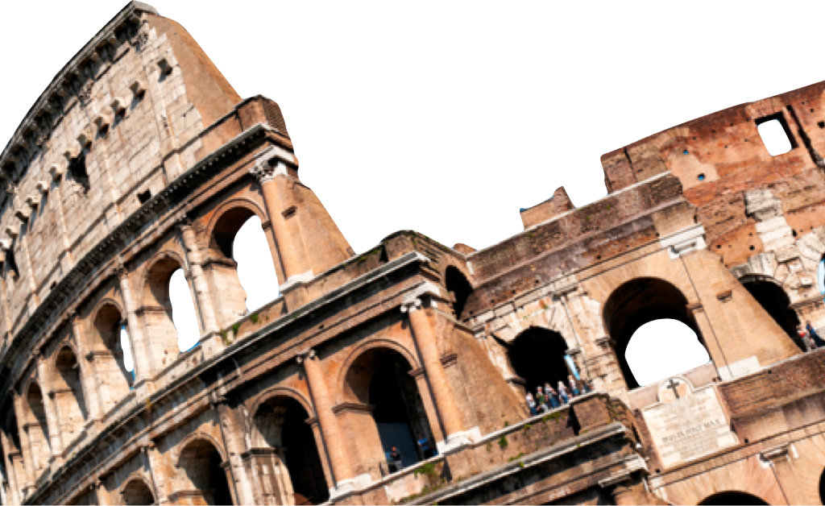
ROMANS
Principles of Christian Growth
Romans 12:9-21
Paul J. Bucknell
OIF
Laying a solid foundation
www.foundationsforfreedom.net

Slide 2
An Outline of the Book of Romans
A. Righteousness Revealed: Gospel (Rom 1:1-17)
B. Righteousness Obsolete: Sin (Rom 1:18-3:20)
C. Righteousness Made: Justification (Rom 3:21-5:21)
D. Righteousness Attained: Sanctification (Rom 6-8)
E. Righteousness eNlarged: Worldwide (Rom 9-11)
F. Righteousness Spread: Service (Rom 12-16)
Romans 12
12:1-2: Dedication to God
12:3-8: Spiritual gifts
12:9-21: Exhortation to Righteousness

Slide 3
25 Tweetable exhortations to righteousness
^{12:9} Let love be without hypocrisy. Abhor what is evil; cling to what is good. ¹⁰ Be devoted to one another in brotherly love; give preference to one another in honor; ¹¹ not lagging behind in diligence, fervent in spirit, serving the Lord; ¹² rejoicing in hope, persevering in tribulation, devoted to prayer, ¹³ contributing to the needs of the saints, practicing hospitality.
^{12:9} Let love be without hypocrisy.
^{12:12} Rejoicing in hope
^{12:9} Abhor what is evil
^{12:12} Persevering in tribulation
^{12:9} Cling to what is good.
^{12:13} Contributing to the needs of the saints
^{12:10} Be devoted to one another in brotherly love
^{12:12} Devoted to prayer
^{12:10} Give preference to one another in honor
^{12:11} Not lagging behind in diligence
^{12:13} Practicing hospitality
^{12:11} Fervent in spirit
^{12:11} Serving the Lord

Slide 4

Transformation by renewing the mind (Rom 12:2)
^{12:1} I urge you therefore, brethren, by the mercies of God, to present your bodies a living and holy sacrifice, acceptable to God, which is your spiritual service of worship. ² And do not be conformed to this world, but be transformed by the renewing of your mind, that you may prove what the will of God is, that which is good and acceptable and perfect.
Be transformed
by the renewing of your mind
The expected change
the means

Slide 5

By the renewing of the mind!
Exhortations
Each instruction reveals weaknesses we need to stand guard against.
e.g. Cling to what is good: “ I know what I should do but….”
The truth is a restatement of what ought to be true in our lives.
This is the way I ought to be!
The exhortation challenges us to extend our faith further in God to carry out what He deems to be important.
There are certain times it is very difficult for me to carry this out.
Our resolve to obey helps us to target the changes that we need to make in our lives, often including a change in our attitudes and values.
Renewing the mind enables us to consistently live like Jesus.

Slide 6
Objection please
Let love be without hypocrisy. (Romans 12:9)
Objection: “But what if I don’t really love them?"
Abhor what is evil. (Romans 12:9 )
Objection: “But then I can't watch my programs!"
Cling to what is good. (Romans 12:9)
Objection: “But I only sometimes meet with God and have devotions.”
Be devoted to one another in brotherly love. (Romans 12:10)
Objection: “But can’t I just be nice?"

Slide 7

You discover the rest!
Be devoted to one another in brotherly love. (Romans 12:10)
Pick out significant words
Ask yourself why do I or others have problem doing this without exceptions?
The reasons people don’t carry the exhortation out is largely due to doubts about it being the best thing to be done.
Make one or more sentences that expresses that doubt or reserve in doing it. This is your objection.
Give preference to one another in honor. (Romans 12:10 )
Key words:
Problem with obedience:
Doubts:
Objection:

Slide 8
Exhortations
Not lagging behind in diligence. (Romans 12:11)
Fervent in spirit. (Romans 12:11)
Serving the Lord. (Romans 12:11)
Rejoicing in hope. (Romans 12:12)
Persevering in tribulation. (Romans 12:12)
#6-10
Devoted to prayer. (Romans 12:12)
Contributing to the needs of the saints. (Romans 12:13)
Practicing hospitality. (Romans 12:13)
Bless those who persecute you. Bless and curse not. (Romans 12:14)
Rejoice with those who rejoice. (Romans 12:15)
#11-15
Weep with those who weep. (Romans 12:15)
Be of the same mind toward one another. (Romans 12:16)
Do not be haughty in mind but associate with the lowly. (Romans 12:16)
Do not be wise in your estimation. (Romans 12:16)
Never pay back evil for evil to anyone. (Romans 12:17)
#16-20
Respect what is right in the sight of all men. (Romans 12:17)
As far as it depends on you, be at peace with all men. (Romans 12:18)
Never take your own revenge, but leave room for the wrath of God… (Romans 12:19)
If your enemy is hungry, feed him, and if he is thirsty, give him a drink.… (Romans 12:20)
Do not be overcome by evil, but overcome evil with good. (Romans 12:21)
#21-25

Slide 9
Objection please
#6-10
Not lagging behind in diligence. (Romans 12:11)
Objection:
Fervent in spirit. (Romans 12:11)
Objection:
Serving the Lord. (Romans 12:11)
Objection:
Rejoicing in hope. (Romans 12:12)
Objection:
Persevering in tribulation. (Romans 12:12)
Objection:

Slide 10
Objection please
#11-15
Devoted to prayer. (Romans 12:12)
Objection:
Contributing to the needs of the saints. (Romans 12:13)
Objection:
Practicing hospitality. (Romans 12:13)
Objection:
Bless those who persecute you. Bless and curse not. (Romans 12:14)
Objection:
Rejoice with those who rejoice. (Romans 12:15)

Slide 11
Objection please
#16-20
Weep with those who weep. (Romans 12:15)
Objection:
Be of the same mind toward one another. (Romans 12:16)
Objection:
Do not be haughty in mind but associate with the lowly. (Romans 12:16)
Objection:
Do not be wise in your estimation. (Romans 12:16)
Objection:
Never pay back evil for evil to anyone. (Romans 12:17)
Objection:

Slide 12
Objection please
#21-25
Respect what is right in the sight of all men. (Romans 12:17)
Objection:
As far as it depends on you, be at peace with all men. (Romans 12:18)
Objection:
Never take your own revenge, but leave room for the wrath of God… (12:19)
Objection:
If your enemy is hungry, feed him, and if he is thirsty, give him a drink.… (12:20)
Objection:
Do not be overcome by evil, but overcome evil with good. (Romans 12:21)
Objection:

Slide 13
Principles of Christian Growth ( Rom 12:9-21)
Summary
By touching on many aspects of our lives, Paul provides a powerful portrait of the Christian’s life. At the beginning of Romans 5, Paul started to relate what it means for Christ to live through His people right now on earth. He continues that here by showing how God’s people live above the world by caring for others more than themselves.
Discussion questions
Would you consider the above exhortations laws? Why or why not?
If a person could do all these things, does it make a person a Christian. Explain.
Share one or more items from above and share how you need to improve the way you live out your life.

Slide 14
ROMANS
Principles of Christian Growth
Romans 12:9-21
Paul J. Bucknell
OIF
Laying a solid foundation
www.foundationsforfreedom.net

