Slide 1
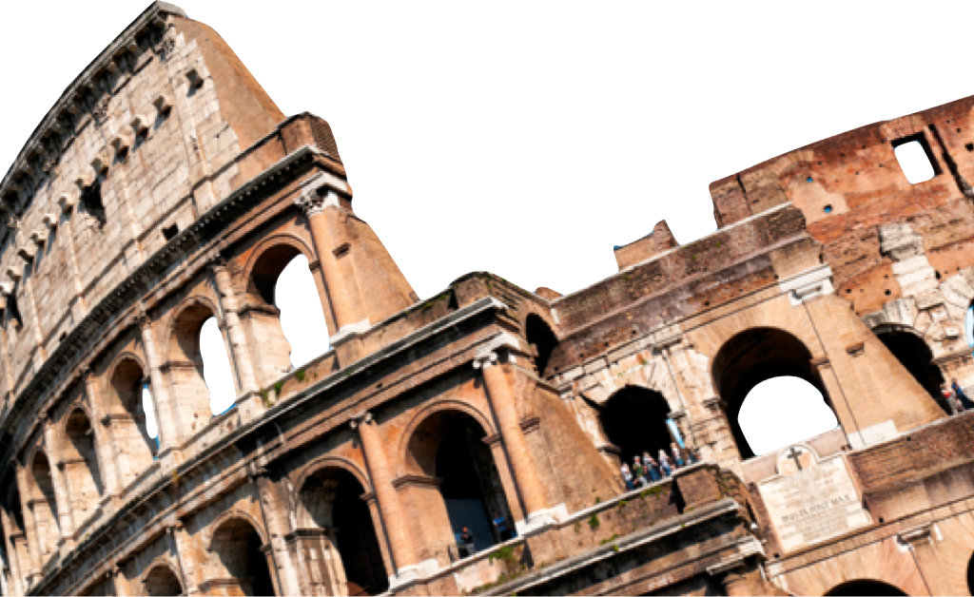
ROMANS
Living in the World
Romans 13:1-14
Paul J. Bucknell
Laying a solid foundation
Oakland International Fellowship

Slide 2

Outline of Romans 13
Romans 1-12
How to gain righteous lives
Romans 13-16
How to live righteous lives
Right living in the world
(Romans 13)
Relationship with government (13:1-7)
Relationship within society
(13:8-14)

Slide 3
A) Living Subject to Governing Authorities (Ro 13:1-7)
God’s establishment of governing authorities (13:1)
^{13:1} Let every person be in subjection to the governing authorities. For there is no authority except from God, and those which exist are established by God.
“No authority except from God”
God establishes and leaves societal authorities in control and responsible for carrying out God’s orders.
“Be in subjection”: God calls every person to be subject to their governing authorities.
e.g. Attitude towards speeding
Do not assume everything done by a government is right!

Slide 4
A) Living Subject to Governing Authorities (Ro 13:1-7)
Need to subject oneself (13:2-5)
^{13:2} Therefore he who resists authority has opposed the ordinance of God; and they who have opposed will receive condemnation upon themselves. 3 For rulers are not a cause of fear for good behavior, but for evil. Do you want to have no fear of authority? Do what is good, and you will have praise from the same; 4 for it is a minister of God to you for good. But if you do what is evil, be afraid; for it does not bear the sword for nothing; for it is a minister of God, an avenger who brings wrath upon the one who practices evil. 5 Wherefore it is necessary to be in subjection, not only because of wrath, but also for conscience’ sake (13:2-5).
“Resists authority” (2): Oppose or resist authority oppose God.
“Not a cause for fear” (3): One only fears the government when being uncivil. Do good and fear disappears.
“Minister of God” (4): Literally ‘servant.’ God appoints these ‘ministers’ to help restrain evil. There are two reasons to be subject to our government: (1) Safety and (2) conscience before God.

Slide 5

A) Living Subject to Governing Authorities (Ro 13:1-7)
Paying taxes (13:6-7)
^{13:6} For because of this you also pay taxes, for rulers are servants of God, devoting themselves to this very thing. 7 Render to all what is due them: tax to whom tax is due; custom to whom custom; fear to whom fear; honor to whom honor (Ro 13:6-7).
“You also pay taxes” (6): Should pay (not hide)
Our attitude: servants of God (like paying a pastor).
Our attitude: Allow God to judge them. Meanwhile be faithful paying taxes and praying for your leaders (1 Ti 2:2).
What about participatory governments?
Vote!
Go up for office!
Support!
Be informed!

Slide 6
B) General principles for living in the world (Ro 13:8-14)
Love summarizes the laws (13:8-10)
^{13:1} Owe nothing to anyone except to love one another; for he who loves his neighbor has fulfilled the law. 9 For this, “YOU SHALL NOT COMMIT ADULTERY, YOU SHALL NOT MURDER, YOU SHALL NOT STEAL, YOU SHALL NOT COVET,” and if there is any other commandment, it is summed up in this saying, “YOU SHALL LOVE YOUR NEIGHBOR AS YOURSELF.” 10 Love does no wrong to a neighbor; love therefore is the fulfillment of the law (Ro 13:8-10).
Subtle transition: From regarding government (1-6) to “all” (7,8)
“Owe nothing to anyone” (8): “Never for no reason” owe…. Usury: interest (Dt 23:3; Pr 22:6-7)?
Be practical: Buying a car?
“Love one another”(7): positively give and share rather than to be in obligation to others for money, “custom to whom custom, fear to whom fear; honor to honor”.
“Love …is fulfillment of law” (10): Love summarizes the law in everyday.

Slide 7
B) General principles for living in the world (Ro 13:8-14)
Love supersedes impurity (13:11-14)
^{13:11} And this do, knowing the time, that it is already the hour for you to awaken from sleep; for now salvation is nearer to us than when we believed. 12 The night is almost gone, and the day is at hand. 13 Let us therefore lay aside the deeds of darkness and put on the armor of light. Let us behave properly as in the day, not in carousing and drunkenness, not in sexual promiscuity and sensuality, not in strife and jealousy. 14 But put on the Lord Jesus Christ, and make no provision for the flesh in regard to its lusts.
“Awaken from sleep” (11):
“Salvation” (11): the final glorification when Christ returns.
“Not in drunkenness, not in sensuality” (13): Fun and love cannot mix with our flesh’s passion. What is love?
“Put on the Lord Jesus Christ” (14): Imagery of putting on a set of clothes means that we purposely adopt His holy ways
“Make no provision for the flesh” (14): Forbid even a little room

Slide 8
B) General principles for living in the world (Ro 13:8-14)
“Make no provision for the flesh” (14)
List ways to do this:
1
2
3
4
5

Slide 9
Living in the World ( Rom 13:1-14)
Summary
Being Jesus’ disciples has great ramifications on the way we live in the world around us. These clear directives help guide our general attitude and approach to political entities – respect them, as well as handling ourselves in the evil-stained culture about us – live holy lives.
Discussion questions
What do you believe about debt? Why? How does this passage affect your decisions?
What is one way that you have “put on Christ”?
In what ways do you find it difficult to believe that the government is God’s servant?

Slide 10
ROMANS
Living in the World
Romans 13:1-14
Paul J. Bucknell
Laying a solid foundation
Oakland International Fellowship

