Slide 1
Revelation 21:9-22:19
Scene 8: Jerusalem the Bride
Oakland International Fellowship
Paul J. Bucknell

Slide 2
The 8 Scenes of Revelation
Idea from Wilcock’s book
# | Scenes | 7 Settings | Opening scene | Summary | Special focus | Key thought
1 | 1:19-3:22 Church in the World | Seven letters dictated | John turns to see who is speaking | Christ speaks to the 7 churches | 7 commonalities with pointed differences. | Cure for lukewarmness?Readmit the excluded Christ! p.58
2 | 4:1-8:1 Suffering for Church | Seven seals opened | A door in heaven opens | God’s power (4-5); woes in history | Seals will not be opened until chapter. 6. p.66 | Christ’s explanation of history makes it full of meaning. p.69
3 | 8:2-11:18 Warnings for World | Seven trumpets sounded | Angels with trumpets appear | #1-4 prove God’s power; 5-7 are 3 woes | No datable events but can be true at anytime. p.92 | Evil must be exposed for what it is–absolute wickedness. p. 108
4 | 11:19-15:4 Drama of History | Seven visions of cosmic conflict | The temple in heaven opens | Perennial spiritual conflict of history | Seven visions are oddly static; an ongoing battle. p.121 | Spiritual deliverance by Christ is the real Exodus!
5 | 15:5-16:21 Punishment for World | Seven bowls poured out | Tabernacle of testimony in heaven opens | Babylon’s career | The plagues from the bowls are total; no more time for repentance. p.144 | Classic horror: Finding oneself locked in with what you fear. p.143
6 | 17:1-19:10 Babylon the Whore | Seven words of justice | Angel shows John the harlot | Babylon’s destruction | Babylon’s career is brought to ruin and successor introduced. p.141 | Openness to these mighty words brings us to our knees–worship. p.174
7 | 19:11-21:8 Drama Behind History | Seven visions of ultimate reality | Heaven itself is opened | Recapitulation underlying realities | A picture of history revealing Jerusalem as the climax. p.141 | Not future but present conquering King, righteous Judge. p.183
8 | 21:9-22:19 Jerusalem the Bride | Seven final revelations | Angel calls John to view the bride of Christ | Beyond time and history | The glorious Jerusalem fully occupies scene. | Chapter 1 now begins and goes on forever. p.203

Slide 3
Revelation 21:9-22:19
“And one of the seven angels who had the seven bowls …, saying, ‘Come here, I shall show you the bride, the wife of the Lamb’” (Rev 21:9).
#1 The Holy City, Jerusalem (Rev 21:10-21)
#2 The Glory of the Lord (Rev 21:22-27)
#3 The River of Life (Rev 22:1-5)
#4-7 The Last Four Revelations (Rev 22:6-19)

Slide 4
#1 The Holy City, Jerusalem (Rev 21:10-21)
21:10 And he carried me away in the Spirit to a great and high mountain, and showed me the holy city, Jerusalem, coming down out of heaven from God, 11 having the glory of God. Her brilliance was like a very costly stone, as a stone of crystal-clear jasper.
“The holy city, Jerusalem” is the bride of Christ, the church (10; 21:2; Ez 40:2).
“I shall show you the bride, the wife of the Lamb” (9)
“and showed me the holy city, Jerusalem, coming down out of heaven from God, “ (10)
This NT definition directs how we should interpret OT prophetic images of the future.
2 In the visions of God He brought me into the land of Israel, and set me on a very high mountain; and on it to the south there was a structure like a city. (Ez 40:2)

Slide 5
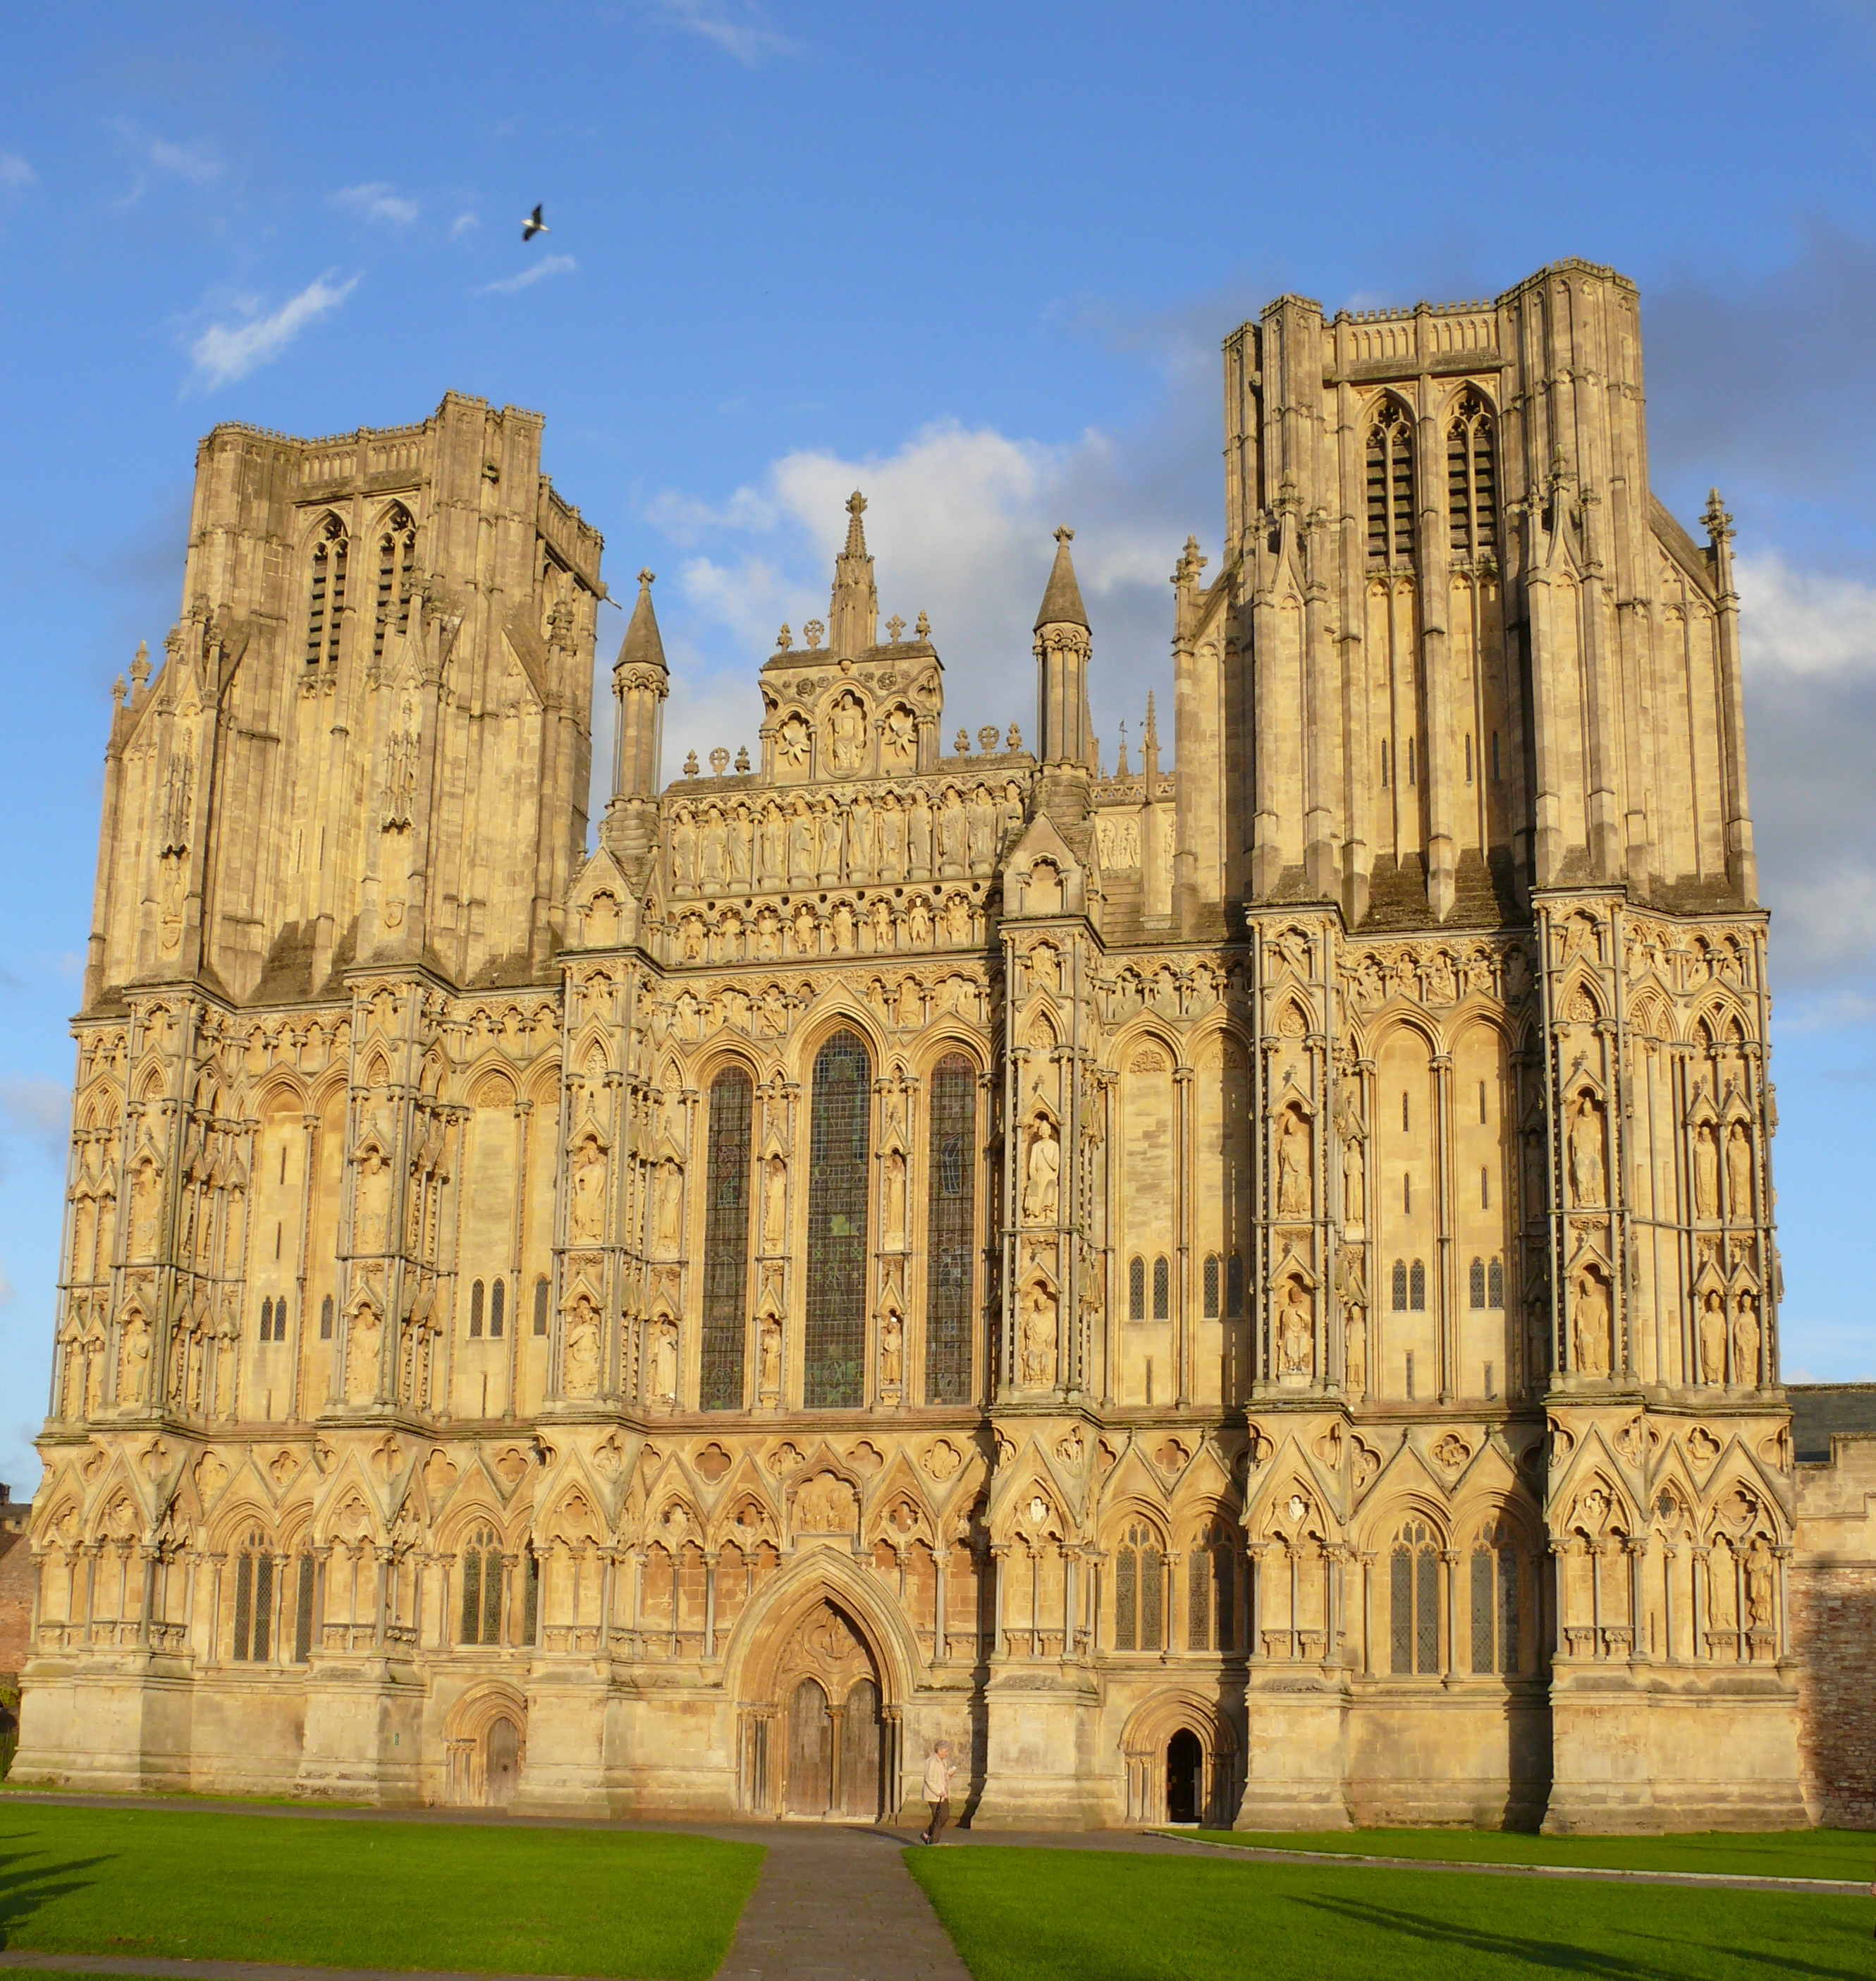
Revelation 21:10-21
Wells Cathedral
21:12 It had a great and high wall, with twelve gates, and at the gates twelve angels; and names were written on them, which are those of the twelve tribes of the sons of Israel. 13 There were three gates on the east and three gates on the north and three gates on the south and three gates on the west. 14 And the wall of the city had twelve foundation stones, and on them were the twelve names of the twelve apostles of the Lamb.
12
gates
12
founding stones
Wiki Common Use

Slide 6
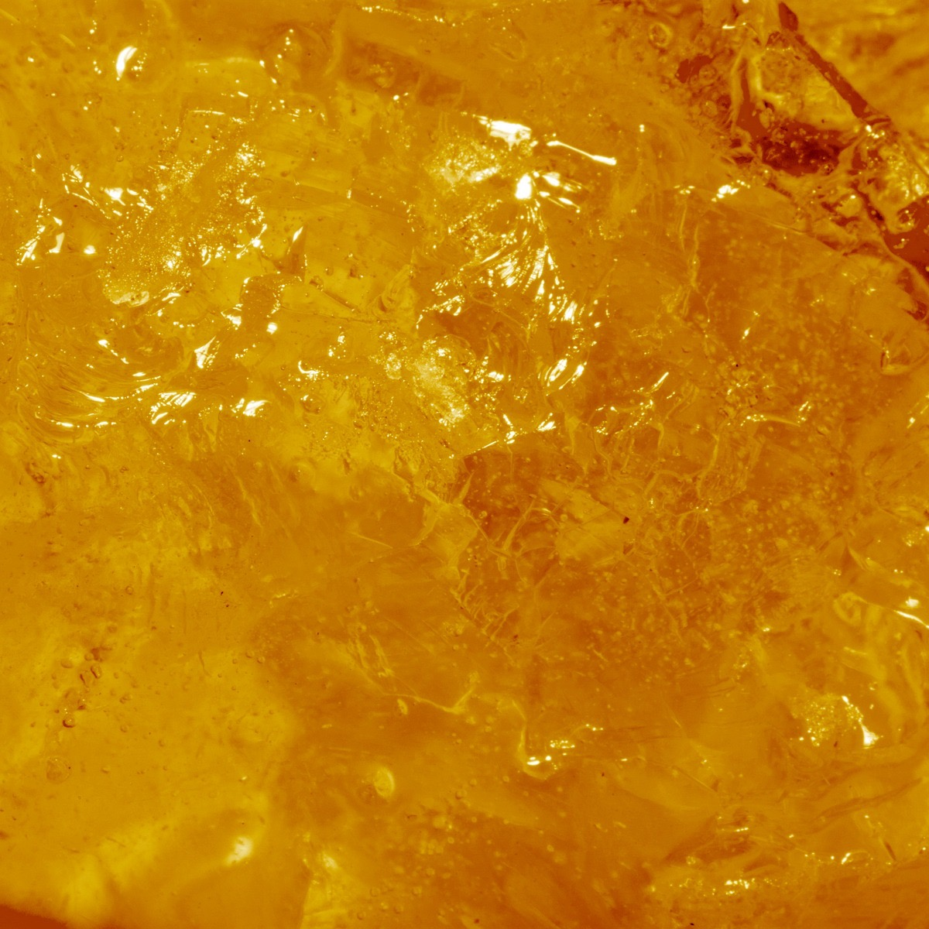
Jerusalem
12,000 stadia = 1,500 miles
Jerusalem
1,500 miles
1,500 miles
Its length and width and height are equal.
1,500 miles
21:16 And the city is laid out as a square, and its length is as great as the width; and he measured the city with the rod,12,000 stadia; its length and width and height are equal…. 18 And the material of the wall was jasper; and the city was pure gold, like clear glass. 19 The foundation stones of the city wall were adorned with every kind of precious stone… 21 And the street of the city was pure gold, like transparent glass.

Slide 7
#2 The Glory of the Lord (Rev 21:22-27)
21:22 And I saw no temple in it, for the Lord God, the Almighty, and the Lamb, are its temple.23 And the city has no need of the sun or of the moon to shine upon it, for the glory of God has illumined it, and its lamp is the Lamb. 24 And the nations shall walk by its light, and the kings of the earth shall bring their glory into it. 25 And in the daytime (for there shall be no night there) its gates shall never be closed; 26 and they shall bring the glory and the honor of the nations into it; 27 and nothing unclean and no one who practices abomination and lying, shall ever come into it, but only those whose names are written in the Lamb’s book of life.
No temple in it (22)
God/Jesus is the temple (22)
No need of sun or moon (23)
Glory of God illumines (23-24; Is 60:1-5). New creation with new light! (Ro 8:22)
The lost are sinful, abhorring the light (27)
Only for those whose names in Lamb’s Book of Life (27)

Slide 8
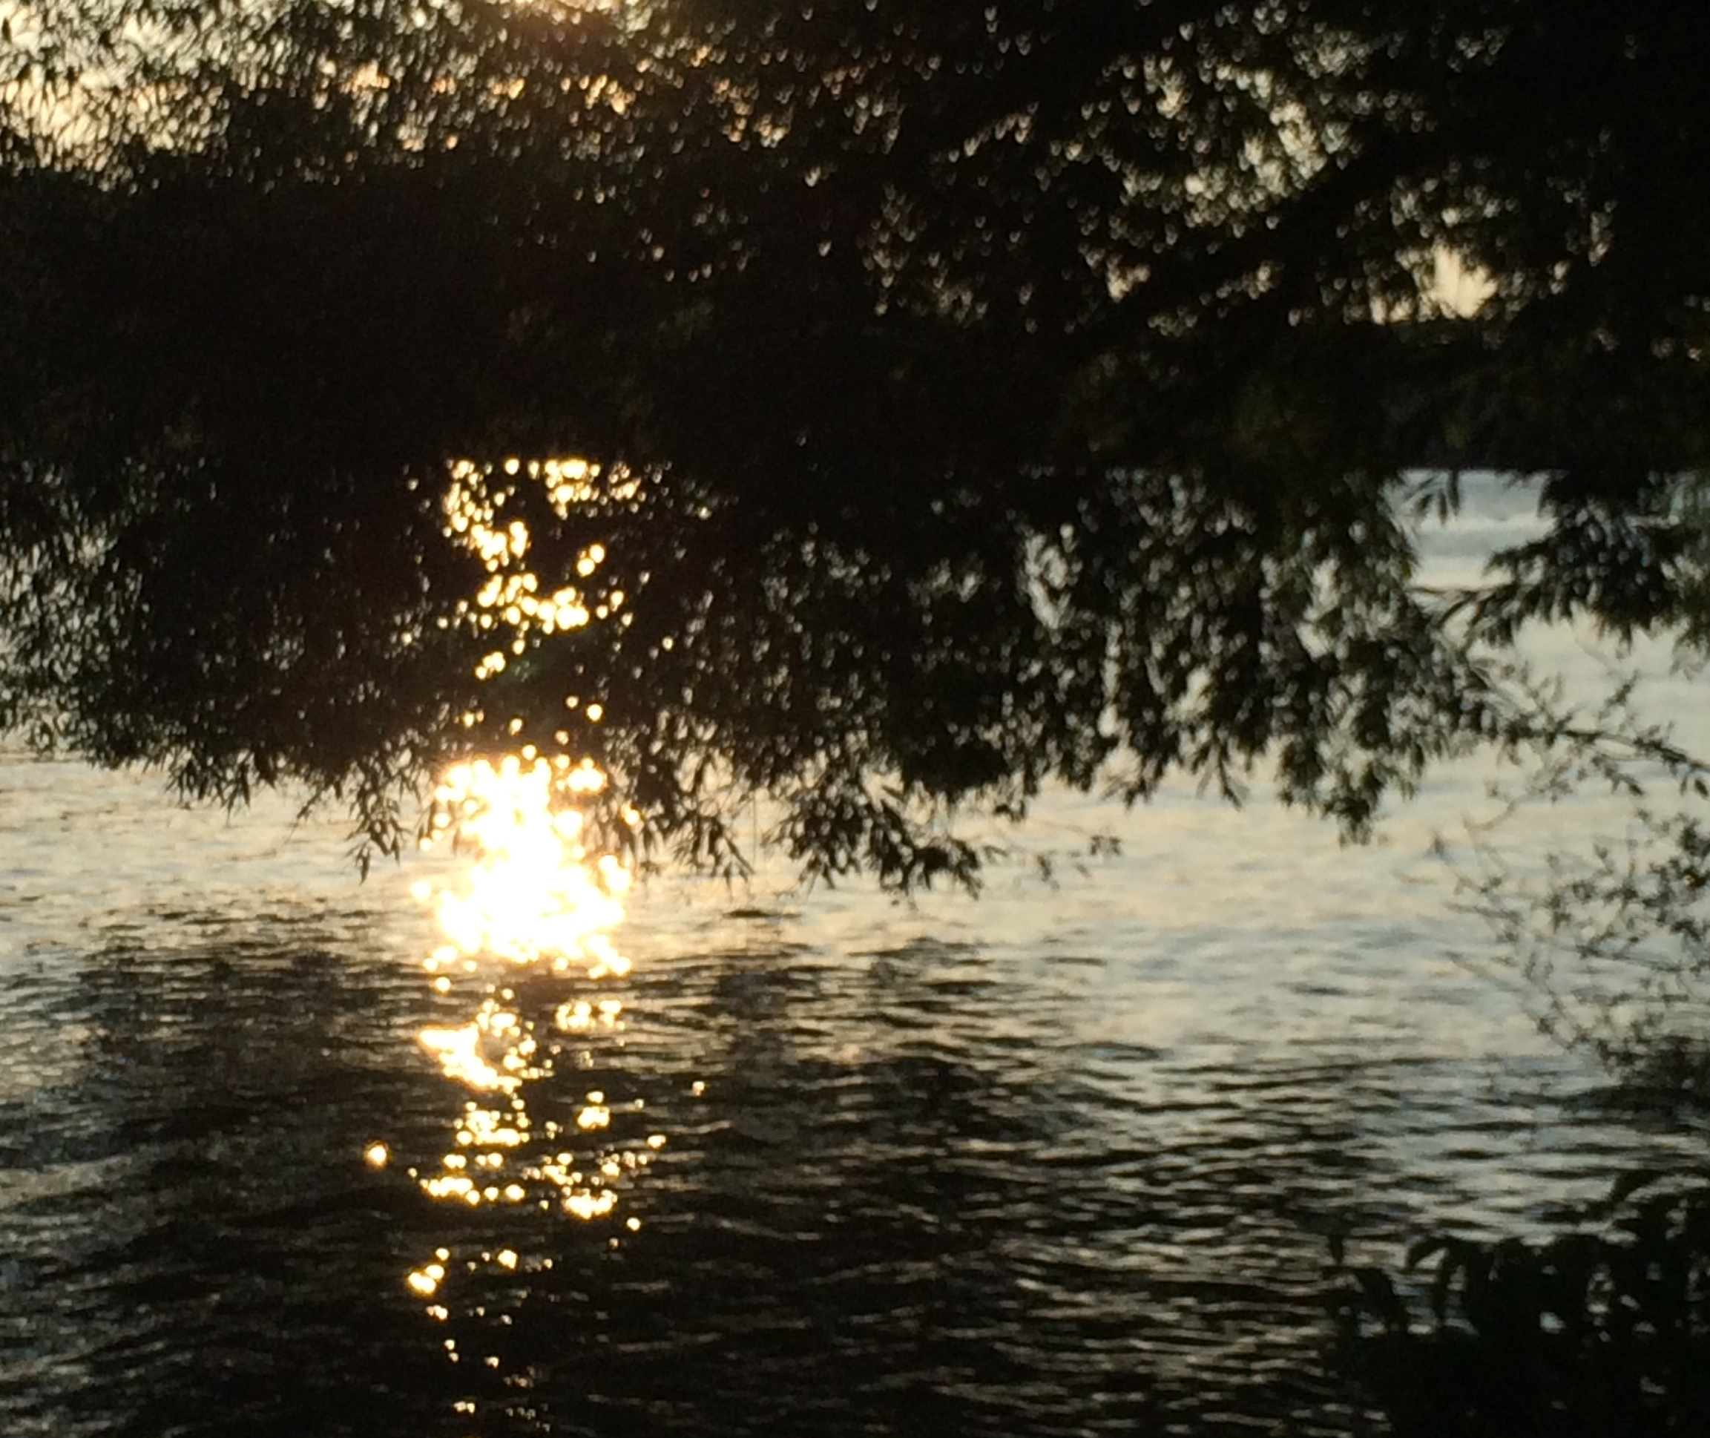
#3 The River of Life (Rev 22:1-5)
^{22:1} And he showed me a river of the water of life, clear as crystal, coming from the throne of God and of the Lamb, ² in the middle of its street. And on either side of the river was the tree of life, bearing twelve kinds of fruit, yielding its fruit every month; and the leaves of the tree were for the healing of the nations. ³ And there shall no longer be any curse; and the throne of God and of the Lamb shall be in it, and His bond-servants shall serve Him; ⁴ and they shall see His face, and His name shall be on their foreheads. ⁵ And there shall no longer be any night; and they shall not have need of the light of a lamp nor the light of the sun, because the Lord God shall illumine them; and they shall reign forever and ever.
River of the water of life (22:1; Gen 2:10; Ez 47:1)
Coming from the throne of God and Lamb
Tree of life bearing 12 kinds of fruit
Leaves for healing
No longer be a curse
Throne of God and Lamb
His servants serve Him
Lord God shall illumine them
They shall reign forever

Slide 9
#4 The Last Four Revelations (Rev 22:6-19)
6 And he said to me, “These words are faithful and true”; and the Lord, the God of the spirits of the prophets, sent His angel to show to His bond-servants the things which must shortly take place.7 “And behold, I am coming quickly. Blessed is he who heeds the words of the prophecy of this book.” 8 And I, John, am the one who heard and saw these things. And when I heard and saw, I fell down to worship at the feet of the angel who showed me these things. 9 And he said to me, “Do not do that; I am a fellow servant of yours and of your brethren the prophets and of those who heed the words of this book; worship God.” 10 And he said to me, “Do not seal up the words of the prophecy of this book, for the time is near.
11 “Let the one who does wrong, still do wrong; and let the one who is filthy, still be filthy; and let the one who is righteous, still practice righteousness; and let the one who is holy, still keep himself holy.” 12 “Behold, I am coming quickly, and My reward is with Me, to render to every man according to what he has done. 13 “I am the Alpha and the Omega, the first and the last, the beginning and the end.” 14 Blessed are those who wash their robes, that they may have the right to the tree of life, and may enter by the gates into the city. 15 Outside are the dogs and the sorcerers and the immoral persons and the murderers and the idolaters, and everyone who loves and practices lying.
Last 4 revelations: (3+4)
Revelation #4: 22:6-10 Show = revealed > soon “Do not seal up” <>Dan12:4 “Servant” (6,9)
Revelation #5: 22:11-15 Persevere Anticipate/fear reward Wash robes/tree of life

Slide 10
#4 The Last Four Revelations (Rev 22:6-19)
Revelation #6: 22:16-17
Jesus’ words (16)
Saints’ words (17; Mt 25)
Last Gospel offer (17)
16 “I, Jesus, have sent My angel to testify to you these things for the churches. I am the root and the offspring of David, the bright morning star.” 17 And the Spirit and the bride say, “Come.” And let the one who hears say, “Come.” And let the one who is thirsty come; let the one who wishes take the water of life without cost.
And let the one who is thirsty come; let the one who wishes take the water of life without cost.
18 I testify to everyone who hears the words of the prophecy of this book: if anyone adds to them, God shall add to him the plagues which are written in this book; 19 and if anyone takes away from the words of the book of this prophecy, God shall take away his part from the tree of life and from the holy city, which are written in this book.
Revelation #7: 22:18-19
Warning (18)
Distorts (19)
Not loose salvation but reveal one’s heart

Slide 11
The New Jerusalem
Summary
All the disappointments from Genesis 3 onwards are richly surpassed in a new river, fruit, tree of life, couple, service, intimacy, glory, etc.
The Old Testament prophesies find their true fulfillment in the beautified eternal and new age rather than in a temporary millennium.
God’s people need to stay poised, looking intently for her Bridegroom to come for her, calling out, “Come!”
The last Gospel offer goes out by giving a glimpse of the contrast, again, trying to gather to Himself any before they are forever locked away from His glory in darkness.
Truth, honesty = friendship
Lying - deceit = pretense
Kindness, love and care
Dislike, hatred, bitterness
Light, glory, beauty
Darkness, evil, ugliness

Slide 12
“In 1737, when Whitefield was only twenty-two years old, he was preaching to crowded churches in London and thousands were turned away because there was no room; he had not yet begun preaching in the open air. At this time he said of the congregations,”They were all attention, and heard like people hearing for eternity” (Revival by Edwards, p. 43).
Discussion Questions
What extra significance does our relationship with God have by describing the church as Christ Jesus’ bride?
How does light create fantastic scenes? What is the most fantastic light scene you have seen? In what way will God’s light be much more glorious than the sun?
What does the phrase from the quote about Whitfield mean, “like people hearing for eternity” mean? Is that the way you listen to God’s Word or is His voice stifled by the world’s guck?

Slide 13
Revelation 21:9-22:19
Scene 8: Jerusalem the Bride
Paul J. Bucknell

