Slide 1
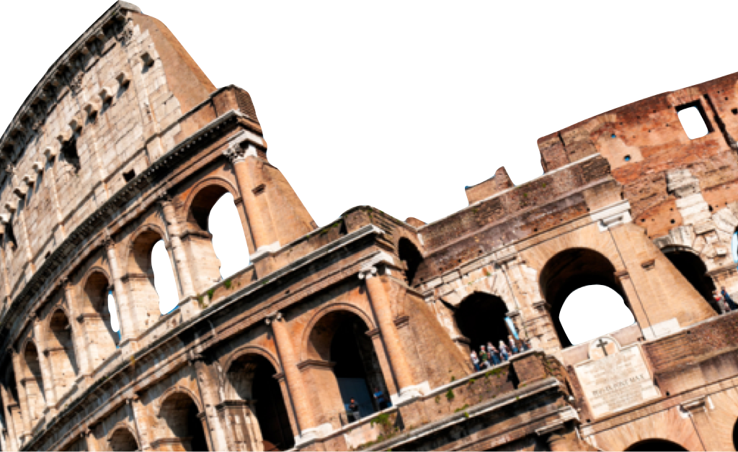
ROMANS
A Faith Worth Believing
Romans 5:1-11
Laying a solid foundation
Calvin Chiang

Slide 2
Previously on Romans….
Looking at the life of Abraham, the father of the Hebrews, who was declared righteous by God not by his “works” or “actions” but simply by believing in God. The key verse from Genesis 15:6 is: “Abraham believed the Lord, and He credited it to him as righteousness”.
Therefore since Abraham was credited righteous because of his faith, then we have been “justified by faith” also.
Notes:
Again, what does the word justify mean?
--To render a favorable verdict, to be acquitted and treated as righteous.
--Used a lot in Romans, when someone is justified, he is not only declared righteous, he becomes righteous.

Slide 3
Icebreaker Question
What kinds of things make you joyful?
We all long to be joyful, to experience the pure delight that life sometimes offers. But life’s joys are often elusive, momentary, gone as quickly as they come. How can we have an abiding, enduring joy—especially when suffering intrudes into our lives?

Slide 4
The Blessings of Justification (Rom 5:1-5)
Therefore, having been justified by faith, we have peace with God through our Lord Jesus Christ, 2 through whom also we have obtained our introduction by faith into this grace in which we stand; and we exult in hope of the glory of God. 3 And not only this, but we also exult in our tribulations, knowing that tribulation brings about perseverance; 4 and perseverance, proven character; and proven character, hope; 5 and hope does not disappoint, because the love of God has been poured out within our hearts through the Holy Spirit who was given to us.
Since Christians are declared righteous by faith, the result of our justification is peace with God. (5:1-2)
This peace is not conditional. Not based on our goodness or degree of sanctification, but grounded in Christ. It is an objective fact and not a subjective feeling.
Peace with God is the removal of the alienation and hostility between God and us. No fear of being rejected by God. Have full access to God’s presence and favor.*
Why is there a lack of peace with many Christians today? (Fear of God’s wrath, judgment, feeling unworthy?)
Notes:
*Point #2: We have full access to God’s presence and favor. If you want to talk to President Obama, do you think it will be easy to do so? There will be many levels of security that you will have to go through in order to have a chance to talk to him. But very different when the President’s 2 daughters (Natasha and Malia Ann) want to talk to him.
*Part of the reason why Paul takes a break here and spends so much time talking about these assurances is because later on in chapters 6, 7, and 8 he is going to talk about how we can find consistent victory over sin. He knows that we don’t learn overnight to walk with God consistently. As we grow in our walk with God, we may struggle with temptations to sin, face discouragements and self-doubt. When that happens, Satan starts to bombard us with doubt, despair, insecurity.
*However there is victory in a Christian life. We can transition from a flesh directed life to a spirit led life and that requires a change in our belief system as well as different habits of living and thinking. So this starts with the assurance that we are secure in Christ. Not a performance based or conditional salvation but a salvation bought by Christ’s own blood.

Slide 5
Access to God’s Favor
"I am the way, and the truth, and the life; no one comes to the Father, but through Me." (John 14:6)
"Through [Christ] we both have our access in one Spirit to the Father." (Ephesians 2:18)
"In [Christ] we have boldness and confident access through faith in Him." (Ephesians 3:12)
"Let us then approach the throne of grace with confidence, so that we may receive mercy and find grace to help us in our time of need." (Hebrews 4:16)
"Since therefore, brethren, we have confidence to enter the holy place by the blood of Jesus." (Hebrews 10:19)

Slide 6
Causes for Rejoicing (Rom 5:3-5)
3 And not only this, but we also exult in our tribulations, knowing that tribulation brings about perseverance; 4 and perseverance, proven character; and proven character, hope; 5 and hope does not disappoint, because the love of God has been poured out within our hearts through the Holy Spirit who was given to us.
“Sufferings” or “tribulations” means pressure, or trouble that inflicts distress, oppression, affliction.*
Christians are able to rejoice during sufferings because God uses it to develop:
Perseverance (ability to hold out in the face of difficulty)
Character (experience of going through a test; a tried character)
Hope (enables us to know why we are who we are and we know where we are going)*
Lastly, we are given the gift of the Holy Spirit (God’s presence with us) as a down payment so we can have a preview of what we will experience on the day when the Lord returns again.
Notes:
*Natural tendency while we are suffering or going through tribulations is to withdraw or hunker down (resist the pressure).
*Jeremy Lin’s story.
*Examples of those going through suffering but not affected by it. (Woman who was infected with ebola (God was the same before and after).

Slide 7
God’s Love vs. Human Love (Rom 5:6-8)
6 For while we were still helpless, at the right time Christ died for the ungodly. 7 For one will hardly die for a righteous man; though perhaps for the good man someone would dare even to die. 8 But God demonstrates His own love toward us, in that while we were yet sinners, Christ died for us.
Before we experienced God’s working in our lives, when we were without hope, without God, while we were powerless and ungodly, Christ died for us. (5:6)
Our situation was dire. We were completely cut off from God because of our sins.
However, God didn’t wait for us to get better or to improve but took the initial step to help us instead. “I have not come to call the righteous, but sinners.” (Matt 9:13)
Cross is the ultimate demonstration of God’s love for you. God made it very clear here that the demonstration of love here is made for your interest, on your behalf for your sins.
“For even the Son of Man did not come to be served, but to serve, and to give His life as a ransom for many.” (Mark 10:45)
Notes:
*Often times we may say to ourselves, “we are just too sinful, God won’t really accept us after all. Paul speaks directly to this fear in this passage.
-Later on in Chapter 8, Paul says that we have been adopted as sons and daughters. Just like any good parent, misbehavior is not cause for turning us away. Misbehavior though is cause for discipline and training in righteousness.

Slide 8
Salvation from God’s Wrath (Romans 5:9-11)
9 Much more then, having now been justified by His blood, we shall be saved from the wrath of God through Him. 10 For if while we were enemies we were reconciled to God through the death of His Son, much more, having been reconciled, we shall be saved by His life. 11 And not only this, but we also exult in God through our Lord Jesus Christ, through whom we have now received the reconciliation.
Paul implies in these verse that the most difficult part has already taken place. We have been justified by means of His blood. Christians will be saved from God’s wrath having been declared righteous through Christ’s blood.
Christians are now reconciled to God (exchanging the hostility for a friendly relationship). Instead of estrangement and hostility, there is harmony and friendship instead. There is now peace with God. (5:1)
Christians should rejoice in God through Christ since they are now reconciled to God (5:11). Holy Spirit continues to work in our lives, the sanctification process that brings about in us the character of Christ.

Slide 9
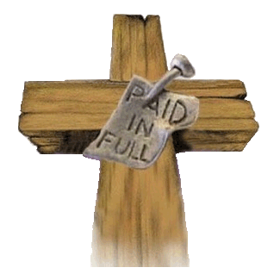
Conclusion
God has always shown us His unique way of love and favor. And He did this while we were still His enemies. Now that we are assured of our salvations and know that He will not give up on us in the future, we are at peace with Him.

Slide 10
Discussion Questions
Is suffering an indication that God does not love us or that He is punishing us?
How can a knowledge of the process of character change help us to rejoice in our sufferings?
This passage gives us many reasons to rejoice in Christ. What are some things that you are thankful for?

