Slide 1
GENESIS
An Introduction
The Book of Foundations
Oakland International Fellowship
Paul J. Bucknell

Slide 2


A Brief Introduction to Genesis
“If the foundations are destroyed, what can the righteous do?”
(Psalms 11:3)
Genesis forms the secure foundation of our tall life towers upon which we can safely build.
Notes:
Only with the foundations of God’s Word can we understand and choose His kingdom way.

Slide 3


A Brief Introduction to Genesis
“He only is my rock and my salvation, My stronghold; I shall not be shaken. On God my salvation and my glory rest; The rock of my strength, my refuge is in God. Trust in Him at all times, O people; Pour out your heart before Him; God is a refuge for us” (Psalm 62:5-8).
success
Our _______ in life depends on how closely we align our lives to God’s foundation, the foundation of foundations.

Slide 4
A Brief Introduction to Genesis
Reflect on Genesis’ place with the other books of Moses and the Bible.
Provide two Genesis outlines to emphasize its unity and remember its content.
Provide five graphic ways Genesis truths are interweaved into the whole Bible.
Challenge us to the importance of embedding the truths of Genesis in order to live strong Christian lives.

Slide 5
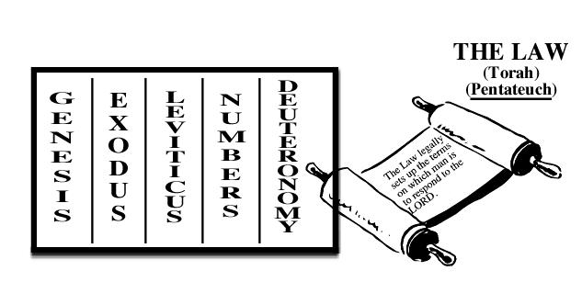
The Importance of Genesis
Genesis (lit. ‘beginning’ or ‘chief’) is the first book of the Law (Pentateuch or Torah).
God’s Word written by Moses.
“And it came about, when Moses finished writing the words of this law in a book until they were complete, that Moses commanded the Levites who carried the ark of the covenant of the LORD, saying, ‘Take this book of the law and place it beside the ark of the covenant of the LORD your God, that it may remain there as a witness against you’” (Deut 31:24-26).

Slide 6
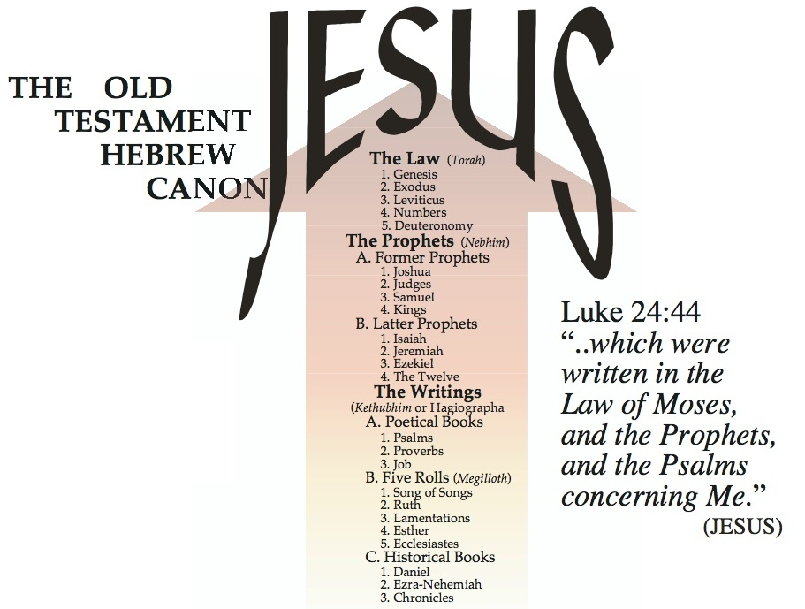
The Importance of Genesis
The Jews and Jesus taught the unity of the Hebrew scriptures contained in three sections (Luke 24:44): the Law, Prophets, and Psalms .
The underlying purpose of the Old Testament scriptures is to reveal the person and work of Jesus the Messiah (lit. Christ).

Slide 7
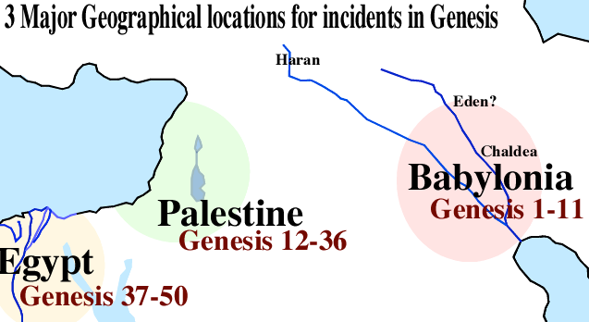
The Unity and Reliability of Genesis
(1) Geographical Outline of Genesis
Note the three major geographical locations in Genesis:
Babylonia (1-22); Palestine (12-36); and Egypt (37-50).

Slide 8
The Unity and Reliability of Genesis
(2) Genealogical Outline of Genesis
1:1-2:3 Prologue
“In the beginning God created the heavens and the earth” (Gen 1:1).
2:4-4:26 The Generations of Heaven and Earth
“This is the account of the heavens and the earth when they were created, in the day that the LORD God made earth and heaven” (Gen 2:4).
5:1-6:8 The Generations of Adam
“This is the book of the generations of Adam. In the day when God created man, He made him in the likeness of God” (Gen 5:1).
6:9-9:29 The Generations of Noah
“These are the records of the generations of Noah…” (Gen 6:9).
10:1-11:19 The Generations of Noah’s Sons
“Now these are the records of the generations of Shem, Ham, and Japheth, the sons of Noah; and sons were born to them after the flood” (Gen 10:1).
11:10-26 The Generations of Shem
“These are the records of the generations of Shem…” (Gen 11:10).
11:27-25:11 The Generations of Terah
“Now these are the records of the generations of Terah…” (Gen 11:27).
25:12-18 The Generations of Ishmael
“Now these are the records of the generations of Ishmael, Abraham’s son, whom Hagar the Egyptian, Sarah’s maid, bore to Abraham” (Gen 25:12).
25:19-35:29 The Generations of Isaac
“Now these are the records of the generations of Isaac, Abraham’s son…” (Gen 25:19).
36:1-37:1 The Generations of Esau
“Now these are the records of the generations of Esau (that is, Edom)” (Gen 36:1).
37:2-50:26 The Generations of Jacob
“These are the records of the generations of Jacob. Joseph,..” (Gen 37:2).
Genesis is composed of ten genealogies, each introduced by the same Hebrew word meaning ‘records of the generations’ (Hebrew - Toledot).
Genesis is an impressive organized collection of records with a singular focus to identify God’s redemptive lineage and plan.

Slide 9
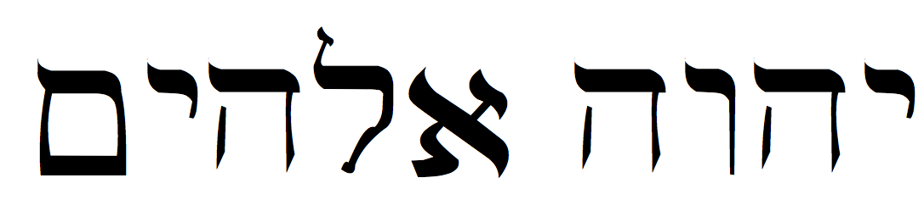
The Unity and Reliability of Genesis
(3) Demonstration of Genesis’ Unity
Genesis’ unity is evident through the community’s understanding, Jesus’ teaching, clear outlines and interweaving themes.
The underlying assumptions from which some espouse numerous authors are inconsistent (e.g., Documentary Hypothesis suggested authors: JEDP).
Note: Jahweh (J–Yahweh) and Elohim (E–God) used together (Gen 2:4).

Slide 10
The Unity and Reliability of Genesis
(3) Demonstration of Genesis’ Unity
Meticulous scribal work preserved the Hebrew Bible
–the Masoretic text (11th century)
Dead Sea Scrolls: Ancient (from about 300 years before Jesus) Hebrew manuscripts of all Bible books except Esther. Discovered in late 1940s. Now on display!
www.deadseascrolls.org

Slide 11


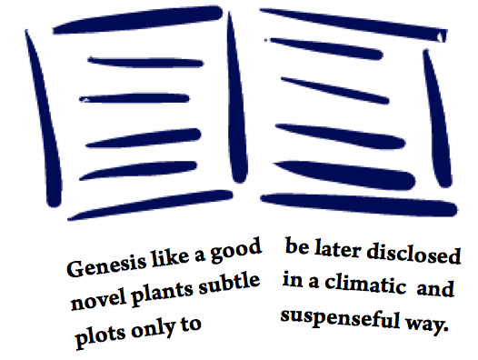
The Genius of Genesis
Various biblical approaches to Genesis
SEEDS: Genesis is the ground where seeds of truth are sown in our minds.
GENES: Genesis is the gene pool of truth, largely unseen but very influential.
PLOT: Genesis carefully introduces a powerful story line full with key characters and intriguing events.
Genesis, like a package of seeds, provides the right start allowing the truth to fulfill the Lord’s purposes.
What seeds?

Slide 12

The Genius of Genesis
Various approaches to Genesis
PROPHECY: Genesis with powerful accuracy predicts future events.
“And I will put enmity Between you and the woman, And between your seed and her seed; He shall bruise you on the head, And you shall bruise him on the heel.” To the woman He said, “I will greatly multiply Your pain in childbirth, In pain you shall bring forth children; Yet your desire shall be for your husband, And he shall rule over you.” (Gen 3:15-16)
HISTORY: Genesis is the key unlocking the link between ancient and modern history.
Genesis is ‘His Story’ in which He begins to reveal His agenda for man’s world in time and space.

Slide 13

Summary: The Success of Our Lives
Genesis provides a theological and moral framework that we can build our lives upon, introducing and partly explaining: marriage, troubles, death, gender, God’s presence, human beings special design, salvation, and man’s purpose, Messiah, etc.).
Genesis directs us to ask the right questions so that we search and find the needed answers.
God spoke the world into being (general revelation) and wrote to us communicating His thoughts (special revelation).
Finding success for our lives.
Rebuilding Your Life
What part of Genesis has helped you most from your past study of the book?
How is Genesis said to set a foundation for our beliefs and lives?
Give several reasons for the trustworthiness of the Genesis scriptures.

Slide 14
GENESIS
An Introduction
The Book of Foundations
Oakland International Fellowship
Paul J. Bucknell

