Slide 1
GENESIS
1:1-2:3
The Book of Foundations
Creation and the Worship of God
Oakland International Fellowship
Paul J. Bucknell

Slide 2

Introduction to Genesis 1:1-2:3
Creation and the Worship of God
Develop honor for our Creator and respect for others
Read Genesis 1 and find answers to these 3 questions:
What is God like?
What do we know about the world?
How are people unique?
Notes:
Is all of mankind obligated to worship God? Why or why not?
Are non-Christians who never heard of God liable for their knowledge of God?

Slide 3
Genesis 1:1-2:3
1:1 In the beginning God created the heavens and the earth. 2 And the earth was formless and void, and darkness was over the surface of the deep; and the Spirit of God was moving over the surface of the waters. 3 Then God said, “Let there be light”; and there was light. 4 And God saw that the light was good; and God separated the light from the darkness. 5 And God called the light day, and the darkness He called night. And there was evening and there was morning, one day.
6 Then God said, “Let there be an expanse in the midst of the waters, and let it separate the waters from the waters.” 7 And God made the expanse, and separated the waters which were below the expanse from the waters which were above the expanse; and it was so. 8 And God called the expanse heaven. And there was evening and there was morning, a second day. 9 Then God said, “Let the waters below the heavens be gathered into one place, and let the dry land appear”; and it was so.

Slide 4
Genesis 1:1-2:3
1:10 And God called the dry land earth, and the gathering of the waters He called seas; and God saw that it was good. 11 Then God said, “Let the earth sprout vegetation, plants yielding seed, and fruit trees bearing fruit after their kind, with seed in them, on the earth”; and it was so. 12 And the earth brought forth vegetation, plants yielding seed after their kind, and trees bearing fruit, with seed in them, after their kind; and God saw that it was good. 13 And there was evening and there was morning, a third day.
14 Then God said, “Let there be lights in the expanse of the heavens to separate the day from the night, and let them be for signs, and for seasons, and for days and years; 15 and let them be for lights in the expanse of the heavens to give light on the earth”; and it was so. 16 And God made the two great lights, the greater light to govern the day, and the lesser light to govern the night; He made the stars also.

Slide 5
Genesis 1:1-2:3
17 And God placed them in the expanse of the heavens to give light on the earth, 18 and to govern the day and the night, and to separate the light from the darkness; and God saw that it was good. 19 And there was evening and there was morning, a fourth day. 20 Then God said, “Let the waters teem with swarms of living creatures, and let birds fly above the earth in the open expanse of the heavens.” 21 And God created the great sea monsters, and every living creature that moves, with which the waters swarmed after their kind, and every winged bird after its kind; and God saw that it was good. 22 And God blessed them, saying, “Be fruitful and multiply, and fill the waters in the seas, and let birds multiply on the earth.” 23 And there was evening and there was morning, a fifth day. 24 Then God said, “Let the earth bring forth living creatures after their kind: cattle and creeping things and beasts of the earth after their kind”; and it was so. 25 And God made the beasts of the earth after their kind, and the cattle after their kind, and everything that creeps on the ground after its kind; and God saw that it was good.

Slide 6
Genesis 1:1-2:3
1:26 Then God said, “Let Us make man in Our image, according to Our likeness; and let them rule over the fish of the sea and over the birds of the sky and over the cattle and over all the earth, and over every creeping thing that creeps on the earth.” 27 And God created man in His own image, in the image of God He created him; male and female He created them. 28 And God blessed them; and God said to them, “Be fruitful and multiply, and fill the earth, and subdue it; and rule over the fish of the sea and over the birds of the sky, and over every living thing that moves on the earth.” 29 Then God said, “Behold, I have given you every plant yielding seed that is on the surface of all the earth, and every tree which has fruit yielding seed; it shall be food for you; 30 and to every beast of the earth and to every bird of the sky and to every thing that moves on the earth which has life, I have given every green plant for food”; and it was so. 31 And God saw all that He had made, and behold, it was very good. And there was evening and there was morning, the sixth day.

Slide 7
Getting to Know Genesis 1
What do we know about God from Genesis 1?
Notes:
Ask the students what they know about God from reading Genesis 1.

Slide 8

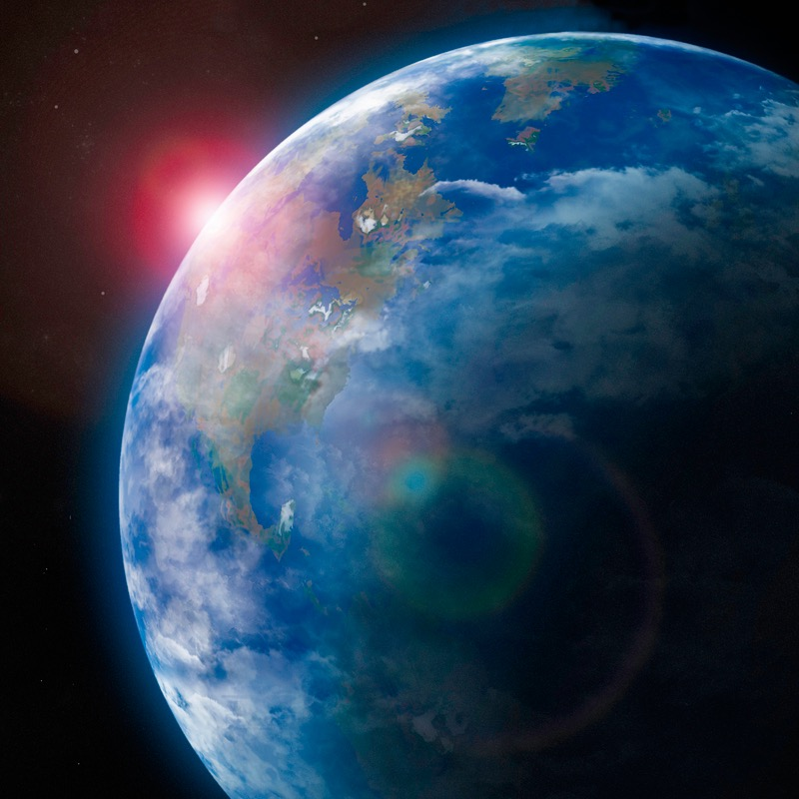
A. 3 Absolutes to Know from Genesis 1
1) God is Creator
People are His creation and are wholly dependent upon Him for all.
2) God created a good world
God made a great and good world in which we can trust His care for us.
3) God created people to relate to Him
God purposely made us to enjoy what He has made, relate to Him, and work with Him in this world.
God

Slide 9
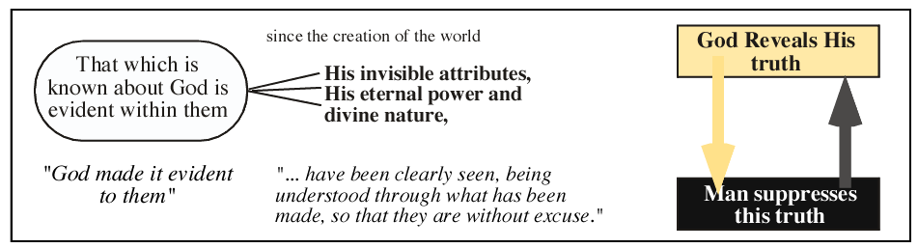
1) God is Creator
God’s glorious attributes are projected through creation.
God’s power, eternal nature, His love, beauty, and goodness are clearly seen.
His order, design, and purposes are everywhere enjoyed.
No doctrinal statement is as powerful as the record of God’s mighty works in Genesis 1.
Romans 1:18-21

Slide 10
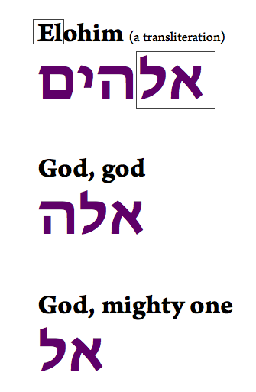
1) God is Creator
God’s title - ‘God’-plural, 34x
God’s word - ‘Let’, ‘Said’
God’s thoughts - ‘Called’
God’s power - ‘created’ (ex nihilo), ‘made’
God’s goodwill – “good”
God’s wisdom - 7th day complete
“Thus says God the LORD, who created the heavens and stretched them out, who spread out the earth and its offspring, who gives breath to the people on it, and spirit to those who walk in it” (Isaiah 42:5).
Notes:
Plural of Elohim is unusual for one it takes a singular verb and yet represents a plurality of the Godhead for the Father, Son, and Holy Spirit are all said to take part in creation.

Slide 11

1) God is Creator– A Summary
God wants us to know we are His creation and are wholly dependent upon Him.
  God alone made the world in orderly fashion.
  The world including animals and people are not moving balls of chaotic atoms.
  There are no other ‘gods’, and if so, they are dependent upon him (e.g. sun).
  The Eternal is clearly separated from that which was created (i.e. time).
  All things owe their existence and purpose to God their Maker.
  Autonomy, self-expression or individualism all voice disagreement with God’s assessment.
People everywhere ought to worship God.
Notes:
Autonomy or self-expression or individualism all voice disagreement with God’s assessment.

Slide 12

2) God created a good world
God made a great and good world in which we can trust His care for us.
God describes what He thought of His work.
“God saw that it was good.”
(Gen 1:4, 10, 12, 18, 21, 25, 31)
“And God saw all that He had made, and behold, it was extremely good” (Gen 1:31).
Notes:
FANTASTIC

Slide 13
2) God created a good world
Created versus Made
1:1 In the beginning God created the heavens and the earth.
1:7 And God made the expanse, and separated the water
1:21 And God created the great sea monsters, and every living creature that moves,
1:16 And God made the two great lights
1:25 And God made the beasts of the earth after their kind
1:27 And God created man in His own image
“Then God blessed the seventh day and sanctified it, because in it He rested from all His work which God had created and made” (Gen 2:3).

Slide 14
2) God created a good world
God is wise - the 7th day rest
1 Thus the heavens and the earth were completed, and all their hosts. 2 And by the seventh day God completed His work which He had done; and He rested on the seventh day from all His work which He had done. 3 Then God blessed the seventh day and sanctified it, because in it He rested from all His work which God had created and made (Gen 2:1-3).
The 7th day of rest shows the work was completed, not needing further help.
The designed was produced (created).
The pause reminds us of our greater purpose enjoying a relationship with God.

Slide 15
2) God created a good world
God made a great and good world, one in which we can live in trust.
As our Maker, God brought us into existence.
As our Designer, He has seen through all the details of our lives.
As our Provider, He adequately provides for all our genuine needs (e.g. symbiotic).
God is interested in our lives. He desires the increase of blessing in our lives and has created a world to fulfill that goal (God does have other goals as well).

Slide 16
2) God created a good world
The world possesses design and purpose and is not accidental, purposeless, or haphazard.
Without God’s good intention, the world would have been put into a bad spin.
God carefully situated the pieces to reflect His goodness.
We hardly have to save the world but learn to trust our Creator and care for the world!
“The LORD is good to all, and His mercies are over all His works” (Psalms 145:9).

Slide 17
3) God created people to relate to Him
27 And God created man in His own image, in the image of God He created him; male and female He created them. 28 And God blessed them; and God said to them, “Be fruitful and multiply, and fill the earth, and subdue it; and rule over the fish of the sea and over the birds of the sky, and over every living thing that moves on the earth.”
God purposely made us enjoy what He has made, relate to Him, and work with Him in this world.
Both male and female were created in His image.
Each gender specially reflects God’s person and purpose.
“But from the beginning of creation, God made them male and female” (Mark 10:6). –Jesus
More on the image of God in the next session

Slide 18

A. Summary
The Gospel in Genesis 1!
God’s goodwill welcomes us into His fellowship and invites us to cowork with Him!

Slide 19
B) Creation’s Design
Order of Creation
Day #1 | Created light. Separated light from darkness (4).
Day #2 | Created an atmosphere. Waters below separated from waters above. Separated waters from waters (6). Define: Expanse above heaven.
Day #3 | Creation of continent(s) (dry land). Define: Waters called seas; Dry land is earth. Separated waters from land (10). Earth sprout vegetation/trees with seeds.
Day #4 | Created great light (sun) and lesser light (moon). Created stars also. Purpose: give light on earth; to rule (govern) the day and night. to separate light from darkness.
Day #5 | Created sea creatures including monsters. God created sky creatures: every winged bird.
Day #6 | Created land creatures, walking and crawling. Created man in God’s image. Created male and female. Charged them to rule over the sky, seas and land. God’s provision for man and animal alike.
Day #7 | God completed the heavens and earth (form) and all their hosts (fill). God rested on 7th day from His work. God blessed and sanctified the 7th day.
Truth:
Sequenced, purposed, completed,
designed
Falsehood:
Chaos, meaningless, incomplete, chance

Slide 20
B) Creation’s Design
God reveals Truth about Himself
General revelation
Special revelation
Both seek the truth
Truth from God’s works
(Psalm 19:1-6)
Truth from God’s Word
(Psalm 19:7-14)
Alternate interpretations arise because of a felt need to reconcile knowledge with one’s faith.
Notes:
Alternate interpretations arise because the felt need to reconcile knowledge to the Christian faith.

Slide 21
B) Creation’s Design
Creation versus evolution
Gap Theory (1:1 > gap 1:2)
Indeterminate time
Poor translation (‘became’ not ‘was’)
Day – Age Theory
Each day represents a whole age which could accommodate evolution
Framework Hypothesis
First couple of chapters would be partly poetically written, giving room for other meanings for a literal day.
Six Day Creation (literal, young earth)
“By faith we understand that the worlds were prepared by the word of God, so that what is seen was not made out of things which are visible” (Heb 11:3).
Each can be held by a Christian and not yet all are true.
Notes:
Science and Religion
1) The world is real and the human mind is capable of knowing real nature.
2) The structure of science is based upon cause and effect.
3) Nature is unified.

Slide 22
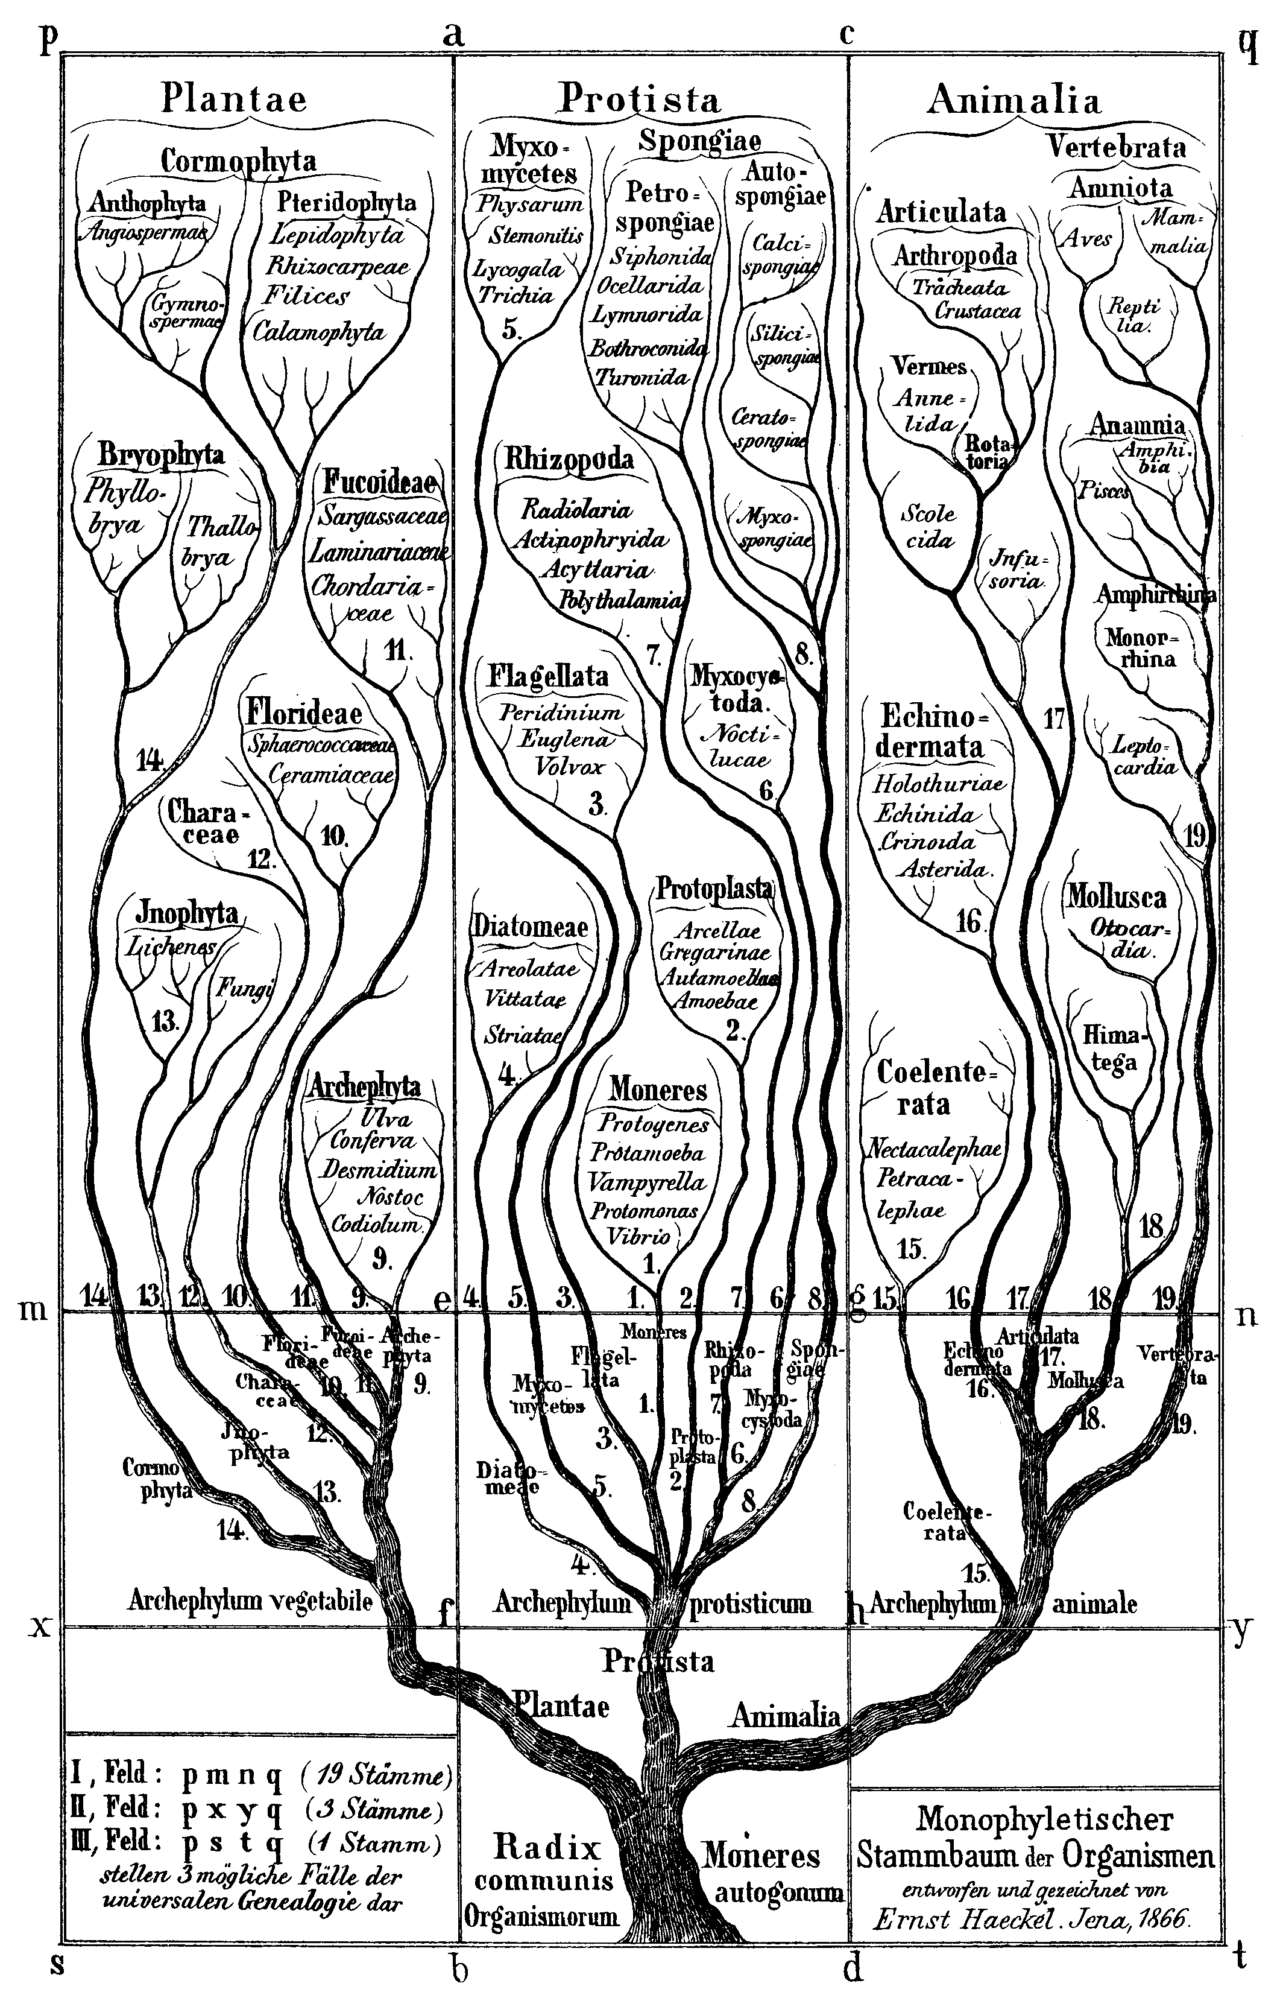
“Creation of the World” by natural evolution
Dr. Dave Whitcomb
Sir Charles Lyell (1797–1875) wrote Principles of Geology, which popularized uniformitarianism, the idea that the Earth was shaped by the same processes that are in operation today.
Lyell urged Charles Darwin to look for evidence that supported his theory of uniformitarian geology on his voyage on the HMS Beagle, & arrange for publication of The Origin of the Species in 1859.
By 1959 (100th anniversary) it was declared that the Genesis account of creation was DEAD.
Nearly all Christian teachers taught the “Gap Theory” (eons between Gen. 1:1 and 1:2) to account for fossils, and that God somehow directed evolution.
“Tree of Life”

Slide 23
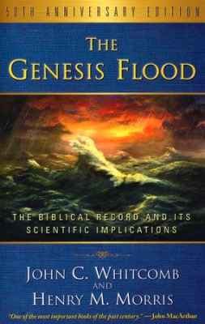
Creation-Destruction of the World
Dr. Dave Whitcomb
1961 – publishing of The Genesis Flood.
Biblical approach:
  Literal-historical hermeneutics
  Presuppositional approach to apologetics
Scientific approach:
  Geology +
  Hydrodynamics
Conclusions:
  The Bible is clear, detailed and internally consistent.
  A scientific mechanism that explains modern geology is a universal flood.
Result:
  The Biblical Creation account became orthodox doctrine
  The “hypotheses” of Lyell and Darwin were exposed as mechanistically impossible.

Slide 24
Critical Thinking….
Dr. Dave Whitcomb
Biblical Arguments:
  Man is uniquely in the image of God. Genesis 2:17. Then the LORD God formed man of dust from the ground, and breathed into his nostrils the breath of life; and man became a living being. Cf Gen. 1:16-27 not an APE.
  No death before sin. Romans 5:12. “Therefore, just as through one man sin entered into the world, and death through sin, and so death spread to all men, because all sinned—” So the “Gap Theory” must be false.
Opposition to Creation:
  Creation requires GOD and Miracles (outside the domain of experimental science)
  If Creation and the Flood were true.....

Slide 25
2 Peter 3:3-7
Dr. Dave Whitcomb
3 Know this first of all, that in the last days mockers will come with their mocking, following after their own lusts,
4 and saying, “Where is the promise of His coming? For ever since the fathers fell asleep, all continues just as it was from the beginning of creation.”
5 For when they maintain this, it escapes their notice that by the word of God the heavens existed long ago and the earth was formed out of water and by water,
6 through which the world at that time was destroyed, being flooded with water.
7 But by His word the present heavens and earth are being reserved for fire, kept for the day of judgment and destruction of ungodly men.
Do NOT underestimate the power and wisdom of The Most High God!
- Common error, “You thought that I was just like you”, Ps 50:21.

Slide 26
C) Creation’s Purpose
Creation’s purpose
Man is expected, like the rest of creation, to completely join in with God’s plan.
Genesis 1 destroys the many barriers man uses to excuse his disobedience by presenting how intimately He is involved in our lives.
Man’s greatest knowledge comes from understanding his life in relationship with God’s purpose for his life.
Man’s greatest peace comes from living in harmony with God’s purpose for his life.

Slide 27
Summary
God made us to know and obey Him.
God spreads out the universe to capture our hearts and minds in worship and adoration.
God made us in His image so we can know Him and thoroughly delight in Him and what He has made.
God’s goodness is evidenced by the way He sent His Son Jesus into our sin-warped world and lives, restoring us to His glorious kingdom purposes.
Notes:
By being made in His image, He also has given us a will and heart. This is our test - do we love Him with all our heart?

Slide 28
Discussion Questions
Do you think everyone is obligated to worship God? Explain.
Why is there no inconsistency between the Bible and truth found through science?
Why should we believe there is a literal creation as presented in Genesis 1?

Slide 29
GENESIS
1:1-2:3
The Book of Foundations
Creation and the Worship of God
Oakland International Fellowship
Paul J. Bucknell

