Slide 1
GENESIS 5-9
Preservation of the Godly
From the Beginning of Time
Oakland International Fellowship
Paul J. Bucknell

Slide 2

A. From the Beginning of Time (Genesis 5:1-11)
The Generations of Adam (Gen 5:1-6:8)
5:1 “This is the book of the generations of Adam. In the day when God created man, He made him in the likeness of God. 2 He created them male and female, and He blessed them and named them Man in the day when they were created. 3 When Adam had lived one hundred and thirty years, he became the father of a son in his own likeness, according to his image, and named him Seth.”
Adam’s record (2nd/10) - “This is the book of the generations of Adam” (5:1). Noah is 3rd Genesis record (6:9).
The accuracy of the genealogy: The age of the father had a son (Adam 130…Seth at birth) (Gen 5:3)
“And Seth lived one hundred and five years, and became the father of Enosh. 7 Then Seth lived eight hundred and seven years after he became the father of Enosh, and he had other sons and daughters” (6-7).

Slide 3



A. From the Beginning of Time (Genesis 5:1-11)
First and Second Adam (1 Cor 15:45,47)
God’s image
Adam’s image
“In the day when God created man, He made him in the likeness of God” (5:1).
Adam’s image
Seth’s image
“He (Adam) became the father of a son (Seth) in his own likeness, according to his image” (5:3).
Christ’s image
God’s image
“And He (Christ) is the image of the invisible God, the first-born of all creation” (Col 1:15).
Our (Christian) image
God’s image
“And have put on the new self who is being renewed to a true knowledge according to the image of the One who created him” (Col 3:10).
Notes:
1 Cor 15:44* it is sown a natural body, it is raised a spiritual body. If there is a natural body, there is also a spiritual body. 45* So also it is written, “The first MAN, Adam, BECAME A LIVING SOUL.” The last Adam became a life-giving spirit. 46* However, the spiritual is not first, but the natural; then the spiritual. 47* The first man is from the earth, earthy; the second man is from heaven.

Slide 4
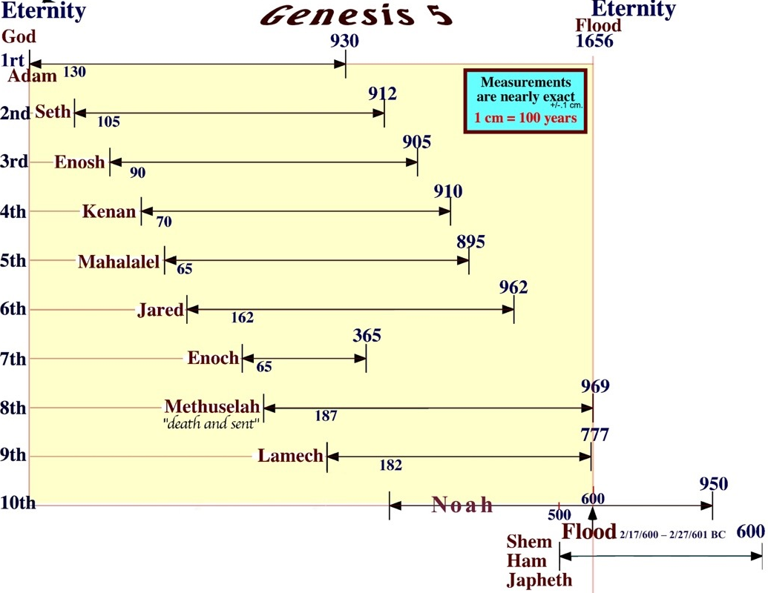

Scaled
Peleg was born in 2247 BC
“Peleg, for in his days the earth was divided”
Gen 10:25
Flood occurred in 2349–2348 BC (Usher)
Notes:
Babylon begins
The year was 331 BC. After Alexander the Great had defeated Darius at Gaugmela near Arbela, he journeyed to Babylon. Here he received 1903 years of astronomical observations from the Chaldeans, which they claimed dated back to the founding of Babylon. If this was so, then that would place the founding of Babylon in 2234 BC, or about thirteen years after the birth of Peleg.

Slide 5
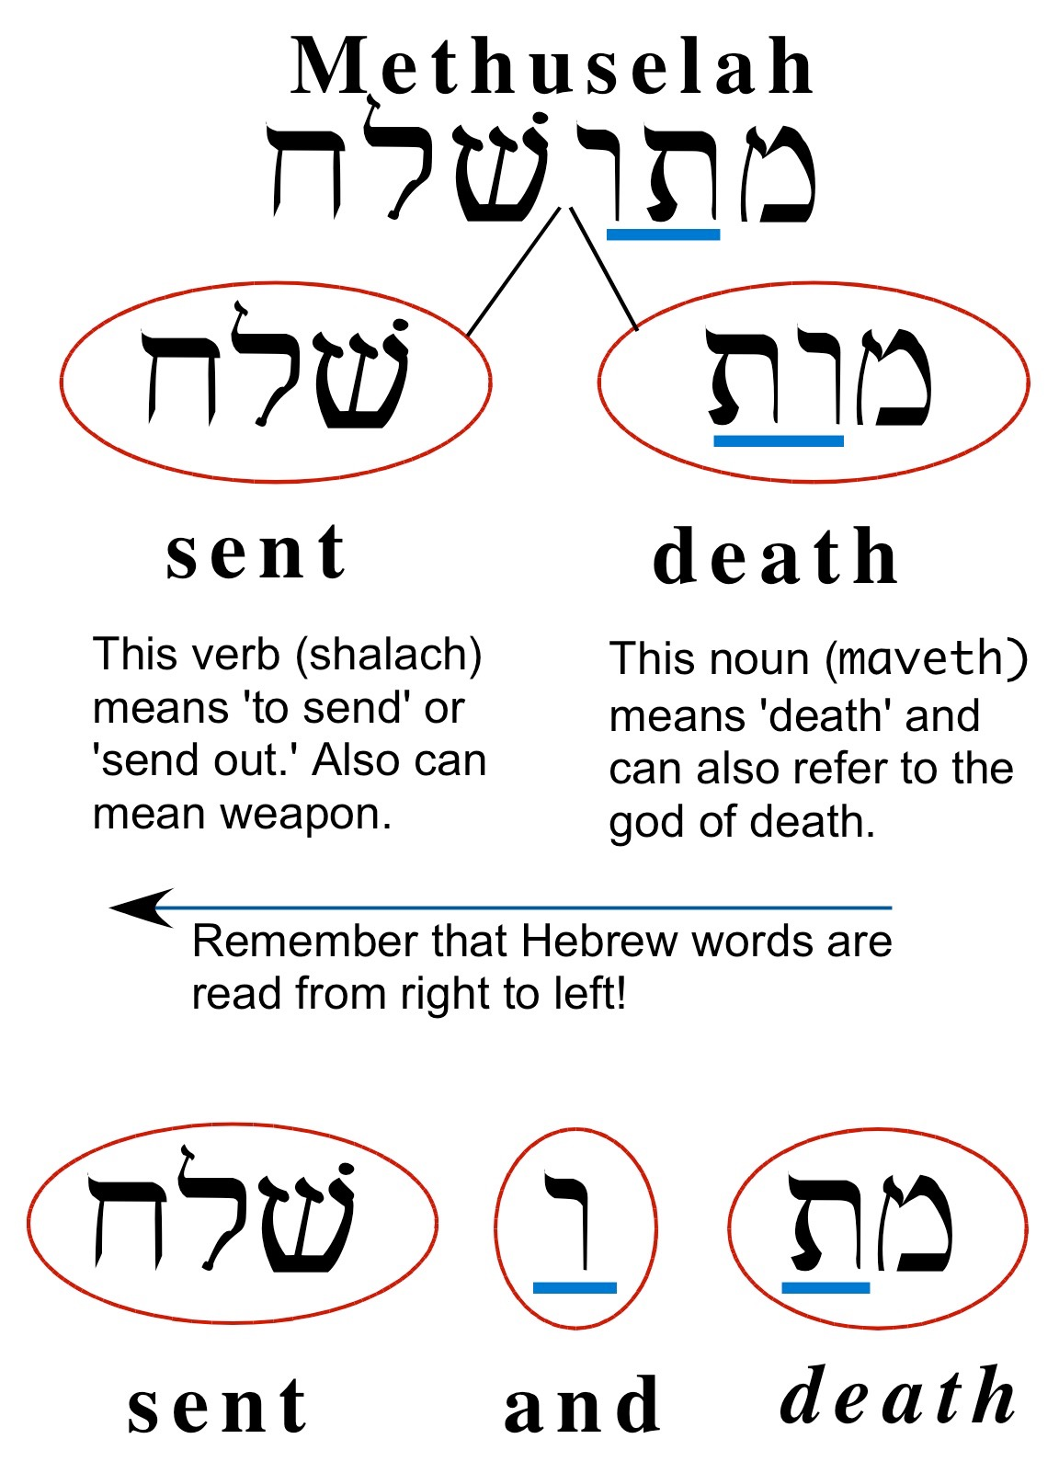
B. Enoch’s Secret Word: Methuselah (Gen 5:21-25)
“22 Then Enoch walked with God three hundred years after he became the father of Methuselah, and he had other sons and daughters. 23 So all the days of Enoch were three hundred and sixty-five years. 24 And Enoch walked with God; and he was not, for God took him. 25 And Methuselah lived one hundred and eighty-seven years, and became the father of Lamech.”
Death
Methusaleh - _______ and _______ meaning:
Cosmic happening at his death 1656–the flood
Great prophecy in Jude 14-15
sent
“Upon death it will be sent”
Notes:
“And about these also Enoch, in the seventh generation from Adam, prophesied, saying, ‘Behold, the Lord came with many thousands of His holy ones, to execute judgment upon all, and to convict all the ungodly of all their ungodly deeds which they have done in an ungodly way, and of all the harsh things which ungodly sinners have spoken against Him’” (Jude 14-15).

Slide 6

B. Enoch’s Secret Word: Methuselah (Gen 5:21-25)
Significant prophecy in Jude 14-15
“And about these also Enoch, in the seventh generation from Adam, prophesied, saying, ‘Behold, the Lord came with many thousands of His holy ones, to execute judgment upon all, and to convict all the ungodly of all their ungodly deeds which they have done in an ungodly way, and of all the harsh things which ungodly sinners have spoken against Him’” (Jude 14-15).
Notes:
“And about these also Enoch, in the seventh generation from Adam, prophesied, saying, ‘Behold, the Lord came with many thousands of His holy ones, to execute judgment upon all, and to convict all the ungodly of all their ungodly deeds which they have done in an ungodly way, and of all the harsh things which ungodly sinners have spoken against Him’” (Jude 14-15).

Slide 7


C. Sons of God (Gen 6)
1 Now it came about, when men began to multiply on the face of the land, and daughters were born to them, 2 that the sons of God saw that the daughters of men were beautiful; and they took wives for themselves, whomever they chose. 3 Then the LORD said, “My Spirit shall not strive with man forever, because he also is flesh; nevertheless his days shall be one hundred and twenty years.” 4 The Nephilim were on the earth in those days, and also afterward, when the sons of God came in to the daughters of men, and they bore children to them. Those were the mighty men who were of old, men of renown (Gen 6:1-4).
Identification of “Sons of God” – “saw that the daughters of men were beautiful.”
Identification of Nephilim (Literally “giants”
or renown)
Compromise often begins by marrying
outside of one’s faith (1 Cor 7:39).

Slide 8
C. Sons of God (Gen 6)
3 Major interpretations of the “sons of God” ( Gen 6:2,4)
(1) Fallen Angels
Some suggest that devils (i.e. fallen angels) somehow took on human nature to intermarry and interbreed with the human race. This suggestion does give sufficient reason as to why they could have brought on the judgment of God through the flood. The human race got increasingly depraved with the advances of these evil beings, but there is no basis for an interpretation with intermarrying angels.“For in the resurrection they neither marry, nor are given in marriage, but are like angels in heaven” (Matt 22:30).
(2) Great and Powerful Rulers
Another possibility is that the “sons of God” referred to men of renown such as kings or rulers (be godlike-Kline). This interpretation, however, does not add anything new for it is a common practice of powerful men to take women they like. How would that drastically worsen the pre-flood world situation so to incur God’s wrath?
(3) Seth’s Godly Line
We favor the interpretation that associates the “sons of God” with the Seth line, the godly line that kept communion with God. This line of thinking is strongly supported by the strong emphasis of the godly line pictured in chapter five and supports the need for judgment.

Slide 9


D. Judgment and Noah (Gen 6-9)
6:7 “Then the LORD saw that the wickedness of man was great on the earth, and that every intent of the thoughts of his heart was only evil continually… 8 But Noah found favor in the eyes of the LORD. 9 These are the records of the generations of Noah. Noah was a righteous man, blameless in his time; Noah walked with God. 10 And Noah became the father of three sons: Shem, Ham, and Japheth. 11 Now the earth was corrupt in the sight of God, and the earth was filled with violence.”
“Favor” of Noah (6:8)
Wickedness of mankind (6:7,11)
Without God’s extended grace man declines into evil
The flood and ark was a unique means to keep a people devoted to Him
The ark preserved the godly seed: “And did not spare the ancient world, but preserved Noah, a preacher of righteousness, with seven others, when He brought a flood upon the world of the ungodly” (2 Pet 2:5).

Slide 10
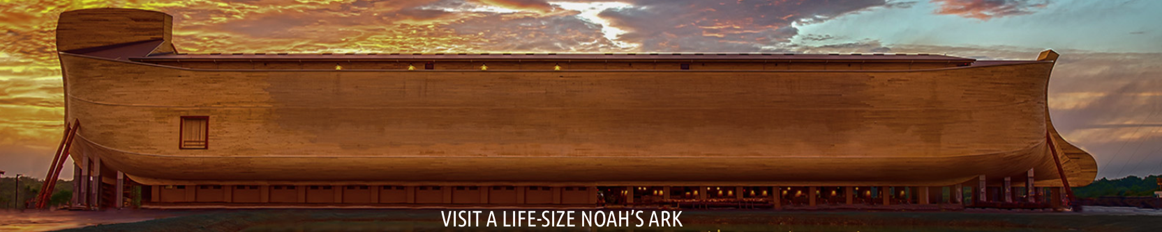
D. Judgment and Noah (Gen 6-9)
Mankind wasn’t that bad, were they?
Was God fair?
Why did God spare Noah?
www.arkencounter.com
How bad are we now?
The world goes on until…“They were eating, they were drinking, they were marrying…, until the day that Noah entered the ark, and the flood came and destroyed them all…It will be just the same on the day that the Son of Man is revealed.” (Lu 17:27,30).

Slide 11

Summary Pattern: Danger => Solution => Means
Incident | Danger | God’s Action | Preservation
Noah’s ark (Gen 6-9) | Intermingle in marriage | God purges the wicked by flood | Restarts anew with Noah
Tower of Babel (Gen 11) | The world’s strong power | Slows deterioration by isolation | Creates sub-societies by languages
Calls Abraham from Ur (Gen 12) | Swallowed up by pagan culture | Births a people unto Himself | Calls Abraham to Promised Land
Raises up Joseph (Gen 37-50) | Dependent on world power | Keeps separate in Egypt-sheep herders | Carefully places Joseph to help
People of faith => New nation (Israel) => Covenant (the Law)
GENESIS
EXODUS
LEV - NUMB - DEUT

Slide 12

Discussion Questions
Does God still judge the world?
How do we maintain a fervent love for God in this wicked world?
How does Jesus help us restore the image of God?

Slide 13
GENESIS 5-9
Preservation of the Godly
From the Beginning of Time
Oakland International Fellowship
Paul J. Bucknell

Slide 14
C. Sons of God (Gen 6)
“Identifying the Nephilim
Debate as to who the Nephilim were; literally means giant.
The Nephilim were referred to before and after the flood, but it doesn’t necessarily refer to the same group.
  The Book of Numbers refers to them as physical giants. Genesis 6:4 interestingly comments the Nephilim existed before and afterwards. This does not mean we should quickly conclude those in Moses’ time (Num 13:33) south of Canaan (around 1500 BC) and those before the flood (around 2300 BC) were the same. After all, all the Nephilim perished in the flood. More likely, the second reference of the Nephilim, “also afterwards,” identifies the period when the Sons of God came to intermarry, “...also afterward, when the sons of God came into....” (Gen 6:4).
It is unclear whether the daughters of men refers to the daughters of the Nephilim. Either the Nephilim are mentioned due to their daughters being involved in intermarrying or because the identification of the[…]”

