Slide 1
GENESIS 10-11
#9 Unity & Diversity
The development of the nations
Oakland International Fellowship
Paul J. Bucknell

Slide 2
Review
Genesis 5-9
A) Preserve the Godly Seed (5-9)
Noah and His Ancestors
Genesis 10-11
B) Understand Unity & Diversity (10-11)
Noah’s Sons and Babel

Slide 3
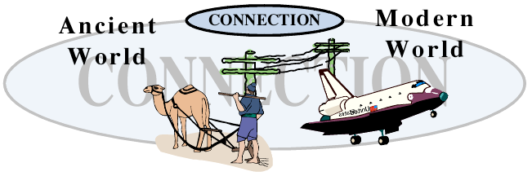
Unity & Diversity (Gen 10-11)
Genealogy – Noah’s Three Sons Genesis 10:1-32 | Shows how the different races developed under Noah’s grandsons.
Narrative – Tower of Babel Genesis 11:1-9 | Reveals the reason for the many thousands of languages forming barriers between cultures.
Genealogy – Shem’s line Genesis 11:10-32 | Focuses us on the line of men through which God revealed His truth and would send a Savior.

Slide 4
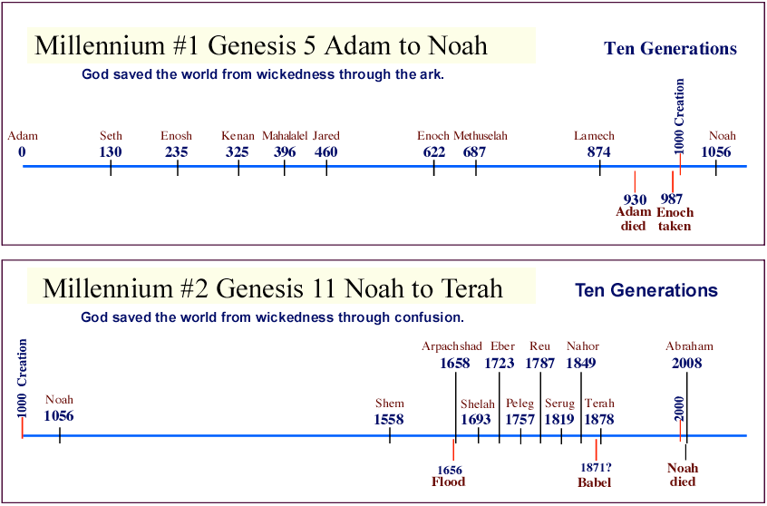
Unity & Diversity (Gen 10-11)
They both mark off ten generations.
They conclude with the three sons of: Noah and Terah.
The genealogies are accurately self-referenced.

Slide 5
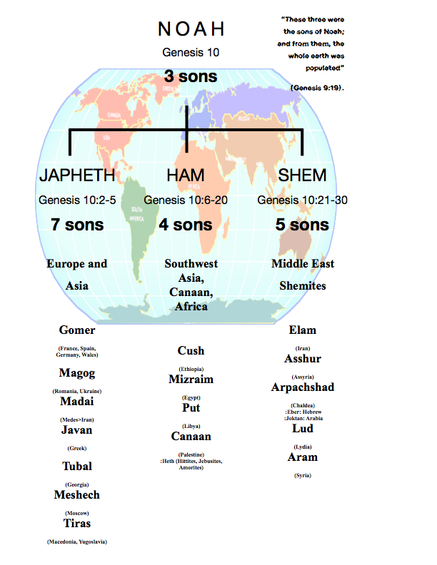
A United People

Slide 6

A United History (Gen 10:6-11)
“And the sons of Ham were Cush and Mizraim and Put and Canaan. And the sons of Cush were Seba and Havilah and Sabtah and Raamah and Sabteca; and the sons of Raamah were Sheba and Dedan. Now Cush became the father of Nimrod; he became a mighty one on the earth. He was a mighty hunter before the LORD; therefore it is said, “Like Nimrod a mighty hunter before the LORD.” And the beginning of his kingdom was Babel and Erech and Accad and Calneh, in the land of Shinar. From that land he went forth into Assyria, and built Nineveh and Rehoboth-Ir and Calah” (Gen 10:6-11).
Noah
|
Ham
|
Cush
|
Nimrod
  Cush is city of Kish
  Babel is Babylon near Bagdad
  Erech is Uruk (Gilgamesh epic)
  Gilgamesh is probably Nimrod
  Nineveh - mound outside Mosul means “Prophet Jonah”

Slide 7
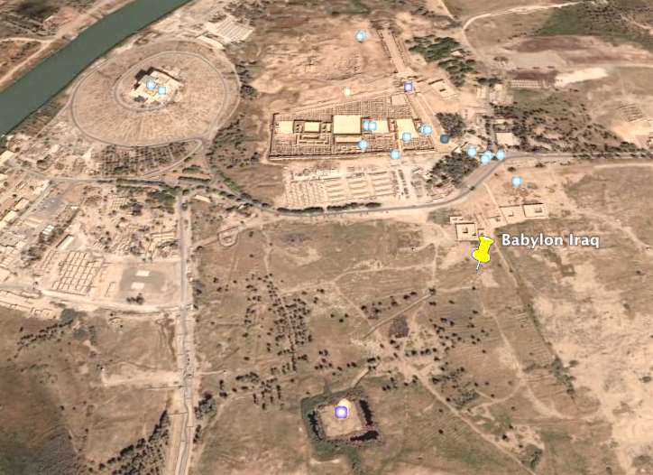
Development of Language (Genesis 11:1-9)
• Babylon palace
Euphrates River
From Google earth
• Tower of Babel

Slide 8
Development of Language (Genesis 11:1-9)
Major Language Groupings
* Indo-European (Northern India/Europe)
* Afro-Asiatic (Northern Africa/Middle East/Southwestern Asia)
* Kartvelian (Caucasus Mountains/Southern Russia)
* Uralic (Northern Europe/Central Siberia/Eurasia)
* Altaic (Eastern Europe/Central Asia)
* Dravidian (Central & Southern India)
* Sino-Tibetan (Northern & Eastern Asia)
* Malayo-Polynesian (Southeastern Asia/Pacific Islands)
* Austro-Asiatic (Eastern India/Southwestern Asia)
* Niger-Congo (Western & Central Africa)
* Nilo-Saharan (Northeastern Africa)
* Khoisan (Southern Africa)
* Eskimo-Aleut (Northeastern Siberia/Alaska/Aleutians)
* Algonkian, Athapascan, Iroquoian, & Mosan (North America)
* Uto-Aztecan, Oto-Manguean, Mayan, & Macro-Chibchan (Central A.)
* Carib, Andean-Equatorial (South America)
* Torricelli, West Papuan & Sepik-Ramu (New Guinea)
* Bunaban, Ngaran & Yiwaidjan (Northern Australia)
* Pama-Nyungan (Central & Southern Australia)
http://freepages.folklore.rootsweb.ancestry.com/~sturnbo/files/oldest/Table%20of%20Nations%20and%20Genealogy%20of%20Mankind.htm
“Many of the languages of the world are related and that, subsequently, many of the cultures of the ancient world are thus also related in origin.”

Slide 9
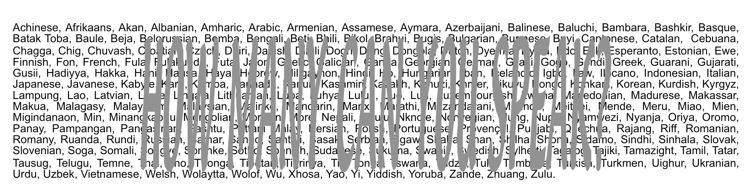
Development of Language (Genesis 11:1-9)
“The total number of languages in the world is estimated to be around 6000. Here are the most common spoken & written languages worldwide” (Ibid).

Slide 10

The Danger and Opportunities of Shifting Cultures
  Cultures protect from fast decay - isolation
  Language barriers also protect one’s traditions
  Each culture has its own accepted authorities
  Urbanization, internet, translators, music push rate of world culture
  Jesus’ command to make disciples of the nations is almost fulfilled!
  Train up our own children - be careful (Dt 6)
Over the last twenty years an amazing 400,000 churches have started.

Slide 11

Discussion Questions
How does a people’s own language help create and preserve their culture?
What significance does unity have on the world and the church (Genesis 11:6; Acts 2:44-45; Acts 4:32-33)?

Slide 12
GENESIS 10-11
#9 Unity & Diversity
The development of the nations
Oakland International Fellowship
Paul J. Bucknell

