Slide 1
The Book of Foundations
GENESIS
12-16,20
Responding to Life’s Challenges
Learning from other people’s mistakes
NASB
Paul J. Bucknell
Notes:
Michael Lim
“Life detours result from a missing or misplaced faith. Our lives are full of events both large and small to which we must respond by faith in the Lord. Among these, none is more important than that we respond by faith to believe in God when He calls us each to follow Him. From that point on, we must continue to strive forward by faith amidst a multitude of situations we face, avoiding detours which bring unnecessary consequences into His plans for us. As we mature in the steadfastness of our faith, more and more will we choose God as our guide, provider, and protector, and ever greater will His glory be in our lives.

Slide 2
Responding to Life’s Challenges
Genesis 12:1-3
“Now the LORD said to Abram,
‘Go forth from your country,
And from your relatives
And from your father’s house,
To the land which I will show you
And I will make you a great nation….’”
God made great promises to Abram because of his faith–
not because of his poor decisions.
Objectives
Understand more of Abraham’s weaknesses so that we can better learn from his life.
Show how insecurities develop and avoid such paths.
Be aware of relativism and pledge to live by God’s Word no matter what it costs.
Reject making life decisions by our senses and prioritize faith.

Slide 3
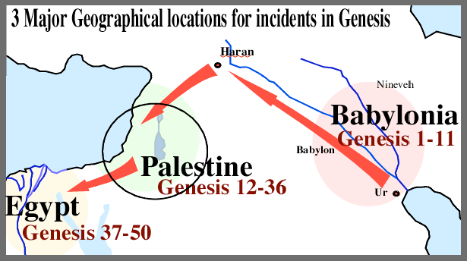

Genesis 12-16
Haven’t we all made some bad life decisions?
Now the LORD said to Abram,
“Go forth from your country,
And from your relatives
And from your father’s house,
To the land which I will show you and I will make you a great nation.”
A. Place Detour (Gen 12)
Went where he wasn’t supposed to.
B. Person Detour (Gen 13-14)
Stayed with those he shouldn’t
C. Procedure Detour (Gen 16)
Did things in ways he shouldn’t
When God speaks, listen carefully to details.
They might not make sense for a while, but they are important.

Slide 4

1.) Place Detour (Genesis 12:10-20, 20)
Is it God’s will to go to such and such a place?
Where did the Lord originally want him
to go and why? _______________
Abram went down to _______ (Gen 12:10).
Palestine/Canaan
Egypt
10 Now there was a famine in the land; so Abram went down to Egypt to sojourn there, for the famine was severe in the land. 13 “Please say that you are my sister so that it may go well with me because of you, and that I may live on account of you.” 14 And it came about when Abram came into Egypt, the Egyptians saw that the woman was very beautiful. 16 Therefore he treated Abram well for her sake. 17 But the LORD struck Pharaoh and his house with great plagues because of Sarai, Abram’s wife. 19 “Why did you say, ‘She is my sister,’ so that I took her for my wife? Now then, here is your wife, take her and go.” 20 And Pharaoh commanded his men concerning him; and they escorted him away, with his wife and all that belonged to him.
      Why did Abram leave the Promised Land?
      How else could Abram have responded?
Notes:
Abram was stuck. Famines last for a while; the test persisted.

Slide 5

1.) Place Detour (Genesis 12:10-20, 20)
Is it God’s will to go to such and such a place?
    3. Abraham settled further south, finally in the land of the Philistines (Gen 20).
      “Now Abraham journeyed from there toward the land of the Negev, and settled between Kadesh and Shur; then he sojourned in Gerar. 2 And Abraham said of Sarah his wife, “She is my sister.” So Abimelech king of Gerar sent and took Sarah settled between Kadesh and Shur; then he lived in Gerar. 3 But God came to Abimelech in a dream of the night, and said to him, “Behold, you are a dead man because of the woman whom you have taken, for she is married.”” (Gen 20:1-2).
      • Movement: Abram settled between Kadesh and Shur; then he lived in Gerar (Gen 20:1). Notice the steps away from God’s promised land.
      • Fear: “Abraham said, ‘Because I thought, surely there is no fear of God in this place; and they will kill me because of my wife’” (20:11).
      • Resentment: “When God caused me to
      wander from my father’s house” (20:13).
Disobedience => Insecurity => Fears => Immoral decisions
Obedience => Trust => Peace => Good decisions

Slide 6
2.) Person Detour (Genesis 13-14)
Being with those you shouldn’t
1) Abram and Lot’s Workmen (Genesis 13)
The first problem was over Abram and Lot’s workmen.
13:1 So Abram went up from Egypt to the Negev, he and his wife and all that belonged to him; and Lot with him. 5 Now Lot, who went with Abram, also had flocks and herds and tents. 6 And the land could not sustain them while dwelling together; for their possessions were so great that they were not able to remain together. 7 And there was strife between the herdsmen of Abram’s livestock and the herdsmen of Lot’s livestock. Now the Canaanite and the Perizzite were dwelling then in the land. 8 Then Abram said to Lot, “Please let there be no strife between you and me, nor between my herdsmen and your herdsmen, for we are brothers. 9 “Is not the whole land before you? Please separate from me:
The conflict arose with Lot due to Abram’s disobedience. The negative consequences, as always, was unnecessary if Abram obeyed God, though we can readily understand how ‘natural’ it was to feel more secure with Lot’s company.

Slide 7
2.) Person Detour (Genesis 13-14)
Being with those you shouldn’t
2) Abram’s Rescue of Lot (Genesis 14)
Having Lot nearby led to getting caught in a very risky fight.
14:11 Then they took all the goods of Sodom and Gomorrah and all their food supply, and departed. 12 And they also took Lot, Abram’s nephew, and his possessions and departed, for he was living in Sodom. 14 And when Abram heard that his relative had been taken captive, he led out his trained men, born in his house, three hundred and eighteen, and went in pursuit as far as Dan. 15 And he divided his forces against them by night, he and his servants, and defeated them… 16 And he brought back all the goods, and also brought back his relative Lot with his possessions, and also the women, and the people.
It appears that Abram’s rescue of Lot and others put off the judgment on Sodom and Gomorrah. His courageous behavior did, however, remain as a strong witness.
Can you think of any times?
Notes:
Application
God clearly does not want us to associate with certain people.
• He doesn’t want us to date or court non-Christians.
• He is not pleased when we marry people our parents do not approve of.
• He doesn’t want us to hang around those given to anger.
• He doesn’t want us to listen to gossiper and backbiters.

Slide 8
3.) Procedure Detour (Genesis 16-17)
Doing things in ways you shouldn’t
“And I will make you a great nation.”
1) The Difficulty
“Now Sarai, Abram’s wife had borne him no children, and she had an Egyptian maid whose name was Hagar” (Genesis 16:1).
The problem:
The temptation:
2) The Detour
A cultural practice.
“And after Abram had lived ten years in the land of Canaan, Abram’s wife Sarai took Hagar the Egyptian, her maid, and gave her to her husband Abram as his wife. And he went in to Hagar, and she conceived; and when she saw that she had conceived, her mistress was despised in her sight” (Genesis 16:3-4).
Application
Don’t always follow the advice of your _________.
The husband is responsible to do the right thing.
Respect God’s hand in fertility.
Remember it is God Himself who makes our situation harder at times.
wife
Notes:
Doing things in ways you shouldn’t
“And I will make you a great nation.”
God’s promise is to shape our faith in such a way that we can live boldly, trusting Him to lead and provide for us.

Slide 9
3.) Procedure Detour (Genesis 16-17)
Doing things in ways you shouldn’t
3) The consequences
    Self-reliance is a huge problem.
Ishmael’s descendants became a major threat towards Israel
(against Isaac the Promised son)
Further difficulties in Abraham and Sarah’s marriage (cf. Gen 16)
Unable to prove God’s faithfulness in his own life
Poor testimony to the world. (“I didn’t think there is such a God.”)
4) God’s solution
God wants us to withstand the enemy’s testing and endure the tests set before us.

Slide 10
Summary
COSTLY DETOURS
The World | The Godly | Scenario
World’s ways are never best | God’s ways are always best | Bad consequences
Seems compelling | Not really urgent | Waited 14 more years
Self-reliant | God-dependent | The miracle of Isaac
Prideful | Exalts the Lord | God supplies
Relativistic | Set on God’s principles | Abraham’s marriage
Lives by senses | Lives by faith | Abraham’s faith
List a spiritual crisis that you have or are now experiencing. Identify the actual temptation and how your faith is tested. Did you endure the testing? What was God trying to teach you?
Notes:
List a spiritual crisis that you have or are now experiencing. Identify the actual temptation and how your faith is tested. Did you endure the testing? What was God trying to teach you?

Slide 11

Discussion Questions
What are spiritual detours and some of the costs of taking them?
What specific difficulties and mistakes did faith allow Abram to overcome and avoid?
Give an example of how faith has helped you overcome or avoid a life challenge?
Notes:
Discussion Questions
1. What are spiritual detours and what are some of the costs of taking detours in our lives?
2. What specific difficulties and mistakes did faith allow Abram to overcome and avoid? (or would have allowed him to if he had shown faith) Give an incident when faith helped you overcome/avoid?
3. How can we be assured that our faith in God’s promises is truly enough?
4. List a spiritual crisis that you have or are now experiencing. Identify the actual temptation and how your faith is tested. Did you endure the testing? What was God trying to teach you? What was God trying to teach you?
5. Temptation (detours) become sin if we fail to trust God. When we fall, we need to get up right away. How long have you been a Christian? How has the time from which you fall and the time you repent and confess your sins changed. If you before took two days, is it now shorter?
6. Explain the principle of flesh versus the spirit. How is it important to a Christian who walks in the Spirit?

Slide 12
The Book of Foundations
GENESIS
12-16,20
Responding to Life’s Challenges
Learning from other people’s mistakes
NASB
Paul J. Bucknell

Slide 13
1.) Place Detour (Genesis 12:10-20)
Is it God’s will to go to such and such a place?
10 Now there was a famine in the land; so Abram went down to Egypt to sojourn there, for the famine was severe in the land. 11 And it came about when he came near to Egypt, that he said to Sarai his wife, “See now, I know that you are a beautiful woman; 12 and it will come about when the Egyptians see you, that they will say, ‘This is his wife’; and they will kill me, but they will let you live. 13 “Please say that you are my sister so that it may go well with me because of you, and that I may live on account of you.” 14 And it came about when Abram came into Egypt, the Egyptians saw that the woman was very beautiful. 15 And Pharaoh’s officials saw her and praised her to Pharaoh; and the woman was taken into Pharaoh’s house. 16 Therefore he treated Abram well for her sake; and gave him sheep and oxen and donkeys and male and female servants and female donkeys and camels.
17 But the LORD struck Pharaoh and his house with great plagues because of Sarai, Abram’s wife. 18 Then Pharaoh called Abram and said, “What is this you have done to me? Why did you not tell me that she was your wife? 19 “Why did you say, ‘She is my sister,’ so that I took her for my wife? Now then, here is your wife, take her and go.” 20 And Pharaoh commanded his men concerning him; and they escorted him away, with his wife and all that belonged to him.

Slide 14
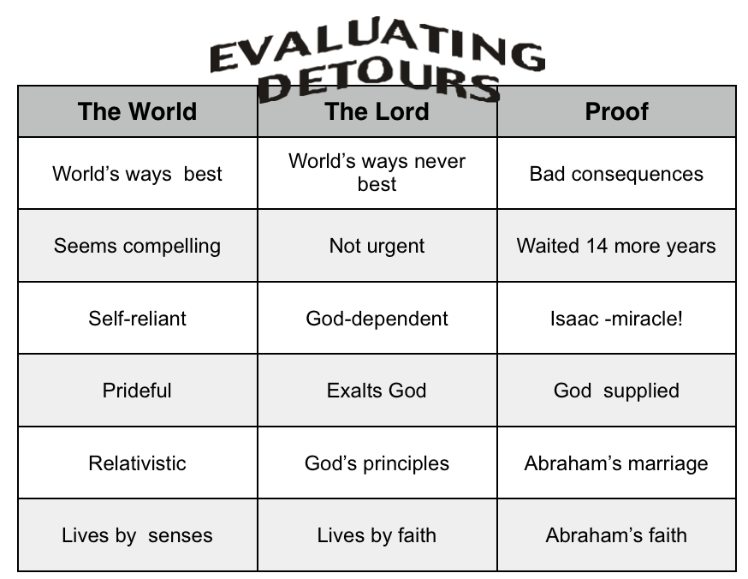

Conclusion
List a spiritual crisis that you have or are now experiencing. Identify what the actual temptation was and how your faith was tested? Did you endure through the testing? What was God trying to teach you?
Explain the principle of flesh versus the spirit. How is it important to a Christian who walks in the Spirit?

