Slide 1
The Book of Foundations
GENESIS
21-26
Making Tough Choices
Highlights from the Life of Isaac
NASB
Paul J. Bucknell

Slide 2



Grace in Genesis
Grace
Adam/Eve (2-4)
Noah/Flood (6-10)
Babel (11)
Abram (12-22)
Isaac/Jacob (21-36)
Joseph
(37-50)
Offers up his son
Sends son away
Type of son
God’s judgments display His holiness and grace.
Genesis => The Book of Foundations

Slide 3

Grace in the Scriptures
“And I saw the holy city, new Jerusalem, coming down out of heaven from God, made ready as a bride adorned for her husband the holy city, Jerusalem, coming down out of heaven from God…11 having the glory of God.…14 wash their robes, that they may have the right to the tree of life, and may enter by the gates into the city” (Rev 21:2,11,14).
Book of Foundations
“And the Word became flesh, and dwelt among us, and we beheld His glory, glory as of the only begotten from the Father, full of grace and truth” (John 1:14).
“Now when Solomon had finished praying, fire came down from heaven and consumed the burnt offering and the sacrifices; and the glory of the LORD filled the house..… 3 And all the sons of Israel, seeing the fire come down and the glory of the LORD upon the house… gave praise to the LORD, saying, “Truly He is good, truly His lovingkindness is everlasting”” (2 Chr 7:1-3).
Notes:
“Blessed are those who wash their robes, that they may have the right to the tree of life, and may enter by the gates into the city” (Rev 21:14).

Slide 4

A Simple Chronology of Isaac’s Life
21:5
25:7
Abram
100
140
160
175
25:20
25:26
35:28
Born
Married
Twins
Dad died
Proven
Died
Isaac
21
22
24
25
25
26
0
Teen
40
60
75
180
Lost Mom
(23:1-2)
Been
offered
Miracle find
Barren & prayed
Inherits all
Stayed in land (26:2)
Compromised his wife
Greatly blessed
Chased out in steps
Altar at Beersheba (26:24)
Wrongly blessed Jacob
Sent Jacob away for wife
25:5
8th Record: “Now these are the records of the generations of Isaac, Abraham’s son: Abraham became the father of Isaac” (25:19).
Notes:
Isaac was probably a teen when accompanying his father to be offered up. This reminds me of how it is our parents’s faith that brings us to church, fellowship, etc., and make decisions because of our parents’ faith more than our own. We must, though, like Isaac, possess our own faith in God. Isaac and Jacob both seem to be best understood in their various ways of gaining faith in the invisible good God.
Questions on chronology
Do the verses at the end of Genesis 26 about Esau marrying foreign women at 40 indicate that the famine and Gerar incident happened before then? Probably not, as it is hard to understand how all those incidences could happen within a year (Isaac first married). Would they not have found out that Rebekah already had children? Chapter 26 could be placed earlier before the twins were born or perhaps later, if Rebekah’s countenance was still young like Sarahs.
We are not sure at what age Isaac was offered up by Abraham. We assume it was when he was young, but older than a boy as he needed to carry the wood up the mountain.

Slide 5

Life, Struggles, and Spiritual Growth
25
#1 Struggles Bring Focus (Gen 25:1)
“And Isaac prayed to the LORD on behalf of his wife, because she was barren; and the LORD answered him and Rebekah his wife conceived” (Gen 25:21).
Was Rebekah too bitter to pray? Did he not pray earlier?
Sometimes only difficulties can get a husband involved!
Difficulties test what I really want, asking if it really matters.
#2 Womb War Casts Vision (Gen 25:22-24)
“But the children struggled together within her; and she said, “If it is so, why then am I this way?” So she went to inquire of the LORD. 23 And the LORD said to her, “Two nations are in your womb; And two peoples shall be separated from your body; And one people shall be stronger than the other; And the older shall serve the younger.” 24 When her days to be delivered were fulfilled, behold, there were twins in her womb” (Gen 25:22-24).
Puzzles in life get us seeking the Lord (if not embittered).
God revealed an answer to Rebekah’s question.
Notes:
Isaac’s Genealogy (Genesis 25:19-34)
Genesis 25:19 starts like the other genealogical records throughout Genesis. It begins with the traditional, “Now these are the records of the generations of …” In this case, it continues with Isaac. Interestingly, it first describes his wife Rebekah’s ancestry.
Rebekah’s ancestry
Abraham sought to preserve the wholesome devotion to God by isolating his family from the surrounding Canaanite culture. The mention of Rebekah being from Syria doesn’t seem consistent with this until we remember Abraham’s directions to his servant when he went looking for a bride for Isaac (Genesis 24:3-4). Notice in Genesis 24:10 that he went to Nahor in Mesoptamia. He found a bride from the godly seed who recognized God as creator. She was from the same place and family of his grandfather Terah.
Isaac’s sons
The first thing we note is that the sons of Isaac are obtained through prayer. Rebekah herself was barren. Isaac was forty when married (Genesis 25:20) and sixty when they had children (Genesis 25:26). How difficult it must have been for her! Twenty years without children! There was pressure (even if unspoken) from Abraham (now 160!), from God’s evident plan, one’s own expectations and the society.
God did answer Isaac’s prayer for Rebekah. This is interesting especially in light of all of his father’s struggles to have a son.

Slide 6
Election of God’s People (Genesis 25:22-23)
25
Discussion on Predestination
“So she went to inquire of the LORD. 23 And the LORD said to her, “Two nations are in your womb; And two peoples shall be separated from your body; And one people shall be stronger than the other; And the older shall serve the younger” (Gen 25:22-23).
The Lord gave these clues to help them not get confused by normal life expectations and keep on the spiritual track.
God reveals His choice of the second born, “born again”–Jn 3:3,10
Through these words we see God’s intervention in man’s affairs.
  God’s plan for us begins before we are born (Gen 25:23).
  God’s plan begins before the world or time existed (Eph 1:4).
“Just as He chose us in Him before the foundation of the world, that we should be holy and blameless before Him. In love 5 He predestined us to adoption as sons through Jesus Christ to Himself, according to the kind intention of His will” (Eph 1:4-5).
  Why does predestination bother people?

Slide 7

Election of God’s People (Genesis 25:22-23)
25
Related Scriptures
“For the LORD has chosen Jacob for Himself, Israel for His own possession” (Ps 135:4).
“But you, Israel, My servant, Jacob whom I have chosen, Descendant of Abraham My friend” (Isa 41:8).
“Was not Esau Jacob’s brother?” declares the LORD. “Yet I have loved Jacob; but I have hated Esau, and I have made his mountains a desolation....”” (Malachi 1:2, 3).
“But there was Rebekah also, when she had conceived twins by one man, our father Isaac; for though the twins were not yet born, and had not done anything good or bad, in order that God’s purpose according to His choice might stand, not because of works, but because of Him who calls, it was said to her, “THE OLDER WILL SERVE THE YOUNGER.” Just as it is written, “JACOB I LOVED, BUT ESAU I HATED.” What shall we say then? There is no injustice with God, is there? May it never be! For He says to Moses, “I will have mercy on whom I have mercy, and I will have compassion on whom I have compassion.” So then it does not depend on the man who wills or the man who runs, but on God who has mercy” (Romans 9:10-16).
Notes:
Significance of Twins (Esau & Jacob)
We might be surprised by what happens next. Notice the way Isaac and Rebekah related God to their lives and how God related to them. He did this above in 25:21 too.
She felt the struggle within her. The battle was so intense she actually inquired of the Lord. It is interesting to note that the Lord actually spoke to her.
And the LORD said to her, “Two nations are in your womb; And two peoples shall be separated from your body; And one people shall be stronger than the other; And the older shall serve the younger. (Genesis 25:23).
Each son would become a nation (that is very significant)! One would be stronger (Esau stronger than Jacob) but the older (Esau again) would serve the younger (Jacob). Esau, the red hairy hunter was firstborn and stronger than the heel-grabber stay-around-home later born Jacob.
Genesis 25:22-34 holds two powerful teachings.
Election of God’s People (Genesis 25:22-23)
The teaching of election bothers some. People do not like how God interferes with anyone’s life. Perhaps this intrudes in the modern day concept of freedom, “I can do anything I want.” They do not like the idea that they are boxed into God’s plan as if it is wrong.
Positive blessing
“By faith Isaac blessed Jacob and Esau, even regarding things to come.” (He 11:20).
Isaac blessed both his sons. Each had their own advantage. Each was to become a nation. Each was blessed by God. God was working in both their lives.
A selection, a choice
Much is said about this in the scriptures.
“Was not Esau Jacob’s brother?” declares the LORD. “Yet I have loved Jacob; but I have hated Esau, and I have made his mountains a desolation....”” (Malachi 1:2, 3).
“But there was Rebekah also, when she had conceived twins by one man, our father Isaac; for though the twins were not yet born, and had not done anything good or bad, in order that God’s purpose according to His choice might stand, not because of works, but because of Him who calls, it was said to her, “THE OLDER WILL SERVE THE YOUNGER.” Just as it is written, “JACOB I LOVED, BUT ESAU I HATED.” What shall we say then? There is no injustice with God, is there? May it never be! For He says to Moses, “I will have mercy on whom I have mercy, and I will have compassion on whom I have compassion.” So then it does not depend on the man who wills or the man who runs, but on God who has mercy” (Romans 9:10-16).
God holds it as His own prerogative to choose. “In order that God’s purpose according to His choice might stand” (Romans 9:11). There is a shaping of our lives just as there is a womb containing the pre-born child. Paul is aware of the charge of this predetermination being ‘unjust’ (25:14). He strongly replies, “May it never be!”
Does God need to be merciful? God is merciful to all (He provides for us and keeps us living for a while). God states though, “I will have mercy on whom I have mercy, and I will have compassion on whom I have compassion” (Romans 9:15). Although God goes out of His way in His love to reach out. He does not have to save anyone. Judgment is what He does need to give us. Judgment is fair. That is what we deserve. The fallen angels only have judgment to face.
Many things are predetermined. Our family and home are chosen for us. Our existence is chosen for us. But it is within this context we need to see the responsibility of our own decisions.
Reflection questions
If you think God is committing injustice by exercising His compassion on some rather than all, then you should repent. You are dead wrong. God cannot be unjust.
If you experience God’s mercy, then you should be overwhelmed with joy and thankfulness. Are you? Why or why not?
Ps 135:4 For the LORD has chosen Jacob for Himself, Israel for His own possession.
Isa 14:1 When the LORD will have compassion on Jacob, and again choose Israel, and settle them in their own land, then strangers will join them and attach themselves to the house of Jacob.
Isa 41:8 “But you, Israel, My servant, Jacob whom I have chosen, Descendant of Abraham My friend,
Isa 44:1 “But now listen, O Jacob, My servant; And Israel, whom I have chosen:
Isa 44:2 Thus says the LORD who made you And formed you from the womb, who will help you, ‘Do not fear, O Jacob My servant; And you Jeshurun whom I have chosen.

Slide 8
Justice and Mercy
Election of God’s People (Genesis 25:22-23)
Mercy
25
Justice
God’s holiness demands all
sinners die under His judgment.
“For if by the transgression of the one,
death reigned through the one” (Rom 5: 17).
Mercy
Mercy reaches the lost with salvation, but not because we are good but by God’s choice. Nothing obligates God to save any of us.
So then it does not depend on the man who wills or the man who runs, but on God who has mercy” (Romans 9:16).

Slide 9
#3 Drifts from and Returns to God (Gen 26)
“26:1 Now there was a famine in the land, besides the previous famine that had occurred in the days of Abraham. So Isaac went to Gerar, to Abimelech king of the Philistines. 2 And the LORD appeared to him and said, “Do not go down to Egypt; stay in the land of which I shall tell you. 3 “Sojourn in this land and I will be with you and bless you, for to you and to your descendants I will give all these lands, and I will establish the oath which I swore to your father Abraham. 4 “And I will multiply your descendants as the stars of heaven, and will give your descendants all these lands; and by your descendants all the nations of the earth shall be blessed; 5 because Abraham obeyed Me and kept My charge, My commandments, My statutes and My laws.” 6 So Isaac lived in Gerar. 7 When the men of the place asked about his wife, he said, “She is my sister,” for he was afraid to say, “my wife,” thinking, “the men of the place might kill me on account of Rebekah, for she is beautiful.” 8 And it came about, when he had been there a long time, that Abimelech king of the Philistines looked out through a window, and saw, and behold, Isaac was caressing his wife Rebekah. 9 Then Abimelech called Isaac and said, “Behold, certainly she is your wife! How then did you say, ‘She is my sister’?” And Isaac said to him, “Because I said, ‘Lest I die on account of her.’” 10 And Abimelech said, “What is this you have done to us? One of the people might easily have lain with your wife, and you would have brought guilt upon us.” 11 So Abimelech charged all the people, saying, “He who touches this man or his wife shall surely be put to death” (Genesis 26:1-11).
A caution/promise from God
Temptations from the world

Slide 10
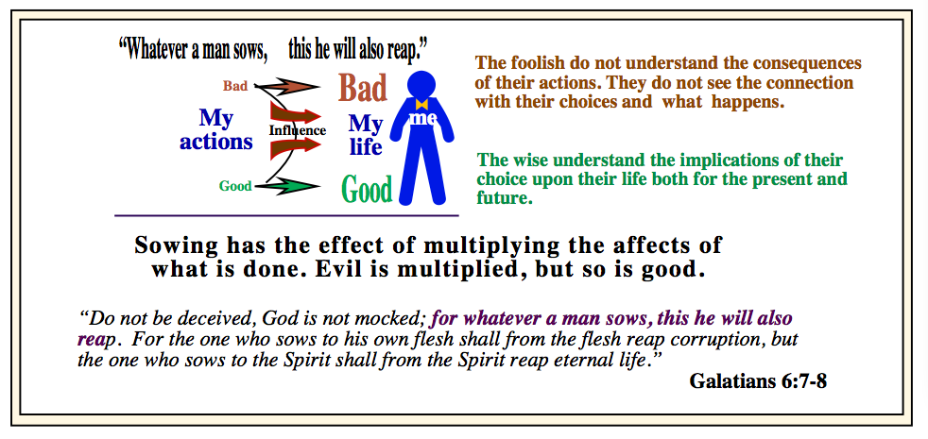
Drift#3 Drifts from and Returns to God (Gen 26)

Slide 11

#3 Drifts from and Returns to God (Gen 26)
“12 Now Isaac sowed in that land, and reaped in the same year a hundredfold. And the LORD blessed him, 13 and the man became rich, and continued to grow richer until he became very wealthy; 14 for he had possessions of flocks and herds and a great household, so that the Philistines envied him. 15 Now all the wells which his father’s servants had dug in the days of Abraham his father, the Philistines stopped up by filling them with earth. 16 Then Abimelech said to Isaac, “Go away from us, for you are too powerful for us.” 17 And Isaac departed from there and camped in the valley of Gerar, and settled there. 18 Then Isaac dug again the wells of water which had been dug in the days of his father Abraham, for the Philistines had stopped them up after the death of Abraham; and he gave them the same names which his father had given them. 19 But when Isaac’s servants dug in the valley and found there a well of flowing water, 20 the herdsmen of Gerar quarreled with the herdsmen of Isaac, saying, “The water is ours!” So he named the well Esek, because they contended with him. 21 Then they dug another well, and they quarreled over it too, so he named it Sitnah. 22 And he moved away from there and dug another well, and they did not quarrel over it; so he named it Rehoboth, for he said, “At last the LORD has made room for us, and we shall be fruitful in the land.” 23 Then he went up from there to Beersheba. 24 And the LORD appeared to him the same night and said, “I am the God of your father Abraham; Do not fear, for I am with you. I will bless you, and multiply your descendants, For the sake of My servant Abraham.” 25 So he built an altar there, and called upon the name of the LORD, and pitched his tent there; and there Isaac’s servants dug a well.” (Genesis 26:12-25).
Contentment
Spiritual discontentment

Slide 12
#3 Drifts from and Returns to God (Gen 26:23-25)
Return to God is occasioned by clarifying our commitment to Him.
“23 Then he went up from there to Beersheba. 24 And the LORD appeared to him the same night and said, “I am the God of your father Abraham; Do not fear, for I am with you. I will bless you, and multiply your descendants, For the sake of My servant Abraham.” 25 So he built an altar there, and called upon the name of the LORD, and pitched his tent there; and there Isaac’s servants dug a well” (Genesis 26:23-25).
The World
Seeking God’s Presence
Gerar
Beersheba
Influence from surrounding cultures
When he departed from Gerar’s culture, he experienced a new freedom.
Though gaining an uncontested well, he suddenly left it and the world.
The Lord, then, again revealed Himself to him.
Isaac responded by building his first altar.
Each of us, like Isaac, must possess our own faith.
Notes:
There appears a full release from the surrounding cultures when he departed Gerar’s surrounding area and influence. Even though Isaac gained an uncontested well, he left it, as if suddenly, a light dawned on him that God was leading him away from the world’s influence. This is where the Lord again revealed Himself to him, and he responded by building his first altar. Abraham’s faith fully becomes Isaac’s faith.

Slide 13
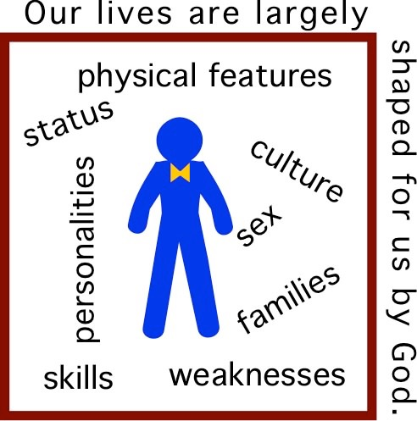
#4 Getting a Life Perspective
God ordained our families, culture, status, physical features, weaknesses, skills, and personalities and does not judge us on these unchangeables.
We must focus on what we can change through our choices.
“Why has God put me in this situation?”
“What is God’s life purposes for me?”
“Have I pursued the Lord above all?”
“Draw near to God and He will draw near to you. Cleanse your hands, you sinners; and purify your hearts, you double-minded” (Jas 4:8).
Notes:
“Submit therefore to God. Resist the devil and he will flee from you. 8 Draw near to God and He will draw near to you. Cleanse your hands, you sinners; and purify your hearts, you double-minded” (James 4:7-8).

Slide 14
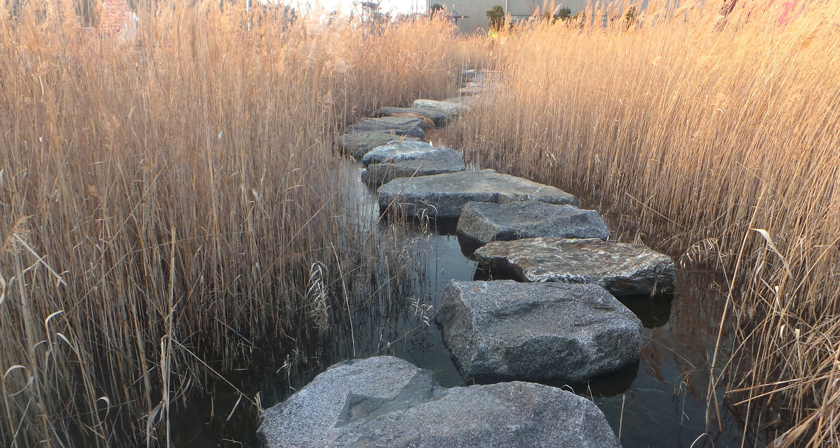
Conclusions from Isaac’s Life
Don’t fear life’s difficulties but use them as stepping stones to experience more of God and His grace.
Be grateful for your “givens” from God. Focus on making wise choices.
Be attentive to God’s grace even during our failures.
Worldliness can destroy a vivacious faith.
God awaits expression of our clear commitment towards Him.
Notes:
Don’t fear life’s difficulties but use them as stepping stones to experience more of God and His grace.
Be grateful for your “givens” from God. Focus on your choices.
Be attentive to God’s grace even during our failures.
Worldliness destroys a vivacious faith.
God awaits expression of our clear commitment towards Him.

Slide 15

Discussion Questions
Why does the Lord allow famines to be part of the lives of His people whom He seeks to bless?
God is not troubled with His free choice, are you? Why? How do you resolve issues regarding free will?
Identify anything that might prevent you from “building an altar” signifying that your life now centers on serving God and not yourself.
Notes:
Why does the Lord allow famines to be part of the lives of His people whom He seeks to bless?
How is the Lord involved with the birth of our children? Why might have God waited for Isaac’s prayer before He granted them children?
God is not troubled with His free choice, are you? Why? How do you resolve issues revolving around free will?
Identify anything that might prevent you from “building an altar” signifying that your life will center on serving God and not yourself.

Slide 16
The Book of Foundations
GENESIS
Faith Over Sight
21-26
Combating the World
Making Tough Choices
The Life of Isaac
NASB
Paul J. Bucknell

Slide 17
Our Choice and Predestination
Arminianism |  | Calvinism
Free will Though morally hurt by sin in Eden, man still has a free will to choose to obey God. Sin has not corrupted his ability or desire to cooperate with God. God graciously enables every sinner to repent and believe. |  | Total Depravity Man's nature is corrupt due to his sin in Eden. He lost his ability and desire to choose good. By his own nature he will not and cannot please God. He must be given a new nature by God to choose righteousness.
Conditional Election God chose those He foresaw would believe for eternal life. Election is based on man's free choice. It was left to man as to who would believe and therefore those who would be elected to salvation. |  | Unconditional Election God chose some men to eternal life by His own will. When He considered mankind, God saw only sin and no faith or good works. It is God's choice and not the sinner's that is the basis of salvation.
Gen 2:17; Rom 5:12; I Cor 2:14; Eph 2:1-3; Rom 3:10-12; 8:7-8; Jer 13:23; John 8:47. |  | Ps 14:1-3; 1 Peter 1:2; Rom 8:28-33; 9:11,22; Ac 13:48; 2 The 2:13;
The chart is taken from and modified from www.letgodbetrue.com. Reference books: “The Five Points of Calvinism” by Steele and Thomas. A larger work is Boettner’s “The Reformed Doctrine of Predestination.”

Slide 18
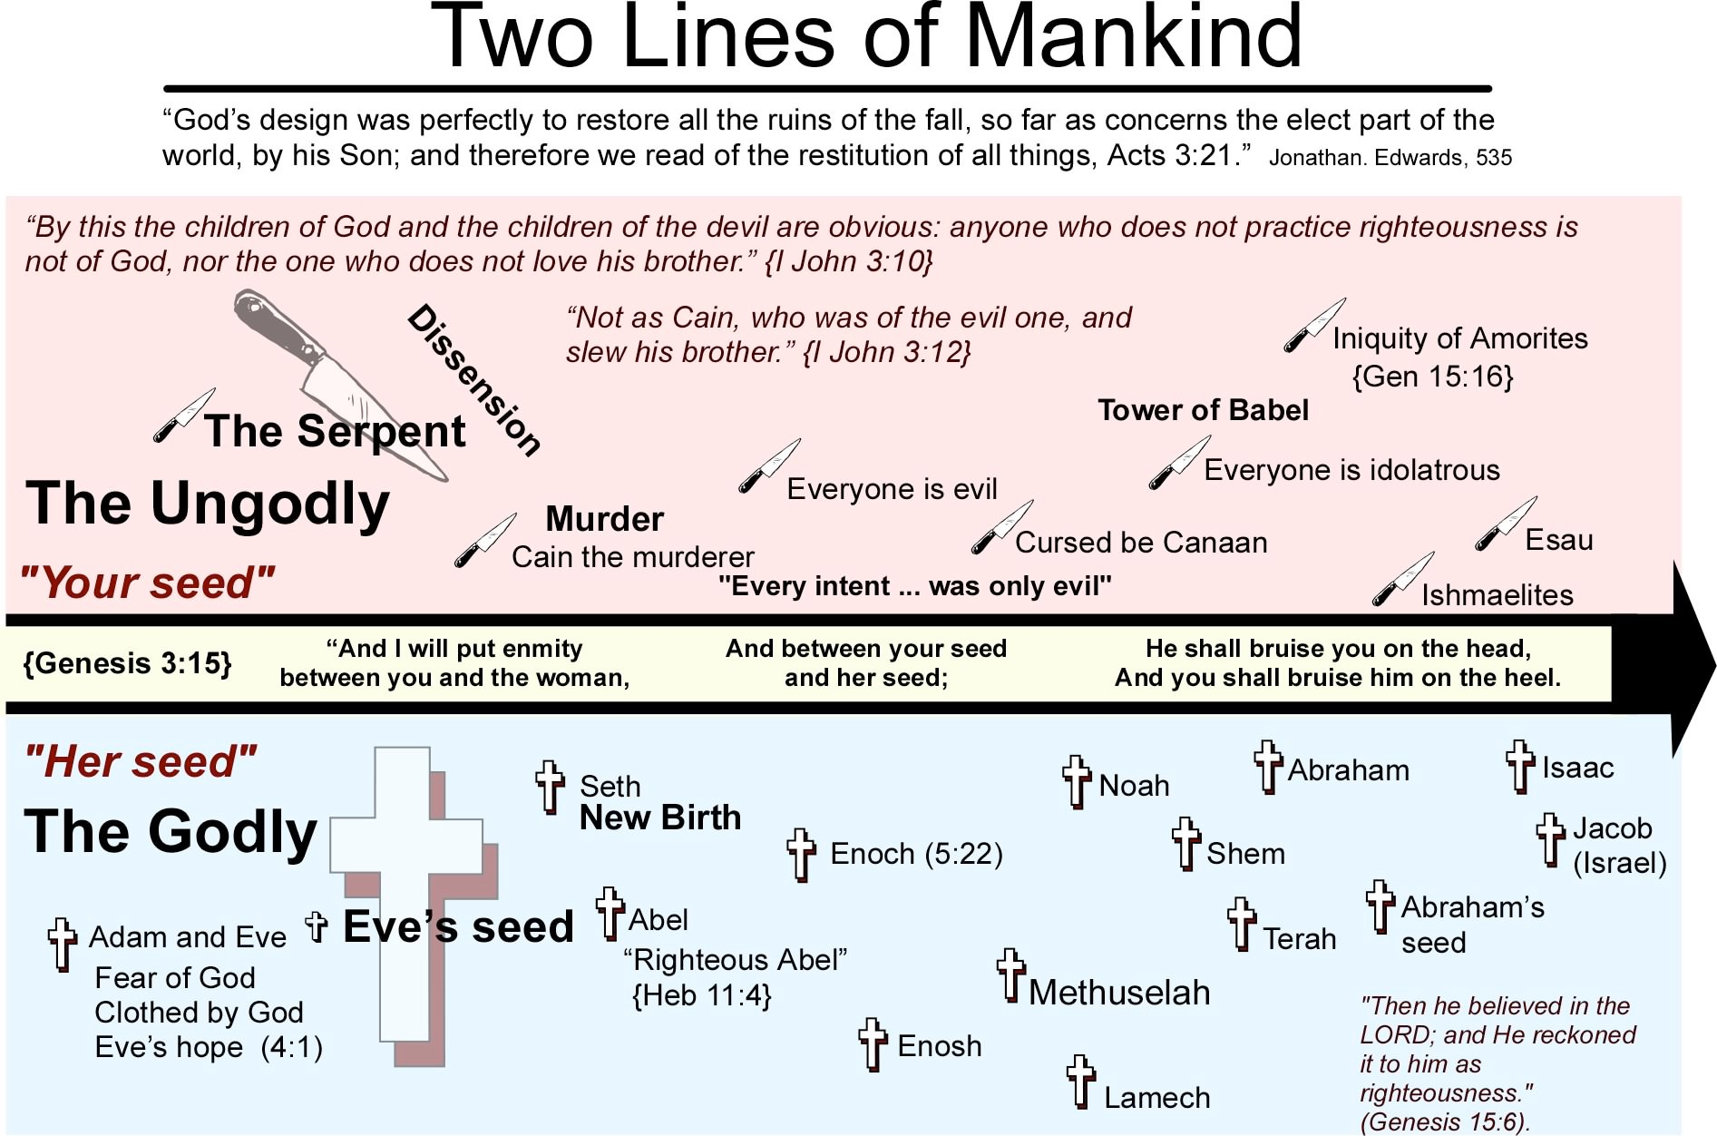
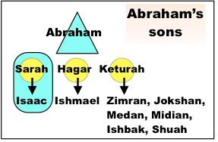

Slide 19

Does it Really Matter?
Abraham sacrificed Isaac in obedience
15 Then the angel of the LORD called to Abraham a second time from heaven, 16 and said, “By Myself I have sworn, declares the LORD, because you have done this thing, and have not withheld your son, your only son, 17 indeed I will greatly bless you, and I will greatly multiply your seed as the stars of the heavens, and as the sand which is on the seashore; and your seed shall possess the gate of their enemies. 18 “And in your seed all the nations of the earth shall be blessed, because you have obeyed My voice.” (Gen 22:15-18)
25:21 And Isaac prayed to the LORD on behalf of his wife, because she was barren; and the LORD answered him and Rebekah his wife conceived.
25:22 But the children struggled together within her; and she said, “If it is so, why then am I this way?” So she went to inquire of the LORD. 23 And the LORD said to her, “Two nations are in your womb; And two peoples shall be separated from your body; And one people shall be stronger than the other; And the older shall serve the younger.” 24 When her days to be delivered were fulfilled, behold, there were twins in her womb.

Slide 20
Life, Struggles, and Spiritual Growth
25
Struggles With Our Flesh
“Now Isaac loved Esau, because he had a taste for game; but Rebekah loved Jacob.” (Gen 25:28).
Parents need to be careful that their vision for children surpass their natural preferences.
  Husband-wife tension
  Jealousy between children
  Spiritual insensitivity (e.g. God’s plans: full-time ministry over getting Ph.D.)

Slide 21
Possibility of Interpretations
Was it sin to go to Gerar? (Part of a certain answer is unsurety of where Gerar was (8-30 miles south of Gaza on coast or inland.)
On the way to Egypt, Isaac faithfully went to Gerar, the land God had pointed him to. There God greatly blessed him. (Gerar was part of the Promised Land)
Isaac was straying and headed towards Egypt, and though God told him to stay where He said, Isaac compromised and stayed in Gerar. God, like Abraham, blessed him still in that time, and yet chose to push him back to where He wanted him to. (Gerar was not the Promised Land)
We will conclude Gerar was okay to stay in but it was a dangerous place one would be influenced by others. In this case, Isaac had fear rather than faith, and like his father sold out his wife.
Initial obedience
Gerar
Disobeyed God
Obeyed but still had tests to face.
Notes:
EXODUS 23:31
“I will establish your borders from the Red Sea to the Sea of the Philistines, and from the desert to the River. I will hand over to you the people who live in the land and you will drive them out before you.”
EZEKIEL 47:19
“On the south side it will run from Tamar as far as the waters of Meribah Kadesh, then along the Wadi of Egypt to the Great Sea. This will be the south boundary.”
GENESIS 15:18
On that day the Lord made a covenant with Abram and said, “To your descendants I give this land, from the river of Egypt to the great river, the Euphrates ...”

Slide 22
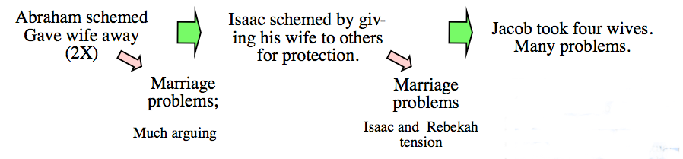
Spiritual principle: One can only love God as much as he truly loves his wife. A chart on the names and mothers of Jacob’s children

Slide 23
Introduction to Genesis 21-26
Isaac was warned but disobedient and moved to Gerar. Spiritual meetings with God are not always convincing enough to lead and protect us.
It is only after Isaac moves back to Beersheba do we see a significant renewal in his life. 23 Then he went up from there to Beersheba.
26:24 And the LORD appeared to him the same night and said, “I am the God of your father Abraham; Do not fear, for I am with you. I will bless you, and multiply your descendants, For the sake of My servant Abraham.” 25 So he built an altar there, and called upon the name of the LORD, and pitched his tent there; and there Isaac’s servants dug a well.
We notice that he followed his Dad’s misbehavior and lack of faith
(1) went to Philistines during a famine, and (2) Offers his wife as a sister to another (definite lack of faith).
Isaac continued to face problems with the Philistines, largely with regards to the wells, but he was being chased away–until God had him where he wanted to be. (26:18; 20,
On the contrary, once he got back to Beersheba, good things started happening: Philistines made peace; discovered water, (ch. 26)

Slide 24
Our Choice and Predestination
Arminianism |  | Calvinism
Free will Though morally hurt by sin in Eden, man still has a free will to choose to obey God. Sin has not corrupted his ability or desire to cooperate with God. God graciously enables every sinner to repent and believe. |  | Total Depravity Man's nature is corrupt due to his sin in Eden. He lost his ability and desire to choose good. By his own nature he will not and cannot please God. He must be given a new nature by God to choose righteousness.
Conditional Election God chose those He foresaw would believe for eternal life. Election is based on man's free choice. It was left to man as to who would believe and therefore those who would be elected to salvation. |  | Unconditional Election God chose some men to eternal life by His own will. When He considered mankind, God saw only sin and no faith or good works. It is God's choice and not the sinner's that is the basis of salvation.
Gen 2:17; Rom 5:12; I Cor 2:14; Eph 2:1-3; Rom 3:10-12; 8:7-8; Jer 13:23; John 8:47. |  | Ps 14:1-3; 1 Peter 1:2; Rom 8:28-33; 9:11,22; Ac 13:48; 2 The 2:13;
The chart is taken from and modified from www.letgodbetrue.com. Reference books: “The Five Points of Calvinism” by Steele and Thomas. A larger work is Boettner’s “The Reformed Doctrine of Predestination.”
Notes:
Ps 135:4 For the LORD has chosen Jacob for Himself, Israel for His own possession.
Isa 14:1 When the LORD will have compassion on Jacob, and again choose Israel, and settle them in their own land, then strangers will join them and attach themselves to the house of Jacob.
Isa 41:8 “But you, Israel, My servant, Jacob whom I have chosen, Descendant of Abraham My friend,
Isa 44:1 “But now listen, O Jacob, My servant; And Israel, whom I have chosen:
Isa 44:2 Thus says the LORD who made you And formed you from the womb, who will help you, ‘Do not fear, O Jacob My servant; And you Jeshurun whom I have chosen.

Slide 25
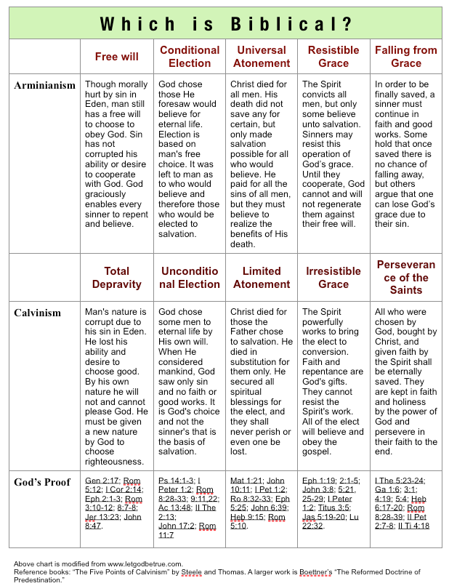
Our Choice and Predestination

Slide 26
Insights gleaned from the Scriptures
Genesis 25-26
Don’t fear life’s difficulties but use
them as stepping stones to experience more of God and His grace.
Notes:
Be aware of God’s grace even in our failures.
Waywardness always delays and limits God’s blessing, further seeding trouble into one’s family and God’s plan.
The clearer we turn to God, the more He turns to us (James 4:7-8).
When we face life troubles, we should seek the Lord to see if we have made a bad decision (disobedience) somewhere along the way.

