Slide 1
The Book of Foundations
GENESIS
31-32
The Making of a Man of God
A Penetrating Look at Jacob’s Life
NASB
Paul J. Bucknell

Slide 2


Our Spiritual Pilgrimages
Hopefully, we are all on one!
Our expectations, however, are not always met.
Expectations of success
Jacob met great disappointments.
Joseph met great periods of trouble too.
But not because of same reasons!
Notes:
Most of us want a comfortable and easy life, but this is atypical–especially if God is in our lives. Actually, many of us, especially in our expectations, we really want something more than average–we want success.
Jacob and Joseph both met up with great ups and downs in life but not for the same reasons. The commonality is that God was working in both of them, but Jacob’s down process was where he was learning he needed God and to live God’s ways (recognize God’s ways are best - not deceiving). Joseph, however, met great periods of trouble for his faith to be proved and tested. Jacob suffered extra because of his sin but Joseph to prove his character through suffering, but both had the same direction of equipped for service. Jacob had angel experiences to bring hope and guidance but Joseph had to look at his circumstances to see God’s blessings (though he had gift of dreams).

Slide 3
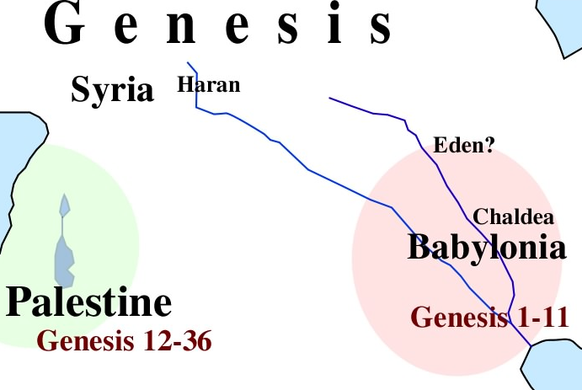

Introduction to Genesis 31-32
Can people–like us–really improve?
With God all things are possible!
Jacob returns home
Bethel
Jacob is put on stage to display God’s gracious ability to work with people like us.
Jacob is used to encourage us to observe where we are in our spiritual journey and avoid some of life’s pitfalls.
Notes:
Our spiritual journey perhaps is composed of 80% energy spent on character improvement, at least in our younger Christian lives, and 20% service. God wants us close to Him but without change, we will not be able to effectively serve Him. God can work out all the flaws but hopefully with less stubbornness than Jacob had!

Slide 4

1) Jacob’s Changing World (Genesis 31)
Observation: Signs of Change (1-5)
1 Now Jacob heard the words of Laban’s sons, saying, “Jacob has taken away all that was our father’s, and from what belonged to our father he has made all this wealth.”
2 And Jacob saw the attitude of Laban, and behold, it was not friendly toward him as formerly.
Certain incidents can highlight past events
In this case, probably was fear of loss (e.g., Esau)
3 Then the LORD said to Jacob, “Return to the land of your fathers and to your relatives, and I will be with you.” 4 So Jacob sent and called Rachel and Leah to his flock in the field, 5 and said to them, “I see your father’s attitude, that it is not friendly toward me as formerly, but the God of my father has been with me (Genesis 31:1-5).

Slide 5

Genesis 31:6-11
Evaluation: Evidence of God’s Grace (31:6-16)
31:6 “And you know that I have served your father with all my strength. 7 “Yet your father has cheated me and changed my wages ten times; however, God did not allow him to hurt me. 8 “If he spoke thus, ‘The speckled shall be your wages,’ then all the flock brought forth speckled; and if he spoke thus, ‘The striped shall be your wages,’ then all the flock brought forth striped. 9 “Thus God has taken away your father’s livestock and given them to me. 10 “And it came about at the time when the flock were mating that I lifted up my eyes and saw in a dream, and behold, the male goats which were mating were striped, speckled, and mottled.
Ripped Off!
What was Jacob’s problem?

Slide 6
1) Jacob’s Changing World (31:6-55)
Observation: Signs of Change (31:1-5)
All those things Jacob worked hard for were threatened!
Evaluation: Retells of God’s Grace (31:6-16)
Jacob recounts God’s blessings to him and reveals his plan to his wives.
Evacuation: Takes Desperate Action (31:17-21)
Jacob packs up and sneaks away–family and all.
Confrontation: Faces Dark Consequences (31:22-42)
Laban caught up and confronted Jacob’s escape.
Reconciliation: Forges a New Future (31:43-55)
Laban covers up his guilt by steering the conversation to his contribution of Jacob’s prosperity, but Jacob insists that Laban contributed little or nothing, and that it was God who had helped him.

Slide 7
1) Jacob’s Changing World (31)
Hardships (Gen 31:38-42a)
Read Gen 31:38-42 and write down all the ways Jacob labored hard for Laban.
Notes:
The Payback (Gen 31:38-41)
Twenty years service
14 years for two daughters
6 years for the flock
No animal miscarrying
Have not eaten Laban’s food
Bore loss of lost sheep
Bore loss of stolen sheep
Changed wages ten times
Overpowering heat by day
Frost at night

Slide 8
2) Jacob’s Humbled and Changed Life (32)
Jacob humbly faces the past (32:3-12)
32:1 Now as Jacob went on his way, the angels of God met him. 2 And Jacob said when he saw them, “This is God’s camp.” So he named that place Mahanaim. 3 Then Jacob sent messengers before him to his brother Esau in the land of Seir, the country of Edom. 4 He also commanded them saying, “Thus you shall say to my lord Esau: ‘Thus says your servant Jacob, “I have sojourned with Laban, and stayed until now; 5 and I have oxen and donkeys and flocks and male and female servants; and I have sent to tell my lord, that I may find favor in your sight.”’
Perhaps the angels brought extra confidence to help Jacob correct his past offenses with Esau.
6 And the messengers returned to Jacob, saying, “We came to your brother Esau, and furthermore he is coming to meet you, and four hundred men are with him” (Genesis 32:1-6).
Possibly lose all again

Slide 9
2) Jacob’s Humbled and Changed Life (32:7-12)
Jacob humbly faces the past
32:7 Then Jacob was greatly afraid and distressed; and he divided the people who were with him, and the flocks and the herds and the camels, into two companies; 8 for he said, “If Esau comes to the one company and attacks it, then the company which is left will escape.” 9 And Jacob said, “O God of my father Abraham and God of my father Isaac, O LORD, who didst say to me, ‘Return to your country and to your relatives, and I will prosper you,’ 10 I am unworthy of all the lovingkindness and of all the faithfulness which Thou hast shown to Thy servant; for with my staff only I crossed this Jordan, and now I have become two companies. 11 “Deliver me, I pray, from the hand of my brother, from the hand of Esau; for I fear him, lest he come and attack me, the mothers with the children. 12 For Thou didst say, ‘I will surely prosper you, and make your descendants as the sand of the sea, which cannot be numbered for multitude’” (Gen 32:7-12).

Slide 10
2) Jacob’s Humbled and Changed Life 32:24-32
Jacob’s Meeting with God - Peniel (32:24-32)
“24 Then Jacob was left alone, and a man wrestled with him until daybreak. 25 And when he saw that he had not prevailed against him, he touched the socket of his thigh; so the socket of Jacob’s thigh was dislocated while he wrestled with him. 26 Then he said, “Let me go, for the dawn is breaking.” But he said, “I will not let you go unless you bless me.” 27 So he said to him, “What is your name?” And he said, “Jacob.” 28 And he said, “Your name shall no longer be Jacob, but Israel; for you have striven with God and with men and have prevailed.” 29 Then Jacob asked him and said, “Please tell me your name.” But he said, “Why is it that you ask my name?” And he blessed him there. 30 So Jacob named the place Peniel, for he said, “I have seen God face to face, yet my life has been preserved.” 31 Now the sun rose upon him just as he crossed over Penuel, and he was limping on his thigh. 32 Therefore, to this day the sons of Israel do not eat the sinew of the hip which is on the socket of the thigh, because he touched the socket of Jacob’s thigh in the sinew of the hip” (Genesis 32:24-32).

Slide 11


C) God’s Life Interruptions (Genesis 31-32)
Four wrestling matches
Lost all with Esau - ran away empty-handed
Managed to get away from Laban thanks to God’s help
His coming match with Esau -
might lose everything- even his life
“I am a crumb and deserve to lose everything!”
    (4) Wrestles with the Angel of God
“I have nothing apart from God’s grace!”
Manipulators must learn the lesson that only what God rightly provides is good.

Slide 12
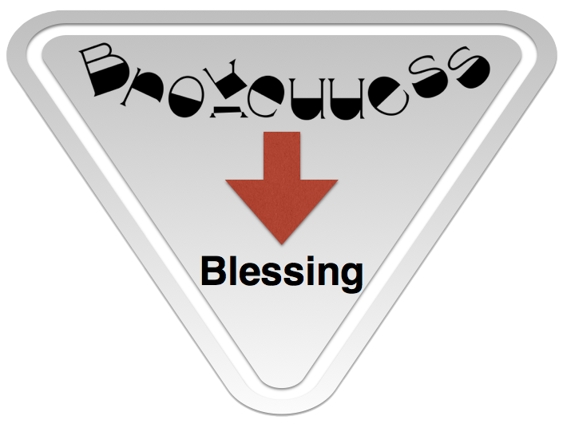
C) God’s Life Interruptions (Genesis 31-32)
Brokenness Leads to Blessings
An Intense Struggle (31:1-21)
Realizing God’s grace (31:22-42)
Willing to make peace (31:43-55)
New spiritual insight (32:1-2)
Facing deeper conviction (32:3-12)
Making restoration for wrongs (32:13-23)
A humble meeting with God (32:24-32)

Slide 13
Summary Thoughts for Genesis 31-32
God greatly blessed Jacob and yet had many bad things happen to him over these 20 years.
Perhaps the difficult situations we find ourselves in are opportunities to spiritually grow.
God genuinely blessed Jacob but at the same time allowed hime to weather many oppressive years.
God brings all of His loved ones through training times to foster good spiritual change in our lives.
What short description might best summarize your spiritual walk after the end of your life?
Notes:
Worldly aggressiveness and biblical aggressiveness are similar but have significant differences. What are they?

Slide 14

What does it take to shape you into God’s use for His glory?
Quickly learn early on.
Repent and adopt God’s way as best.
Notes:
Can we really change? Parts of us cannot, but our character can thanks to God’s amazing sanctifying grace! Though having a religious background, Jacob typified the world: a deceiver, greedy, and hardened. God, however, was working through his life to cultivate the seed of faith planted twenty years ago at Bethel.

Slide 15

Discussion Questions
What is one thing you find surprising in Genesis 31-32? Why?
How do you respond in crisis times?
Think about Jacob’s life and new name, Israel. Highlight the differences between a worldly seeking spirit and a biblical one.
Notes:
What is one thing you find surprising in Genesis 31-32? Why?
How do you respond in crisis times?
How is worldly aggressiveness different from biblical aggressiveness? Give specific examples.
Name 2 or 3 traits that have bad and good aspects: e.g. stubbornness <> tenacity

Slide 16
The Book of Foundations
GENESIS
31-32
The Making of a Man of God
A Penetrating Look at Jacob’s Life
NASB
Paul J. Bucknell

