Slide 1
The Book of Foundations
GENESIS
45-50
Resilience in Difficult Times
Joseph’s Life at the Best
NASB
Paul J. Bucknell

Slide 2
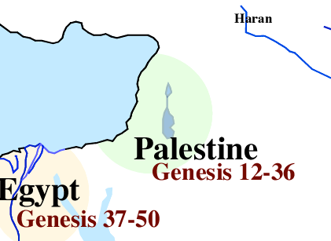
Jacob and Joseph’s Travels
2:4-4:26 The Generations of Heaven and Earth
5:1-6:8 The Generations of Adam
6:9-9:29 The Generations of Noah
10:1-11:19 The Generations of Noah’s Sons
11:10-26 The Generations of Shem
11:27-25:11 The Generations of Terah
25:12-18 The Generations of Ishmael
25:19-35:29 The Generations of Isaac
36:1-37:1 The Generations of Esau
37:2-50:26 The Generations of Jacob: “These are the records of the generations of Jacob. Joseph,..” (Gen 37:2).
Jacob
Jacob returns home
Joseph

Slide 3

The Difficulties of Our Lives
Joseph, like Jacob, met great periods of trouble.
Explain how the difficulties Joseph and Jacob met were different in character.
Jacob’s life shows the need of a Messiah.
Joseph’s life provides a picture of the Messiah.
Notes:
Joseph, like Jacob, met great periods of trouble for his faith to be proved and tested. Jacob suffered extra because of his sin but Joseph to prove his character through suffering, but both had the same direction of equipped for service. Jacob had angel experiences to bring hope and guidance but Joseph had to look at his circumstances to see God’s blessings (though he had gift of dreams).

Slide 4

Joseph’s Testings
"He sent a man before them, Joseph, [who] was sold as a slave. ¹⁸They afflicted his feet with fetters, He himself was laid in irons; ¹⁹Until the time that his word came to pass, the word of the LORD tested him" (Psalm 105:17-19).
1) Test of Trust => betrayal & abandonment (Gen 37)
2) Test of Pride => extreme ups and downs (Gen 39-41)
3) Test of Compassion => opportunity for revenge (42-50)
Notes:
The word for ‘test’ means to refine, purge such as in melting metals to get impurities out from them.

Slide 5

Joseph’s Testings
1) Test of Trust => Betrayal & Abandonment (Genesis 37)
How does Joseph personally bear the fact that his brothers sold him and almost killed him?
Do you trust your past life to the Lord along with all the difficulties experienced? “Rejoice in the Lord always!” (Phil 4:4)

Slide 6
Joseph’s Testings
2) Test of Pride => Extreme Ups and Downs (Genesis 39-41)
How does the ‘blessed’ Joseph deal with successive successes and injustice?
How do you respond when you should be treated nicely but find yourself being treated terribly wrong?

Slide 7
Joseph’s Testings
3) Test of Compassion => Opportunity for Revenge (Genesis 42-50)
How does the powerful Joseph treat his brothers before and after his father dies?
Forgiving and feeding (42-47)
Forgiving and blessing after his father died (48-50)
How can God’s grace help you conquer the corruption of power that comes with success and instead persistently carry out acts of kindness?
Notes:
Forgiving and feeding his brothers (Genesis 42-47)
Forgiving and blessing his brothers after his father died (Genesis 48-50)

Slide 8
Why is Joseph’s section (37-50) so long?
Captivating
These chapters have all the power of a tremendously stirring movie: Violence. Seduction. Extremism. Compassion. Greed. Jealousy.
Historical
In order to clearly set the stage for redemption they had to go into the land to be rescued out of it, otherwise there would be no Exodus.
Gracious
To illustrate the extremes of God’s grace and the power of forgiveness that God willingly gives to His undeserving people through Jesus.

Slide 9
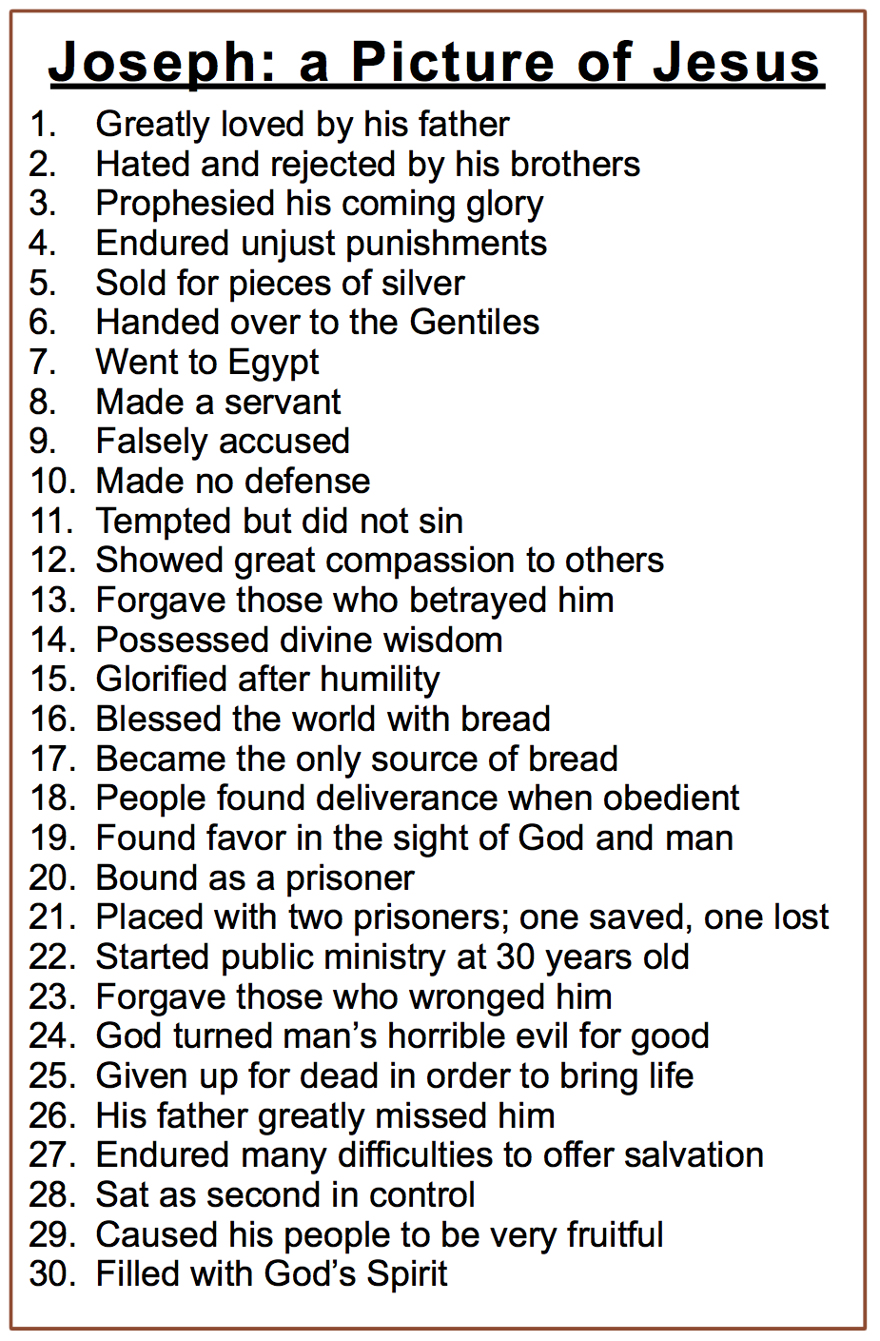
Why is Genesis 37-50 so long?
Faithful
God demonstrates His faithfulness both by disciplining His own and fulfilling given dreams and covenants.
Pure
God shows His willingness to greatly bless those who live with integrity before God and man.
Prophetical
Joseph is a type of Jesus: betrayed by brothers, sunken down before raised up, forgives those who hurt him, etc. (chart).

Slide 10

1) Responding to Abusers (Genesis 45:4-5)
“Then Joseph said to his brothers, “Please come closer to me.” And they came closer. And he said, “I am your brother Joseph, whom you sold into Egypt. And now do not be grieved or angry with yourselves, because you sold me here; for God sent me before you to preserve life” (Gen 45:4-5).
Joseph leaks out the secret
Joseph withholds revenge
Joseph sends signs of genuine peace by mentioning God’s greater purpose
Freely forgiving is forgiving even if they do not ask.

Slide 11
2) Lessons From the Past (Genesis 45:26-27)
“And they told him, saying, “Joseph is still alive, and indeed he is ruler over all the land of Egypt.” But he was stunned, for he did not believe them. When they told him all the words of Joseph that he had spoken to them, and when he saw the wagons that Joseph had sent to carry him, the spirit of their father Jacob revived” (Genesis 45:26-27).
Jacob was incredulous until he saw the wagons
Jacob finally learned the pain of deceit
Some memories are never forgotten

Slide 12
3) Work Through Disappointment (Genesis 46:1-4)
“So Israel set out with all that he had, and came to Beersheba, and offered sacrifices to the God of his father Isaac. And God spoke to Israel in visions of the night and said, “Jacob, Jacob.” And he said, “Here I am.” And He said, “I am God, the God of your father; do not be afraid to go down to Egypt, for I will make you a great nation there. “I will go down with you to Egypt, and I will also surely bring you up again; and Joseph will close your eyes” (Gen 46:1-4).
Israel (Jacob) returned to God
Beersheba was Abraham’s worship place
Why does it take so long to return to God?
God was always close by, and Jacob could have trusted God with Joseph and God’s promises.

Slide 13
4) Seek God’s Best (Genesis 47:10-11)
“And Jacob blessed Pharaoh, and went out from his presence. So Joseph settled his father and his brothers, and gave them a possession in the land of Egypt, in the best of the land, in the land of Rameses, as Pharaoh had ordered” (Genesis 47:10-11).
Jacob blessed Pharaoh; the greater blesses the lesser
God’s purposes for Jacob fulfilled by Joseph
“Best of land”: Israel became protected and fruitful
Israelites remained free while the Egyptians became serfs, losing all their property.
“Israel also came into Egypt; Thus Jacob sojourned in the land of Ham. 24 And He caused His people to be very fruitful, And made them stronger than their adversaries” (Ps 105:23-24).

Slide 14
5) Living Under God’s Wisdom (Genesis 50:20)
“And as for you, you meant evil against me, but God meant it for good in order to bring about this present result, to preserve many people alive” (Gen 50:20).
You could have taken advantage of those who hurt you.
God’s good providence includes even man’s malice (Rom 8:28; e.g., Jesus’ suffering)
Joseph placed himself under God’s leadership.
Joseph could see that all the evil and good were under God’s sovereign control.
Joseph saw how God brought good from it all.

Slide 15
6) The Breakthrough of Kindness (Genesis 50:21)
“So therefore, do not be afraid; I will provide for you and your little ones. So he comforted them and spoke kindly to them” (Gen 50:21).
Joseph could have ignored them but showed ongoing kindness.
The opportunity to show kindness to the mean-spirited is always before us (Luke 6:27-28).
Friendly forgiving enables us to focus on the kindness that we need to exercise. Instead of being caught up in revenge, we compassionately think about their needs and in some little way attempt to fulfill them.
Notes:
Luke 6:27* ¶ “But I say to you who hear, love your enemies, do good to those who hate you,
28* bless those who curse you, pray for those who mistreat you.

Slide 16
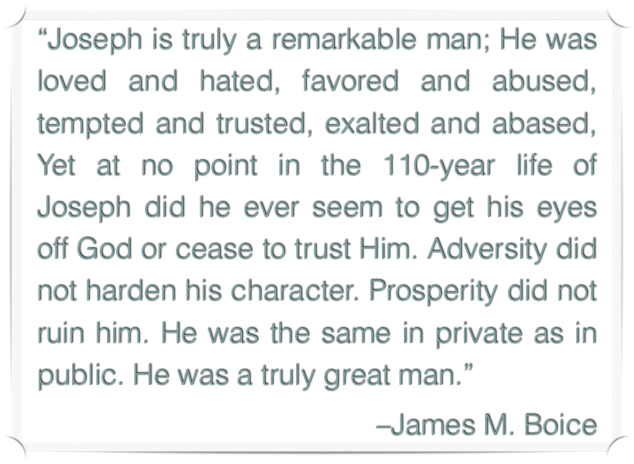
Summary Thoughts for Genesis 45-50

Slide 17

Discussion Questions
Why is it so easy to get bitter and hardened than to forgive? Do you have a hard time forgiving others?
Can you accept how God can work through your life or another, even though it might include evil acts?

Slide 18
The Book of Foundations
GENESIS
45-50
Resilience in Difficult Times
Joseph’s Life at the Best
NASB
Paul J. Bucknell

