Slide 1
Fostering Spiritual Growth in the Church
Fostering Spiritual Growth in the Church
Oakland International Fellowship
bit.ly/SG-ST
Notes:
Fostering Spiritual Growth in the Church, is all about reviving the people of God, initiating spiritual growth. We must not think this as the work of man. Revival is all about the work of God. Being made into the image of Christ is Christ living Himself in our lives through the Holy Spirit. We are fools if we use humans means to accomplish God’s work. On the other hand, we must remember that we must pay very close attention to how we can get God to work. Remember this. God is powerfully working in His people’s lives. This is the whole meaning behind the life-giving essence of The Flow. The most important part is getting in a place where God is freely able to move and work. Think of a river. Things can block a river from going a certain direction.
So I want to begin this series by focusing on how we can make ourselves fully open to the Spirit of God. This can be a dangerous topic as there are many thoughts on spirituality out there. The best is for us to go back to Jesus who was full of the Holy Spirit. We can learn much from His life on how to live in close communion with God. Interestingly, we will go to a prophesy about Christ in Isaiah 50:4-9 to study the person of Christ. We begin and end our study with Jesus Christ.
The Flow
Establishing a Growth Pattern in the Church
1 Theology of the Flow
#2 The Flow in the whole of scriptures
#3 Level #1 - New believers (the child)
#4 Level #2 - Maturing disciple (young men) & mobilize coworkers
#5 Level #3 - Servant Leaders (within)
#6 Using the Flow with newcomers (house visitation)
#7 Full-time or tent maker (bivocational)
#8 Use as discipleship material
#1 Theology of the Flow (Eph 4 and 1 John 2:12-14)
Popular Purpose: The excitement of seeing how God can help me and others grow in the church.
Teaching Purpose: Excite people as to what God wants to do in the church through training by showing them the theological basis and nature of The Flow.
The energy within: Excitement to see what God is doing and working with Him. How leaders work and what God expects of all His people. Seeing the mobilization of those in the church. God treasures the use of every bodies’ gifts. He wants to reward them.
: Growth in our lives: Godly character - living like Jesus; ministry skills ( serving like Jesus) and biblical knowledge - knowing like Jesus (growth comes by seeing how God works through the Word in your life). Christlike character, service (ministry), and knowledge.
Excitement, design, necessity and context (church Eph 4) of growth.

Slide 2
Fostering Spiritual Growth in the Church
3 Stages of Spiritual Life
0
0
Is 54
Is 54
2 Lessons:
Being like Jesus (Isaiah 54:4-9)
1
1
2
2
2
1 Lesson:
Vision of Church
3
3
Church
6-8 Lessons:
Topical Analysis of Christian Growth
Growth
Growth
Growth
A) The Pattern of Spiritual Growth
B) The Application of Spiritual Growth
A) The Pattern of Spiritual Growth
B) The Application of Spiritual Growth
Growth
Growth
Growth
Growth
Notes:
Establishing a Growth Pattern in the Church
1 Theology of the Flow
#2 The Flow in the whole of scriptures
#3 Level #1 - New believers (the child)
#4 Level #2 - Maturing disciple (young men) & mobilize coworkers
#5 Level #3 - Servant Leaders (within)
#6 Using the Flow with newcomers (house visitation)
#7 Full-time or tent maker (bivocational)
#8 Use as discipleship material
#1 Theology of the Flow (Eph 4 and 1 John 2:12-14)
Popular Purpose: The excitement of seeing how God can help me and others grow in the church.
Teaching Purpose: Excite people as to what God wants to do in the church through training by showing them the theological basis and nature of The Flow.
The energy within: Excitement to see what God is doing and working with Him. How leaders work and what God expects of all His people. Seeing the mobilization of those in the church. God treasures the use of every bodies’ gifts. He wants to reward them.
: Growth in our lives: Godly character - living like Jesus; ministry skills ( serving like Jesus) and biblical knowledge - knowing like Jesus (growth comes by seeing how God works through the Word in your life). Christlike character, service (ministry), and knowledge.
Excitement, design, necessity and context (church Eph 4) of growth.

Slide 3
1
Embracing God’s Purposes for the Church
1 Peter 1:23-25
Fostering Spiritual Growth in the Church
Paul J. Bucknell
Notes:
This series, Fostering Spiritual Growth in the Church, is all about reviving the people of God, initiating spiritual growth. We must not think this as the work of man. Revival is all about the work of God. We are fools if we use humans means to accomplish God’s work. On the other hand, we must remember that we pay very close attention to how we can get God to work. Remember this. God is at work. This is the whole meaning behind the Flow. The most important part is getting in a place where God is freely able to move and work. Think of a river. Things can block a river from going a certain direction.
So I want to begin this series by focusing on how we can make ourselves fully open to the Spirit of God. This can be a dangerous topic as there are many thoughts on spirituality out there. The best is for us to go back to Jesus who was full of the Holy Spirit. We can learn much from His life on how to live in close communion with God. Interestingly, we will go to a prophesy about Christ in Isaiah 50:4-9 to study the person of Christ. We begin and end our study with Jesus Christ.
The Flow
Establishing a Growth Pattern in the Church
1 Theology of the Flow
#2 The Flow in the whole of scriptures
#3 Level #1 - New believers (the child)
#4 Level #2 - Maturing disciple (young men) & mobilize coworkers
#5 Level #3 - Servant Leaders (within)
#6 Using the Flow with newcomers (house visitation)
#7 Full-time or tent maker (bivocational)
#8 Use as discipleship material
#1 Theology of the Flow (Eph 4 and 1 John 2:12-14)
Popular Purpose: The excitement of seeing how God can help me and others grow in the church.
Teaching Purpose: Excite people as to what God wants to do in the church through training by showing them the theological basis and nature of The Flow.
The energy within: Excitement to see what God is doing and working with Him. How leaders work and what God expects of all His people. Seeing the mobilization of those in the church. God treasures the use of every bodies’ gifts. He wants to reward them.
: Growth in our lives: Godly character - living like Jesus; ministry skills ( serving like Jesus) and biblical knowledge - knowing like Jesus (growth comes by seeing how God works through the Word in your life). Christlike character, service (ministry), and knowledge.
Excitement, design, necessity and context (church Eph 4) of growth.

Slide 4
No spiritual map
Here I am
So I stay where I am (stagnant)
me
Or leave the Lord for another
(worldliness)
Confused
No goals
No life direction
Notes:
Believers often confuse devotion with attending worship, and though it does not exclude that, it goes much deeper–often unobserved by our eyes and therefore easily ignored. When we equate religious acts with our Christian lives, we then have no real spiritual direction in our lives, merely going to church each week. Many are distracted and go off into the world where things are happening! but actually, much is happening in the Christian life if we would only see it. This work is the powerful work of God in our personal lives and it is not only exciting but enriching!

Slide 5
The Flow
A power
A direction
A force
God’s life-giving spiritual presence

Slide 6
Missions (the outward expansion)
Spiritual life (the inner transformation)
Notes:
Missions and its worldwide evangelism thrust is the more well-known strong outward and expansive thrust of God, but there is also an inner transformative thrust, penetrating deeper into our lives affecting our love for God and others. The outward should come from the inner, and though the mission effort often starts that way, the development of the inner life in the presence of God is lost in the shuffle to accomplish the more outward and visible expansion of God’s kingdom. Jesus wonderfully kept the balance of the two thrusts of the Holy Spirit’s work.

Slide 7
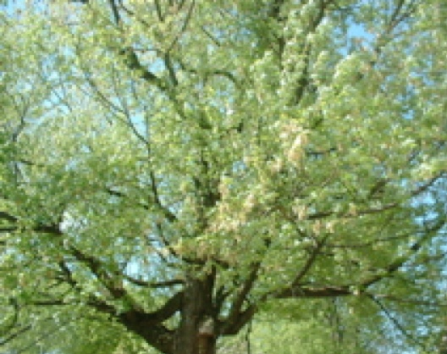
The Potential of a Seed
Notes:
The Lord has given us simple explanations for complicated questions. He often gives us visual pictures for those spiritual truths that we cannot see. He does this for a number of spiritual truths. Spiritual growth is one of them. Let’s read a Bible passage together and see what truth is being revealed.

Slide 8
1 Peter 1:23-25 Born Again
“For you have been born again not of seed which is perishable but imperishable, that is, through the living and abiding word of God. For, “All flesh is like grass, and all its glory like the flower of grass. The grass withers, and the flower falls off, but the Word of the Lord abides forever.” And this is the word which was preached to you.” (1 Peter 1:23-25).
• New life
• Seed=Word of God
• Living
Notes:
Spiritual Life Begins!
There are two key things, if we want to be simplistic, to know about spiritual growth to be effective in the ministry
(1) how one gains spiritual life (evangelism). I am glad that this knowledge is becoming more common among Christians. I am not so sure that God’s people are so convinced on
(2) how one grows in one’s spiritual life (Sanctification).

Slide 9
Signs of life & death
Alive | Dead
Breathing | Not breathing
Growing | Does not grow
Cry | Does not cry
Hungry | Is not hungry
“Bring forth fruit in keeping with repentance! (Mat 3:8).
Notes:
This is the signs of new life. If one does not observe them in the person with whom he is speaking, he should go back to John 1:12 and further discuss the new life in Christ.

Slide 10
What are the signs of spiritual life and death?
??? | ???
??? | ???
??? | ???
??? | ???
??? | ???
??? | ???
??? | ???
Notes:
What are the signs of spiritual life? The clearer we can identify them, the greater our faith will be encouraged. We find that God has started a work in us, the seed of spiritual life has begun.

Slide 11
Spiritual Life Begins!
Beloved, let us love one another, for love is from God; and everyone who loves is born of God and knows God. (1 John 4:7)
Gains faith - Evangelism (John 1:12-13)
Grows in faith - Sanctification (Phil 1:6)
Spiritual life is that persistent force of God that drives us toward God, like light for a plant.
Notes:
Spiritual Life Begins!
There are two key things, if we want to be simplistic, to know about spiritual growth to be effective in the ministry
(1) how one gains spiritual life (evangelism). I am glad that this knowledge is becoming more common among Christians. I am not so sure that God’s people are so convinced on
(2) how one grows in one’s spiritual life (Sanctification).

Slide 12
The Scriptures and Spiritual Life
“But as many as received Him, to them He gave the right to become children of God, even to those who believe in His name, who were born not of blood, nor of the will of the flesh, nor of the will of man, but of God” (John 1:12-13).
Spiritual life starts with being born of God. Tradition and ritual or even self-determination do not bring life.
“Jesus answered, ‘Truly, truly, I say to you, unless one is born of water and the Spirit, he cannot enter into the kingdom of God. That which is born of the flesh is flesh, and that which is born of the Spirit is spirit’” (John 3:5-6).
This spiritual life begins with the Spirit of God’s work!
Jesus and scripture writers used analogies including the term ‘life’ to help us grasp and understand important truths for our Christian lives.
Notes:
Seed, growth, and life are three such analogies.

Slide 13
Scriptures and Spiritual Life
“The Spirit gives life” (2 Corinthians 3:6).
The Spirit of God begins our spiritual lives and continues to empower us to affect our whole beings.
“But whoever drinks of the water that I shall give him shall never thirst; but the water that I shall give him shall become in him a well of water springing up to eternal life” (John 4:14).
Spiritual life will abound and go on into eternity.
“I came that they might have life, and might have it abundantly” (John 10:10).
Spiritual life is of such design to grow and be magnificent!
Notes:
Spiritual Life Begins!
There are two key things, if we want to be simplistic, to know about spiritual growth to be effective in the ministry
(1) how one gains spiritual life (evangelism). I am glad that this knowledge is becoming more common among Christians. I am not so sure that God’s people are so convinced on
(2) how one grows in one’s spiritual life (Sanctification).

Slide 14
The seed presents a great vision for our spiritual lives
“16 That He would grant you, according to the riches of His glory, to be strengthened with power through His Spirit in the inner man; 17 so that Christ may dwell in your hearts through faith; and that you, being rooted and grounded in love, 18 may be able to comprehend with all the saints what is the breadth and length and height and depth, 19 and to know the love of Christ which surpasses knowledge, that you may be filled up to all the fulness of God” (Eph 3:16-19).
Notes:
Where does spiritual life end up? What are the signs of its fullness?
Do you see the seeds there? Each of you are as a seed to grow into the full potential of God’s purpose in you.

Slide 15
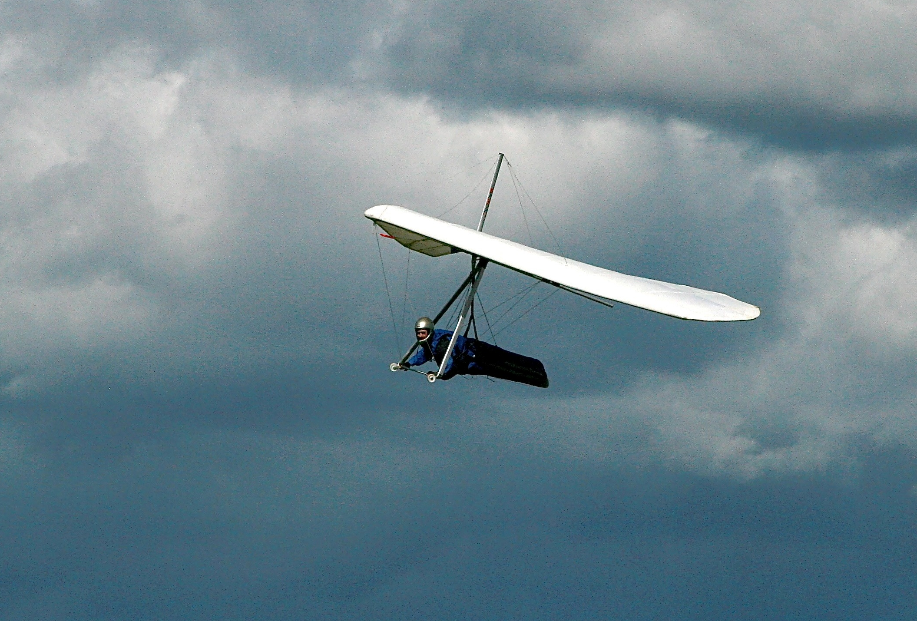
The Flow’s Stream
“And it will come about in the last days that the mountain of the house of the LORD will be established as the chief of the mountains. It will be raised above the hills, and the peoples will stream to it” (Micah 4:1-2; Is 2:1-3).
God’s life pours out as a constant stream in the lives of His people.
Notes:
Where does spiritual life end up? What are the signs of its fullness?
Life is a frame on which all the other truths can hang.
Theology classes include teaching on holiness and sanctification (very important topics no doubt), but they are presented more in terms of concepts rather than the practical steps to spiritual living. So much so, that although many can describe what sanctification is, few can explain how spiritual life can be gained.

Slide 16
1
Embracing God’s Purposes for the Church
1 Peter 1:23-25
Fostering Spiritual Growth in the Church
Paul J. Bucknell
Notes:
The Heart of Discipleship Isaiah 50:4 (part 1/2)
This series, Fostering Spiritual Growth in the Church, is all about reviving the people of God, initiating spiritual growth. We must not think this as the work of man. Revival is all about the work of God. We are fools if we use humans means to accomplish God’s work. On the other hand, we must remember that we pay very close attention to how we can get God to work. Remember this. God is at work. This is the whole meaning behind the Flow. The most important part is getting in a place where God is freely able to move and work. Think of a river. Things can block a river from going a certain direction.
So I want to begin this series by focusing on how we can make ourselves fully open to the Spirit of God. This can be a dangerous topic as there are many thoughts on spirituality out there. The best is for us to go back to Jesus who was full of the Holy Spirit. We can learn much from His life on how to live in close communion with God. Interestingly, we will go to a prophesy about Christ in Isaiah 50:4-9 to study the person of Christ. We begin and end our study with Jesus Christ.
The Flow
Establishing a Growth Pattern in the Church
1 Theology of the Flow
#2 The Flow in the whole of scriptures
#3 Level #1 - New believers (the child)
#4 Level #2 - Maturing disciple (young men) & mobilize coworkers
#5 Level #3 - Servant Leaders (within)
#6 Using the Flow with newcomers (house visitation)
#7 Full-time or tent maker (bivocational)
#8 Use as discipleship material
#1 Theology of the Flow (Eph 4 and 1 John 2:12-14)
Popular Purpose: The excitement of seeing how God can help me and others grow in the church.
Teaching Purpose: Excite people as to what God wants to do in the church through training by showing them the theological basis and nature of The Flow.
The energy within: Excitement to see what God is doing and working with Him. How leaders work and what God expects of all His people. Seeing the mobilization of those in the church. God treasures the use of every bodies’ gifts. He wants to reward them.
: Growth in our lives: Godly character - living like Jesus; ministry skills ( serving like Jesus) and biblical knowledge - knowing like Jesus (growth comes by seeing how God works through the Word in your life). Christlike character, service (ministry), and knowledge.
Excitement, design, necessity and context (church Eph 4) of growth.

