Slide 1
4
The Heart of Discipleship
Isaiah 50:5-9
Fostering Spiritual Growth in the Church
Paul J. Bucknell
Notes:
The Heart of Discipleship Isaiah 50:4 (part 1/2)
This series, Initiating Spiritual Growth in the Church, is all about reviving the people of God, initiating spiritual growth. We must not think this is the work of man. Revival is all about the work of God. We are fools if we use humans means to accomplish God’s work. On the other hand, we must remember that we pay very close attention to how we can get God to work. Remember this. God is at work. This is the whole meaning behind the Flow. The most important part is getting in a place where God is freely able to move and work. Think of a river. Things can block a river from going a certain direction.
So I want to begin this series by focusing on how we can make ourselves fully open to the Spirit of God. This can be a dangerous topic as there are many thoughts on spirituality out there. The best is for us to go back to Jesus who was full of the Holy Spirit. We can learn much from His life on how to live in close communion with God. Interestingly, we will go to a prophesy about Christ in Isaiah 50:4-9 to study the person of Christ. We begin and end our study with Jesus Christ.
The Flow
Establishing a Growth Pattern in the Church
1 Theology of the Flow
#2 The Flow in the whole of scriptures
#3 Level #1 - New believers (the child)
#4 Level #2 - Maturing disciple (young men) & mobilize coworkers
#5 Level #3 - Servant Leaders (within)
#6 Using the Flow with newcomers (house visitation)
#7 Full-time or tent maker (bivocational)
#8 Use as discipleship material
#1 Theology of the Flow (Eph 4 and 1 John 2:12-14)
Popular Purpose: The excitement of seeing how God can help me and others grow in the church.
Teaching Purpose: Excite people as to what God wants to do in the church through training by showing them the theological basis and nature of The Flow.
The energy within: Excitement to see what God is doing and working with Him. How leaders work and what God expects of all His people. Seeing the mobilization of those in the church. God treasures the use of every bodies’ gifts. He wants to reward them.
: Growth in our lives: Godly character - living like Jesus; ministry skills ( serving like Jesus) and biblical knowledge - knowing like Jesus (growth comes by seeing how God works through the Word in your life). Christlike character, service (ministry), and knowledge.
Excitement, design, necessity and context (church Eph 4) of growth.

Slide 2
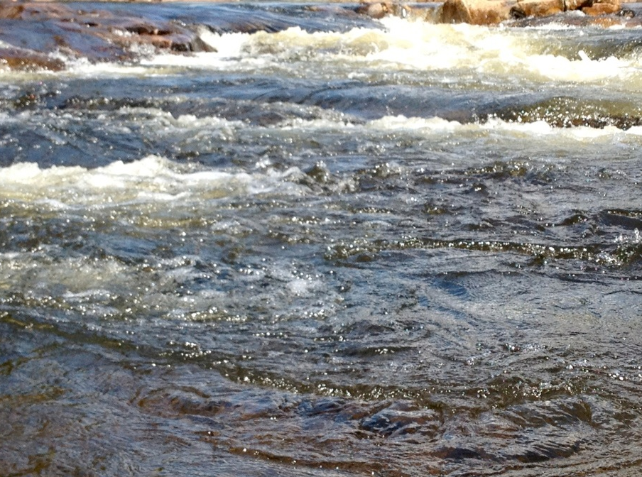
Fostering Spiritual Growth in the Church
3 Stages of Spiritual Life
0
0
Is 54
Is 54
2 Lessons:
Being like Jesus (Isaiah 54:4-9)
1
1
2
2
2
1 Lesson:
Vision of Church
3
3
Church
Growth
A) The Pattern of Spiritual Growth
B) The Application of Spiritual Growth
6-8 Lessons:
Topical Analysis of Christian Growth
A) The Pattern of Spiritual Growth
B) The Application of Spiritual Growth
Growth
Growth
Growth
Growth
Growth
Growth
Notes:
Our purpose for these two Isaiah 54 lessens is to connect what is happening in us with our spiritual lives to Jesus’ own life. The Spirit of Jesus, the Holy Spirit, lives in us and therefore as we follow His pattern, then we will maximize our spiritual lives. The counter point is equally valid. If we discourage the life of Jesus in our lives, then we will not feel His strength and direction in our lives.
Establishing a Growth Pattern in the Church
1 Theology of the Flow
#2 The Flow in the whole of scriptures
#3 Level #1 - New believers (the child)
#4 Level #2 - Maturing disciple (young men) & mobilize coworkers
#5 Level #3 - Servant Leaders (within)
#6 Using the Flow with newcomers (house visitation)
#7 Full-time or tent maker (bivocational)
#8 Use as discipleship material
#1 Theology of the Flow (Eph 4 and 1 John 2:12-14)
Popular Purpose: The excitement of seeing how God can help me and others grow in the church.
Teaching Purpose: Excite people as to what God wants to do in the church through training by showing them the theological basis and nature of The Flow.
The energy within: Excitement to see what God is doing and working with Him. How leaders work and what God expects of all His people. Seeing the mobilization of those in the church. God treasures the use of every bodies’ gifts. He wants to reward them.
: Growth in our lives: Godly character - living like Jesus; ministry skills ( serving like Jesus) and biblical knowledge - knowing like Jesus (growth comes by seeing how God works through the Word in your life). Christlike character, service (ministry), and knowledge.
Excitement, design, necessity and context (church Eph 4) of growth.

Slide 3
5 Points to be a Good Discipler
A.) The Training of the Disciple A disciple is a learner.
B.) The Purpose of the Disciple A disciple serves others.
C.) The Discipline of the Disciple A disciple regularly communes with God.
D.) The Attention of the Disciple A disciple attentively listens and obeys God.
E.) The Resolve of the Disciple A disciple withstands difficulties to please His Master.
Notes:
4 Points to be a Good Discipler
A.) The Training of the Disciple: A disciple is a learner.
B.) The Purpose of the Disciple: A disciple serves others.
C.) The Discipline of the Disciple: A disciple regularly communes with God.
D.) The Attention of the Disciple: A disciple attentively listens and obeys God.
E.) The Resolve of the Disciple:
A disciple withstands difficulties to please His Master.
Each point is from one section of Isaiah 50:4.

Slide 4
Lived with our Limitations
“Have this attitude in yourselves which was also in Christ Jesus, who, although He existed in the form of God, did not regard equality with God a thing to be grasped, but emptied Himself, taking the form of a bond-servant, and being made in the likeness of men” (Philippians 2:5-7).
Notes:
Lived with our Limitations
One last thing that is critical if we are to rightly learn from Jesus’ example. He put His powers aside when He came to earth (Philippians 2:5-7).
1) He gave us His divine prerogatives.
2) Jesus was made in likeness of men (if we summed up what that practically meant).
3) And we are to have this same attitude.

Slide 5
E.) The Resolve of a Disciple (Is 50:5-9)
A disciple withstands difficulties to please His Master
1. Our Heart Commitment (50:5)
2. Our Choice to Serve (50:6)
3. Our Trust in God (50:7)
4. Our Victory over Bitterness (50:8-9)
Notes:
E.) The Resolve of the Disciple (Isaiah 50:5-9)
“The Lord GOD has opened My ear; And I was not disobedient, Nor did I turn back. (6) I gave My back to those who strike Me, And My cheeks to those who pluck out the beard; I did not cover My face from humiliation and spitting. (7) For the Lord GOD helps Me, Therefore, I am not disgraced; Therefore, I have set My face like flint, And I know that I shall not be ashamed. (8) He who vindicates Me is near; Who will contend with Me? Let us stand up to each other; Who has a case against Me? Let him draw near to Me. (9) Behold, the Lord GOD helps Me; Who is he who condemns Me? Behold, they will all wear out like a garment; The moth will eat them.” Isaiah 50:5-9.
Although we could stop with verse 4, the Servant’s Song continues on until verse 9. We would prefer to ignore these verses. But the fact is that they need to be stated and accepted. Christians will face difficult times. It is good enough for the disciple to say that he will listen and obey the Lord. But having said that, sometimes one does not fully know what the cost of that statement might be. We will look at four keys to properly endure difficult times.
1. Our Heart Commitment (50:5)
“The Lord GOD has opened My ear; And I was not disobedient, Nor did I turn back.”
Isaiah 50:5 speaks about opening the ear while 50:4 speaks about awakening the ear. What is the difference? Awakening speaks about bringing out of sleep while opening shows the need for an operation. Ears don’t close like eyes. Something serious has to be done. We might need to think of this opening of the ear as an operation. Yes, we know the ears are made to be open. They are inherently open. But I think we all know that by opening of the ear, it means that there is an operation of the heart. The word to awaken in verse 4 means to rouse or call to attention. But here it refers to taking something that is closed and opening it. Our ear and heart is not just sleeping but closed. We need to admit to the fact that none of us like suffering and pain. Something in our hearts needs to change to bring us to the point where we can face persecution.
He Himself, you see, had to first go through the stage of committing Himself to do whatever the Father wants. It is nice to hear that we should obey things that we like to hear about. For instance, we like to think of starting a church and being a pastor. We like the idea of helping others in their needs. We need to be able to say as Jesus did, “The Lord GOD has opened My ear; And I was not disobedient, Nor did I turn back” (Isaiah 50:5).
Let’s think of the Lord Jesus for a moment. Jesus could have had a wonderful ministry if He just avoided Jerusalem. He knew it was there in that city that He would face rejection. For that matter, He could have continued the proclamation of the kingdom of God in Galilee or even in Samaria or among the Gentiles. Surely, the people would flock to hear Him speak and see the miracles that He did. But we know that this would avoid a key part of the ministry that the Father had for the Son. Jesus came out and stated this very clearly.
“And he who does not take his cross and follow after Me is not worthy of Me.” Matthew 10:38.
“Then Jesus said to His disciples, “If anyone wishes to come after Me, let him deny himself, and take up his cross, and follow Me.” Matthew 16:24.
“And He was saying to them all, “If anyone wishes to come after Me, let him deny himself, and take up his cross daily, and follow Me.” Luke 9:23.
Perhaps we can say it this way. “God Yahweh broke the door of resistance that would hold back a full and complete dedication to doing whatever the Lord would want.” This is the evident meaning of this verse, for the disciple immediately went on and said, “And I was not disobedient, nor did I turn back.”
There is no doubt that each of us must make this step in our discipleship if our discipleship is worth anything. I realize that without persecution, it might be easy to hold to a superficial kind of discipleship. We say we are fully committed, but when it gets difficult, we turn back. If we are not fully committed, our service is half-hearted.
“He who is a hireling, and not a shepherd, who is not the owner of the sheep, beholds the wolf coming, and leaves the sheep, and flees, and the wolf snatches them, and scatters them” John 10:12.
I recently was traveling with some good Christian brothers to a distant city for training pastors. The conversation turned around to how careful they need to be in the city where we were going. There were many Hindu activists. The key brother said, “Yea, I didn’t want to tell you earlier.” He was afraid that I might not come. After all, this was the place that a missionary named Stanley from Australia was torched to death in his car with his two sons. Fortunately, I already knew of the sensitivity of the mission. But God had to open my heart and make me willing to go where I might face danger.
We need to realize that the Lord is training us while Satan is trying to detour us. Although for Christ, He could say that God had opened his ears. Perhaps, we will need to have several special training situations that make us to the point where we are usable.
I have recently read through the Old Testament historical books, starting with Judges up to 2 Chronicles. I can’t but be troubled by how many times there is a man who starts right but does not end right. King Jehoshaphat in 2 Chronicles 20 had won one of the most wonderful battles in the history of the earth. He sent his musicians ahead of the army. When they started to play, the enemy turned on themselves and destroyed themselves. But it is this same king who later on allied himself with Ahaziah king of Israel. The scriptures are clear when it says, “He acted wickedly in so doing” (2 Chronicles 20:35) and forced God to judge him. Jehoshaphat turned back at the end. We need to focus on being a disciple all our lives. Never get too comfortable. Never think all is going well. This is a battle, and the evil one wants to cause us to come up short.
2. Our Choice to Serve (Isaiah 50:6)
Isaiah 50:6 tells us how the Servant, the faithful disciple, did three amazing things. Today, we might look as if He was being victimized. Perhaps, the others thought they were in control. But this is not what we see here at all. Notice the way it is written.
(1) “I gave My back to those who strike Me.”
(2) “I gave … My cheeks to those who pluck out the beard.”
(3) ”I did not cover My face from humiliation and spitting.”
What do we find here? The servant realizes that the Lord God is in control. Any difficult times that His servants go through are not accidental. They are, first of all, fully in God’s hand. They, therefore, become special requests for His servants to bear. It becomes for us, then, a choice to obey Him. Actually, the choice is made ahead of time. The Lord prepares our heart. We already spoke of that. But in time, we see that there are special requests. Let us look at these three requests God Yahweh had for Christ.
He gave His back to those who struck Him. We remember the floggings before His death. This was a serious beating that one is barely able to live with. He couldn’t even carry the wooden cross and needed someone else to carry it. But note, this was not Pilate’s decision. Nor was it the Jews decision. It was primarily Christ’s. He chose it because He chose to do His Father’s will.
He also gave his cheeks to those who plucked out his beard. This indeed is a most humbling and painful deed. But again, it wasn’t His tormentors’ initial act but Christ’s. We remember what Jesus said to Pilate.
“Pilate therefore said to Him, “You do not speak to me? Do You not know that I have authority to release You, and I have authority to crucify You?” Jesus answered, “You would have no authority over Me, unless it had been given you from above; for this reason he who delivered Me up to you has the greater sin.” (John 19:10-11).
Thirdly, we find Jesus did not cover His face from humiliation and spitting. He did this for us. This was the One without sin who became sin for us. How we deal with people’s humiliating deeds is also a decision we need to make. He was, after all, doing what His Master wanted. As long as His Father asked Him to do something, then it was a morally good thing to do. He was doing well. Even though from man’s perspective there was terrible shame to it all. He was doing it to please His Father in heaven, and therefore, holds that privilege with great honor and prestige. He did not cover His face with shame.
Application
Now we know that the evil one will often come and try to torment us with thoughts, “He doesn’t love you. See!” Or “You have wasted your life and effort.” Persecution and trials are times that the evil one often comes and tries to persuade us to have an unbiblical perspective. Satan wants us to doubt God’s overall good will. We merely need to trust Him and like Christ, we can be in the very presence of God even though it might be a place that man despises. You are not alone when you suffer. Brothers and sisters around the world suffer with you. But remember, you are in God’s glorious presence. There is no shame in obeying the Lord. If He appoints difficult times for you, then you will need to go through them. He has carefully prepared the works we are to do (Ephesians 2:10). Listen to what the Lord says to the church in Smyrna.
“And to the angel of the church in Smyrna write: The first and the last, who was dead, and has come to life, says this: ‘I know your tribulation and your poverty (but you are rich), and the blasphemy by those who say they are Jews and are not, but are a synagogue of Satan. ‘Do not fear what you are about to suffer. Behold, the devil is about to cast some of you into prison, that you may be tested, and you will have tribulation ten days. Be faithful until death, and I will give you the crown of life” (Revelation 2:8-10).
The Lord has different paths for us to walk. We are merely His servants. We will do as our Master asks us. But how can we endure such ridicule and pain? This is what He next speaks of.
3. Our Trust in God (50:7)
For the Lord GOD helps Me, Therefore, I am not disgraced; Therefore, I have set My face like flint, And I know that I shall not be ashamed
The secret, of course, is not in denying the pain. No. Pain is pain. Some religions would have us believe that pain is all an illusion. But in fact, pain is very real. Seeing loved ones hurt because of our enemies trying to weaken our resolve is most difficult. There are accounts of how they kill a father’s children and wife so that he will turn back from His faith in God. What tremendous pain! The secret of having this kind of endurance is found here in verse 7. Yahweh God helps us.
Well, then, how does God help Christ? Jesus said He could have had legions of angels to rescue Him. “Or do you think that I cannot appeal to My Father, and He will at once put at My disposal more than twelve legions of angels?” (Matthew 26:53). One legion was about 6,700 men. This would have been twelve times that, nearly 80,000 in number. It would be natural to assume that the availability of these angels would become the means God would help Him, but in fact they became part of the test for Him. Jesus knew provision did not mean that it was God’s will. Jesus never asked them to keep Him from His Father’s will but to help Him do God’s will. This is what we need to remember. God’s grace is to help us to do His will.
“Let us therefore draw near with confidence to the throne of grace, that we may receive mercy and may find grace to help in time of need.” Hebrews 4:16.
There at the throne of grace, we may find all the mercy and grace to help in time of need. We need not worry whether His grace is sufficient. Paul said the same thing regarding His difficult trials.
“And He has said to me, “My grace is sufficient for you, for power is perfected in weakness.” Most gladly, therefore, I will rather boast about my weaknesses, that the power of Christ may dwell in me.” (2 Corinthians 12:9).
Application
Many of us face extra troubles because of certain weaknesses. We spend much time trying to escape those weaknesses or at least trying not to let other people know of our weaknesses. Perhaps one pastor doesn’t have the eloquence of another. He tries to copy him. He thinks that if he was a more stylish speaker, that more people would come. But his chief concern is for his own prestige and welfare. It looks like he wants more people saved, but he truly is interested in only in himself. We all have different portions of God’s grace. We can all by God’s grace conquer sin and live holy lives; this is a powerful testimony.
Paul had his weaknesses, but learned to boast in them because it meant that God would specially help him in those circumstances. If His Master had given that weakness to him, then he could be sure that the weakness were important to His service. Paul stopped struggling with the weakness and just accepted it.
The Lord has humbled me in the last six years. At times I was not sure where I would fit into ministry. We did not have a regular income. Let me talk about the later a bit. With a family of ten, some of them being older, we had a lot of expenses. I also chose to keep giving away material and helping others in ministry. The Lord has made us live on the borderline. We have no savings. If we run out of money, we just don’t spend. I might think that I could serve the Lord better if I had this or that, but He doesn’t think so. This so-called weakness is the way He has trained me. While others can talk about what they have saved for retirement, I have found that I need to boast in how He cares for us even when we have nothing. But God has used this very lifestyle to prepare me to minister to others who live by faith overseas. I can very much identify with their needs because I share similar difficult straits. I choose not to think about those who hardly work and have lots of money and delight in focusing serving my Lord with what He gives me. He has shown Himself so faithful.
When it says that the Lord will help, it means that God will give us all the grace that we need to do His will. And because of it, we will not be emotionally discouraged. We will not be disgraced. We have set our minds on serving the Lord in whatever circumstances that He brings our ways. We can be sure it is no accident.
Application
What are your present circumstances? What weaknesses do you have? Are you still wrestling with them? Are you still trying to get out of them? Slow down and begin, like Jesus, to see:
(1) that God will give you all you need to accomplish what He asks of you, and
(2) that the weakness is deliberately given to you for a certain time so that your Master in Heaven can better get His will done through your life. Praise God for your weakness. Thank Him for it. Accept it for as long as He wants. And
(3) remember the moment it is not needed, it will be gone. God is our help, and therefore we need not be ashamed.
4. Our Victory over Bitterness (Isaiah 50:8-9)
“He who vindicates Me is near; Who will contend with Me? Let us stand up to each other; Who has a case against Me? Let him draw near to Me. Behold, the Lord GOD helps Me; Who is he who condemns Me? Behold, they will all wear out like a garment; The moth will eat them.” (Isaiah 50:8-9).
It is crucial that we understand one other matter if we are to endure difficult trials. Satan wants to make us bitter. Bitterness blocks God’s grace. If we do not forgive, the Lord says He will not forgive us. “For if you forgive men for their transgressions, your heavenly Father will also forgive you. But if you do not forgive men, then your Father will not forgive your transgressions” (Matthew 6:14, 15). We are, then, at that point running on our own power. His grace helps us weather these storms. Without Him and His grace, we certainly will fall. It is precisely in these last two verses that we find the Servant’s right attitude toward those that oppress Him.
God says, “Revenge is Mine, thus says the Lord.” He basically says that we are not to take revenge into our own hands. We are to forgive others. We are not to live with a spirit of pride, on how we are better than they, or how they deserve this or that. It is true that those who hurt us or mean to hurt us do deserve judgment. But we are to entrust the matter into the Lord’s hands. Our job is to forgive. Satan wants us to step out of order and act superior to others. Jesus, in these verses, helps us to keep our perspectives straight.
First of all, we find that He sees the wrongness of the situation. He was not blind to all the unjust things done to Him. Neither do we need to pretend that the others are innocent. In fact, they had done some very wrong things. Every time something wrong is done, it becomes another court case that one day will be settled. God is just and does not look lightly at the wrong things being done. We might dismiss sin, but God never can or will. Each sin will have its day of judgment. It is okay to admit something was done wrong, even if it is against us. Do not think that evil will persist. It will not.
Secondly, we need to recognize that every wrong deed will be corrected. When we do this, we step back and admit that it is not us that will straighten things out. The temptation is for us to bring about revenge early by our own tactics. God is jealous for His justice. We cannot carry it out here on earth. We need to wait for His timing. This means that we need to forgive our enemies. Now is the day of salvation. We need to concentrate on bringing God’s love and light to this generation rather than God’s judgment.
Thirdly, we should not think that the evil that comes upon us is His judgment. It could be, of course. We might have our sexual sins and find we have some form of STD. But when we are faithfully serving the Lord, like Christ, suffering, pain or tribulation does not mean we are doing something is wrong. Instead, it often means we are doing something right!
Fourthly and lastly, God’s judgment is soon to come. It helps us stand upright when evil seems so strong. We do not depend on our own strength for this. “He who vindicates me is near.” “Behold, the Lord God helps Me.” With this confidence, he can say, “Who is he who condemns Me? Behold, they will all wear out like a garment; The moth will eat them.” Evil will be done away with. Justice will completely be cared for. Our world right now does have much injustice. God has prolonged this age of injustice so that He might show His grace to many. If He brought judgment earlier, truly we all would have perished. Earth would have been destroyed many a year ago.
Application
Are you carrying out revenge now? How do people carry out revenge? Either by plans to do harm, or by real deeds to harm another. Some people talk behind another’s back. Another lies about a person. Another might steal something from another (and of course justify himself).
Most often, people just carry in them an unforgiving spirit. This unforgiving spirit does not live out God’s love and grace and therefore as far as we are concerned is sin. Paul says it in a very special way, quoting from the Old Testament.
“Never take your own revenge, beloved, but leave room for the wrath of God, for it is written, “VENGEANCE IS MINE, I WILL REPAY,” says the Lord. “BUT IF YOUR ENEMY IS HUNGRY, FEED HIM, AND IF HE IS THIRSTY, GIVE HIM A DRINK; FOR IN SO DOING YOU WILL HEAP BURNING COALS UPON HIS HEAD.” Do not be overcome by evil, but overcome evil with good.” (Romans 12:19-21).
The only way we can pay back people is to love them. The man of God is not touched by the temptation to pay back others with evil. He is too consumed with carrying out the ways of the kingdom. Satan wants us to be offended with others so that we will withhold grace. This is his evil way. But we, deliberately walk in faith, trusting God will at the right time and right way judge those who do wrong. This allows us to keep doing good.
What if someone is talking behind your back? You are to forgive him and somehow think of a way to bring extra grace into their lives. Yes, he might laugh at you. Who cares? Remember, we are here to please our Master in heaven. We are, as Paul stated again and again, God’s slave. We are His servant.
What if someone has stolen some of your sheep (i.e. Church members) by saying something bad about you and something good about himself? Entrust the situation into the Lord’s hands. And if they are settled into his church, just talk to the Chief Shepherd. Allow Him to deal with it. But you should follow this up by somehow become a blessing to that church and brother.
What if we have ‘stolen’ these sheep? We are to humble ourselves before God and return them. What if they are the ones that tithe, and it will affect how much you get? All the more, you dare not take their money. This is stolen money.
Summary
Let us be disciples that never stop growing in communion with God. The evil one wants to break our fellowship so that bitterness arises. Forgiveness is like an oil that makes hard working parts work smoothly.
God preoccupies the life of the great servant of God. The best disciple is shaped by His master’s purpose and will. We see this here with Jesus. The Lord Yahweh became Christ’s life. Just like the hub of a wheel, every part of the wheel is constantly revolving around the center hub point. Nothing happens in its existence without reference to the axle upon which it is fixed. It might get jostled about, and it might be at every different angle. It might be clean or dirty, but it is fixed around the center point. So it was with Christ Jesus. He lived to do His Father’s will. And so it must be for us as Christ’s disciples. In Christ our lives hover about the Lord our Maker and Savior. We have no other purpose other than to live for Him and His will.
Certainly, we have no higher calling. We have no more grand opportunity than to be like Jesus our Master.

Slide 6
Isaiah 50:5-9
“The Lord GOD has opened My ear; And I was not disobedient, Nor did I turn back. (6) I gave My back to those who strike Me, And My cheeks to those who pluck out the beard; I did not cover My face from humiliation and spitting. (7) For the Lord GOD helps Me, Therefore, I am not disgraced; Therefore, I have set My face like flint, And I know that I shall not be ashamed. (8) He who vindicates Me is near; Who will contend with Me? Let us stand up to each other; Who has a case against Me? Let him draw near to Me. (9) Behold, the Lord GOD helps Me; Who is he who condemns Me? Behold, they will all wear out like a garment; The moth will eat them.” NASB
Notes:
“The Lord GOD has opened My ear; And I was not disobedient, Nor did I turn back. (6) I gave My back to those who strike Me, And My cheeks to those who pluck out the beard; I did not cover My face from humiliation and spitting. (7) For the Lord GOD helps Me, Therefore, I am not disgraced; Therefore, I have set My face like flint, And I know that I shall not be ashamed. (8) He who vindicates Me is near; Who will contend with Me? Let us stand up to each other; Who has a case against Me? Let him draw near to Me. (9) Behold, the Lord GOD helps Me; Who is he who condemns Me? Behold, they will all wear out like a garment; The moth will eat them.”

Slide 7
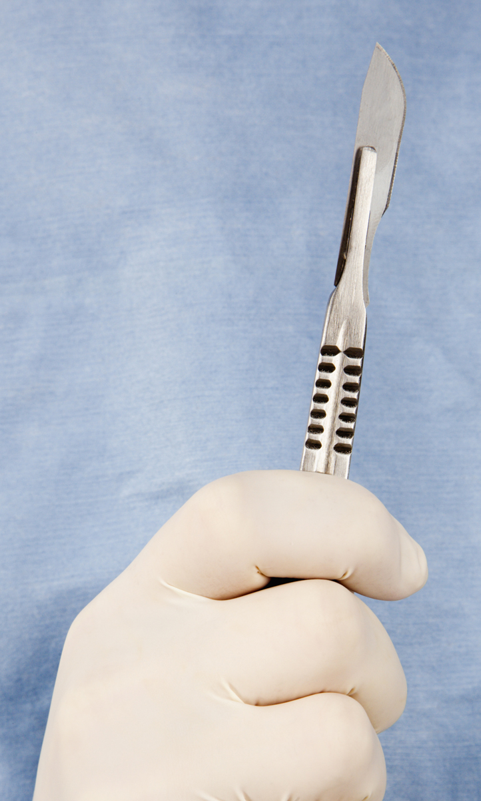
1. Our Heart Commitment (50:5)
“The Lord GOD has opened My ear; And I was not disobedient, nor did I turn back.”
Awakening (4) differs from opening the ear (5)
God Yahweh broke the door of resistance
Our hearts need changing
Testimony - The Surgeon
Notes:
Awakening (4) differs from opening the ear (5)
Our ___________ need changing
God Yahweh broke the door of resistance
This is a battle, and the evil one wants to cause us to come up short. (Jehoshaphat: “Because you have allied yourself with Ahaziah, the Lord has destroyed your works” (2 Chr 20:35-37).

Slide 8
2. Our Choice to Serve (50:6)
(1) “I gave My back to those who strike Me.”
(2) “I gave … My cheeks to those who pluck out the beard.”
(3) “I did not cover My face from humiliation and spitting.”
“I” – His choice not His enemies
“I gave My back” – God is in control “You would have no authority over Me, unless it had been given you from above” (John 19:10-11).
“I did not cover My face” – Not ashamed

Slide 9
3. Our Trust in God (50:7)
“For the Lord GOD helps Me, Therefore, I am not disgraced; Therefore, I have set My face like flint, And I know that I shall not be ashamed.”
Not a denial of pain
“The Lord God helps Me” - God’s sufficient grace
“My grace is sufficient for you, for power is perfected in weakness” (2 Cor 12:9).
Accepts our vulnerability and weaknesses
Notes:
Paul’s weaknesses (2 Cor 12:9)
8* Concerning this I entreated the Lord three times that it might depart from me.
9* And He has said to me, “My grace is sufficient for you, for power is perfected in weakness.” Most gladly, therefore, I will rather boast about my weaknesses, that the power of Christ may dwell in me.

Slide 10
4. Our Victory over Bitterness (8-9)
“He who vindicates Me is near; Who will contend with Me? Let us stand up to each other; Who has a case against Me? Let him draw near to Me.”
Not blind to injustice
Not seeking revenge (Ro 12:19)
Persecution does not mean one has done wrong
God’s judgment is coming soon to judge wicked
Notes:
Not seeking revenge (Ro 12:19)
19* Never take your own revenge, beloved, but leave room for the wrath of God, for it is written, “VENGEANCE IS MINE, I WILL REPAY,” says the Lord.

Slide 11
5 Points to be a Good Discipler
A.) The Training of the Disciple A disciple is a learner.
B.) The Purpose of the Disciple A disciple serves others.
C.) The Discipline of the Disciple A disciple regularly communes with God.
D.) The Attention of the Disciple A disciple attentively listens and obeys God.
E.) The Resolve of the Disciple A disciple withstands difficulties to please His Master.
Notes:
4 Points to be a Good Discipler
A.) The Training of the Disciple: A disciple is a learner.
B.) The Purpose of the Disciple: A disciple serves others.
C.) The Discipline of the Disciple: A disciple regularly communes with God.
D.) The Attention of the Disciple: A disciple attentively listens and obeys God.
E.) The Resolve of the Disciple:
A disciple withstands difficulties to please His Master.
Each point is from one section of Isaiah 50:4.

Slide 12
I want to be a Good Discipler
I am willing to be a lifelong learner.
I will develop my gifts and use my resources to effectively serve others.
I will regularly commune with God.
I will attentively listen to and obey God.
I will withstand what difficulties are necessary in order to please my Master.
Notes:
4 Points to be a Good Discipler
A.) The Training of the Disciple: A disciple is a learner.
B.) The Purpose of the Disciple: A disciple serves others.
C.) The Discipline of the Disciple: A disciple regularly communes with God.
D.) The Attention of the Disciple: A disciple attentively listens and obeys God.
E.) The Resolve of the Disciple:
A disciple withstands difficulties to please His Master.
Each point is from one section of Isaiah 50:4.

Slide 13
4
Discussion Questions
How do you respond if you do not like what your Heavenly Father asks you to do?
What is so wrong with bitterness? Is there someone you haven’t forgiven?
What do you think about the way Jesus was mistreated and His response (7)?

Slide 14
4
The Heart of Discipleship
Isaiah 50:5-9
Fostering Spiritual Growth in the Church
Paul J. Bucknell
Notes:
The Heart of Discipleship Isaiah 50:4 (part 1/2)
This series, Initiating Spiritual Growth in the Church, is all about reviving the people of God, initiating spiritual growth. We must not think this is the work of man. Revival is all about the work of God. We are fools if we use humans means to accomplish God’s work. On the other hand, we must remember that we pay very close attention to how we can get God to work. Remember this. God is at work. This is the whole meaning behind the Flow. The most important part is getting in a place where God is freely able to move and work. Think of a river. Things can block a river from going a certain direction.
So I want to begin this series by focusing on how we can make ourselves fully open to the Spirit of God. This can be a dangerous topic as there are many thoughts on spirituality out there. The best is for us to go back to Jesus who was full of the Holy Spirit. We can learn much from His life on how to live in close communion with God. Interestingly, we will go to a prophesy about Christ in Isaiah 50:4-9 to study the person of Christ. We begin and end our study with Jesus Christ.
The Flow
Establishing a Growth Pattern in the Church
1 Theology of the Flow
#2 The Flow in the whole of scriptures
#3 Level #1 - New believers (the child)
#4 Level #2 - Maturing disciple (young men) & mobilize coworkers
#5 Level #3 - Servant Leaders (within)
#6 Using the Flow with newcomers (house visitation)
#7 Full-time or tent maker (bivocational)
#8 Use as discipleship material
#1 Theology of the Flow (Eph 4 and 1 John 2:12-14)
Popular Purpose: The excitement of seeing how God can help me and others grow in the church.
Teaching Purpose: Excite people as to what God wants to do in the church through training by showing them the theological basis and nature of The Flow.
The energy within: Excitement to see what God is doing and working with Him. How leaders work and what God expects of all His people. Seeing the mobilization of those in the church. God treasures the use of every bodies’ gifts. He wants to reward them.
: Growth in our lives: Godly character - living like Jesus; ministry skills ( serving like Jesus) and biblical knowledge - knowing like Jesus (growth comes by seeing how God works through the Word in your life). Christlike character, service (ministry), and knowledge.
Excitement, design, necessity and context (church Eph 4) of growth.

