Slide 1

5
Discipling of New Believers-Level 1
1 John 2:12-14
Fostering Spiritual Growth in the Church
Calvin Chiang

Slide 2



Fostering Spiritual Growth
in the Church
3 Stages of Spiritual Life
0
0
Is 54
Is 54
2 Lessons:
Being like Jesus (Isaiah 54:4-9)
1
1
2
2
2
1 Lesson:
Vision of Church
3
3
Church
6-8 Lessons:
Topical Analysis of Christian Growth
Growth
Growth
Growth
A) The Pattern of Spiritual Growth
B) The Application of Spiritual Growth
A) The Pattern of Spiritual Growth
B) The Application of Spiritual Growth
Growth
Growth
Growth
Growth
Notes:
Establishing a Growth Pattern in the Church
1 Theology of the Flow
#2 The Flow in the whole of scriptures
#3 Level #1 - New believers (the child)
#4 Level #2 - Maturing disciple (young men) & mobilize coworkers
#5 Level #3 - Servant Leaders (within)
#6 Using the Flow with newcomers (house visitation)
#7 Full-time or tent maker (bivocational)
#8 Use as discipleship material
#1 Theology of the Flow (Eph 4 and 1 John 2:12-14)
Popular Purpose: The excitement of seeing how God can help me and others grow in the church.
Teaching Purpose: Excite people as to what God wants to do in the church through training by showing them the theological basis and nature of The Flow.
The energy within: Excitement to see what God is doing and working with Him. How leaders work and what God expects of all His people. Seeing the mobilization of those in the church. God treasures the use of every bodies’ gifts. He wants to reward them.
: Growth in our lives: Godly character - living like Jesus; ministry skills ( serving like Jesus) and biblical knowledge - knowing like Jesus (growth comes by seeing how God works through the Word in your life). Christlike character, service (ministry), and knowledge.
Excitement, design, necessity and context (church Eph 4) of growth.

Slide 3
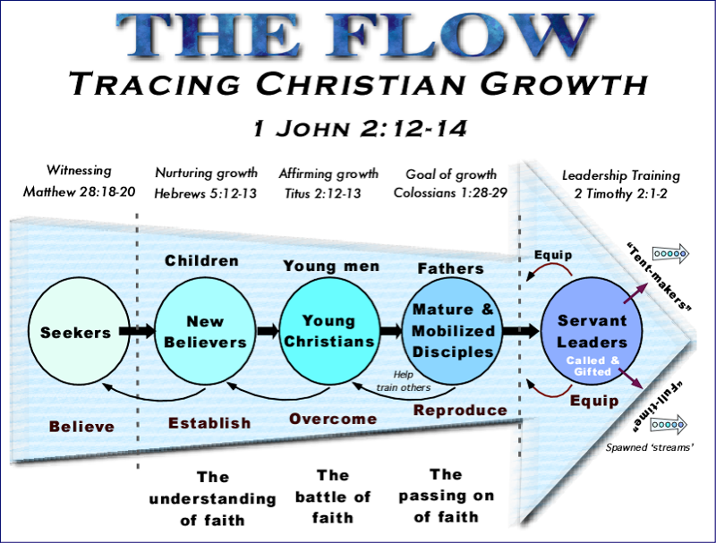
Notes:
**Spiritual growth is a process that requires careful planning and preparation. Imagine all the work expectant parents go through in anticipation of their new baby but at the last moment decided not to take the baby home from the hospital! Often times for new believers, this is exactly what happens. A lot of work goes into reaching out to non-believers but as soon as they become believers, they are left by themselves to grow.

Slide 4
1 John 2:12-14
12 I am writing to you, dear children, because your sins have been forgiven on account of his name.
13 I am writing to you, fathers, because you know him who is from the beginning. I am writing to you, young men, because you have overcome the evil one.
14 I am writing to you, dear children, because you know the Father.
I write to you, fathers, because you know him who is from the beginning.
I write to you, young men, because you are strong, and the word of God lives in you, and you have overcome the evil one.

Slide 5
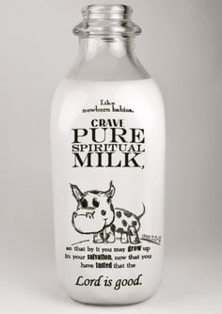
1 John 2:12-14 “Children-New Believers”
V.12 I am writing to you, dear children, because your sins have been forgiven on account of His name.
V.14 I write to you, dear children, because you know the Father.
”Like newborn babies, crave pure spiritual milk, so that by it you may grow up in your salvation, now that you have tasted that the Lord is good.” 1Peter 2:2-3
Notes:
**Spiritual growth develops in stages just like physical growth. Babies are not ready for table food within the 1st year of their life. They learn to crawl before they learn to walk. They are cuddled in care and bottle fed by their parents.
**Children at this stage are unstable and need security just like the new believer is learning about what Christian life is all about. They are like sponges, often soaking up whatever that they can at a very fast rate.
To Crave: When Micah was a baby, he works up a sweat when drinking milk. When we first become believers, we are excited about our newfound faith, wanting to tell everyone about it.
To have an intense desire for.
To need urgently, require.
To beg earnestly for; implore.
Why do you think that sometimes this craving goes away?

Slide 6
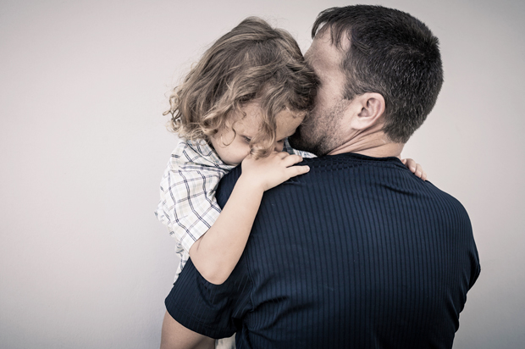
Challenges for New Believers
3 specific things often confuse new believers:
Sin: Need to fight off doubts about their salvation which can cause great degrees of instability. (Encouraged)
Forgiveness: Reject wrong concepts of true Christian faith. (Accepted)
Belonging to God’s family: Being able to relate to God as their Father. (Belonging)
Notes:
**Failing to fully understand what “sin” means. Either go one extreme or the other. Every sin we commit means that we are no longer Christians or since God will forgive us, we can sin freely as much as we want. Understanding the assurance of salvation.
-God is light and in Him there is no darkness at all. (1 John 1:5).
-Sometimes repetitive sin can cause us to doubt and give up.
**Forgiveness: Understanding what forgiveness means in God’s eye. Our sins are forgiven on the account of His name. You are accepted by God. Understanding that there is reconciliation when the trust is broken. Whenever I discipline my kids, I always go back to tell them and ask them why they think I disciplined them and where they think they did wrong. Restore the relationship with a hug, They need to know that I still love them.
-How many times does God forgive us? 7x70 times.
When we are younger, our parents are more forgiving when we do something wrong…because we don’t know the full extent to what we are doing. When we are older, forgiveness is still there but it hurts the person doing the forgiving because by that time, we should know better. Still forgiveness but it hurts the person doing the forgiving more.
**Belonging to God’s Family: Being able to relate to God. Seeing the heavenly Father like our earthly father. What if you didn’t have a good earthly father? (Didn’t have that with my dad when I was younger. Dad never really paid any attention to me. Something that I place a lot of emphasis on now that I have children of my own. Not letting them think that I will only love them when they do well…to be proud of them no matter what. They are constantly seeking my approval).
a. Part of that is learning to serve one another in God’s family. Spending fellowship time together with brothers and sisters. Encouraging each other and building up one another.
b. Example of the guy’s house in ACF days. Saturday morning prayer followed by lunch. Being transparent and praying for one another.

Slide 7
Spiritual Growth for New Believers
“You have come to need milk and not solid food. For everyone who partakes only of milk is not accustomed to the word of righteousness, for he is a babe.” (Hebrews 5:12-13)
New life has begun and will continue to grow if rightly protected and nourished. We all have spiritual needs and these needs have to be fulfilled. It’s easy to fill our bodies with junk food and unhealthy things. New believers need to be cared for and trained up to eat the right things.
The evil one is clever and strategically attacks a set group of weaknesses among new believers.
The child/new believer stage should be temporary not be stuck in this stage for a long time.
Establish a good understanding of the basic Christian teachings for new believers. They are insecure and prone to fall without a lot of close supervision.
Notes:
Cannot drink milk forever. Needs solid food in order to grow.
-Learning how to grow. When I was being discipled, my mentor taught me how to do QT, how to lead Bible study, how to pray, how to prepare well. At the time I was dating Elise and he gave me advice on his relationship with his wife.
2. Evil one will continue to frustrate you with the same things over and over until you are able to overcome these things.
**Testimony of tithe…test of faith.

Slide 8
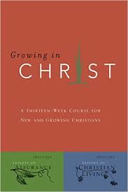
OIF Goals for New Believers
OIF wants to help and establish the faith of all new/young believers during their stay in OIF and help to progress their growth to the next level.
This happens in our discipleship program and would encourage everyone here to be involved whether as a mentor to disciple someone who is just starting their Christian walk or be discipled by someone who is more mature in their Christian walk.

Slide 9

Discussion Questions
Looking back at your spiritual journey. What did you experience at the new believer stage? As special care or experience that you can share?
Did you find that security, encouragement, acceptance, and belonging from God or are you still looking for it?
Do you know how to help new believers to grow through this crucial stage?

