Slide 1
9
Strengthening Faith
“The Fathers”
1 John 2:12-14
Fostering Spiritual Growth in the Church
Paul J. Bucknell

Slide 2
Trying to understand
What is the design that God has for each believer?
How does God lead us into deeper intimacy with Him?
How does serving fit into God’s overall purpose for our lives?
Do believers ever stop growing?

Slide 3
Queue up please
What order were the three groups presented?
Respect
Developmental
Notes:
What order were the three groups presented?

Slide 4
Order Please
‘Father’ summarizes the believer’s purpose, goal, and design.
Adult
Child
Fathers
Mature Christians
Children
New Christians
Youth
Younger Christians
1 John 2:12-14
God’s goal for every believer is to grow to maturity.
Are we consistent in how we work this out?

Slide 5
The Father’s Description
“I am writing to you, little children, because your sins are forgiven you for His name’s sake. I am writing to you, fathers, because you know Him who has been from the beginning. I am writing to you, young men, because you have overcome the evil one. I have written to you, children, because you know the Father. I have written to you, fathers, because you know Him who has been from the beginning. I have written to you, young men, because you are strong, and the word of God abides in you, and you have overcome the evil one.” (1 John 2:12-14 )
Notes:
• The third we need to discover by careful observation.
We are getting familiar with this passage. But what do we observe with the fathers?
That is right. It says exactly the same thing. The only difference is his reference of when he first wrote. He now writes to them and in the past has written to them exactly the same thing, that is, “Because you know Him who has been from the beginning.”
“I am writing to you, little children, because your sins are forgiven you for His name’s sake. I am writing to you, fathers, because you know Him who has been from the beginning. I am writing to you, young men, because you have overcome the evil one. I have written to you, children, because you know the Father. I have written to you, fathers, because you know Him who has been from the beginning. I have written to you, young men, because you are strong, and the word of God abides in you, and you have overcome the evil one.” (1 John 2:12-14, NASB).

Slide 6
Strengthening of Faith
1
Reproductive
I have written to you, fathers, because you know Him who has been from the beginning.
“Older women likewise are ... to encourage the young women to love their husbands, to love their children, to be sensible, pure, workers at home, kind, being subject to their own husbands, that the word of God may not be dishonored” (Titus 2:3-5).
Need
Focus on producing and caring for spiritual children.
Notes:
Fathers does not only stand for men but women too. The emphasis is on spiritual growth where one cares for the younger ones. Notice how older women are to take up that role of caring for and training young women.

Slide 7
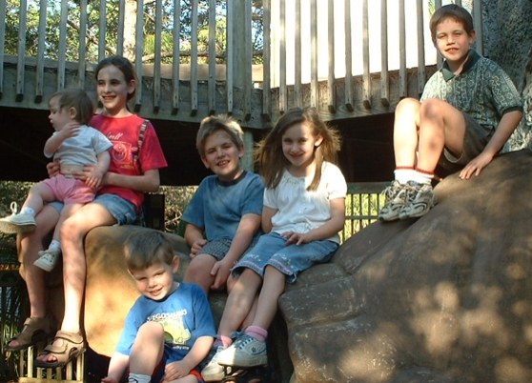
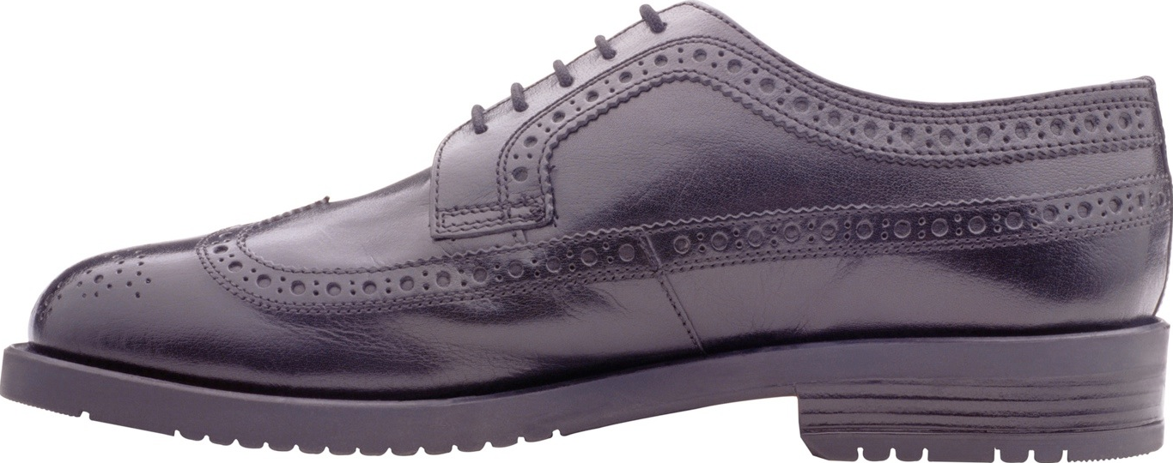
Fathers
children
Notes:
We want our children to grow up like us. Once our family was walking to a church. I heard my son cry out, “Dad, I think you are wearing my shoe.” I couldn’t believe it. But since he mentioned it, they did feel a bit different. As I looked more closely, I saw that I wore one of his shoes and one of mine! My son indeed is growing up!
The lazy father only thinks of creating the children, bringing them into the world. The genuine father oversees the children’s growth and care.

Slide 8
Strengthening of Faith
2
Intimacy
I have written to you, fathers, because you know Him who has been from the beginning.
“But whoever drinks of the water that I shall give him shall never thirst; but the water that I shall give him shall become in him a well of water springing up to eternal life” (John 4:14).
Need
Focus on relationship building
Notes:
The problem is that many believers think that God is distant and far away. They do not know how God could be close or desire to be with them. They felt shunned from their earthly fathers. They easily think the same thing with their heavenly Father.

Slide 9
Strengthening of Faith
3
Depth
I have written to you, fathers, because you know Him who has been from the beginning.
“For from Him and through Him and to Him are all things. To Him be the glory forever. Amen” (Romans 11:36).
Need
Persistent pursuit to deepen our knowledge of the Lord.

Slide 10
Growth of the Mature Believer
Step closer to God while responsibly caring for others
Fathers
Spiritual insight
Maturing Christians
G
Fathers are reproducers
Fathers are shapers
Fathers need to keep growing
Fathers grow by knowing God more.
O
A
L
Focus for Mature Believers
'Fathers' become more intimately acquainted with God through trying experiences and a deepening trust in Him, purposely investing their lives to help others grow in Christ.

Slide 11
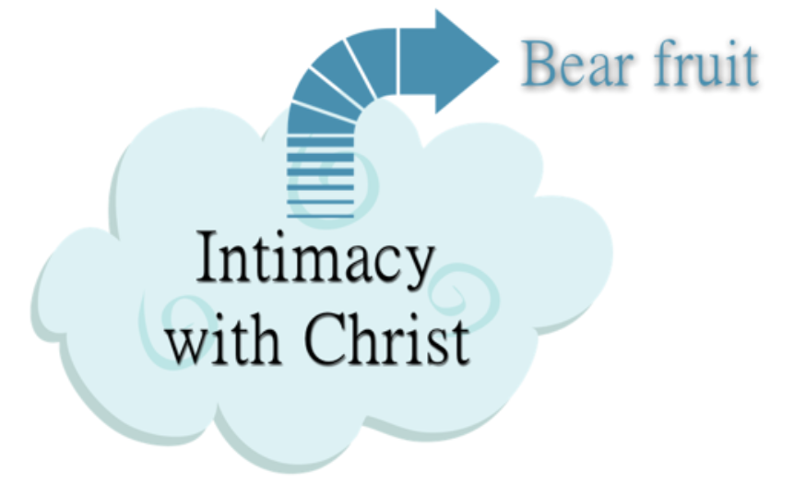
Understanding the Growth Process
Seek intimacy with God (John 15:5)
Dive deeper in His Word
Wrestle with deep personal struggles
Persevere when others have given up
Believe when others doubt
Be pure in an impure society
Demonstrate God’s love through serving others
Kindly confront others as needed
Keep your first love on the Lord
Manage your time well; don’t neglect any responsibility
The challenge to persist in our growth

Slide 12
Path of Discipleship
Strengthening Faith
3
Establishing Hope
Discovering Love
2
1
Fathers
Deep intimacy with God
Young men
Little Children
Great confidence in His word
Strong security from His love
Notes:
Discipleship Level 1: Discovering Love
Theme: Strong Security in His Love
Discover how our trust in God grows as we better grasp God's love for us seen in our salvation through Christ. God adopts us as His children, trains us to be like Him and engages us in His work with Him.
No matter what I face in life, God is with me.
The meaning of life - know we are loved and belong to Christ.
As teachers we excite believers at this level to understand the many ways God loves them in Christ. As we instruct them regarding His salvation and the ways He equips and engages them in His plans, we lay a foundation by which they eagerly adopt God’s plan for their lives and His people as their own.
Discipleship Level 2: Establishing Hope
Theme: Great Confidence in His Word
Establish a greater confidence in God’s Word as we regularly experience the power of the Holy Spirit in our lives. Through His Word the Lord reveals His truths which mark out His path for us. At the same time we are better able to discern the evil one’s way of confusing and distressing us.
No matter what problems I face, God's Word enables me to overcome.
The power of life - obtain victory by our confidence in God’s Word.
As teachers we encourage these believers to look back and see how far God has brought them in their spiritual growth and to observe coming challenges ahead. As they gain confidence, they will increase their number of victories which in turn strengthens them. We hope their increased confidence in God’s Word will inspire hope in the lives of others.
Discipleship Level 3: Strengthening Faith
Theme: Deep Intimacy with God
Learn how intimacy with God the Father produces glorious results as we better discern and complete the Lord’s good works. God further reveals His mysterious self, welcomes us step further in and engages us to carry out His good works.
No matter which situation I find myself in, God will bear fruit that glorifies Him.
The purpose of life - enjoy God and carry out His will.
As teachers we emphasize the special desire of God to create a deep intimacy with us by displaying His magnificent person and ways in good and difficult times so that He can bring about many wonderful great and good things through our lives in this world.

Slide 13
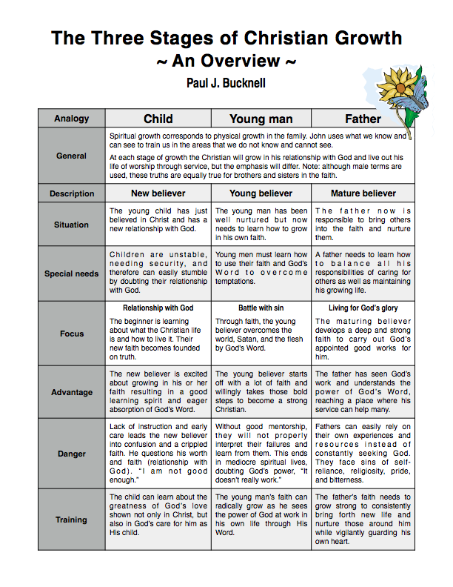

Slide 14
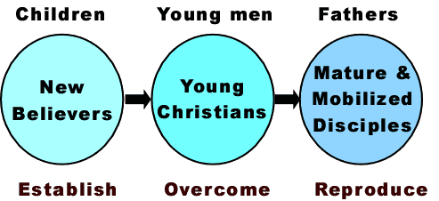
The Consequences of Improper Training
Overburdened pastor/leaders & ineffective church
Notes:
Why is it that sometimes spiritual growth does not occur ? (sheep are not fed)
We often lack proper training and it shows on the problems that the church suffers. If we lack training for new believers then there will be many that fall away. We will wonder why perhaps so many Christians lose their faith. It is largely because of inadequate feeding. The sheep die.
Some churches however suffer from weak and disillusioned Christians. They come off and on. They lack commitment. These Christians suffer from worldliness because they have not overcome the evil one in one or more areas in their lives. They are not convinced that the Word of God is relevant to this modern age and keep God at a distance.
Other churches that seem to do well in some ways lack adequate vision building for the stable Christians. Church for them is regular attendance. They have never been challenged with the Ephesians 4:11-12 ‘works of ministry’ concept. They think of themselves only as taking and not usually as giving. The pastor tends to do more and the congregation less. The longer this goes on the more pressure on the pastor to do ‘everything.’

Slide 15
Notes:
This is the summary of what you have on your sheet. The additional lines and arrow reveal the way that individual and church growth naturally flows. It is essential that we place our confidence on God’s ways. The Word of God gives us faith to make those decisions that will help shape our decisions and priorities.
Just one example. It fosters faith in us to pray for those who seem to have great difficulty. More than this, it helps us to gain confidence in God’s Word that can help the individual believer. We want to look much more closely at this particular aspect. We want to learn how to use this FLOW to help us properly care for believers.
Let me summarize some of the basic things we have learned from the Word of God here so that we can begin to utilize these teachings to help the believer.

Slide 16
What about Full-time Service?
By showing upcoming Christian leaders the complete process of leadership training, they become more eager to find help to foster growth in all areas of their lives.
Notes:
The second question has to do with how full-time ministers fit into this overall scheme.
We should note here that full-time Christian workers described in Ephesians 4:11-12 is a subset of this third group. Not all who are mature in their faith are full-time workers but some are and they are called into full-time ministry and spiritually gifted for it.
Because our training of ministry often focuses on degrees instead of spiritual growth and proof of service in a church, we unfortunately find some full-time workers who have are in fact young believers who have not yet fully grown in their Christian lives. They might have been Christians for many years but have not learn how to use God’s Word to overcome the evil one.
This is a shame and causes much wreckage in the Christian churches. Internships are necessary to avoid this.
We now need to look at an overview of this chart and apply it to our own church situation.
By showing upcoming Christian leaders the whole process to leadership, we can show them how we will work aside them and ready them.

Slide 17
Summary of Growth for Fathers
Every believer is designed to grow into a strong believer who serves others.
Spiritual growth can always deepen our increasing faith in God’s glorious person and ways.
The believer’s intimacy with God is often developed through trying circumstances.

Slide 18
Questions to Ponder
Are you still growing as you should in your relationship with God? Explain.
What is one Christian spiritual discipline that helps shape your life?
Give an example where you have encouraged another person so that they actively helped others.

Slide 19
9
Strengthening Faith
“The Fathers”
1 John 2:12-14
Fostering Spiritual Growth in the Church
Paul J. Bucknell
Notes:
This series, Fostering Spiritual Growth in the Church, is all about reviving the people of God, initiating spiritual growth. We must not think this as the work of man. Revival is all about the work of God. We are fools if we use humans means to accomplish God’s work. On the other hand, we must remember that we pay very close attention to how we can get God to work. Remember this. God is at work. This is the whole meaning behind the Flow. The most important part is getting in a place where God is freely able to move and work. Think of a river. Things can block a river from going a certain direction.
So I want to begin this series by focusing on how we can make ourselves fully open to the Spirit of God. This can be a dangerous topic as there are many thoughts on spirituality out there. The best is for us to go back to Jesus who was full of the Holy Spirit. We can learn much from His life on how to live in close communion with God. Interestingly, we will go to a prophesy about Christ in Isaiah 50:4-9 to study the person of Christ. We begin and end our study with Jesus Christ.
The Flow
Establishing a Growth Pattern in the Church
1 Theology of the Flow
#2 The Flow in the whole of scriptures
#3 Level #1 - New believers (the child)
#4 Level #2 - Maturing disciple (young men) & mobilize coworkers
#5 Level #3 - Servant Leaders (within)
#6 Using the Flow with newcomers (house visitation)
#7 Full-time or tent maker (bivocational)
#8 Use as discipleship material
#1 Theology of the Flow (Eph 4 and 1 John 2:12-14)
Popular Purpose: The excitement of seeing how God can help me and others grow in the church.
Teaching Purpose: Excite people as to what God wants to do in the church through training by showing them the theological basis and nature of The Flow.
The energy within: Excitement to see what God is doing and working with Him. How leaders work and what God expects of all His people. Seeing the mobilization of those in the church. God treasures the use of every bodies’ gifts. He wants to reward them.
: Growth in our lives: Godly character - living like Jesus; ministry skills ( serving like Jesus) and biblical knowledge - knowing like Jesus (growth comes by seeing how God works through the Word in your life). Christlike character, service (ministry), and knowledge.
Excitement, design, necessity and context (church Eph 4) of growth.

Slide 20
Understanding Spiritual growth
Spiritual growth
New believer
Spiritually young believers
Maturing Christians
Follows increase of faith
Seasoned faith

Slide 21
Understanding the Growth Process
Humility
Arrogance
Confession
Ignorance
Wisdom
Foolishness
Creates an amazing change of person!

Slide 22
Ways to Mature our Faith
The Vine - prune
Trials
VISA Delay
There is no implication of any wrongdoing or upset with the Lord, but that He knows greater things can be done through our lives. And so He upstages our lives in one or more ways that we might draw closer to Him, discover His great purposes and strength and so we end up bearing more fruit.

Slide 23
Jehovah-Jireh (Genesis 22:12-14)
But the angel of the LORD called to him from heaven, and said, “Abraham, Abraham!” And he said, “Here I am.” And he said, “Do not stretch out your hand against the lad, and do nothing to him; for now I know that you fear God, since you have not withheld your son, your only son, from Me.”
Then Abraham raised his eyes and looked, and behold, behind him a ram caught in the thicket by his horns; and Abraham went and took the ram, and offered him up for a burnt offering in the place of his son. And Abraham called the name of that place The LORD Will Provide, as it is said to this day, “In the mount of the LORD it will be provided.” (Genesis 22:12-14).

