Slide 1
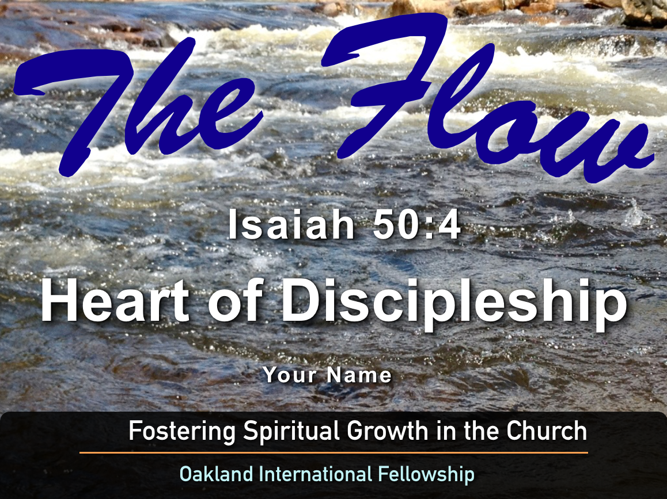
God’s Design for the Church
Session #11
Ephesians 4:11-13
Paul Bucknell /
Raymond Breckenridge Orr

Slide 2
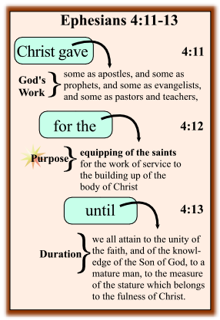
God’s Design of the Church
How have you experienced the life of the church?
Some participants in the church have great expectations and joy, while others feel disappointed or hurt by past experiences.
What makes the church strong or weak?
What we think and understand about the church will greatly influence what shape the church will take in the future.

Slide 3
Godʼs Work: How does God help the church?
“And He gave some to be apostles; and some prophets; and some evangelists; and some pastors and teachers.” (4:11)
Each believer has a God-designed calling (vocation)
Some believers are set aside for specific kinds of service. Their gifts cover everything necessary for Christ’s body to thrive.
God is the divine Giver of every good gift!
Conclusion: It is clear that God calls some for special service; set apart by gifting and training.

Slide 4
Godʼs Purpose: What is Godʼs purpose for this?
“For the perfecting of the saints, unto the work of ministering, unto the building up of the body of Christ.” (4:12)
Each believer has a need to be equipped
The saints are equipped as each one fulfills their responsibility to serve, to minister and to build one another up.
Christʼs Spirit living in and through His people brings this to pass. We are to keep in focus that such work is first and foremost a privilege.
Conclusion: God enables all His people to serve, equipping everyone, but our effectiveness depends on how we do this together as one body.

Slide 5
Godʼs Expectations: What does God expect from the church?
“Until we all attain to the unity of the faith, and of the knowledge of the Son of God, to a mature man, to the measure of the stature which belongs to the fullness of Christ.” (v. 13)
Believers collectively live as a community in the world, but not of the world, according to Godʼs Word.
The church grows to attain a unity in the faith as we embrace the true knowledge of the Son of God.
The church is called to mature into the fullness of Christ; to do the will of God, bringing Him glory and eternal gratitude.
Conclusion: God desires the whole body to mature as we grow in living out the ‘fullness of Christ’. As we do so, God’s divine glory is revealed.

Slide 6
In Summary: Godʼs Design of the Church
It is clear that God calls some for special service; set apart by gifting and training.
God enables / empowers all His people to serve, equipping one-another so that we may mature.
God grows / matures the body in the ‘fullness of Christ, according to His will and for His glory.
Every Christian is to be engaged to some measure in this great responsibility, this divine privilege.

Slide 7
Discussion Questions:
✦ Has God called you to equip others for service and are you being faithful to that calling?
✦ If so, then where are you currently serving to build up the body in the fullness of Christ?
✦ How do you sense God’s joy as you help others grow and mature in Christ?

