Slide 1
12
Growing in God’s Grace
1 John 2:12-14
Fostering Spiritual Growth in the Church
Michael Lim
Notes:
This series, Fostering Spiritual Growth in the Church, is all about reviving the people of God, initiating spiritual growth. We must not think this as the work of man. Revival is all about the work of God. We are fools if we use humans means to accomplish God’s work. On the other hand, we must remember that we pay very close attention to how we can get God to work. Remember this. God is at work. This is the whole meaning behind the Flow. The most important part is getting in a place where God is freely able to move and work. Think of a river. Things can block a river from going a certain direction.
So I want to begin this series by focusing on how we can make ourselves fully open to the Spirit of God. This can be a dangerous topic as there are many thoughts on spirituality out there. The best is for us to go back to Jesus who was full of the Holy Spirit. We can learn much from His life on how to live in close communion with God. Interestingly, we will go to a prophesy about Christ in Isaiah 50:4-9 to study the person of Christ. We begin and end our study with Jesus Christ.
The Flow
Establishing a Growth Pattern in the Church
1 Theology of the Flow
#2 The Flow in the whole of scriptures
#3 Level #1 - New believers (the child)
#4 Level #2 - Maturing disciple (young men) & mobilize coworkers
#5 Level #3 - Servant Leaders (within)
#6 Using the Flow with newcomers (house visitation)
#7 Full-time or tent maker (bivocational)
#8 Use as discipleship material
#1 Theology of the Flow (Eph 4 and 1 John 2:12-14)
Popular Purpose: The excitement of seeing how God can help me and others grow in the church.
Teaching Purpose: Excite people as to what God wants to do in the church through training by showing them the theological basis and nature of The Flow.
The energy within: Excitement to see what God is doing and working with Him. How leaders work and what God expects of all His people. Seeing the mobilization of those in the church. God treasures the use of every bodies’ gifts. He wants to reward them.
: Growth in our lives: Godly character - living like Jesus; ministry skills ( serving like Jesus) and biblical knowledge - knowing like Jesus (growth comes by seeing how God works through the Word in your life). Christlike character, service (ministry), and knowledge.
Excitement, design, necessity and context (church Eph 4) of growth.

Slide 2
Introduction
Grace separates Christianity from all other religions, so much so that failing to grasp what grace means for believers is to completely miss the heart of what God wants for your life. On the other hand, the more you receive grace into your life, the more doors open, allowing you to step into the freedom that was purchased on the cross.
Grace is a like life-force that flows from God into His beloved children throughout our lives. It touches us first at our salvation (saving grace) and then continues to pour into us as we learn (sanctifying grace) to understand all implications of salvation for our lives as we grow. As we embrace God’s grace in greater and greater ways, we are increasingly transformed in how we perceive ourselves, those around us, and our gracious God.

Slide 3
A. New Believers- Saving Grace
God desires new believers to realize and embrace His saving grace.
1. Understanding Saving Grace
a. Saving grace is free, based on neither work nor ranking, nor score
“But the free gift is not like the trespass. For if many died through one man’s trespass, much more have the grace of God and the free gift of grace of that one man Jesus Christ abounded for many.” (Romans 5:15)
b. Saving grace is perfect- no sin precludes you from forgiveness, God, or heaven
“For if by the transgression of the one, death reigned through the one, much more those who receive the abundance of grace and of the gift of righteousness will reign in life through the One, Jesus Christ.” (Romans 5:17)
Notes:
Blue for blanks- got them covered this time!
Christianity is not about church and church involvement, service, record of sin, good deeds, % battles won, or comparisons to others.
Paul and Peter; may cause uncertain hope, or distance from God or sapping joy

Slide 4
A. New Believers- Saving Grace
God desires new believers to realize and embrace His saving grace.
2. Embracing Saving Grace
- Saving grace implies that you have a new identity.
“Therefore, if anyone is in Christ, he is a new creation. The old has passed away; behold, the new has come.” (2 Cor 5:17)
“For we ourselves were once foolish, disobedient, led astray, slaves to various passions and pleasures, passing our days in malice and envy, hated by others and hating one another.” (Titus 3:3)
“1 Remind them to be submissive to rulers and authorities, to be obedient, to be ready for every good work, 2 to speak evil of no one, to avoid quarreling, to be gentle, and to show perfect courtesy toward all people.” (Titus 3:1-2)
“But now that you have been set free from sin and have become slaves of God, the fruit you get leads to sanctification and its end, eternal life.” (Rom 6:22)
Notes:
What does the transformation into a new creation look like? “Remind them” reflects the certainty of their new identities.
Do you know this grace in your life? Do you want to know this grace?
No, not really. Missing communion- didn’t know why but it seemed worse. Paul and Peter sinned, so it’s okay. Connecting perfect salvation, new identity, and begin to see how that helps me not to sin (Romans 6:1-6:2). Transition.
6 What shall we say then? Are we to continue in sin that grace may abound? ² By no means! How can we who died to sin still live in it?

Slide 5
B. Young Believers- Grace for All Times
Once believers realize saving grace, God takes them on deeper journeys into areas of their lives in which God wants us to see positive changes. He does so by bringing grace powerfully into believers’ lives so that they can learn how to walk through any situation reliant on His grace.
1. Young believers are strong because they realize that their identity is secure both in Jesus and by Jesus- His perfect work on the cross means perfect grace is upon them.
“You then, my child, be strengthened by the grace that is in Christ Jesus” (2 Tim 2:1)
2. Young believers learn to apply the truth of grace more and more in their lives.
a. In times of battle, grace fully provides!
Notes:
In Jesus’ identity and by Jesus’ work

Slide 6
B. Young Believers- Grace for All Times
Refining Our Confidence in Grace through Trials
Will God give me peace when mourning for a family member? Will God give me strength through a tough working environment? Will God give me freedom from selfishness in my relationship? Will God give me faith during a time of doubt? Will God give me wisdom to make a decision? Will God give me a bigger heart to love Him and others? Will God give me boldness to share the gospel? Will God give me courage to step up and serve?
b. Through trials, young believers refine their unseasoned faith: by learning to rely confidently on God’s sanctifying grace to provide, they begin to mature into veterans of spiritual battle.
Notes:
Personal Examples: Freedom from selfishness (selfishness is so destructive!), Faith during a time of doubt (recent presentation), bigger heart to love Him and others
Step up and serve: grace, unity, spiritual gifts (root word for gift is grace, an undeserved blessing. Gifts are given that we can bring God’s grace to others.

Slide 7
B. Young Believers- Grace for All Times
Once believers realize saving grace, God takes them on deeper journeys into areas of their lives in which God wants us to see positive changes. He does so by bringing grace powerfully into believers’ lives so that they can learn how to walk through any situation reliant on His grace.
c. Young believers also learn to see God’s grace in wonderful moments, times of celebration, relaxation, and good health, so that in every way, the grace of God begins to shine.
“For it is all for your sake, so that as grace extends to more and more people it may increase thanksgiving, to the glory of God.” (2 Cor 4:15)

Slide 8
C. Mature Believers- Graceful Ambassadors of Christ
The mature believer stage brings together all previous experiences of the manifestation of God’s grace in their lives, from their confidence in God’s saving grace to their assurance of both their constant need for God’s grace and His abundant provision to sustain them.
1. Mature believers know that they can rely on God’s provision of grace at all times.
“And God is able to make all grace abound to you, so that having all sufficiency in all things at all times, you may abound in every good work.” (2 Cor 9:8)
“11 Not that I am speaking of being in need, for I have learned in whatever situation I am to be content. 12 I know how to be brought low, and I know how to abound. In any and every circumstance, I have learned the secret of facing plenty and hunger, abundance and need. 13 I can do all things through him who strengthens me.” (Phil 4:11-13)
Notes:
Wonderful example from Paul in prison

Slide 9
C. Mature Believers- Graceful Ambassadors of Christ
The mature believer stage brings together all previous experiences of the manifestation of God’s grace in their lives, from their confidence in God’s saving grace to their assurance of both their constant need for God’s grace and His abundant provision to sustain them.
2. Mature believers are humble before all, leaders, and preservers of unity.
“1 I therefore, a prisoner for the Lord, urge you to walk in a manner worthy of the calling to which you have been called, 2 with all humility and gentleness, with patience, bearing with one another in love, 3 eager to maintain the unity of the Spirit in the bond of peace.” (Eph 4:1-3)
3. Mature believers are graceful ambassadors of Christ.
“18 All this is from God, who through Christ reconciled us to himself and gave us the ministry of reconciliation; 19 that is, in Christ God was reconciling the world to himself, not counting their trespasses against them, and entrusting to us the message of reconciliation. 20 Therefore, we are ambassadors for Christ, God making his appeal through us. We implore you on behalf of Christ, be reconciled to God.” (2 Cor 5:18-20)
Notes:
Due to length of verses, left a space for you to write a note or two instead of putting the verse in

Slide 10
C. Mature Believers- Graceful Ambassadors of Christ
The mature believer stage brings together all previous experiences of the manifestation of God’s grace in their lives, from their confidence in God’s saving grace to their assurance of both their constant need for God’s grace and His abundant provision to sustain them.
4. Grace is foundational in the lives of a mature believer
a. Reassuring thoughts of God’s grace flow freely to them
b. Thankfulness abounds for the love and mercy of God.
c. Grace pours out from them to put away reluctance to forgive, and to forgive cheerfully
d. Grace pours out from them to love all- God, family, friends, brothers and sisters, and enemies
Notes:
Characteristics of a mature believer

Slide 11
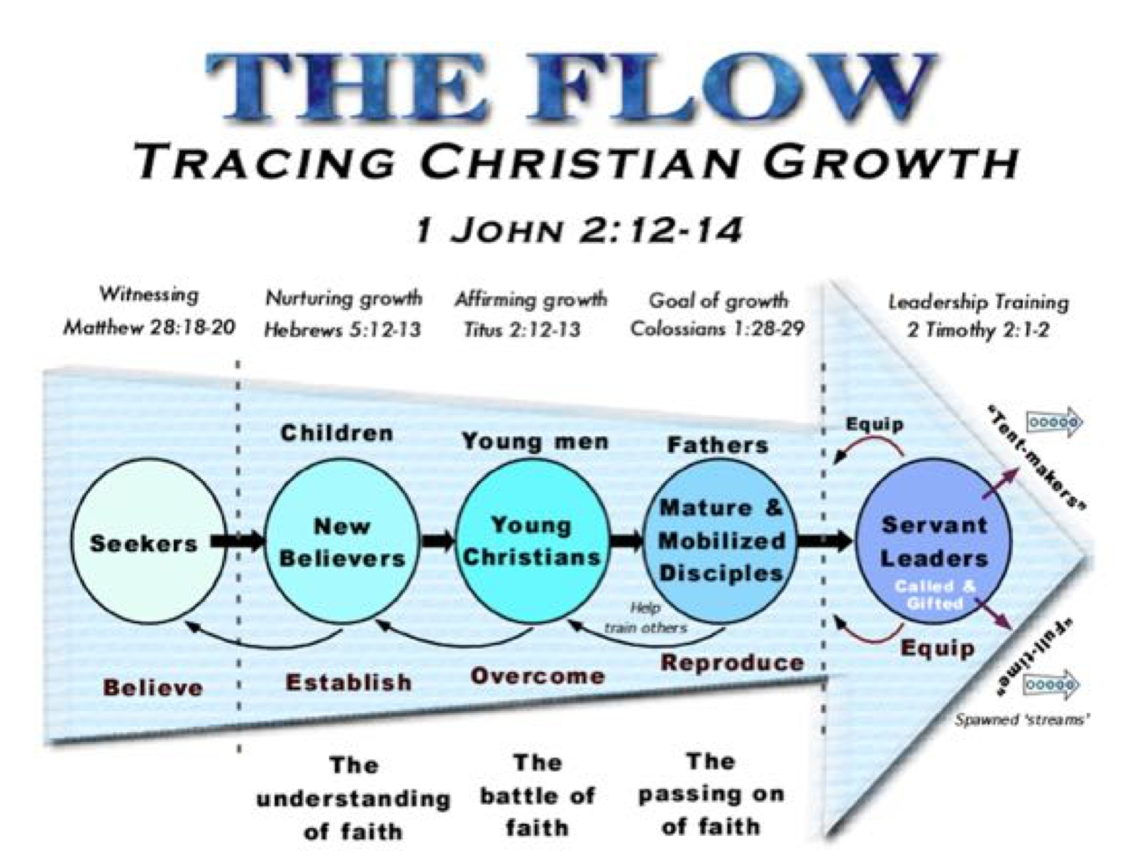
Summary
Keep in perspective from where God has brought you, where you are now, and where God is bringing you in your spiritual growth. If you are a believer, no matter where you are now, be assured of where you are headed and remember the grace of God that will take you there!

Slide 12
Discussion
Choose one aspect of saving grace- free gift, perfect forgiveness, or new identity- and discuss how it changed your perspective of your faith.
Choose a trying time, or a wonderful time, in your life and share how confidence in God’s grace transformed how you felt at that time or how you reflect back on that time now.

