Slide 1
14
Growing Marriages
Ephesians 5:31-33
Fostering Spiritual Growth in the Church
Paul J. Bucknell

Slide 2
Strengthening Faith
3
Establishing Hope
Discovering Love
2
1
Fathers
Deep intimacy with God
Young men
Little Children
Great confidence in His word
Strong security from His love
Notes:
Discipleship Level 1: Discovering Love
Theme: Strong Security in His Love
Discover how our trust in God grows as we better grasp God's love for us seen in our salvation through Christ. God adopts us as His children, trains us to be like Him and engages us in His work with Him.
No matter what I face in life, God is with me.
The meaning of life - know we are loved and belong to Christ.
As teachers we excite believers at this level to understand the many ways God loves them in Christ. As we instruct them regarding His salvation and the ways He equips and engages them in His plans, we lay a foundation by which they eagerly adopt God’s plan for their lives and His people as their own.
Discipleship Level 2: Establishing Hope
Theme: Great Confidence in His Word
Establish a greater confidence in God’s Word as we regularly experience the power of the Holy Spirit in our lives. Through His Word the Lord reveals His truths which mark out His path for us. At the same time we are better able to discern the evil one’s way of confusing and distressing us.
No matter what problems I face, God's Word enables me to overcome.
The power of life - obtain victory by our confidence in God’s Word.
As teachers we encourage these believers to look back and see how far God has brought them in their spiritual growth and to observe coming challenges ahead. As they gain confidence, they will increase their number of victories which in turn strengthens them. We hope their increased confidence in God’s Word will inspire hope in the lives of others.
Discipleship Level 3: Strengthening Faith
Theme: Deep Intimacy with God
Learn how intimacy with God the Father produces glorious results as we better discern and complete the Lord’s good works. God further reveals His mysterious self, welcomes us step further in and engages us to carry out His good works.
No matter which situation I find myself in, God will bear fruit that glorifies Him.
The purpose of life - enjoy God and carry out His will.
As teachers we emphasize the special desire of God to create a deep intimacy with us by displaying His magnificent person and ways in good and difficult times so that He can bring about many wonderful great and good things through our lives in this world.

Slide 3
Growing Marriages
Marriages are designed to grow into full expressions of the commitment between Christ and the church.
The three stages of Christian growth highlight the different growth that is possible at each stage.
Marriage binds us in a life covenant to the other “until death do us part” (Rom 7:1-3), and therefore enables us to more deeply refine ourselves and our relationship with our spouse.
As we grow in our understanding of God’s commitment to bless our marriage, we further deepen our commitment to our spouse and love him/her as God loves us.

Slide 4
A Biblical Picture of Marriage (Eph 5:31-33)
“31 For this cause a man shall leave his father and mother, and shall cleave to his wife; and the two shall become one flesh. 32 This mystery is great; but I am speaking with reference to Christ and the church. 33 Nevertheless let each individual among you also love his own wife even as himself; and let the wife see to it that she respect her husband” (Eph 5:31-33).
31: Marriage is ____________: God’s statement on the essence of marriage. 1 + 1 = 1
32: Marriage is a design: Marriage’s design reflects the eternal pattern between God and His people.
33: Marriage is doable: The concepts of marriage must be translated to our earthly lives.
directive

Slide 5
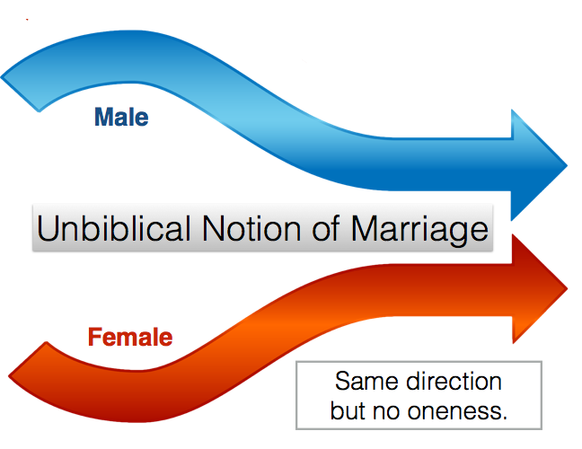
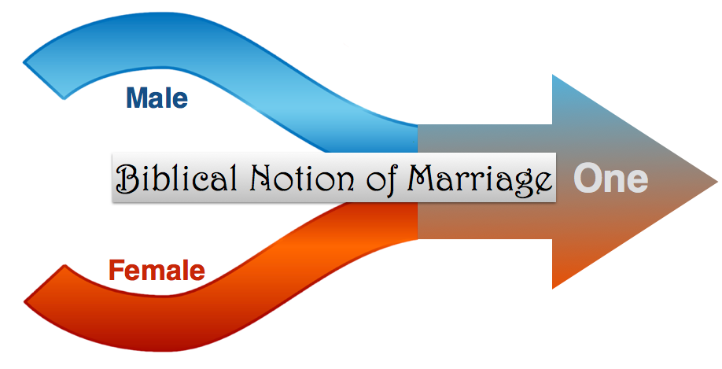
A Framework for Marriage
God’s design and framework of marriage lead to the beauty of intimacy, the two become one flesh, physically and in one’s soul and purpose.

Slide 6
The Makings of a Great Marriage - illustration
Marriage is this ongoing refining experience offering great rewards, something like making a ________ _________!
great meal
Chosen ingredients
A blend is best; two become one
Cooking requires heat
Closeness (can’t escape) creates that friction/heat/trouble
Negatively (the losing) or positively (the gaining and refining).

Slide 7
Level 1 - Newly Marriage: Honeymooners Commitment and Openness
Vision: I MUST be with him/her!
Think of the financial costs, pressures, changes of roles, living locations that occur when a couple gets married, and yet they still want to be married!

Slide 8
Level 1 - Honeymooners
Characteristics
Committed
Desirous
Big expectations.
Challenges
Unstable
Hopes dashed
Hopes regained (make-up)

Slide 9
Level 1 - Honeymooners
Christlike Responses
Excitement
Commitment
Learning spirit
Summary
The early stage of marriage can often be seen as an expression of ‘eros’ love. Although this fatuous love is committal in nature, the commitment tends to be based upon on one’s expectations and dreams (what one receives). When the expectations do not pan out, then great ups and downs shatter the dreams but provide opportunity to deepen one’s commitment.

Slide 10
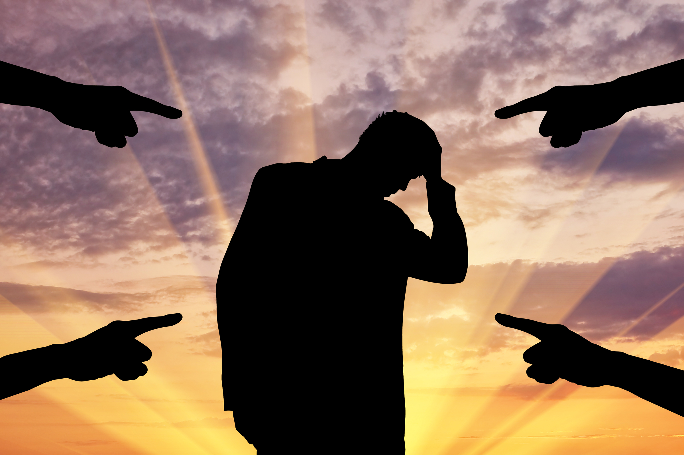
Level 2 – Young Married Couple The Challenged Marriage
Vision: _______ God’s goals of marriage despite temporary setbacks
The hopes of marriage are charged by a deep commitment to God’s hopes that He gives in His Word.
PURSUE
Discouragement comes from regressing from the oneness obtained and stepping back to one’s own desires.

Slide 11
Level 2 - Young Married Couple
Characteristics
Love: I do love being married, but…
Lost temper: I get really upset with my spouse
Lose vision: Is this all there is to marriage?
Challenges
Compromise: Willingness to put my ambitions first
Devious: Fake genuine love to get what I want
Adulterous: Entertain thoughts of other relationships as better

Slide 12
Level 2 - Young Married Couple
Christlike Responses:
Allow God’s Word to retain that vision and commitment
Prayerfully work through difficulties and impasses
Persistently forgive one another
Trust God to meet one’s deepest needs
Summary
God’s Word radiates hope and direction for the troubled couple. Marriage works when one allows God to work through the misunderstandings and make-up times. The young married couple typically lives out a worldly ‘phileo’ love, “As you treat me, I will treat you.”

Slide 13
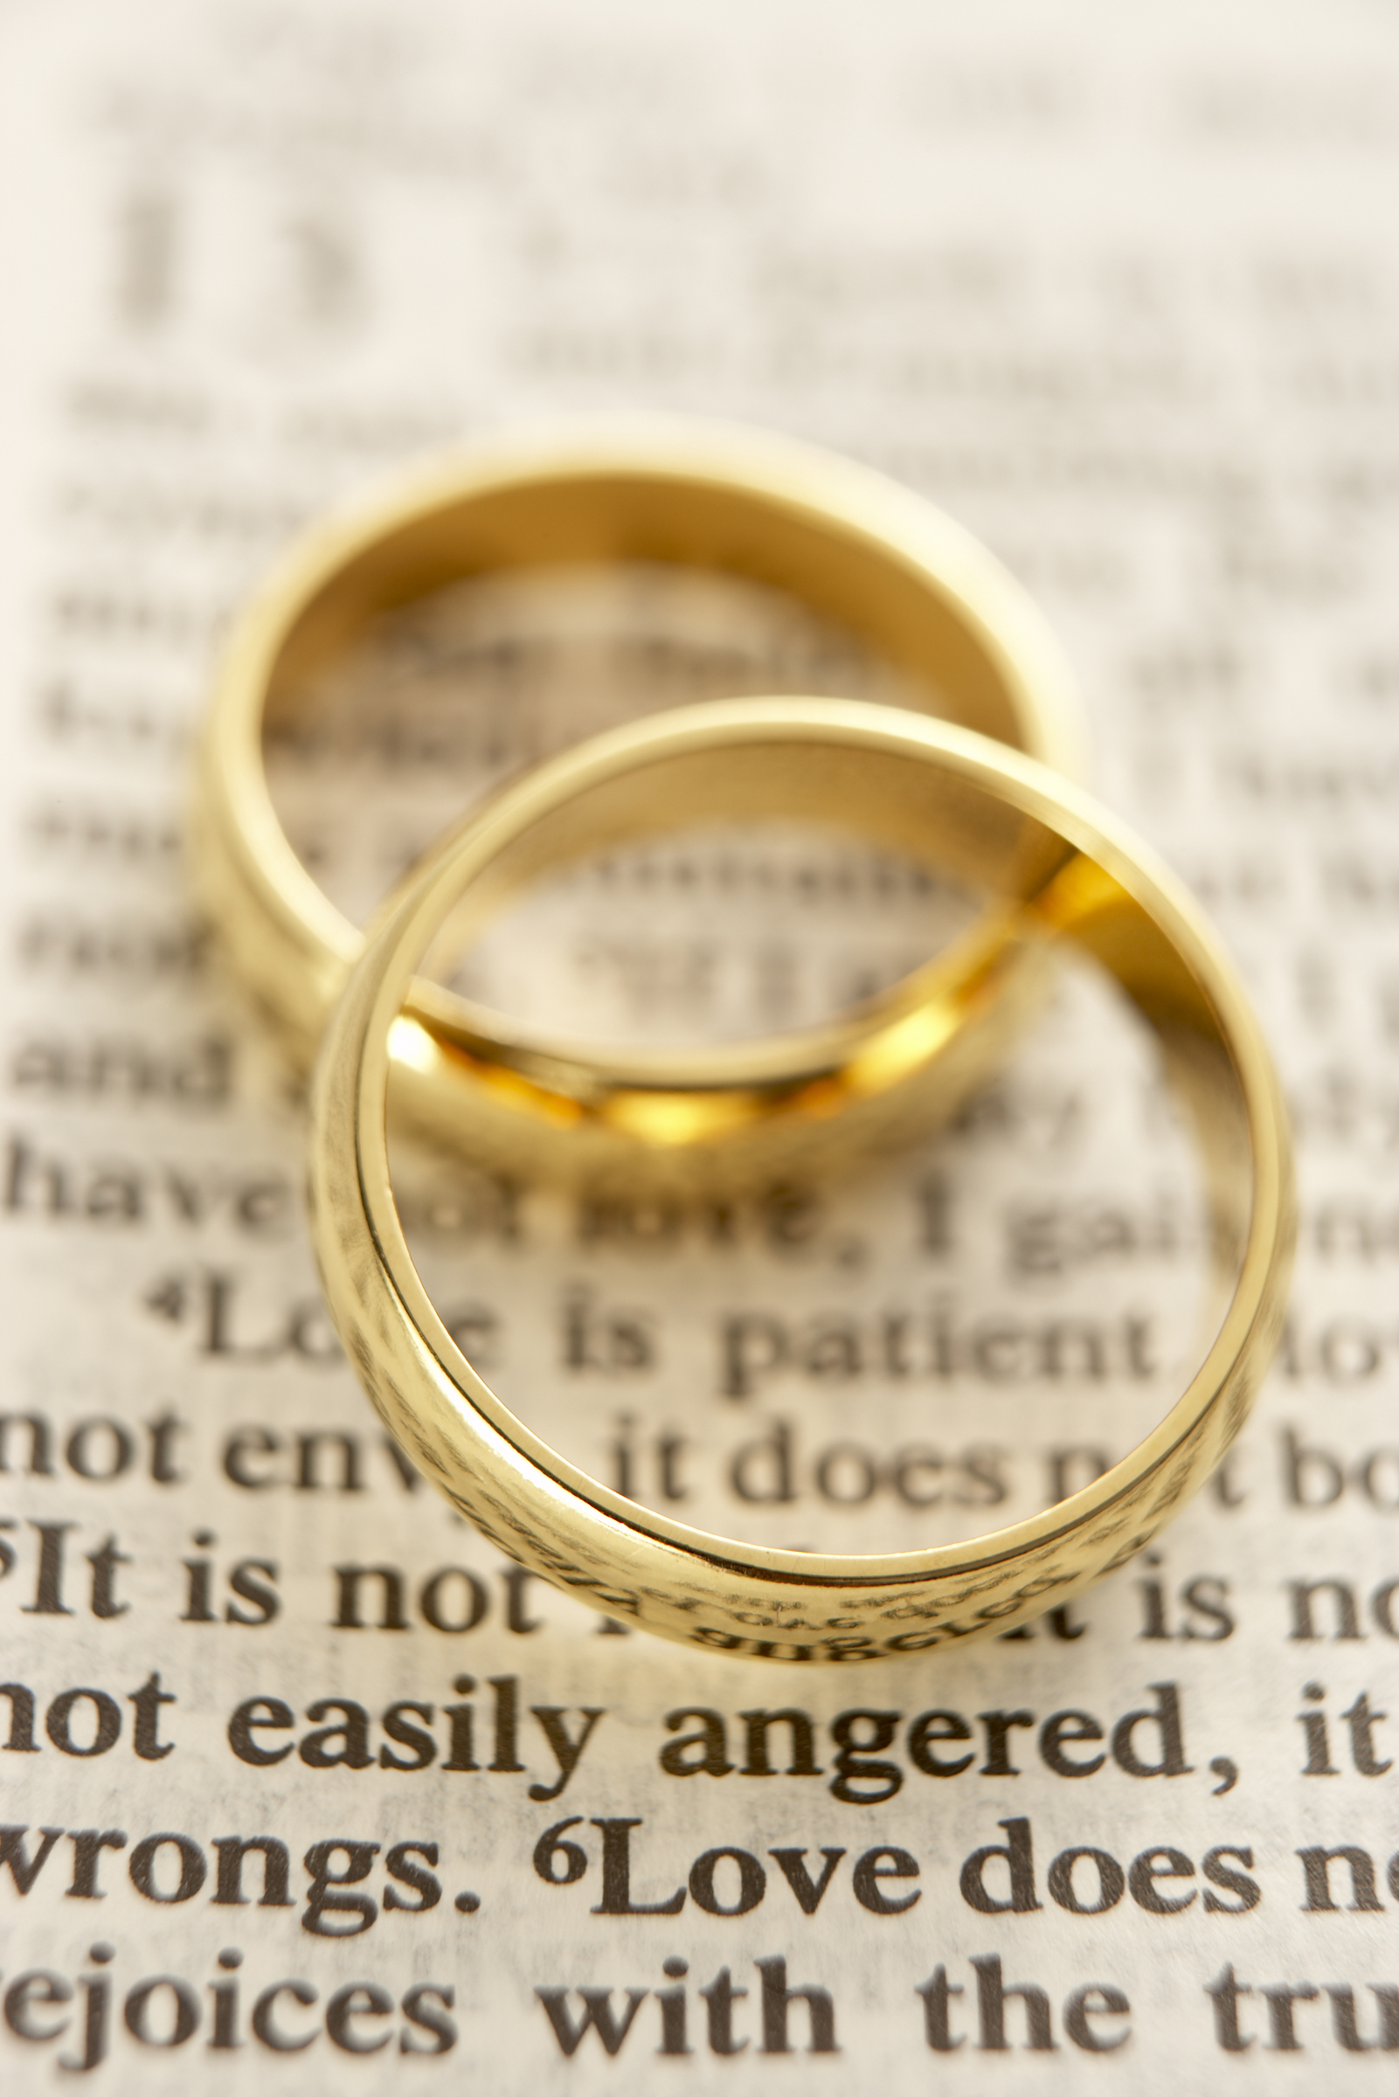
Level 3 - Mature Couple: Responses from God’s Love
Vision: A steady growing devotion towards one’s spouse
Christ’s love is a maturing love that refines our attitudes, words, and touches thus enabling us to increasingly love our spouse despite how differences normally cause insecurity in our marriages.

Slide 14
Level 3 - Mature Couple
Characteristics
Challenges
Consistent Love
Make sacrifices
When wronged can usually quickly forgive
Willing not to get my way
God teaches through one’s spouse
Discovering the needs of my spouse so that I can delight him/her.
Increased age and pain
Decreased function Death of loved ones
Complacency
Depression
Troubled family members

Slide 15
Level 3 - Mature Couple
Christlike Responses:
Able to work through misunderstandings, disappointments, and different expectations
Increasingly intimate times with one’s mate are not based on beauty but devotion
Treasure heart oneness more than physical intimacy
A deeper relationship with God unfolds deeper insights into God’s love, enabling a further refinement of one’s love
Content with one’s own spouse despite imperfections.

Slide 16
Summary
Level 3 - Mature Couple
An enriching ‘_______’ love enables the mature believer to avoid selfish binges and demands, and instead focuses on building up one’s mate through consistent kind acts and words, delighting in the resulting oneness of heart and mind bringing peace, joy, and love.
agape

Slide 17
Discussion Questions
Think of a troubled marriage and point out how personal/spiritual problems affect their marriage.
Have you ever seen a great marriage? What characteristics have you seen of these good marriages?
Identify one or more personal qualities in your life to love people better.

Slide 18
Striving for Moral Purity
“Therefore, since we have so great a cloud of witnesses surrounding us, let us also lay aside every encumbrance, and the sin which so easily entangles us, and let us run with endurance the race that is set before us, fixing our eyes on Jesus, the author and perfecter of faith, who for the joy set before Him endured the cross, despising the shame, and has sat down at the right hand of the throne of God” (Heb 12:1-2, NASB).
#1 Our Thinking
Brings truth:
What does God say anyway?
Understanding God’s commands helps us understand His special design for us.
#2 Our Clean-up
Brings light:
Why do I regularly fall?
Exposing our impure roots shows us how serious we need to fight.
#3 Our Foundation
Brings confidence:
How does theology help me?
Stepping out of failure enables us to conquer the enemy of defeat.
#4 Our Training
Brings wisdom:
What do I need to do to overcome?
By learning how to get around Satan’s temptations, our faith becomes strong.
#5 Our Questions
Brings boldness:
How does God want to use me?
Learning to properly discern and respond to attacks on our godly pursuits.

Slide 19
14
Growing Marriages
Ephesians 5:31-33
Fostering Spiritual Growth in the Church
Paul J. Bucknell

