Slide 1
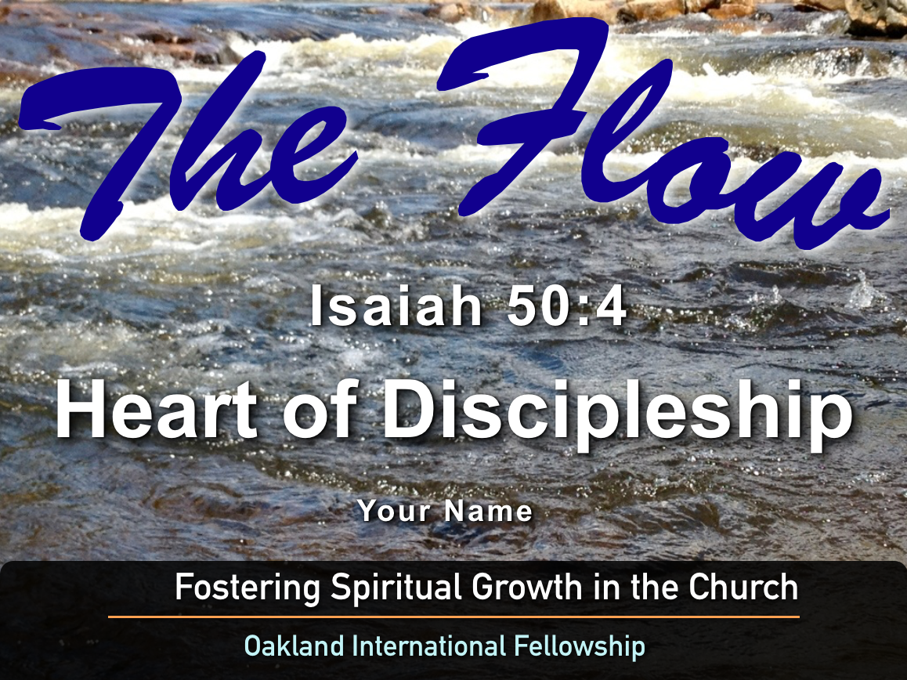
Growing in Personal Relationships
Session #15
Paul Bucknell /
Raymond Breckenridge Orr

Slide 2
Growing in our Personal Relationships
Session # 15
¹⁹ “We love, because He first loved us.
²⁰ If someone says, "I love God," and hates his brother, he is a liar; for the one who does not love his brother whom he has seen, cannot love God whom he has not seen.
²¹ And this commandment we have from Him, that the one who loves God should love his brother also.” (1 John 4:19-21)

Slide 3
❖ Origin of God’s love:
1st given to us by God in order to love Him and to love others
Verse 19: Love exists in us. (It is born in us by God.)
Verse 20: Love is displayed through us. (It is something that is necessary / obligatory.)
Verse 21: Love is God in and through us in every relationship. (It is the norm for Christian life.)

Slide 4
Importance of God’s Love:
Our love grows in depth as we mature in our faith, and therefore our relationships deepen as we grow in Christ.
“And let us consider how to stimulate one another to love and good deeds.” (Heb. 10:24)
“And this I pray, that your love may abound still more and more in real knowledge and all discernment.” (Phil. 1:9)
“By this, love is perfected with us, so that we may have confidence in the day of judgment; because as He is, so also are we in this world.” (1 John 4:17)

Slide 5
❖ Goal of God’s Love: to be so emptied of self that we perfectly reflect Christ’s love in our relationships
“¹ Therefore be imitators of God, as beloved children; ² and walk in love, just as Christ also loved you and gave Himself up for us, an offering and a sacrifice to God as a fragrant aroma.” (Eph. 5:1-2)
“¹⁵ but speaking the truth in love, we are to grow up in all aspects into Him who is the head, even Christ, ¹⁶ from whom the whole body, being fitted and held together by what every joint supplies, according to the proper working of each individual part, causes the growth of the body for the building up of itself in love.” (Eph. 4:15-16)

Slide 6
❖ Level 1
Relational Changes Because of God’s Love
VISION: Because of God’s compassion, a new believer begins seeing people as needing God in their lives. When God’s love is born in us we are changed. Now we become concerned how God cares for the relationships we have been given. Thus, love springs forth with all sorts of practical changes in our attitudes and actual behavior.

Slide 7
New believer’s changing vision and challenges
When first a believer, we start becoming aware of how selfish we are.
We begin to experience true joy in helping people.
At times, we may try to force love in relationships where it is not readily received.
As a new believer’s love must grow to stability.
We see problems as not so overwhelming as before, but current stress or remaining bitterness from former broken relationships may overshadow love, choking its flow.

Slide 8
Level 1
Summary: God’s love is present in new believers, but because the relationship can be shaken due to our poor understanding of God and our changing circumstances, we can easily revert to selfish ways that create abrupt change and brokenness. (Delicate & unstable)

Slide 9
Level 2
Taking Difficult Steps to Apply God’s Love
VISION: The young believer seeks to tackle difficult relationships and choose to love others. Jesus’ life in us is able to help us overcome our major relationship flaws, so that we can grow in our relationships with others, no matter who they are.

Slide 10
Young believer’s changing vision and challenges
We sense a true need to grow in God’s Word, so as to clearly know how to overcome temptation.
We continue to wrestle with the flesh and are troubled by shallow, superficial relationships.
Personal concerns may keep us from meeting others’ need, especially when ambition trumps relationship.
We become more keenly aware of how we can fake love in order to gain ungodly attention.
We are more able to forgive, but some people we may still try to avoid who are difficult to deal with.

Slide 11
Level 2
Summary: The key for young believers is to have the confidence that love is the solution for all kinds of difficult situation. So no matter how bad a relationship or situation might be, believers can trust God’s love to reveal deeper ways to love. Scripture builds the necessary confidence as to how we must do this.

Slide 12
Level 3
The Mature Responses from God’s Love:
VISION: Mature believers experience a steady, persistent devotion towards God and love for others. Christ’s love is a maturing love, refining our attitudes, words, and actions. It enables us to love those who are different from us, or those who may strive with us because of our deepened relationship with Christ.

Slide 13
Mature believer’s consistent vision and challenges
Special intimate times with God unfold deeper insights into our Lord’s love for us.
Our lives become more refined in listening for the Spirit guide us toward gracious acts of love.
We avoid sacrifice out of mere obligation, but rather follow a lifestyle of joyful sacrifice for others.
When wronged, we readily forgive; knowing deeply the grace and forgiveness of God at work in us.
A mature believer’s relationship with God steadies and gives balance to all relationships.

Slide 14
Level 3
Summary: Godly character is the result of walking in obedience. A deep love for God enables the mature believer to avoid the extremes of self-righteousness or self-indulgence. Growth in right relationship to God, in holiness, reveals a deeper knowledge of the depth of human sin. This enables the mature believer to experience God’s love pervasively in all relationships, and causes the body of Christ to grow in unity.

Slide 15
Discussion Questions:
Describe the kinds of relationship that teach us the most about love? Why?
Share how God has taught you to overcome a difficult relationship in the past?
What is a mark of mature love that you most want to see develop in your walk with God? Please explain.

