Slide 1
17
Growing in Prayer
Ephesians 6:18
Fostering Spiritual Growth in the Church
Paul J. Bucknell

Slide 2
Strengthening Faith
3
Establishing Hope
Discovering Love
2
1
Fathers
Deep intimacy with God
Young men
Little Children
Great confidence in His word
Strong security from His love
Notes:
Discipleship Level 1: Discovering Love
Theme: Strong Security in His Love
Discover how our trust in God grows as we better grasp God's love for us seen in our salvation through Christ. God adopts us as His children, trains us to be like Him and engages us in His work with Him.
No matter what I face in life, God is with me.
The meaning of life - know we are loved and belong to Christ.
As teachers we excite believers at this level to understand the many ways God loves them in Christ. As we instruct them regarding His salvation and the ways He equips and engages them in His plans, we lay a foundation by which they eagerly adopt God’s plan for their lives and His people as their own.
Discipleship Level 2: Establishing Hope
Theme: Great Confidence in His Word
Establish a greater confidence in God’s Word as we regularly experience the power of the Holy Spirit in our lives. Through His Word the Lord reveals His truths which mark out His path for us. At the same time we are better able to discern the evil one’s way of confusing and distressing us.
No matter what problems I face, God's Word enables me to overcome.
The power of life - obtain victory by our confidence in God’s Word.
As teachers we encourage these believers to look back and see how far God has brought them in their spiritual growth and to observe coming challenges ahead. As they gain confidence, they will increase their number of victories which in turn strengthens them. We hope their increased confidence in God’s Word will inspire hope in the lives of others.
Discipleship Level 3: Strengthening Faith
Theme: Deep Intimacy with God
Learn how intimacy with God the Father produces glorious results as we better discern and complete the Lord’s good works. God further reveals His mysterious self, welcomes us step further in and engages us to carry out His good works.
No matter which situation I find myself in, God will bear fruit that glorifies Him.
The purpose of life - enjoy God and carry out His will.
As teachers we emphasize the special desire of God to create a deep intimacy with us by displaying His magnificent person and ways in good and difficult times so that He can bring about many wonderful great and good things through our lives in this world.

Slide 3
Growing in Prayer
Every relationship is founded on good back and forth communication, and so prayer becomes the key means the Christian develops his/her relationship with God. Our spiritual conversation (i.e. prayer) develops as we grow in our spiritual lives.
“With all prayer and petition pray at all times in the Spirit, and with this in view, be on the alert with all perseverance and petition for all the saints” (Ephesians 6:18).

Slide 4
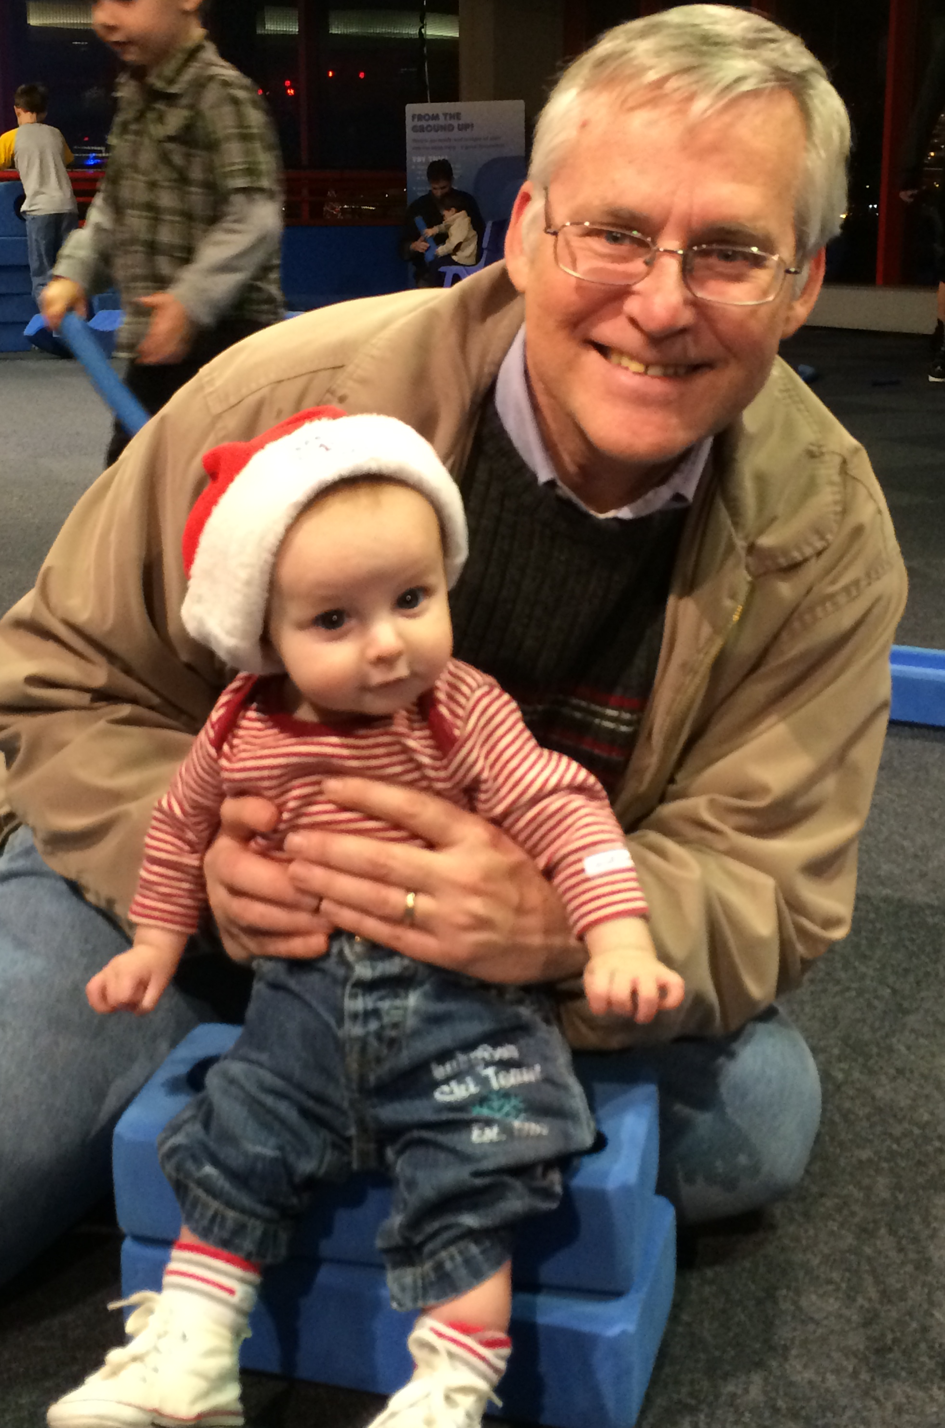
Level 1 - New Believers
Don’t we all love to see how babies learn to talk despite their incorrectly formed words. If they ask amiss, we smile and offer them what is good and safe (Mat 7:10).
Think what happens when a new believer comes to know the Lord and begins talking to God. The Father is so excited at His child’s first words.

Slide 5
Level 1 - New Believers
Like little children learning to talk!
Affirm Faith
New believers begin to _______ to God. Every word spoken to God (i.e. prayer) is an affirmation of their faith.
talk
=> Does your Heavenly Father delight in hearing from you?
Confess Sin
The way believers prayerfully handle their sin greatly affects their spiritual lives.
=> Do you wrestle with confessing your sin?

Slide 6
Level 1 - New Believers
Seek to please God
The Spirit of God begins to prod us to and not to do certain things.
=> Do you question whether God’s will for your life is always best for you? In what areas?
Thank the Father
“In everything give thanks; for this is God’s will for you in Christ Jesus” (1 Thessalonians 5:18).
=> Do you use prayer to express your growing admiration of the Father’s care for you?
Trust Father (Protect, guide, provide, comfort)
The believer is learning to live in God’s presence, even recognizing His presence.

Slide 7
Level 2 - The Young Believer
By seeing the power of God’s Word at work in my life, my faith is increased, and my hope in God’s work in my life is strengthened.

Slide 8
Level 2 - The Young Believer
Being an Overcomer
Prayer brings us to God, starting with a humble prayer
Then proclaiming His truth, and building up our faith.
During prayer, we exercise our shield of faith to bring clarity to our confused minds, “Taking up the shield of faith with which you will be able to extinguish all the flaming missiles of the evil one” (Eph 6:16).

Slide 9
Level 2 - The Young Believer
Power of God’s Word
“Because the Word of God abides in you” – 1 John 2:14
Power: God’s Word is the driving force in prayer providing faith as we bring our requests and praise to God.
Promises (2 Peter 1:4): “He has granted to us His precious and magnificent promises.”
Abraham (Gen 15:8): “And he said, ‘O Lord GOD, how may I know that I shall possess it?’”
Exposes lies (Eph 5:13): “But all things become visible when they are exposed by the light, for everything that becomes visible is light.”

Slide 10
Level 2 - The Young Believer
No, I don’t think prayer helps me gain the wisdom that I need for each day.
Yes, I really need God’s help to live out each day and so I pray to gain His strength.
Doubt about my need and God’s ability to help cripples my spiritual life by a lack of consistent prayer.
Faith enables me to sense my need and find God’s help by regularly seeking the Lord in prayer!

Slide 11
Level 3 - The Mature Believer
By my growing faith, I can know God and trust him even in difficult times. He takes me deeper and closer to Him so that He can bear more fruit through my life to glorify Him.
The two previous stages are temporary while this stage does not ever end on earth.
Notes:
By my growing faith, I get to know God more intimately and trust him even in difficult times. He takes me deeper and closer to Him so that He can bear more fruit through my life to glorify Him.

Slide 12
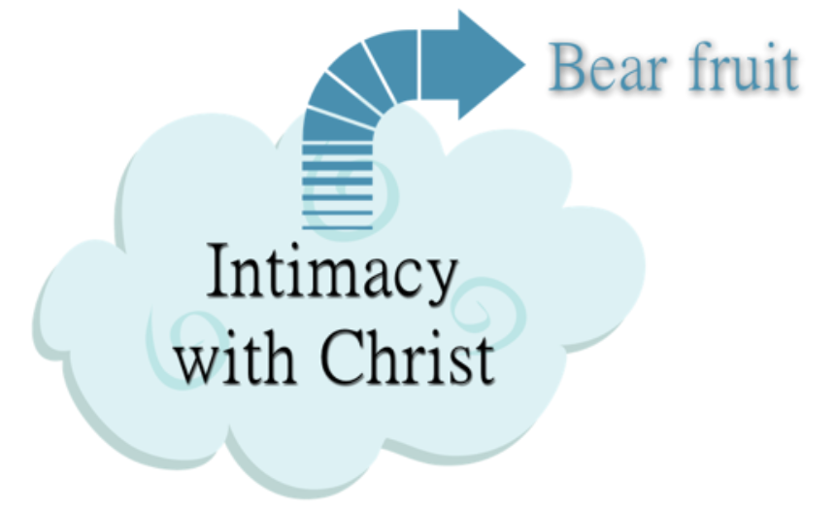
Level 3 - The Mature Believer
Abiding in Christ (John 15:4)
“Abide in Me, and I in you. As the branch cannot bear fruit of itself, unless it abides in the vine, so neither can you, unless you abide in Me”.
Abiding prayer
Searching to please the Lord
Prayer is an intimacy that bears fruit Fruit comes from intimacy with the Lord
Admire & Adore
Adoration occurs at all stages but constantly matures.
e.g., Psalms: “Blessed be the LORD, my rock, who trains my hands for war…” (Psalms 144:1).

Slide 13
Level 3 - The Mature Believer
Devoted despite trials
“The enemy has persecuted my soul; He has crushed my life to the ground; He has made me dwell in dark places, like those who have long been dead. Therefore my spirit is overwhelmed within me” (Ps 143:3-4).
We share our difficulties with God. “I trust in Thee, Teach me the way in which I should walk” (Ps 143:8).
We are not allowed to wallow in self-pity but are commanded to grow in our faith.

Slide 14
Level 3 - The Mature Believer
Pray for Others
“And pray on my behalf, that utterance may be given to me in the opening of my mouth, to make known with boldness the mystery of the gospel” (Eph 6:19).
We need prayer support from others.
Tests of our faith: What is it that we really want? How much do we want it?
Summary
Our prayer lives grow as we grow in the Lord.
Our prayers are naturally affected by our growing faith.
God desires for us to commune with Him and for Him to work through our lives.

Slide 15
Discussion Questions
What is your biggest struggle or greatest delight in prayer?
What is an area of prayer than you want to learn more about or grow in?

Slide 16
17
Growing in Prayer
Ephesians 6:18
Fostering Spiritual Growth in the Church
Paul J. Bucknell

