Slide 1
18
Growing in Spiritual Discernment & Overview
Ephesians 6:12
Fostering Spiritual Growth in the Church
Paul J. Bucknell

Slide 2
Understanding Spiritual Discernment
“But what is this discernment? The word used in Psalm 119:66 means “taste.” It is the ability to make discriminating judgments, to distinguish between, and recognize the moral implications of, different situations and courses of action. It includes the ability to “weigh up” and assess the moral and spiritual status of individuals, groups, and even movements.” –Sinclair Ferguson
Spiritual discernment is the God-given ability to observe and understand the spiritual realm along with one’s own life and surroundings (John 3:3).
The Spirit of God works in new believers (Acts 1:8) bringing a whole new ability to relate to God and observe the dark and light forces around them. At each stage of spiritual development, one’s learning takes on different aspects.
Notes:
But what is this discernment? The word used in Psalm 119:66 means “taste.” It is the ability to make discriminating judgments, to distinguish between, and recognize the moral implications of, different situations and courses of action. It includes the ability to “weigh up” and assess the moral and spiritual status of individuals, groups, and even movements. http://www.ligonier.org/blog/discernment-thinking-gods-thoughts/

Slide 3
Understanding Spiritual Discernment
“For our struggle is not against flesh and blood, but against the rulers, against the powers, against the world forces of this darkness, against the spiritual forces of wickedness in the heavenly places” (Eph 6:12).
Awakened to God, His presence, and one’s sinfulness
Begin to discern God and Satan’s voice from one’s own
Consistently rejects the evil one while seeking God’s will
I have sinned against God.
I am not what I hear.
I seek to obey God.
Notes:
Note from Ephesians 6:12 that the spiritual world is not all good for it is their beyond our immediate fleshly senses exist all sorts of evil forces and powers.
#1 I am unlike God and need forgiveness through Christ.
#2 I am not what I hear. I want to hear God’s voice and obey. I do not need to do everything I hear.
#3
Perhaps, the most important area of discernment is of the spiritual world. Will one have a fear of sin or hell without spiritual discernment? Perhaps, but only in a worldly sense. But for such a fear to have affect it must affect their minds to the point of the choices they make.

Slide 4
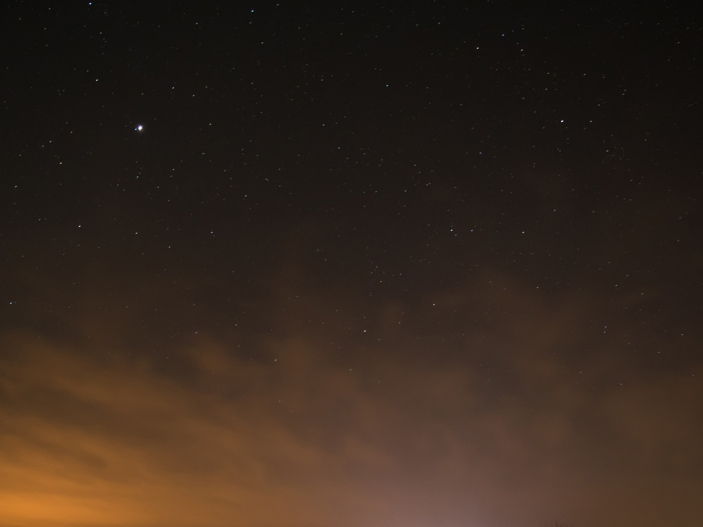
Growing in Spiritual Discernment
God
angels
evil one
demons
love
Wow! God is so good!
sin
temptation
Wow! I am a sinner!
Satan is tempting me!

Slide 5
No spiritual map
Here I am
me
Confused
No goals
No life direction
Notes:
We started off this series by suggesting that many believers have no clue what it means to spiritually grow. They more than often suggest they are good Christians because they go to church. This lack of direction has caused great confusion in the church.

Slide 6
Fostering Spiritual Growth in the Church
3 Stages of Spiritual Life
0
0
Is 54
Is 54
2 Lessons:
Being like Jesus (Isaiah 54:4-9)
1
1
2
2
2
Lesson:
Vision of Church
3
3
Church
6-8 Lessons:
Topical Analysis of Christian Growth
Growth
Growth
Growth
A) The Pattern of Spiritual Growth
B) The Application of Spiritual Growth
A) The Pattern of Spiritual Growth
B) The Application of Spiritual Growth
Growth
Growth
Growth
Growth

Slide 7
Anticipating Spiritual Growth in the Christian Believer

Slide 8
Strengthening Faith
3
Establishing Hope
2
Discovering Love
1
Fathers
Deep intimacy with God
Young men
Little Children
Great confidence from His word
Strong security from His love

Slide 9
New believer
Spiritually young believers
Mature & Mobilized Christians

Slide 11
Discussion Questions
What is one area that you need to grow in spiritual discernment?
Scan the chart and share one aspect that you have learned about Christian life.
Notes:
Name one or two times you heard God clearly guiding, warning, or otherwise speak to you? How did He do it? Describe one time when you became much more clear about God’s will?
Name one or two of the greatest dangers that you face in the path ahead.

Slide 12
18
Growing in Spiritual Discernment & Overview
Ephesians 6:12
Fostering Spiritual Growth in the Church
Paul J. Bucknell

