Slide 1


Life in the Spirit!
Experiencing the Fullness of Christ
#3 The Conviction of the Spirit
Oakland International Fellowship
  Jesse McLaughlin

Slide 2

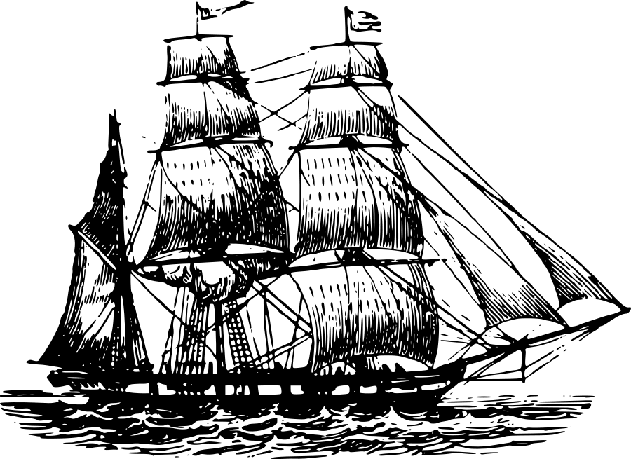
Section 1: Christian Beginnings
1

Slide 3
A) The Holy Spirit’s Conviction (John 16:7-11)
I will send Him to you. And He, when He comes, will convict the world concerning sin, and righteousness, and judgment.
John 16:7-8 (NASB)
  The Spirit is sent to believers (v. 7). The Spirit primarily, but not exclusively, convicts the world through the witness of Scripture and believers (The Church).
  ”Convict” describes God’s way of heightening our longing to know Jesus and awareness of unbelief and brokenness. (expose or reprove)
  God is clearly the initiator in regards to humanity.
  The witness of conscience and the conviction of the Holy Spirit
For when Gentiles who do not have the Law do instinctively the things of the Law, these, not having the Law, are a law to themselves, in that they show the work of the Law written in their hearts, their conscience bearing witness and their thoughts alternately accusing or else defending them.
(Rom. 2:14-15)

Slide 4
Conviction
of sin (v. 9)
of righteousness (v. 10)
of judgment (v.11)

Slide 5

B) Conviction of Sin (John 16:9)
Concerning sin, because they do not believe in Me.
John 16:9 (NASB)
  The sin highlighted in verse 9 is the rejection of Jesus or unbelief.
  Conviction of sin is the crisp consciousness that one senses when failing God’s revealed, holy standards.
  The Holy Spirit’s goal in convicting the world of sin is to move them to repentance and forgiveness through belief in Jesus Christ.
The Spirit reveals unbelief (the rejection of Jesus) as the most serious offense of the world.

Slide 6
C) Conviction of Righteousness (John 16:10)
And concerning righteousness, because I go to the Father, and you no longer behold Me
John 16:10 (NASB)
  The second way the Holy Spirit convicts is through revealing Jesus as the Righteous One.
  We see this error today when people come to incorrect conclusions about the nature of Jesus. Often either the divinity or humanity of Jesus is explained away.
  Conviction about the righteousness of Jesus does not mean one has yet found salvation.
  The resurrection proves the righteousness of Jesus!
we know that this man [Jesus] is a sinner…
(John 9:24)
The Spirit reveals that the world is wrong about Jesus.
He alone is righteous!

Slide 7
D) Conviction of Judgment (John 16:11)
And concerning judgment, because the ruler of this world has been judged.
John 16:11 (NASB)
  The topic of judgment is a natural follow through of the unbelief and inadequate view of Jesus pointed out in the first two areas.
  The Jews counted Abraham as their father because they were biological descendants.

Slide 8
John 8:39-47
They answered and said to Him, “Abraham is our father.” Jesus said to them, “If you are Abraham’s children, do the deeds of Abraham. But as it is, you are seeking to kill Me, a man who has told you the truth, which I heard from God; this Abraham did not do…
Why do you not understand what I am saying? It is because you cannot hear My word. You are of your father the devil, and you want to do the desires of your father. He was a murderer from the beginning, and does not stand in the truth because there is no truth in him. Whenever he speaks a lie, he speaks from his own nature, for he is a liar and the father of lies.

Slide 9
D) Conviction of Judgment (John 16:11)
And concerning judgment, because the ruler of this world has been judged.
John 16:11 (NASB)
  The topic of judgment is a natural follow through of the unbelief and inadequate view of Jesus pointed out in the first two areas.
  The Jews counted Abraham as their father because they were biological descendants.
  The Devil has already been judged by God; by extension the world is also judged.
The Spirit reveals that the Devil and sinful humanity will be judged.

Slide 10
Acts 2 Case Study
  Context: The disciples of Jesus are waiting in a house in Jerusalem during Pentecost. They are all filled with the Spirit. The crowds of people in Jerusalem each here the disciples speaking in their own language. Peter stands before the people and begins to explain what they are witnessing.
1. Conviction of Sin (Unbelief)
“Men of Israel, listen to these words: Jesus the Nazarene, a man attested to you by God with miracles and wonders and signs which God performed through Him in your midst, just as you yourselves know— this Man, delivered over by the predetermined plan and foreknowledge of God, you nailed to a cross by the hands of godless men and put Him to death.”
(Acts 2:22-23)

Slide 11
2. Conviction of Righteousness
“This Jesus God raised up again, to which we are all witnesses. Therefore having been exalted to the right hand of God, and having received from the Father the promise of the Holy Spirit, He has poured forth this which you both see and hear.”
(Acts 2:32-33)
3. Conviction of Judgment
“And with many other words he solemnly testified and kept on exhorting them, saying, “Be saved from this perverse generation!”
(Acts 2:40)

Slide 12
Acts 2 Case Study
  Spirit uses believers and scripture
  Conviction
  “Now when they heard this, they were pierced to the heart” (Acts 2:37)
  Right Response
  “Repent, and each of you be baptized in the name of Jesus Christ for the forgiveness of your sins” (Acts 2:38)

Slide 13
Final Summary
The careful and deliberate work of the Holy Spirit in an unbelievers life makes them aware of their sin, unbelief and coming judgment.
The Spirit’s conviction prepares people to receive the gospel leading to salvation!

Slide 14

Discussion Questions
What is the difference between the conviction of the human conscience and the conviction of the Holy Spirit?
If you are a Christian, how did you experience the conviction of the Spirit leading to salvation? If you are not a Christian, what has made you come to church or made you curious about Jesus?
How should Christians relate to unbelievers? How are you doing?

Slide 15
Life in the Spirit!
Experiencing the Fullness of Christ
#3 The Conviction of the Spirit
Oakland International Fellowship
  Jesse McLaughlin

