Slide 1


Life in the Spirit!
Experiencing the Fullness of Christ
#4 The Birth of the Spirit
Oakland International Fellowship
  Michael Lim/Paul J. Bucknell

Slide 2
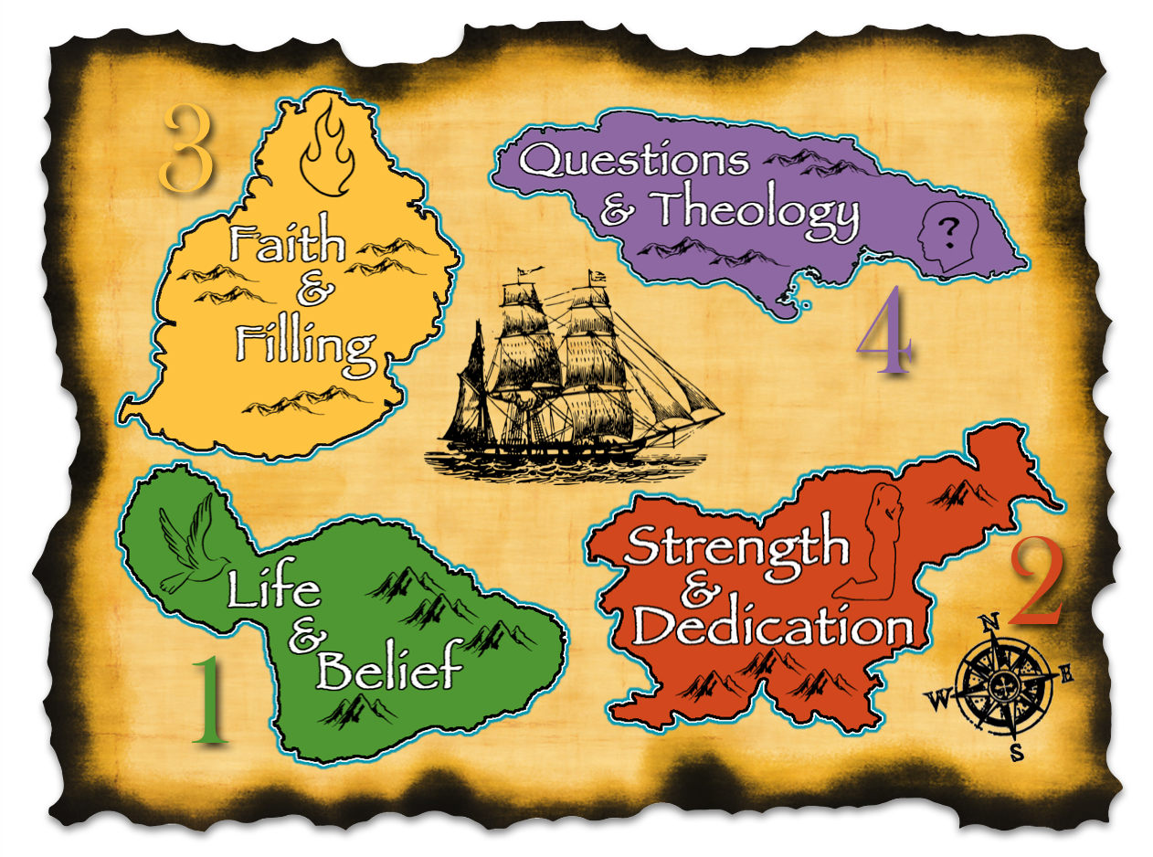

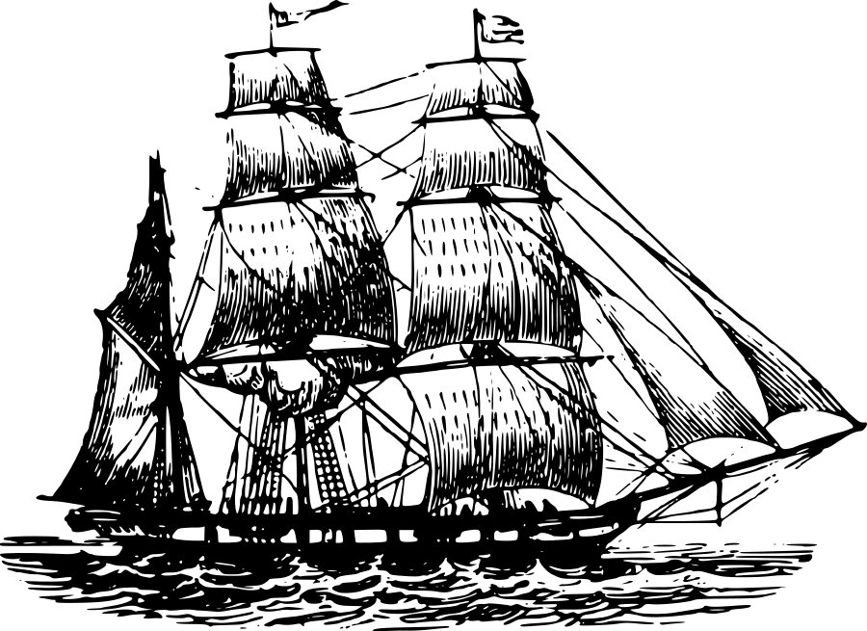
Section 1: Christian Beginnings
1
“So is everyone who is
born of the Spirit.” (Jn 3:8)

Slide 3
A) Born Again (John 3:3-8)
Conviction by the Holy Spirit prepares people to receive Spiritual birth
  What is Spiritual birth?
  Who receives this Spiritual birth?
  How are we born in the Spirit?
3 Jesus answered and said to him, “Truly, truly, I say to you, unless one is born again, he cannot see the kingdom of God.” 4 Nicodemus said to Him, “How can a man be born when he is old? He cannot enter a second time into his mother’s womb and be born, can he?” 5 Jesus answered, “Truly, truly, I say to you, unless one is born of water and the Spirit, he cannot enter into the kingdom of God. 6 “That which is born of the flesh is flesh, and that which is born of the Spirit is spirit. 7 “Do not marvel that I said to you, ‘You must be born again.’ 8 “The wind blows where it wishes and you hear the sound of it, but do not know where it comes from and where it is going; so is everyone who is born of the Spirit.” (NASB)

Slide 4
Born Again- What is it?
To see the kingdom of God, we must be born again (3:3)
To enter the kingdom of God, we must be born of water and the Spirit (3:5)
  Water: Not baptism, but possibly refers to physical birth or to cleansing (Ezek 36:25)
  Spirit: Indicates Holy Spirit’s role in birth (also see Ezek 36:26-27)
  Kingdom of God: New society directed by God and composed of His people born of His Spirit
It is birth performed by the Holy Spirit and distinct from physical birth (John 3:6)
“Regeneration” lit: re (again) + generate (birth)

Slide 5
Born Again- Who?
Anyone can receive Spiritual rebirth
  John 1:12-13: “But as many as received Him, to them He gave the right to become children of God, even to those who believe in His name, who were born, not of blood nor of the will of the flesh nor the will of man, but of God.”
Physical birth is not enough (John 3:6)
Neither is religion, class, status, birthright, family, going to church

Slide 6
Born Again- How?
The Holy Spirit works in our lives to convict us, whether we are aware of it or not (John 3:8)
Nicodemus felt it and found the truth (19:39)
Do you or have you felt the Spirit’s conviction and calling?
We need only respond by having faith in the gospel of Jesus Christ
Why? Next slide!

Slide 7
Born Again- How?
5 He saved us, not on the basis of deeds which we have done in righteousness, but according to His mercy, by the washing of regeneration and renewing of the Holy Spirit (Titus 3:5)
8 For by grace you have been saved through faith. And this is not your own doing; it is the gift of God, 9 not a result of works, so that no one may boast. (Eph 2:8-9)

Slide 8

B) Spiritual Rebirth in the Epistles
Ten times Peter, Paul, and John use the pregnant word “born” to refer to spiritual birth.
Peter
  Peter (1 Pet 1:3,23) emphasizes God’s commitment to His people by choosing and empowering His people.
  “Blessed be the God and Father of our Lord Jesus Christ, who according to His great mercy has caused us to be born again to a living hope through the resurrection of Jesus Christ from the dead” (1 Pe 1:3).
  God “caused us to be born again, one physical and spiritual birth
  “To a living hope” shows the purpose of giving new life.
  “For you have been born again not of seed which is perishable but imperishable, that is, through the living and abiding word of God” (1 Pe 1:23).
  Spiritual birth comes through the “living and abiding Word of God”, heightening the urgency of spreading God’s Word–evangelism/missions.
  “Through…Word of God” states the reason the Holy Spirit will only direct us according to the Word of God, the Bible.
  The Word is our source of ‘spiritual food’.

Slide 9
B) Spiritual Rebirth in the Epistles
Paul
  Paul (Gal 4:23,29) uses the new birth to identify the one means a person gains the life of God.
  “But as at that time he who was born according to the flesh persecuted him who was born according to the Spirit, so it is now also” (Gal 4:29).
  The first birth represents the life of works or merit through human endeavors while the second by the Spirit’s work in us.
John
  John (1 John 2:29, 3:9; 4:7; 5:1,4,18) emphasizes the evidence of the spiritual life (i.e. life from birth).
  “No one who is born of God practices sin, because His seed abides in him; and he cannot sin, because he is born of God” (1Jo 3:9).
  The genuine believer’s spiritual nature loves the things of God and hates those things of the flesh because he/she now has the same nature of God.
  “Beloved, let us love one another, for love is from God; and everyone who loves is born of God and knows God” (1Jo 4:7).
  Those regenerated by God’s Spirit necessarily love one another and know God.

Slide 10


B) Spiritual Rebirth in the Epistles
  Peter: Like a mother that gives birth, so God gives _________ to our spiritual lives.
  Paul: We gain the new birth not from our _______ but from God’s promises.
  John: Believers should anticipate ______ from their lives consistent with God’s purpose.
  birth
  works
  fruit
What promises accompany each spiritual birth?
What does God desire from each believer’s life?

Slide 11
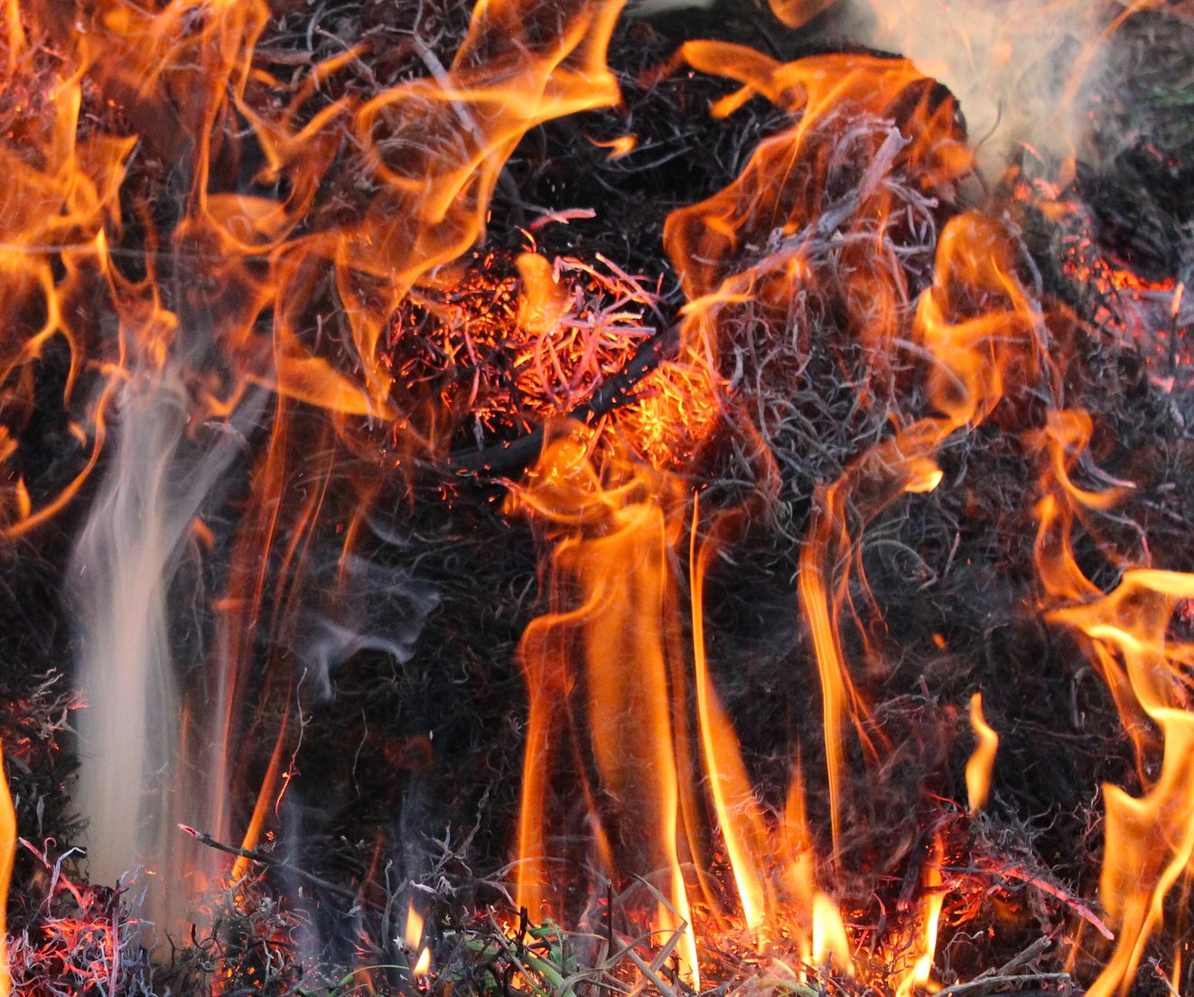

C) Baptized with Fire (Luke 3:16)
John answered and said to them all, “As for me, I baptize you with water; but One is coming who is mightier than I, and I am not fit to untie the thong of His sandals; He will baptize you with the Holy Spirit and fire (Luke 3:16; Mat 3:11; Mk 1:8).
  “Fire” represents a thorough purging of the sinful self through the Spirit’s conviction and repentance which is also pictured by baptism (Ro 6:2-4;1 Pe 2:24).

Slide 12

C) Baptized with Fire (Luke 3:16)
“He will baptize you with the Holy Spirit and fire” (Luke 3:16).
  Repentance
  Dead to self (flesh)
  Flesh engendered strength
  Identify with Christ’s death
  Purging of fire (conviction)
  Faith
  New life
  Spirit–empowered life
  Identify with Christ’s Resurrection
  Washing by Spirit
  “May it never be! How shall we who died to sin still live in it? Or do you not know that all of us who have been baptized into Christ Jesus have been baptized into His death? Therefore we have been buried with Him through baptism into death, in order that as Christ was raised from the dead through the glory of the Father, so we too might walk in newness of life” (Rom 6:2-4).
  If we depend only on water baptism and tradition, we will completely miss God’s work for our lives.

Slide 13
C) Baptized with Fire (Luke 3:16)
“He will baptize you with the Holy Spirit and fire” (Luke 3:16).
  “He will baptize you.” This is God’s work. Regeneration happens to us. God brings forth this birth of spiritual life.
New birth
New life!
  The word ‘fire’ associated with the Holy Spirit was not again used after Acts 2 giving evidence that Pentecost was a special and unique event and yet establishing that the presence of the Spirit is to be associated with every true believer’s life
A true believer obtains a new birth from the Spirit of God and, though not often understood at the start, the Spirit of God brings increasing comfort, security, leading and empowering to do God’s will.

Slide 14

Final Summary
The new birth is the new creation having inner desires to please God (Rom 8:1-6).
The new birth does not nullify the need for faith (John 3:16) but isolates God’s special work in us leading us to belief, showing us how utterly dependent upon God we are for the new life rather than on ourselves.
Salvation, much like a possession, is something we either have or do not have, but it’s consequences are eternal.
The Spirit’s work in our lives is not inconsequential but links to a larger purpose that God has for our lives and well-being.
True spirituality starts with a new birth and life.
“For God so loved the world, that He gave His only begotten Son, that whoever believes in Him should not perish, but have eternal life” (John 3:16).
Guilt => Improved life => Human belief
Religion/humanism’s impoverishment
Conviction => New birth => Faith in Christ => Changed life
Spirit’s empowering of life

Slide 15

Discussion Questions
How is a person ‘born again’? Are there different ways to be saved? Why or why not?
Why do you think some believers are very clear on the time when they came to know the Lord while others are not?
How does the pictures of the fire and wind help us understand God’s spiritual work in one’s life?

Slide 16
Life in the Spirit!
Experiencing the Fullness of Christ
#4 The Birth of the Spirit
Oakland International Fellowship
  Michael Lim/Paul J. Bucknell

