Slide 1


Life in the Spirit!
Experiencing the Fullness of Christ
Oakland International Fellowship
Pastor Hugo Cheng

Slide 2
Life in the Spirit!
Experiencing the Fullness of Christ
#6 The Leading of The Spirit
Oakland International Fellowship
Pastor Hugo Cheng

Slide 3







What is Your Next Port?
3
4
2
1

Slide 4

Section 1: Christian Beginnings
1
“That which is born of the flesh is flesh,
and that which is born of the Spirit is spirit.” (Jn 3:7)

Slide 5
Section 2: Christian Growth
2
“For all who are being led by the Spirit of God,
these are children of God.” (Romans 8:14)

Slide 6
The Leading of the Spirit
Seeking God’s will is an ongoing special interest topic for believers. The assumption is that God through the Holy Spirit gets involved in minute aspects of our decision making, giving us great help in leading a wise life filled with His blessings.
It certainly makes sense that we believers as the children of God who are designed by God would seek His wisdom for the kind of life we should live, but the leading of the Holy Spirit can come in different forms- which includes moral and spiritual guidance to help us live a life of faith and obedience in Christ, the specific personal leading of our directions for life, and wisdom and grace for us to make decisions in freedom and peace.
We need to grow in how to discern and follow His leading.

Slide 7
A) The Certainty and Variety of The Spirit's Leading
God's promise of His leading:
Proverbs 3:5-6
“Trust in the Lord with all your heart And do not lean on your own understanding. In all your ways acknowledge Him, And He will make your paths straight.
Psalm 23:1-3
The Lord is my shepherd, I shall not want. He makes me lie down
in green pastures; He leads me beside quiet waters.He restores
my soul; He guides me in the paths of righteousness. For His name’s sake.
John 10:27
My sheep hear My voice, and I know them, and they follow Me.

Slide 8
A) The Certainty and Variety of The Spirit's Leading
Ways that the Holy Spirit can lead us:
Moral guidance & empowerment
Understanding of God’s truth
Life direction & decision

Slide 9
A) The Certainty and Variety of The Spirit's Leading
Galatians 5:16-23
16 But I say, walk by the Spirit, and you will not gratify the desires of the flesh. 17 For the desires of the flesh are against the Spirit, and the desires of the Spirit are against the flesh, for these are opposed to each other, to keep you from doing the things you want to do. 18 But if you are led by the Spirit, you are not under the law. 19 Now the works of the flesh are evident: sexual immorality, impurity, sensuality, 20 idolatry, sorcery, enmity, strife, jealousy, fits of anger, rivalries, dissensions, divisions, 21 envy, drunkenness, orgies, and things like these. I warn you, as I warned you before, that those who do such things will not inherit the kingdom of God. 22 But the fruit of the Spirit is love, joy, peace, patience, kindness, goodness, faithfulness, 23 gentleness, self-control; against such things there is no law.
1. Moral guidance & empowerment
2. Understanding of God’s truth
3. Life direction & decision

Slide 10
A) The Certainty and Variety of The Spirit's Leading
2Corinthians 3:17-18
17 Now the Lord is the Spirit, and where the Spirit of the Lord is, there is freedom. 18 And we all, with unveiled face, beholding the glory of the Lord, are being transformed into the same image from one degree of glory to another. For this comes from the Lord who is the Spirit.
1. Moral guidance & empowerment
2. Understanding of God’s truth
3. Life direction & decision

Slide 11
A) The Certainty and Variety of The Spirit's Leading
Ephesians 5:15-21
15 Look carefully then how you walk, not as unwise but as wise, 16 making the best use of the time, because the days are evil. 17 Therefore do not be foolish, but understand what the will of the Lord is. 18 And do not get drunk with wine, for that is debauchery, but be filled with the Spirit, 19 addressing one another in psalms and hymns and spiritual songs, singing and making melody to the Lord with your heart, 20 giving thanks always and for everything to God the Father in the name of our Lord Jesus Christ, 21 submitting to one another out of reverence for Christ.
1. Moral guidance & empowerment
2. Understanding of God’s truth
3. Life direction & decision

Slide 12
A) The Certainty and Variety of The Spirit's Leading
Romans 8:13-16
13 For if you live according to the flesh you will die, but if by the Spirit you put to death the deeds of the body, you will live. 14 For all who are led by the Spirit of God are sons of God. 15 For you did not receive the spirit of slavery to fall back into fear, but you have received the Spirit of adoption as sons, by whom we cry, “Abba! Father!” 16 The Spirit himself bears witness with our spirit that we are children of God.
1. Moral guidance & empowerment
2. Understanding of God’s truth
3. Life direction & decision

Slide 13
A) The Certainty and Variety of The Spirit's Leading
John 16:13, 14:26
When the Spirit of truth comes, he will guide you into all the truth, for he will not speak on his own authority, but whatever he hears he will speak, and he will declare to you the things that are to come.
But the Helper, the Holy Spirit, whom the Father will send in my name, he will teach you all things and bring to your remembrance all that I have said to you.
1. Moral guidance & empowerment
2. Understanding of God’s truth
3. Life direction & decision

Slide 14
A) The Certainty and Variety of The Spirit's Leading
John 16:13, 14:26
Then Jesus was led up by the Spirit into the wilderness to be tempted by the devil.
And Jesus, full of the Holy Spirit, returned from the Jordan and was led by the Spirit in the wilderness
1. Moral guidance & empowerment
2. Understanding of God’s truth
3. Life direction & decision

Slide 15
A) The Certainty and Variety of The Spirit's Leading
Acts 13:2, 16:6-7
While they were worshiping the Lord and fasting, the Holy Spirit said, “Set apart for me Barnabas and Saul for the work to which I have called them.”
6 And they went through the region of Phrygia and Galatia, having been forbidden by the Holy Spirit to speak the word in Asia. 7 And when they had come up to Mysia, they attempted to go into Bithynia, but the Spirit of Jesus did not allow them.
1. Moral guidance & empowerment
2. Understanding of God’s truth
3. Life direction & decision

Slide 16
A) The Certainty and Variety of The Spirit's Leading
Acts 13:2, 16:6-7
16 And I will ask the Father, and he will give you another Helper,
to be with you forever, 17 even the Spirit of truth, whom the world cannot receive, because it neither sees him nor knows him. You know him, for he dwells with you and will be in you. 18 “I will not leave you as orphans; I will come to you. 19 Yet a little while and the world will see me no more, but you will see me. Because I live, you also will live. 20 In that day you will know that I am in my Father, and you in me, and I in you.
SUMMARY: Jesus might not be here with us physically, but with the Holy Spirit in us, Jesus is with us all the time through Him, He is here to help us to succeed in our life of faith.

Slide 17
B) Resisting The Spirit's Leading
1Thessalonians 5:19
Do not quench the Spirit.
Ephesians 4:30
And do not grieve the Holy Spirit of God, by whom you were sealed for the day of redemption.
1Corinthians 12:12-13
12 For just as the body is one and has many members, and all the members of the body, though many, are one body, so it is with Christ. 13 For in one Spirit we were all baptized into one body—Jews or Greeks, slaves or free—and all were made to drink of one Spirit.

Slide 18
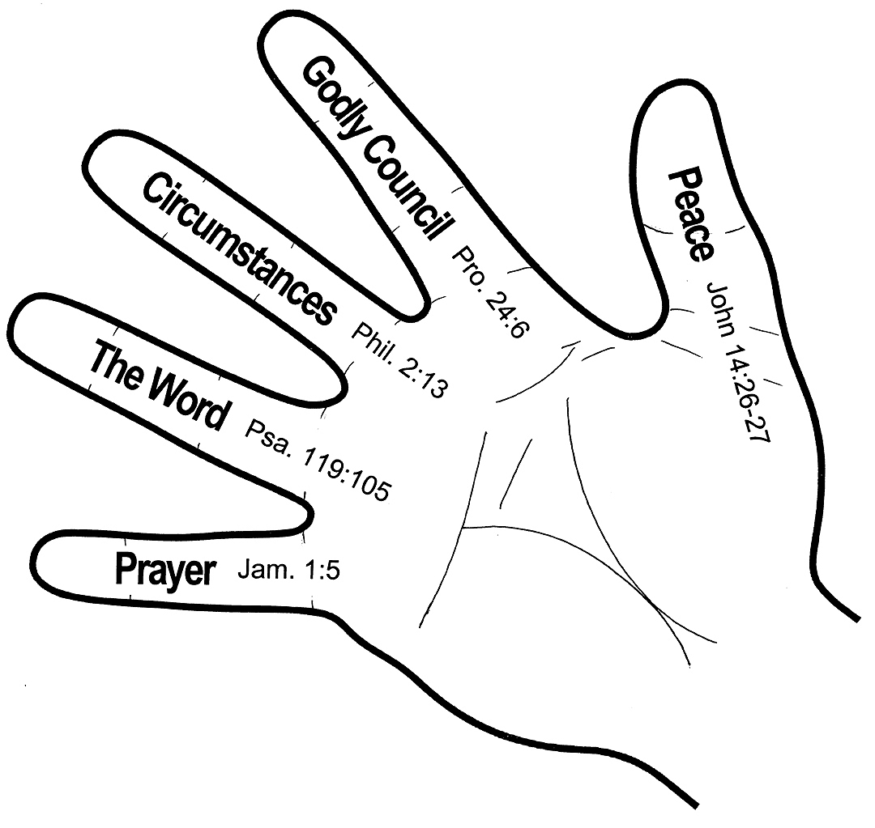
C) Accessing & Experiencing the Spirit's Leading
Jesus is Lord!
Matt. 11:28-30
John 10:27
Romans 12:1-2
Proverbs 3:5-6

Slide 19
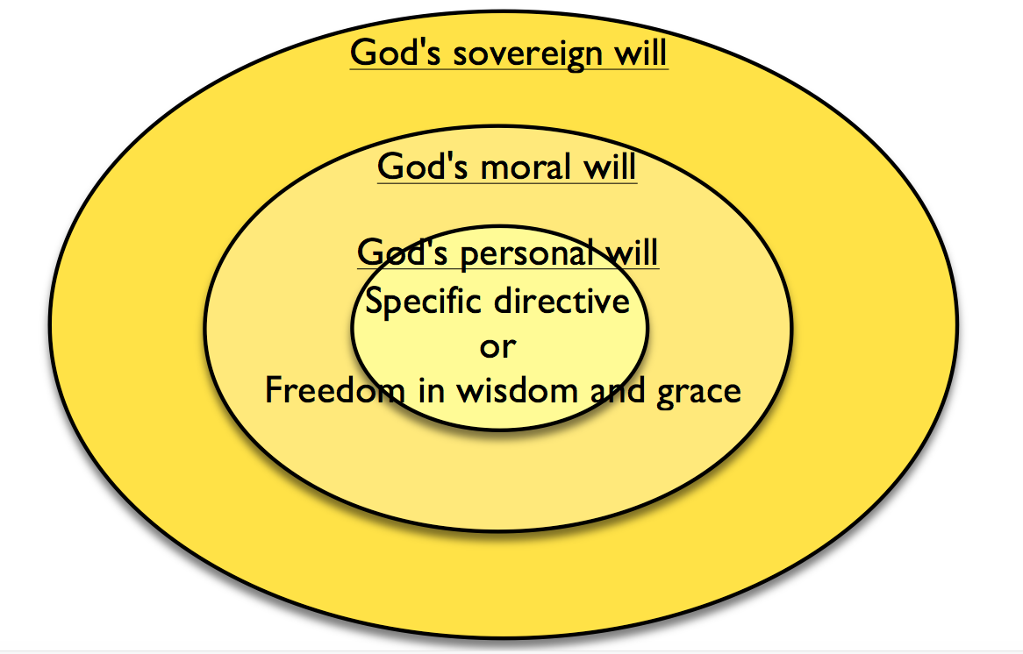
C) Accessing & Experiencing the Spirit's Leading

Slide 20
A) The Certainty and Variety of The Spirit's Leading
Acts 13:2, 16:6-7
16 And I will ask the Father, and he will give you another Helper,
to be with you forever, 17 even the Spirit of truth, whom the world cannot receive, because it neither sees him nor knows him. You know him, for he dwells with you and will be in you. 18 “I will not leave you as orphans; I will come to you. 19 Yet a little while and the world will see me no more, but you will see me. Because I live, you also will live. 20 In that day you will know that I am in my Father, and you in me, and I in you.
FINAL SUMMARY: The Holy Spirit's purpose and desire is to be active in the believer's life. He leads us in the understanding and applications of God's Word. He empowers us to grow in Christ-likeness. He gifts us to serve Jesus. He convicts us when we sin. At times He gives us specific directives in life's decisions, and at other times He provides us wisdom to make the decisions.

Slide 21
Discussion Questions:
Have you ever experienced the guidance of the Holy Spirit?Please share with each other.
Is there currently an area in your life where you are trying to discern the leading of the Spirit? Pray for one another.

