Slide 1


Life in the Spirit!
Experiencing the Fullness of Christ
#10 The Instruction of the Spirit
Oakland International Fellowship
  Paul J. Bucknell

Slide 2
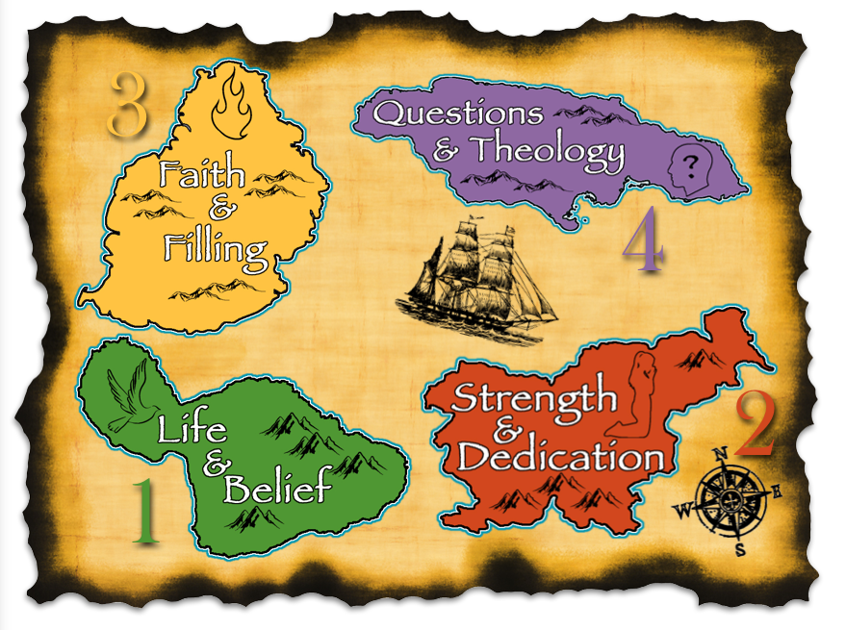


Section 2: Christian Growth
2

Slide 3

A) The Need for the Spirit’s Revealing (John 16:13-15)
“13 But when He, the Spirit of truth, comes, He will guide you into all the truth; for He will not speak on His own initiative, but whatever He hears, He will speak…” (John 16:13-15).
  “Spirit of truth” describes the Spirit by associating Him with truth, almost like a name, Spirit Truth.
  “Comes” refers to the filling of the Spirit in His people starting at Acts 2. This is startling new for them.
  “Will” describes how believers will be shaped by the Spirit’s teaching ministry.
Filling of Believers
“He, the Spirit of truth”

Slide 4

A) The Need for the Spirit’s Revealing (John 16:13-15)
“13 But when He, the Spirit of truth, comes, He will guide you into all the truth; for He will not speak on His own initiative, but whatever He hears, He will speak; and He will disclose to you what is to come 14 He shall glorify Me; for He shall take of Mine, and shall disclose it to you. 15 All things that the Father has are Mine; therefore I said, that He takes of Mine, and will disclose it to you” (John 16:13-15).
Father
Son
Spirit
Church
“Guide you into all the truth”: He strategically leads us into knowing the truth–not instantaneous but as a path of learning.
“He will speak; and He will disclose to you”
Timely passes on all the knowledge we need. (Faith building truth! => Always attentive)
“He shall glorify Me” (see diagram)
Spiritual transformation requires a reordering of one’s decisions in light of new insights the Spirit brings to our attention from God’s Word.

Slide 5

A) The Need for the Spirit’s Revealing (John 16:13-15)
Filling of Believers
Instruction of Believers
God continues to indwell in all of His children, empowering and enabling them, sin aside, to regularly commune with Him in prayer.
God desires to regularly direct and inform His people so that they know
His will and appropriately, in faith, do His will through His strength and for His glory.
Note on Upper Room Discourse
Notes:
The Spirit of God fills us but how does He communicate with us? He takes from the Father and imparts that needed knowledge and faith to us.

Slide 6

“I love those who love me; And those who diligently seek me will find me” (Pr 8:17).
“Type a quote here.”
–Johnny Appleseed
Perhaps the person’s biggest struggle is not discerning God’s will but desiring it.

Slide 7

B) The Holy Spirit’s Personal Presence (John 14:26)
“But the Helper, the Holy Spirit, whom the Father will send in My name, He will teach you all things, and bring to your remembrance all that I said to you” (John 14:26).
  “The Helper, the Holy Spirit” (Grk. parakletos): Counselor, comes alongside of; Comforter. We need Him!
  “The Holy Spirit, whom the Father will send by My name” (Acts 2). Jesus says, “I will ask the Father, and He will give you another Helper, that He may be with you forever” (Jn 14:16; Mat 28:20).
  “All things” includes our calling, needs and gifting which shapes how the Holy Spirit personally teaches us.
  The twofold teaching ministry of the Holy Spirit:
      New truths: “He will teach”
      Old truths: “Bring to your remembrance”
Jesus might not be physically present, but through the Holy Spirit Jesus is always by our side, requiring us to attentively follow Him. When the Spirit is leading, Jesus is leading!

Slide 8

B) The Holy Spirit’s Personal Presence (John 14:26)
“I told him I only have enough to get there to India but not back. I believe God will raise the money. But I was not prepared for this $8,000 budget.” (2004 journal)
  IMPOSSIBLE!
  CONFUSION
  Old truths:
  “Bring to your remembrance”
“You give them something to eat!” (Lu 9:13)
“What do you have?” (Mk 6:38)
Notes:
I told him I only have enough to get there to India but not back. I believe God will raise the money. But I was not prepared for this $8,000 budget. (2004 journal)
The first one was “Feed My sheep.” (Jn 21:15) “You give them something to eat!” (Lu 9:13; Mk 6:37). In other words, I should give them God’s Word. I was to care for the lambs there. God wants to feed them through me. This helped me in two ways. First, it gave me faith in what God wanted. I could trust Him with helping me ‘feed them’ in a spiritual way. But behind the scenes, there was the other issue: the food which made it so expensive–feeding these pastors. But I could trust the Lord to provide for both.
“What do you have?” or from the scriptures: “How many loaves do you have?” (Mk 6:38; Mat 15:34; Mk 7:5). This was significant because it helped me do what I could do. Start with what I have. They only had fish and loaves, but the Lord takes what one has and brings in the rest as needed. Use what I have. So I took what I had and sent away for a visa, late as it was. When money came in for a ticket, I got a ticket–even when I did not have money for the budget.
We gave our little five loaves and two fish and God has multiplied it so that in the end we will have $9,900. Can you believe that $8,695 came in after 9/9? All of a sudden I heard this money was coming in around our deadline.

Slide 9
C) Teaching us in Our Special Needs (Lu 12:12)
“And I say to you, My friends, do not be afraid of those who kill the body, and after that have no more that they can do” (Lu 12:4).
“And when they bring you before the synagogues and the rulers and the authorities, do not become anxious about how or what you should speak in your defense, or what you should say; 12 For the Holy Spirit will teach you in that very hour what you ought to say” (Lu 12:11-12).
  “My friends, do not be afraid” (Lu 12:4) speaks of facing dangers.
  “The Holy Spirit will teach you” reveals how Jesus brings special comfort to any Christian under persecution (Lu 12:10-12)– Stephen.
  “You also became imitators of us and of the Lord, having received the word in much tribulation with the joy of the Holy Spirit” (1 Th 1:6).
  “Teach you” states how the Holy Spirit purposely changes our priorities and commitments–in this case to be a faithful witness.
  “In that very hour what you ought to say” speaks of the
  timeliness and appropriateness of the Spirit’s help.
The Holy Spirit passes on Jesus’ comfort and wisdom by timely bringing to our minds what we need to know.

Slide 10


Final Application
  1) The Spirit is teaching!
  Are you learning?
  2) The Spirit is by our side (Paraclete)!
  Do you have peace?
  3) The Spirit is with us in emergencies!
  Do you trust Him?
“But if any of you lacks wisdom, let him ask of God, who gives to all men generously and without reproach, and it will be given to him” (Jam 1:5).

Slide 11





Faith & Filling is our Next Port?
3
4
2
1

Slide 12

Discussion Questions
What kinds of things does God help us know? Please give an example how the Holy Spirit taught you.
The truth of God is clearly important to living a strong Christian life. What are some ways you regularly bring His Truth into your mind so that the Holy Spirit can “remind” you?
So how does the Holy Spirit practical teach and help us in our various ministries?

Slide 13
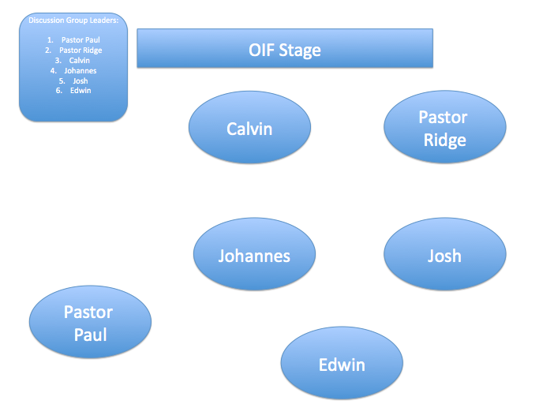

Slide 14
Life in the Spirit!
Experiencing the Fullness of Christ
#10 The Instruction of the Spirit
Oakland International Fellowship
  Paul J. Bucknell

