Slide 1


Life in the Spirit!
Experiencing the Fullness of Christ
#12 The Sending of the Spirit (Acts 13:1-4)
Oakland International Fellowship
Calvin Chiang

Slide 2



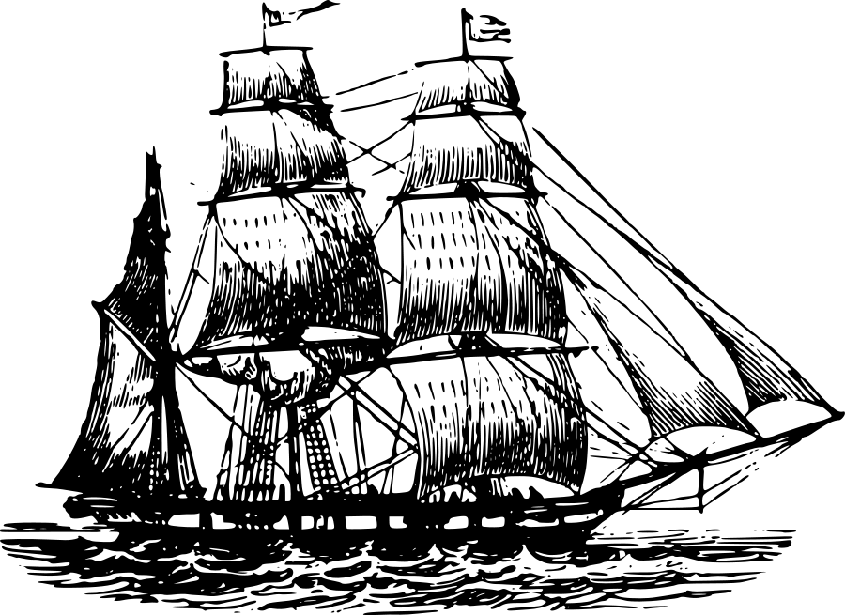



What is Your Next Port?
3
4
2
1

Slide 3
Section 3: Christian Service
3
“Let us also walk by the Spirit” (Gal 5:25).

Slide 4
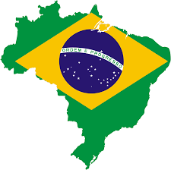

Introduction
The Spirit of God is on a mission, strong enough to lead millions of believers over the ages across the world to complete the grand redemptive plan set in motion before time began. God is doing great work amongst the nations raising up ministers of the gospel and sending them out in their own country and elsewhere. Did you know that Brazil has recently passed Korea in the percentage of missionaries sent forth?

Slide 5
A) The Spirit Equips People to Share the Gospel (Acts 1:8)
“But you shall receive power when the Holy Spirit has come upon you; and you shall be My witnesses both in Jerusalem, and in all Judea and Samaria, and even to the remotest part of the earth.”
The reason for the Holy Spirit coming upon His people is for what?
To what extent should we go forth in spreading the gospel?
Evangelism is at the heart of the Great Commission (Matt 28:19-20). Christians are called to be witnesses of their faith to a fallen world. The word “martyr” comes from the Greek word for “witness”. Many early Christians lost their lives as they “witness” for Christ.
Notes:
*To be God’s witnesses and gives us the opportunity to tell others about Jesus.
*Jerusalem, Judea, Samaria, and to the remotest part of the earth.

Slide 6
Two Questions:
What then is our motivation to share the gospel?
Why are some Christians not motivated for evangelism?
Notes:
*Part of the reason is perhaps some churches have attempted to make the Christian message more marketable for the modern society. Avoiding the topics of sin, judgment, and salvation through Jesus alone rather putting the emphasis on how Christianity can make our lives better. This brand of Christianity appeals to the postmodern world but fails to confront people with the truth of their sin.

Slide 7
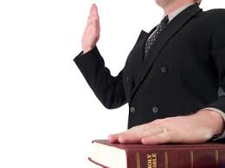

“Witness” vs. “Persuasion” Paradigm
The result is that soul winning becomes a product of our own individual effort instead of the work of the Holy Spirit. We have the temptation to water down the gospel in the hope of soul winning.
Notes:
*A witness is one who simply tells what they have seen, heard, and experienced. Witnesses in a courtroom are bound to “tell the truth, the whole truth, and nothing but the truth.” A witness doesn’t seek to persuade; he doesn’t seek to convince; all he seeks to do is be faithful to proclaim what he knows to be true and why he knows it to be true.
*Persuasion takes on a very different form. In persuasion, one person is engaged in an effort to change the mind of another person to a particular point of view. It’s not uncommon in persuasion to alter or re-package the message to make it more appealing to others. In persuasion, the most important thing isn’t the truth of the message, but the individual’s response to that message.
*The Bible says that it has the power of salvation and we are not be ashamed of it or water it down.
*Example of the person who tried to persuade me to come to Christ in SF.
*Summary: Holy Spirit gives believers the ability to be “witnesses” for Him. He is the one doing the work and moving of hearts. We are to be faithful in witnessing letting the Holy Spirit worry about the results.

Slide 8
B) The Mission Agency Led by the Spirit (Acts 13:1-4)
13:1 Now there were at Antioch, in the church that was there, prophets and teachers: Barnabas, and Simeon who was called Niger, and Lucius of Cyrene, and Manaen who had been brought up with Herod the tetrarch, and Saul. 2 And while they were ministering to the Lord and fasting, the Holy Spirit said, “Set apart for Me Barnabas and Saul for the work to which I have called them.” 3 Then, when they had fasted and prayed and laid their hands on them, they sent them away. 4 So, being sent out by the Holy Spirit, they went down to Seleucia and from there they sailed to Cyprus.
Note the diversity in the church: Barnabas (Hellenistic Jew, Levite), Simeon who was called Niger, Lucius (from Cyrene), Manaen (childhood campanion of King Herod Antipas), and Saul.
Notes:
“In the church” is the key phrase that helps us get some perspective where we will see the Spirit of God doing some major long term foundational work. This is perhaps a shift from focusing on individual sending in the past (e.g. Jonah).
In the passage there are 5 gifted men who are capable of teaching and leading the Antioch church. Noticed that the church is not dependent upon one person. There was enough gifted men in leadership to send 2 of them away without harm to the church.
Note the diversity of the leaders in the church. Diversity demonstrates the power of the gospel. Spirit does not discriminate.
Barnabas, Simeon, Lucius, Manaen, Saul.
Much like what OIF is striving towards.

Slide 9
The Holy Spirit Speaks
V. 2-4. The Holy Spirit chose to communicate His purposes “While they were ministering to the Lord and fasting…”
Some characteristics of the Antioch church and it’s leaders:
How did they receive the Holy Spirit’s call? They desired it, they seeked it, they waited upon the Lord, and lastly, they expected it.
Holy Spirit’s guidance came to those who were actively engaged in ministry. Interceeding, praying for one another.
Holy Spirit’s guidance extended the ministry of those who were doing their present ministry well. This depicts the Spirit’s part in calling or designating believers for special tasks, long or short term.
Holy Spirit’s guidance is not merely for the individual but through the local church.
Holy Spirit’s guidance was only for the next step and not for the entire future. The Spirit guides us on a “need to know” basis and does not unfold the entire plan before us for our approval.
Notes:
Example of Jesse and Emily McLaughlin
Summary: God’s people do not need to be concerned whether the Holy Spirit is muted but whether our hearts are open to hear and immediately respond to the Spirit of God.

Slide 10
C) The Importance of the Local Church
A local church, is a locally organized community of believers in Jesus Christ. Through this imperfect community, it has the responsibility to do its best to recognize the call of God in the lives of its members. Before we commission someone to missionary service, we should verify the call of the Holy Spirit and their spiritual qualification to the best of our abilities.
There are 3 key things that the local church can do to maintain the integrity of this biblical process.
Train its members regarding biblical qualifications for leadership.
Train its members how to identify the calling of the Holy Spirit.
Seek to identify people who are qualified or could be qualified for leadership and who might be used by God in ministry.
Notes:
*Mention the process of going on the field in OIF as well. Importance of working with a missions agency that has similar convictions as PCCO. Such as the agency also seeing the importance of the missionaries working together with a local church.
*Person called by the Holy Spirit to go to the field should pursue their call through the local church.
*Everyone should be involved in missions at some level. Supporting our chuch sponsored missionaries, praying for them, going on a short term missions trip.

Slide 11
Conclusion
Our churches, leaders and selves must be in regular worship and prayer mode to be able to identify what the Spirit of God wants and to be able to respond when necessary. Overall, though we might not understand the details, we should see the power of the Holy Spirit enable all of His works.

Slide 12

Discussion Questions
Do you have any reservations when you share the gospel with others? Does learning about the difference between being a “witness vs. persuasion” help with those reservations?
Why does the Holy Spirit use the local church to send out missionaries to save the lost?

