Slide 1


Life in the Spirit!
Experiencing the Fullness of Christ
14) The Gifts of the Spirit #2
  Paul J. Bucknell

Slide 2
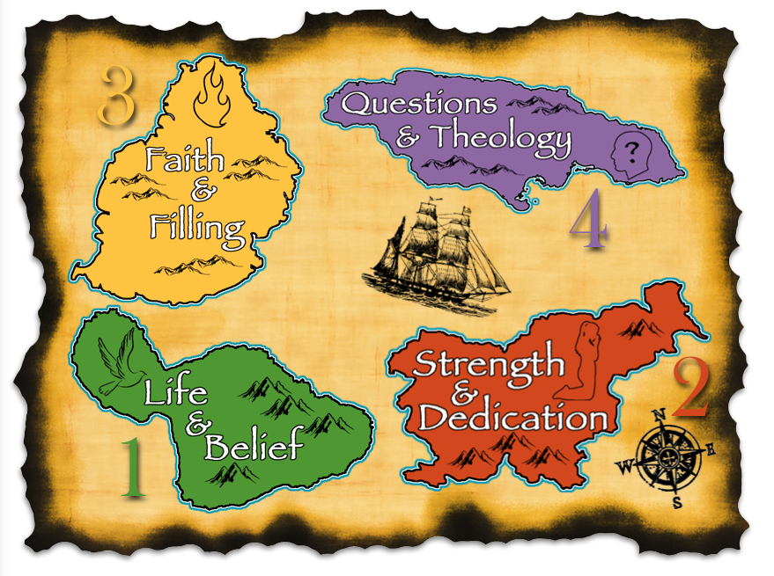

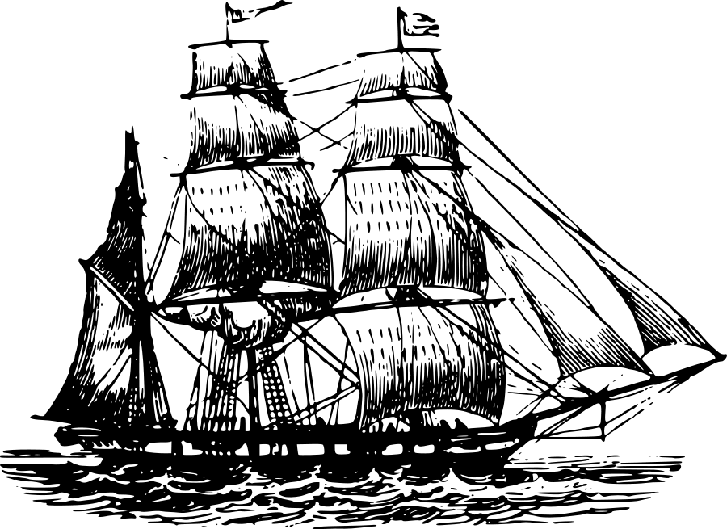
Section 3: Christian Service
3
“Let us also walk by the Spirit” (Gal 5:25).

Slide 3


Context for Spiritual Gifts
Intimacy with God
(As His priests)
SANCTIFICATION
Who we are
What we do
All our works
General: Seek opportunities to love
“For we are His workmanship, created in Christ Jesus for good works, which God prepared beforehand, that we should walk in them” (Eph 2:10).
Spiritual Gifts
Specific: Fulfill Responsibilities

Slide 4
A) Gifts of the Holy Spirit (1 Cor 12:1,4-7)
“1 Now concerning spiritual gifts, brethren, I do not want you to be unaware. 4 Now there are varieties of gifts, but the same Spirit. 5 And there are varieties of ministries, and the same Lord. 6 And there are varieties of effects, but the same God who works all things in all persons. 7 But to each one is given the manifestation of the Spirit for the common good” (1 Cor 12:1,4-7).
spiritual (1) + gifts (4) = spiritual gifts
  “Spiritual gifts” (1) (lit. ‘spiritual things’) emphasize the special imparting of skill, wisdom, speech, miraculous power, etc. by God through the Holy Spirit to equip His people to carry out His service.
  “Gifts, but the same Spirit” (4) (literally charismata–root for charisma, charismatic; root ‘charis’) means grace or divine gift and the fact it is undeserving (grace) and never should be prideful of.
  “Do not want you to be unaware” (1) reflects misunderstandings, denial, and distortion of gifts (chart).

Slide 5
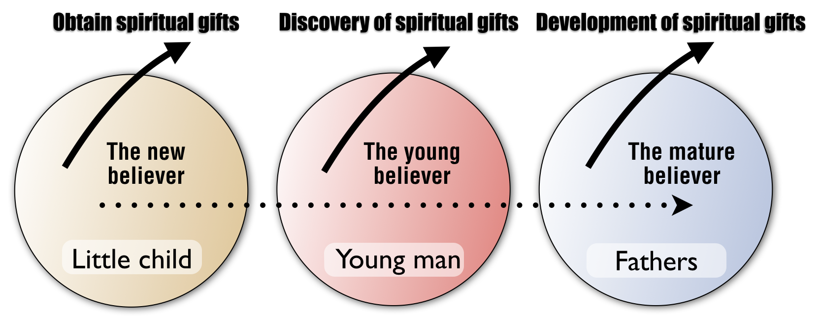
A) Gifts of the Holy Spirit (1 Cor 12:1,4-7)
Unaware of spiritual gifts
Discovery of spiritual gifts
Faithful use of spiritual gifts
Focused on newfound faith
Sometimes pridefully thinks of gifts
Caring for others is mark of maturity
All possess a gift
A gift, not to be puffed up
Opportunity to uniquely serve

Slide 6
A) Gifts of the Holy Spirit (1 Cor 12:5-7)
5 And there are varieties of ministries, and the same Lord. 6 And there are varieties of effects, but the same God who works all things in all persons. 7 But to each one is given the manifestation of the Spirit for the common good” (1 Cor 12:5-7).
  “The same Lord” (5) and “the same God” affirms God is completely in charge of the variety of spiritual gifts. It is amazing that God deems to work through His people to do His divine work.
  “God who works all things in all persons” (6): People do not gain their main identify from their spiritual or natural gifts for they only offer differing opportunities of service. They do not establish a person’s value but shape God’s will for their lives.
  “Each one” (7) and “all things in all persons” (6) speak on how God miraculously works in every genuine believer through His spiritual gifts enabled within him or her “for the common good” (7). “But to each one of us grace was given according to the measure of Christ’s gift” (Eph 4:7)

Slide 7
B) Cessationism Versus Continuationism (1 Cor 12:7)
“7 But to each one is given the manifestation of the Spirit for the common good” (1 Cor 12:7).
Cessationism | vs | Continuationism
Miracles, prophecy and tongues has ceased |  | Miracles, prophecy and tongues continues on
Such gifts only establish apostle’s authority |  | Such gifts have several purposes (common good)
Don’t see gifts after the apostles’ time |  | Those other than apostles had such gifts
Foundation laid makes gifts irrelevant |  | Christ’s fullness is distributed through gifts

Slide 8

B) Cessationism Versus Continuationism (1 Cor 12:7)
  Not equal. Paul praises the gifts of the Corinthians (1:4-7) putting the burden of proof on cessationalists whose arguments are unconvincing.
  Greater purpose: These gifts not only to affirm the authority of the apostles (Eph 2:20) as cessationalists affirm but are “the manifestation of the Spirit for the common good” (1 Cor 12:7).
  Others possess: Stephen, not an apostle, but: “full of grace and power, was performing great wonders and signs among the people” (Acts 6:8) who along with other historical cases (John Knox) testify that miracles and revelatory gifts are not only associated with the apostles’ age.
  Treated as typical: Paul intertwines the revelatory/miraculous gifts with other gifts accepted by all in 1 Cor 12:27-30.
Common mission
  1) Cessationism tends to be divisive rather than together working to accomplish God’s greater purposes.
  2) Without suspicion, we can together better employ discernment for the protection and good of all,.
  3) Working together, we could see the issue deeper–pioneering areas (apostle=missionary=sent ones).
Fight real enemy
Joint true values

Slide 9
C) Clarification on the Gift of Tongues (1 Cor 12:27-31)
“27 Now you are Christ’s body, and individually members of it. 28 And God has appointed in the church, first apostles, second prophets, third teachers, then miracles, then gifts of healings, helps, administrations, various kinds of tongues. 29 All are not apostles, are they? All are not prophets, are they? All are not teachers, are they? All are not workers of miracles, are they? 30 All do not have gifts of healings, do they? All do not speak with tongues, do they? All do not interpret, do they? 31 But earnestly desire the greater gifts. And I show you a still more excellent way” (1 Cor 12:27-31).
  “Then miracles, then gifts of healings, helps” (28). This inclusion in this mixed listing affirms their ongoing importance.
  Paul includes ‘tongues’ with other gifts, prioritizing the appointment of equipping gifts over other gifts (1 Cor 12:27-31).
  Tongues is KJB (1600s) usage of the word for languages and has been improperly translated today as ‘tongues’ rather than languages, allowing some to substitute gibberish for language.
  “All do not have gifts of healings,…tongues,…do they?” (30) insinuates that some have wrongly insisted on the presence of spiritual gifts (tongues) as a sign of salvation or spirituality (28,31). Be wary! (see Lesson 9-Acts)

Slide 10
C) Clarification on the Gift of Tongues (1 Cor 12:27-31)
Why so much division due to tongues?
  We all affirm there is one body of Christ and one Spirit but live opposing each other, suspicious of what the other does.
  Two reasons for confusion over gifts:
  (1) Tongues is seen as confirming presence and fullness of Spirit (earlier discussed-Acts L#9).
  (2) The gift of tongues is confused with special communion with the Lord (1 Cor 14:2) which can lead to pride because of a suggested special intimacy rather than focus on service.
COMMUN
I
ON
GIFTING
Confusion between communion and gifting
“God specially speaks to me.” |  | But God powerfully speaks to all believers through the Spirit.

Slide 11
Final Application
The
Lord
church
me
  1) Communion with the Lord (relationship) and holiness serve as our foundation for proper use of our spiritual gifts.
  2) Spiritual gifts mark God’s special desire to work uniquely in and through the lives of every genuine believer.
  3) Gifts are for a purpose larger than ourselves, completing God’s purposes through us for the church’s good and God’s glory.
  4) Saints on earth may differ in gifting but are required to work together to complete God’s redemptive plan.
  Same Spirit
  Same Team
  Same Goal

Slide 12

Discussion Questions
How can we keep ourselves from getting prideful over our spiritual gifts?
Are all the gifts of the Holy Spirit for this age or only for the early church? Explain.
How should we understand and treat others who look at spiritual gifts different from us?

Slide 13
Life in the Spirit!
Experiencing the Fullness of Christ
14) The Gifts of the Spirit #2
  Paul J. Bucknell

